Slide 1
Our Partner School in China
Jinan Jingshan Primary School
http://jingshan.lixiaedu.com/

Slide 2
Where in the world is China?

Slide 3
Map of China – look for Jinan City

Slide 4
Jinan City is in Shandong Province

Slide 5
Jinan City is in Shandong Province – it is a 4 hour drive to the sea.

Slide 6
Jinan City
Jinan is famous across China for its numerous springs, the lakes fed by the spring water, and the weeping willows that grow along the water edges.
Notes:
https://travelshandong.com/jinan/ https://en.wikipedia.org/wiki/Jinan https://www.tripadvisor.co.uk/Attractions-g297457-Activities-Jinan_Shandong.html

Slide 7
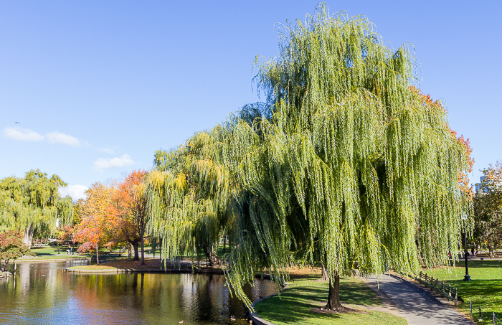
Weeping Willow

Slide 8
Springs and Lakes
Jinan is known as the "City of Springs" because of the large number of natural artesian springs.
The Baotu Spring Park is the most popular of the springs in the City of Jinan. The water in the spring pool can be seen foaming and gushing, looking like a pot of boiling water.

Slide 9
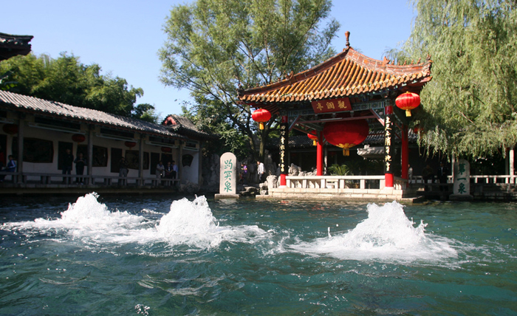
Springs in Jinan City

Slide 10
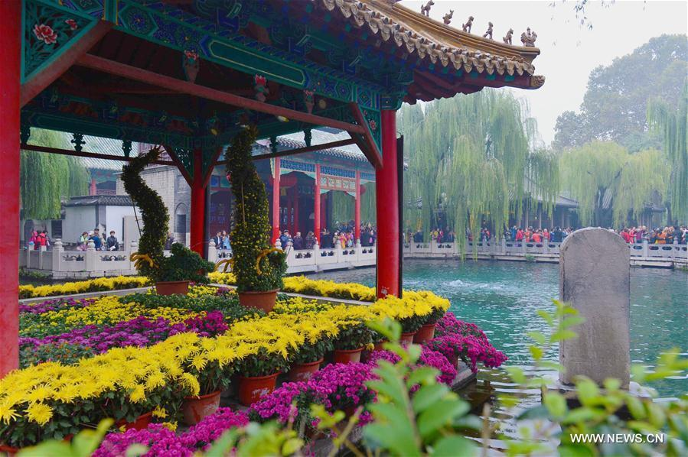
Baotu Spring Park
Bào tū (趵突) means ‘jumping and leaping’ in Chinese.

Slide 11
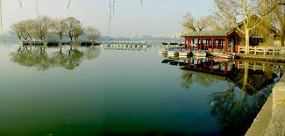
Daming Lake
Not far away to the northeast of Baotu Spring Park is the Daming Lake, which, together with Baotu Spring and the Thousand-Buddha Mountain (千佛山) is often regarded as the "Three Greatest Attractions in Jinan".

Slide 12
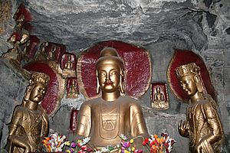
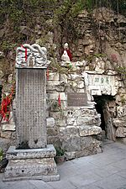
Thousand Buddha Mountain
Jinan was also the historical centre of Buddhist culture for the whole province.

Slide 13
The spring was visited by the Qianlong Emperor (1711–1799) of the Qing dynasty who declared it "the best spring under the heaven”.

Slide 14
School Life
Jinan Jingshan Primary School is a five hour drive from the sea. It is overlooked by mountains.
There are 47 children in each class.
Every morning all the children take part in morning exercises.
Ancient poetry is an essential part of Chinese culture and is taught every week. The children take part in learning and reciting these poems.
Tie-dye is a form of art that is considered a national heritage. The children learn this form of art.
Ancient Chinese writing is taught every week. In Jinan Jingshan Primary School, one of their walls is a Culture Wall where Chinese writing has been carved into it displaying how it has changed through history.

Slide 15
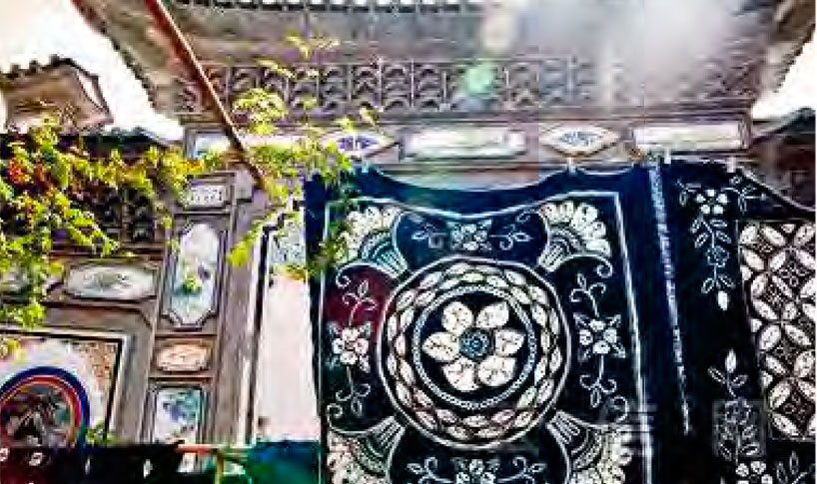
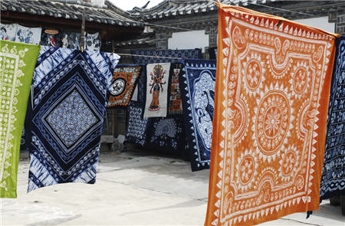
Tie-dye

Slide 16
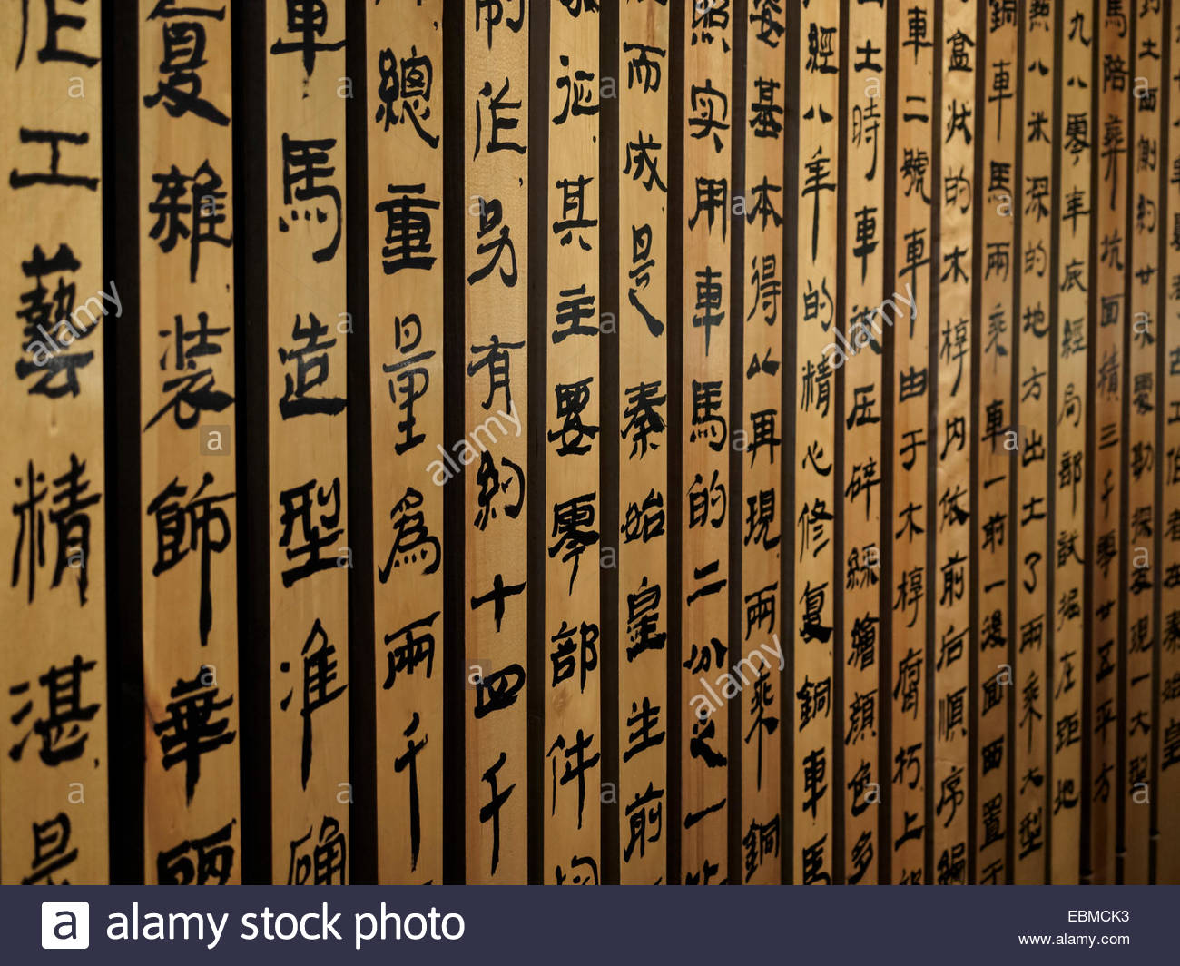
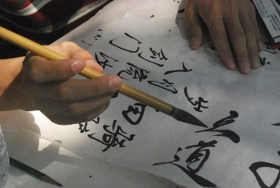
Ancient Chinese Writing

Slide 17
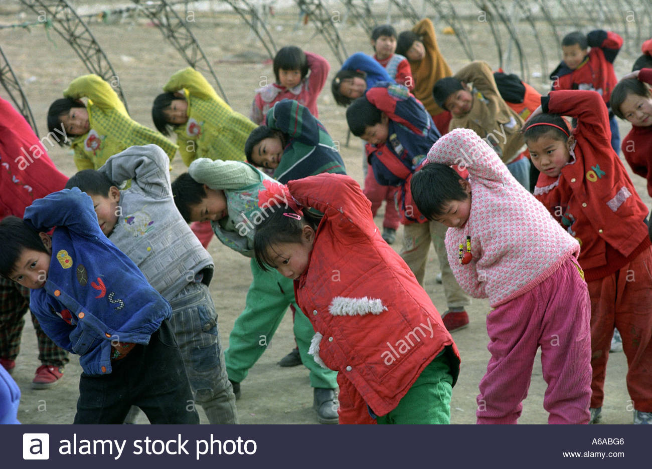
Morning Exercise

Slide 18
An ancient poem from our friends in China:
Friends are worth the sea,
Neighbours are within the other side of the world.
(We can have good friends within a large area. We can still be neighbours even though we are far apart. Our hearts can still be close.)

