Slide 1
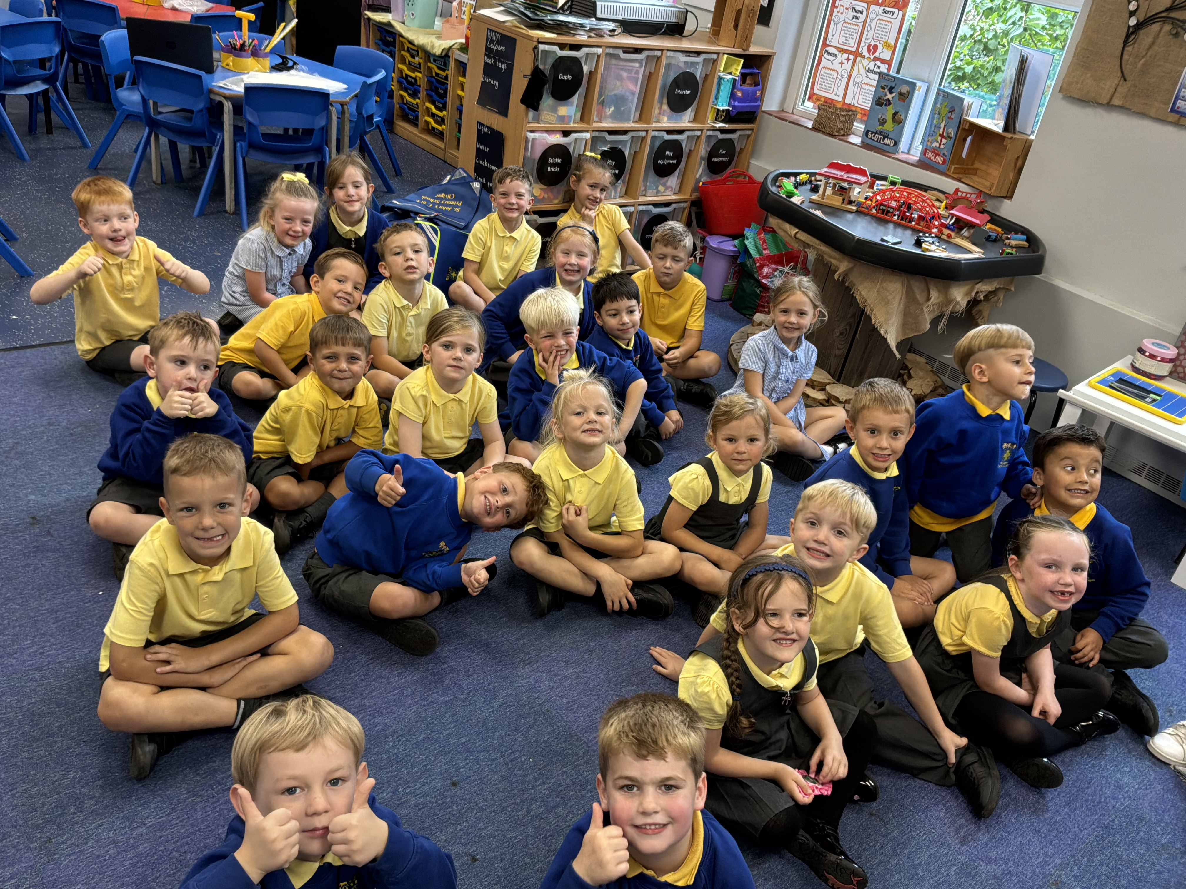
Meet the Teacher and Curriculum Information for Year 1!

Slide 2
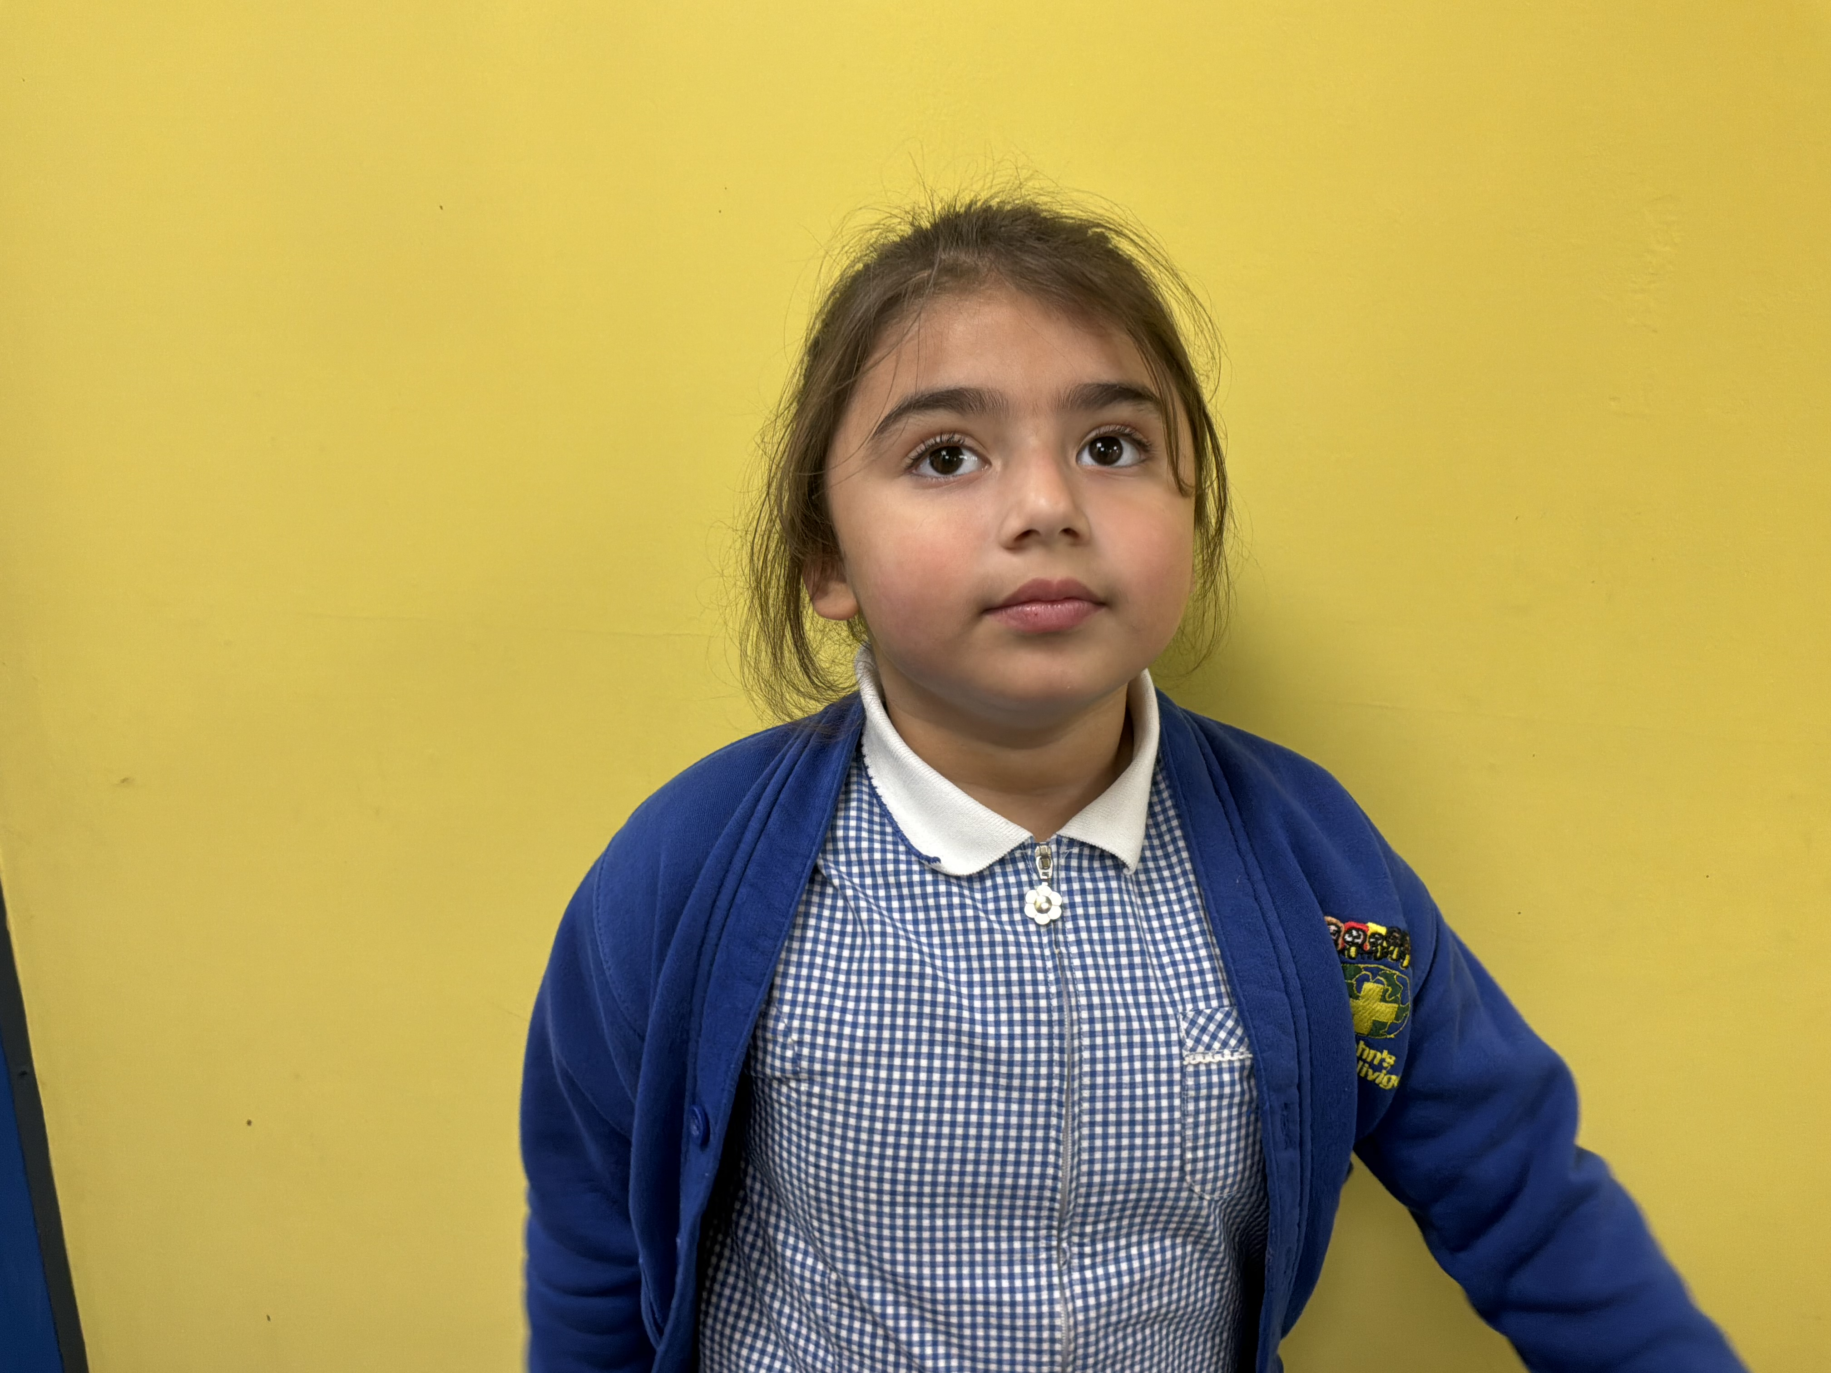
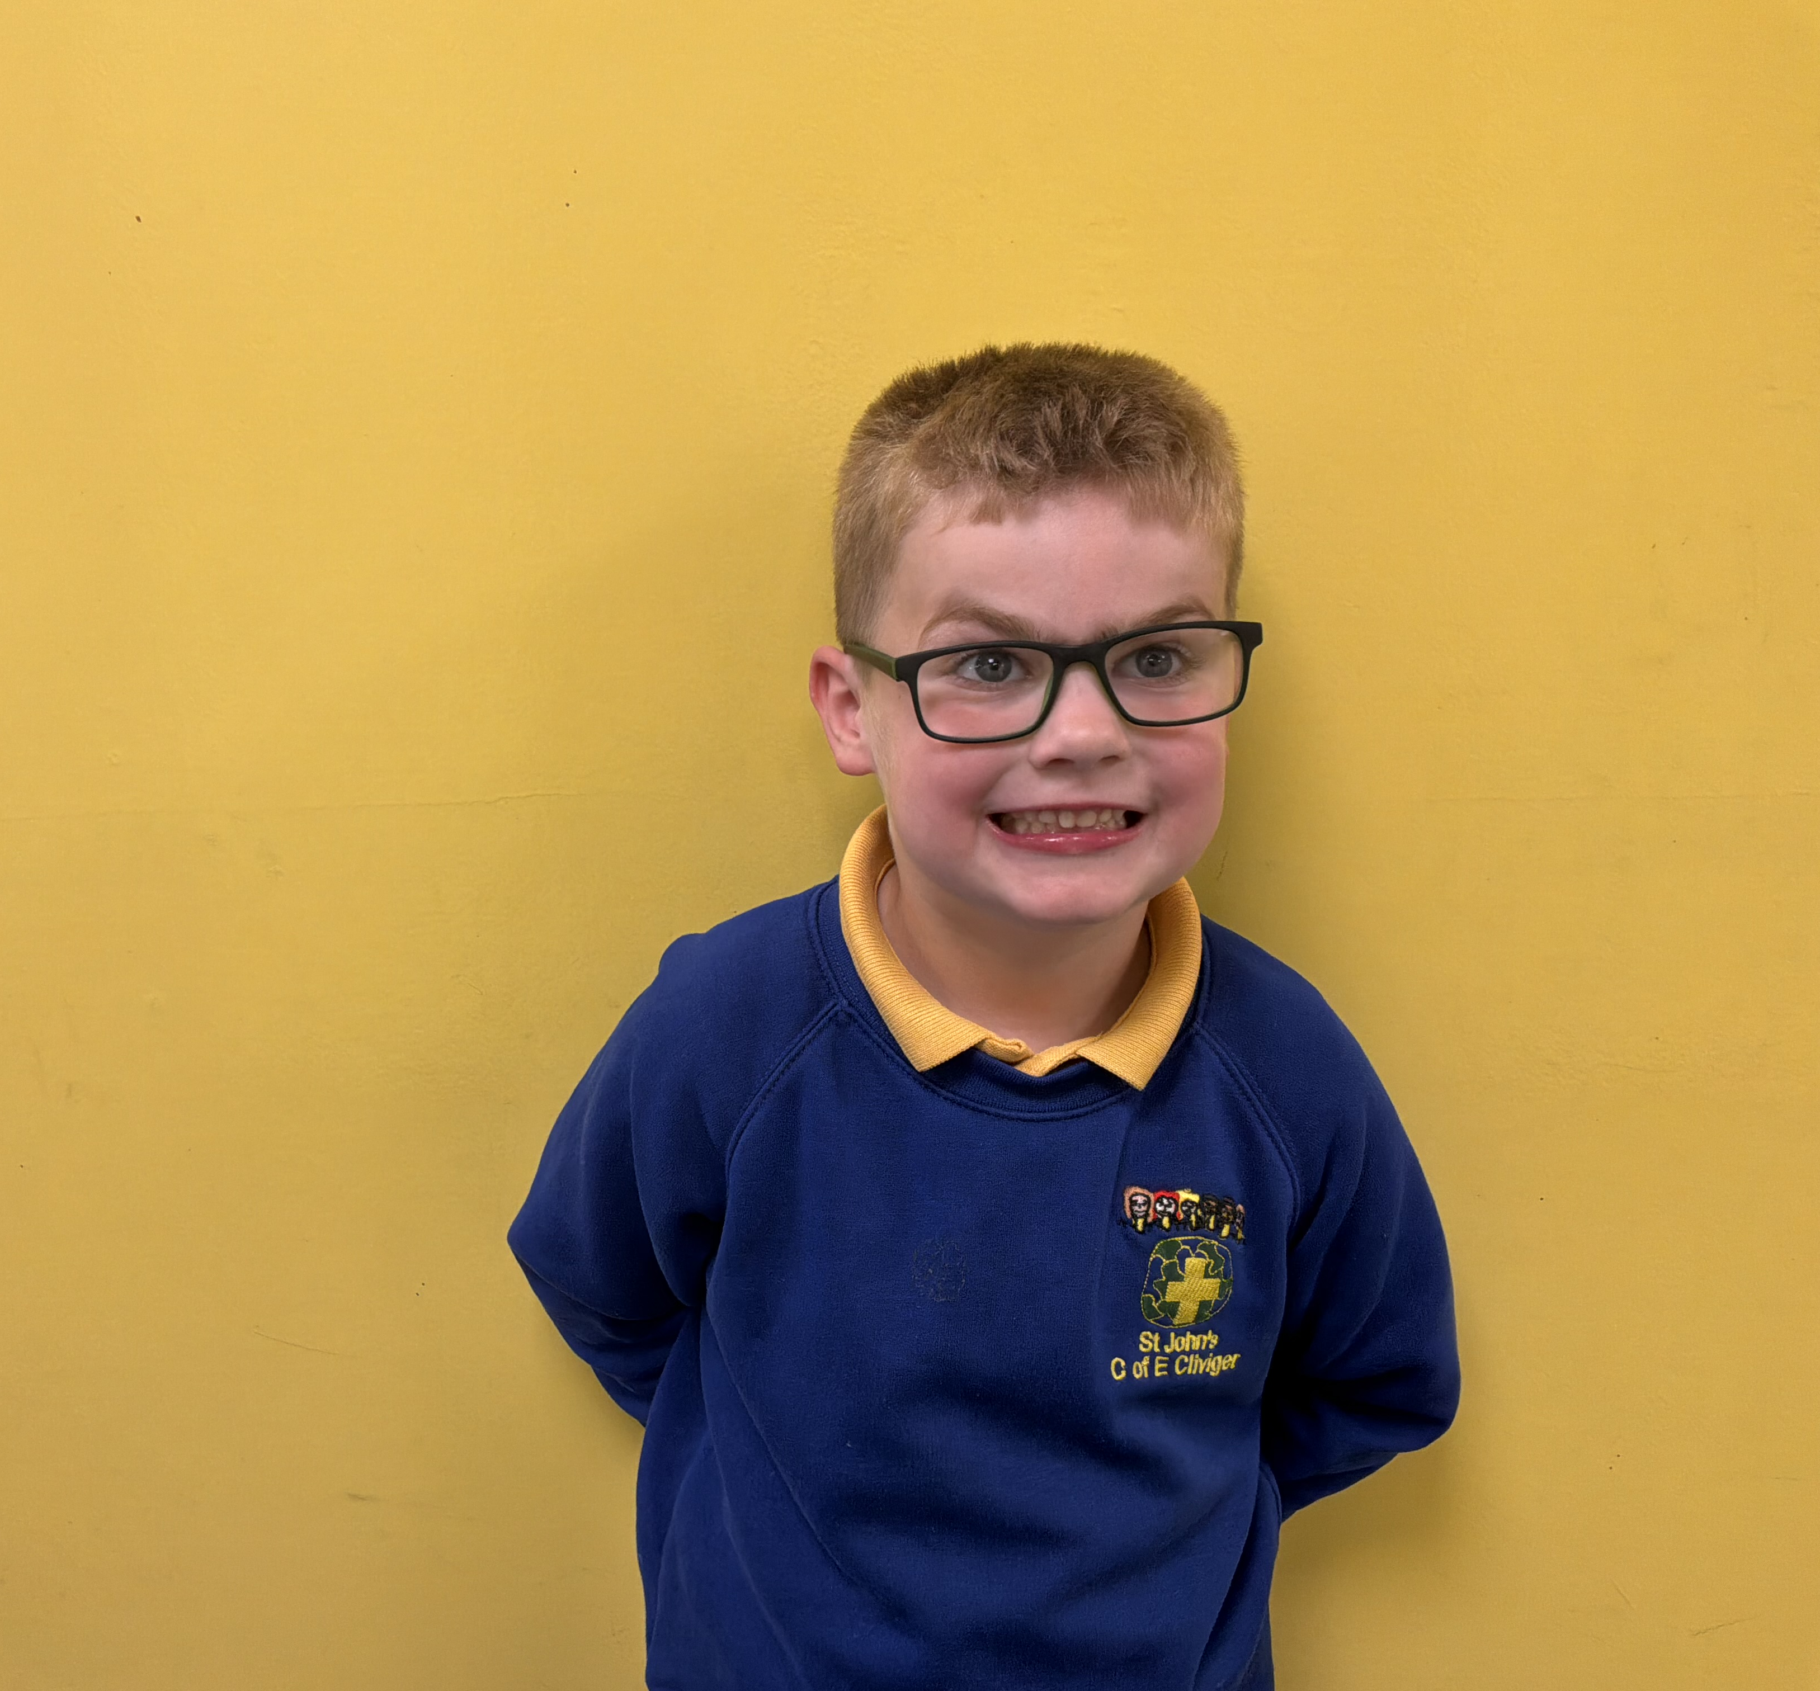
School Uniform
Please make sure that your child is wearing the correct school uniform. Please remember to bring a coat in every day.
Shoes should be plain black and weatherproof (no canvas shoes or trainers please).
No jewellery or nail varnish.

Slide 3

PE & GAMES KIT
Lessons are on Tuesdays and Thursdays, so please send PE kits into school at the beginning of the week and we will send it home on a Thursday to be washed.
All children need a white T-shirt, blue or black shorts and a pair of trainers. Normal school jumper or cardigan to be worn also. Plain blue or black tracksuit bottoms/leggings can be worn in the colder months.
Please ensure your child has a waterproof coat as many PE lessons will be outdoors.

Slide 4

Homework
Homework in KS1 will be daily reading. It is extremely important that this is completed.
Weekly spellings are placed on the Year 1 class page on our school website so you know which phonics sounds we have been working on that week.
Don’t forget maths! Use the newsletter and class webpage to get an idea of what we are covering in class. The children have Numbots log in and password details in their reading records.
Purple Mash can be used at home to assist with your child’s progress. Please find passwords in the back of the reading record books.

Slide 5

Reading
Ideally children should be doing about 10 minutes per night reading ( x4 per week minimum).
Please can parents sign and comment after your child has completed their reading.
Regular reading will be rewarded using the whole school ‘Reading Superstars’ reward which involves house points/stickers/certificates etc.
Any messages I need to pass on or that you need to pass on please put them in reading diary. I check these as often as possible so if it is something you want me to see urgently please ask your child to give it to me in the morning or ring/email the school office.
Please ensure reading book bags are sent into school every day. We will be changing their books on Tuesdays and Thursdays if completed.

Slide 6
Outdoor Learning
Miss Saunders and I, use the outdoors as an extension of the classroom. The children will be learning outside in all weathers so please ensure that they have suitable coats and footwear for the time of year.

Slide 7
E Safety
During our discrete ICT lessons and when using IT in other lessons the children will also be reminded on how to stay safe whilst on the internet.
PLEASE reinforce this at home. Useful link for information and activities you can do with your child.
https://www.thinkuknow.co.uk/5_7/

Slide 8

Rewards
Team/House Points, House Point Certificates
Jar of Joy
Recognition Board
Head teacher's Good Work Awards
Certificates
Golden Book
Raffle tickets.
Terrific Texts.

Slide 9

Promoting Positive Behaviour
Reminder of what is expected.
Use of the school rules.
Discussions with class teacher or teaching assistants to talk and check everything is ok.
Praise.

Slide 10

Curriculum Newsletter
Online termly with brief details of what the class will be covering that term.
Weekly newsletter online.
Check school website
https://st-johns-cofe-va-primary-school-cliviger.secure-primarysite.net/
Subject vocabulary maps available each half term on class webpage.

Slide 11

PPA Arrangements
On Thursday afternoons the class will be taught by Miss Saunders whilst I am on PPA.

Slide 12
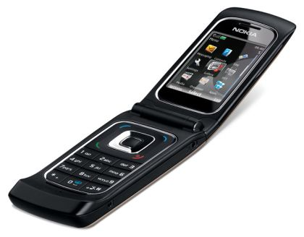
Emergency Contact Information
Please let us know of any changes as they arise.

Slide 13
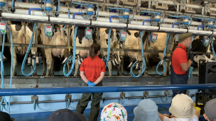

Trips and Visitors
Visitors linked to our topics.
Class trip e.g. Farm visit.
Outdoor Learning Days.
Picnic Walks.

Slide 14


