Slide 1
Welcome to Reception: Meet the School Nursing Service

Slide 2


Welcome and Introductions
Notes:
Introduce yourselves

Slide 3

Who Are We?
The School Health Team are part of Lancashire’s Healthy Young People and Families Service, which is delivered by HCRG Care group.
The School Health team are responsible for delivering the Department of Health recommended Healthy Child Programme.
Our team consists of School Nurses, Community Staff Nurses and Healthy Family Support Workers. We work together to support and improve the health and wellbeing of every child aged 5 to19 years.
We work in partnership with schools, GP’s, Children’s social care and the Children & Families Wellbeing team to support the needs of children, young people and their families

Slide 4
What We offer to Everyone
Prevention and early intervention
Health Needs Questionnaires in Reception, Year 6 and Year 9.
Signposting to other services
Key health priorities including healthy lifestyles, such as healthy eating and weight
• Health promotion advice and activities
National Child Measurement Programme in Reception and Year 6

Slide 5
We can provide additional support for:
• Emotional health and wellbeing
• Healthy lifestyles
• Bladder and Bowel concerns
Sleep Issues
Behaviour
• Supporting complex and additional health and wellbeing needs
• Transition through services.
School Drop In Sessions

Slide 6
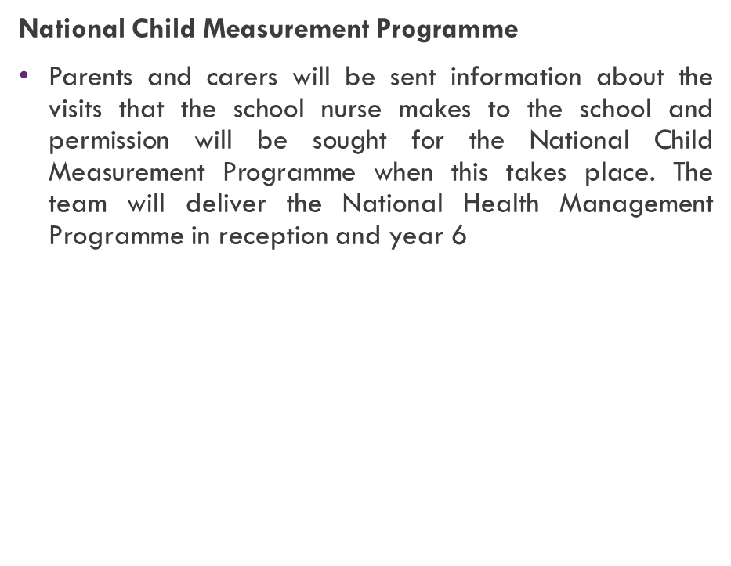
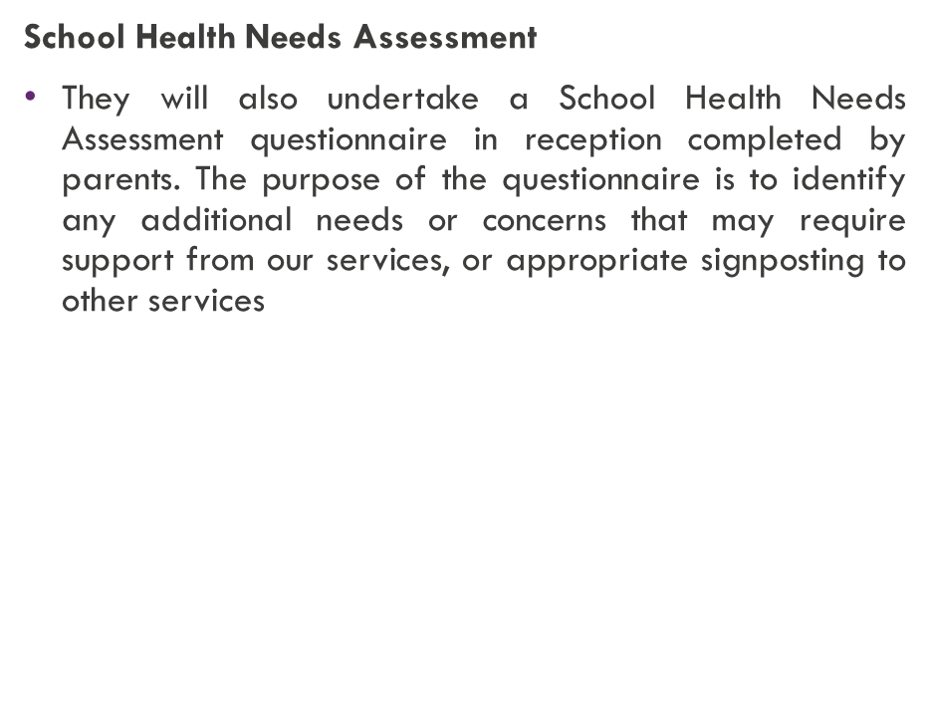
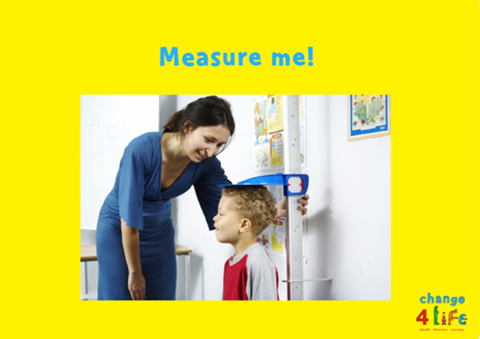

Reception Year Programme
Notes:
Discuss NCMP process
Public Health England (PHE) needs to have a good understanding of how healthy children are, so that the best possible health services and advice can be provided for the children, their families and school communities, where needed.
As a result, a National Child Measurement Programme (NCMP) has been set up, to weigh and measure children, in England, in Reception and Year 6.
Along with PHE the School Nurses will give feedback on how your child is developing and advice on changes you can make to keep them healthy.
SHNA
If you identify any areas of concern the School Nursing Team will be in touch about support or referrals that may be required

Slide 7



Moving into Primary School, some useful tips:
As your child now moves forward into a Primary School setting, it is a good time to encourage independent skills i.e.
Encourage your child with getting dressed / getting changed independently – (putting coat on, putting shoes on the right feet etc. – (Helps with PE, Break and Home times)
Encourage your child with self-help skills: opening yoghurt pots, lids on drinks etc
Toileting, encourage independence
Notes:
A child’s first day at school, is a big moment for you and for them and it can be both an exciting and nervous time

Slide 8
How to access support from your School Health Team
School are able to complete a referral form to request support from the School Health Team with your consent
OR
Parents can contact our dedicated school nurse duty line Mon-Fri – 9-5pm on 0300 247 0040

Slide 9


Thank you for listening, any Questions ?

Slide 10
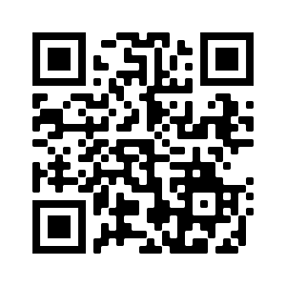
Lancashire Health Visiting and School Nursing Service
Please scan the QR code to go directly to our website for further resources and information.

Slide 11
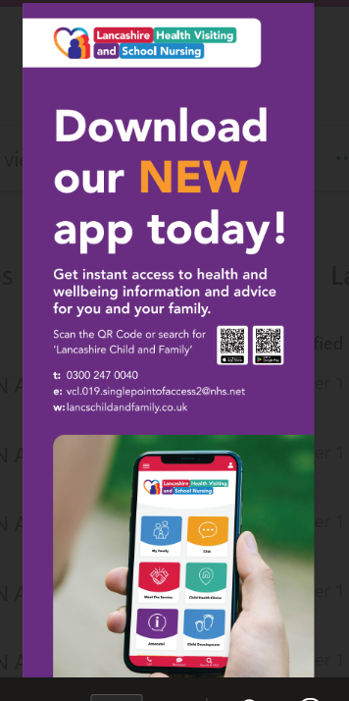

Mobile Rocket Health App
Parents/Carers, Young People and Professionals can now have instant access to health, advice and support on their mobile phones by downloading our new health app. Go to with App Store or Google Play and search Lancs Child and Family or you can scan the QR codes.

Slide 12
Contact Information
Contact Information:
w. https://lancschildandfamily.co.uk/
e.VCL.019.SinglePointofAccess2@nhs.ne
tt. 0300 247 0040

