Slide 1
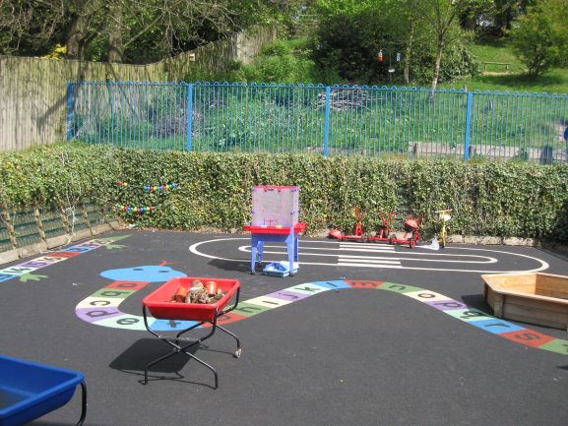
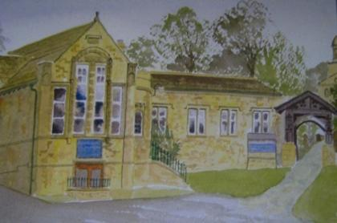
Welcome to Reception

Slide 2
Foundation Stage Curriculum
Personal, Social and Emotional Development
Literacy
Communication and Language
Mathematics
Understanding the World
Physical Development
Expressive Arts and Design
These will be taught through playing and exploring, active learning, and creative and critical thinking.

Slide 3
Personal, Social & Emotional Development

Slide 4
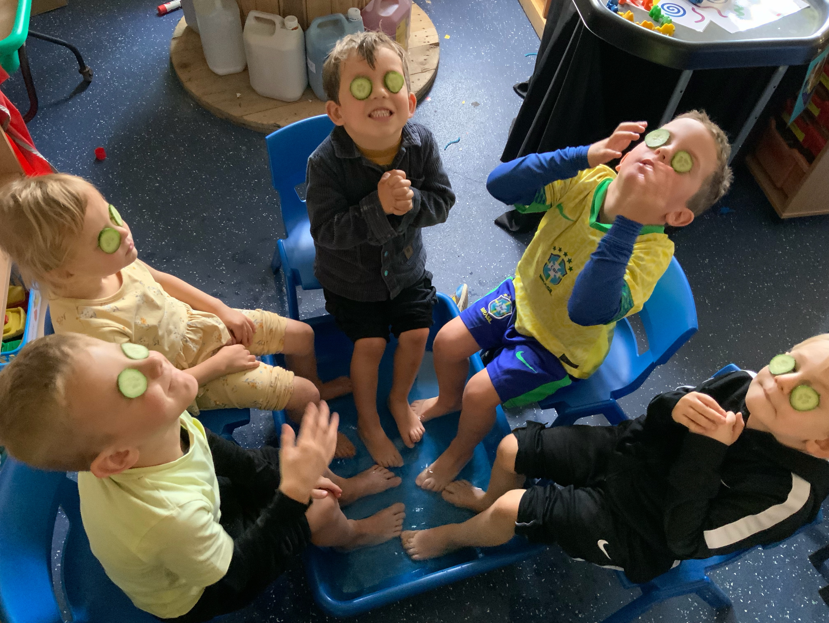
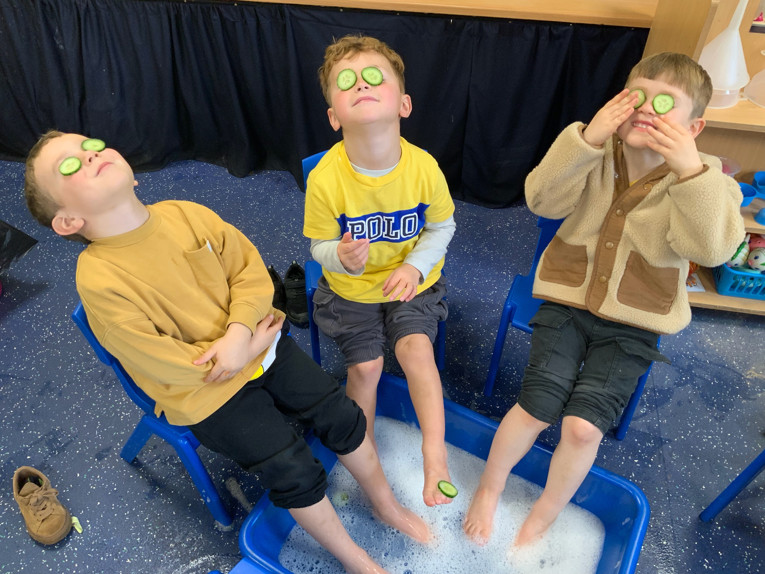
Self-Regulation
Managing Self
Building Relationships
Share Work together Take turns
Understand feelings of self and others
Know right from wrong
Form positive relationships Follow class rules
Be confident to try new activities
Be kind, caring & respectful
Set simple goals Manage own basic hygiene
Follow our Christian value words

Slide 5
Physical Development
Gross Motor Skills
Fine Motor Skills

Slide 6
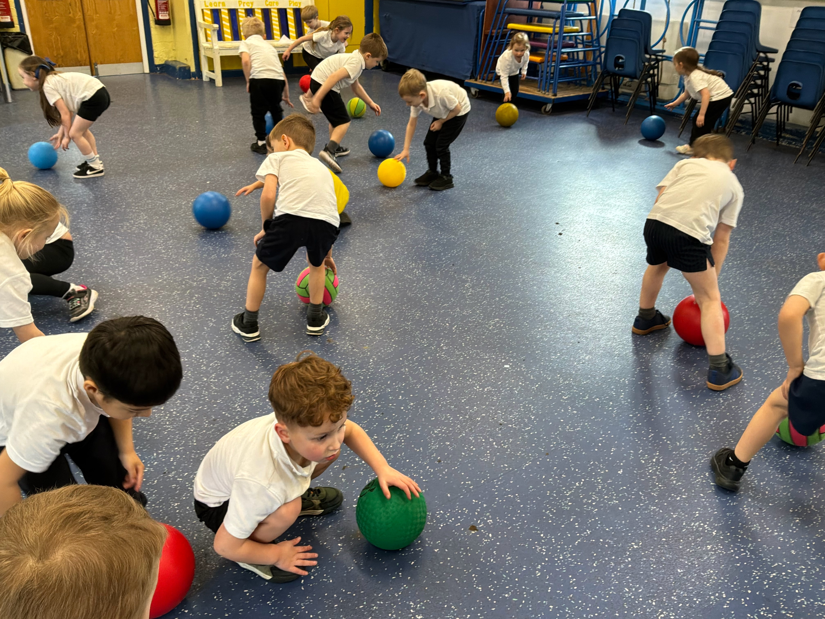
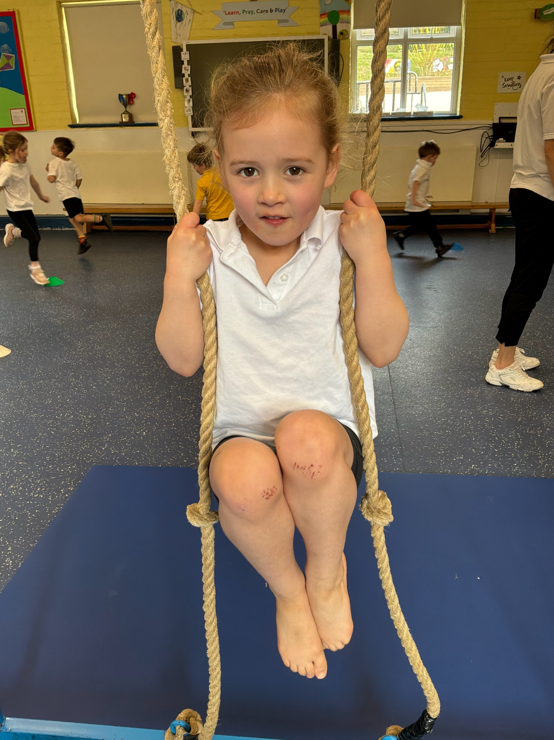
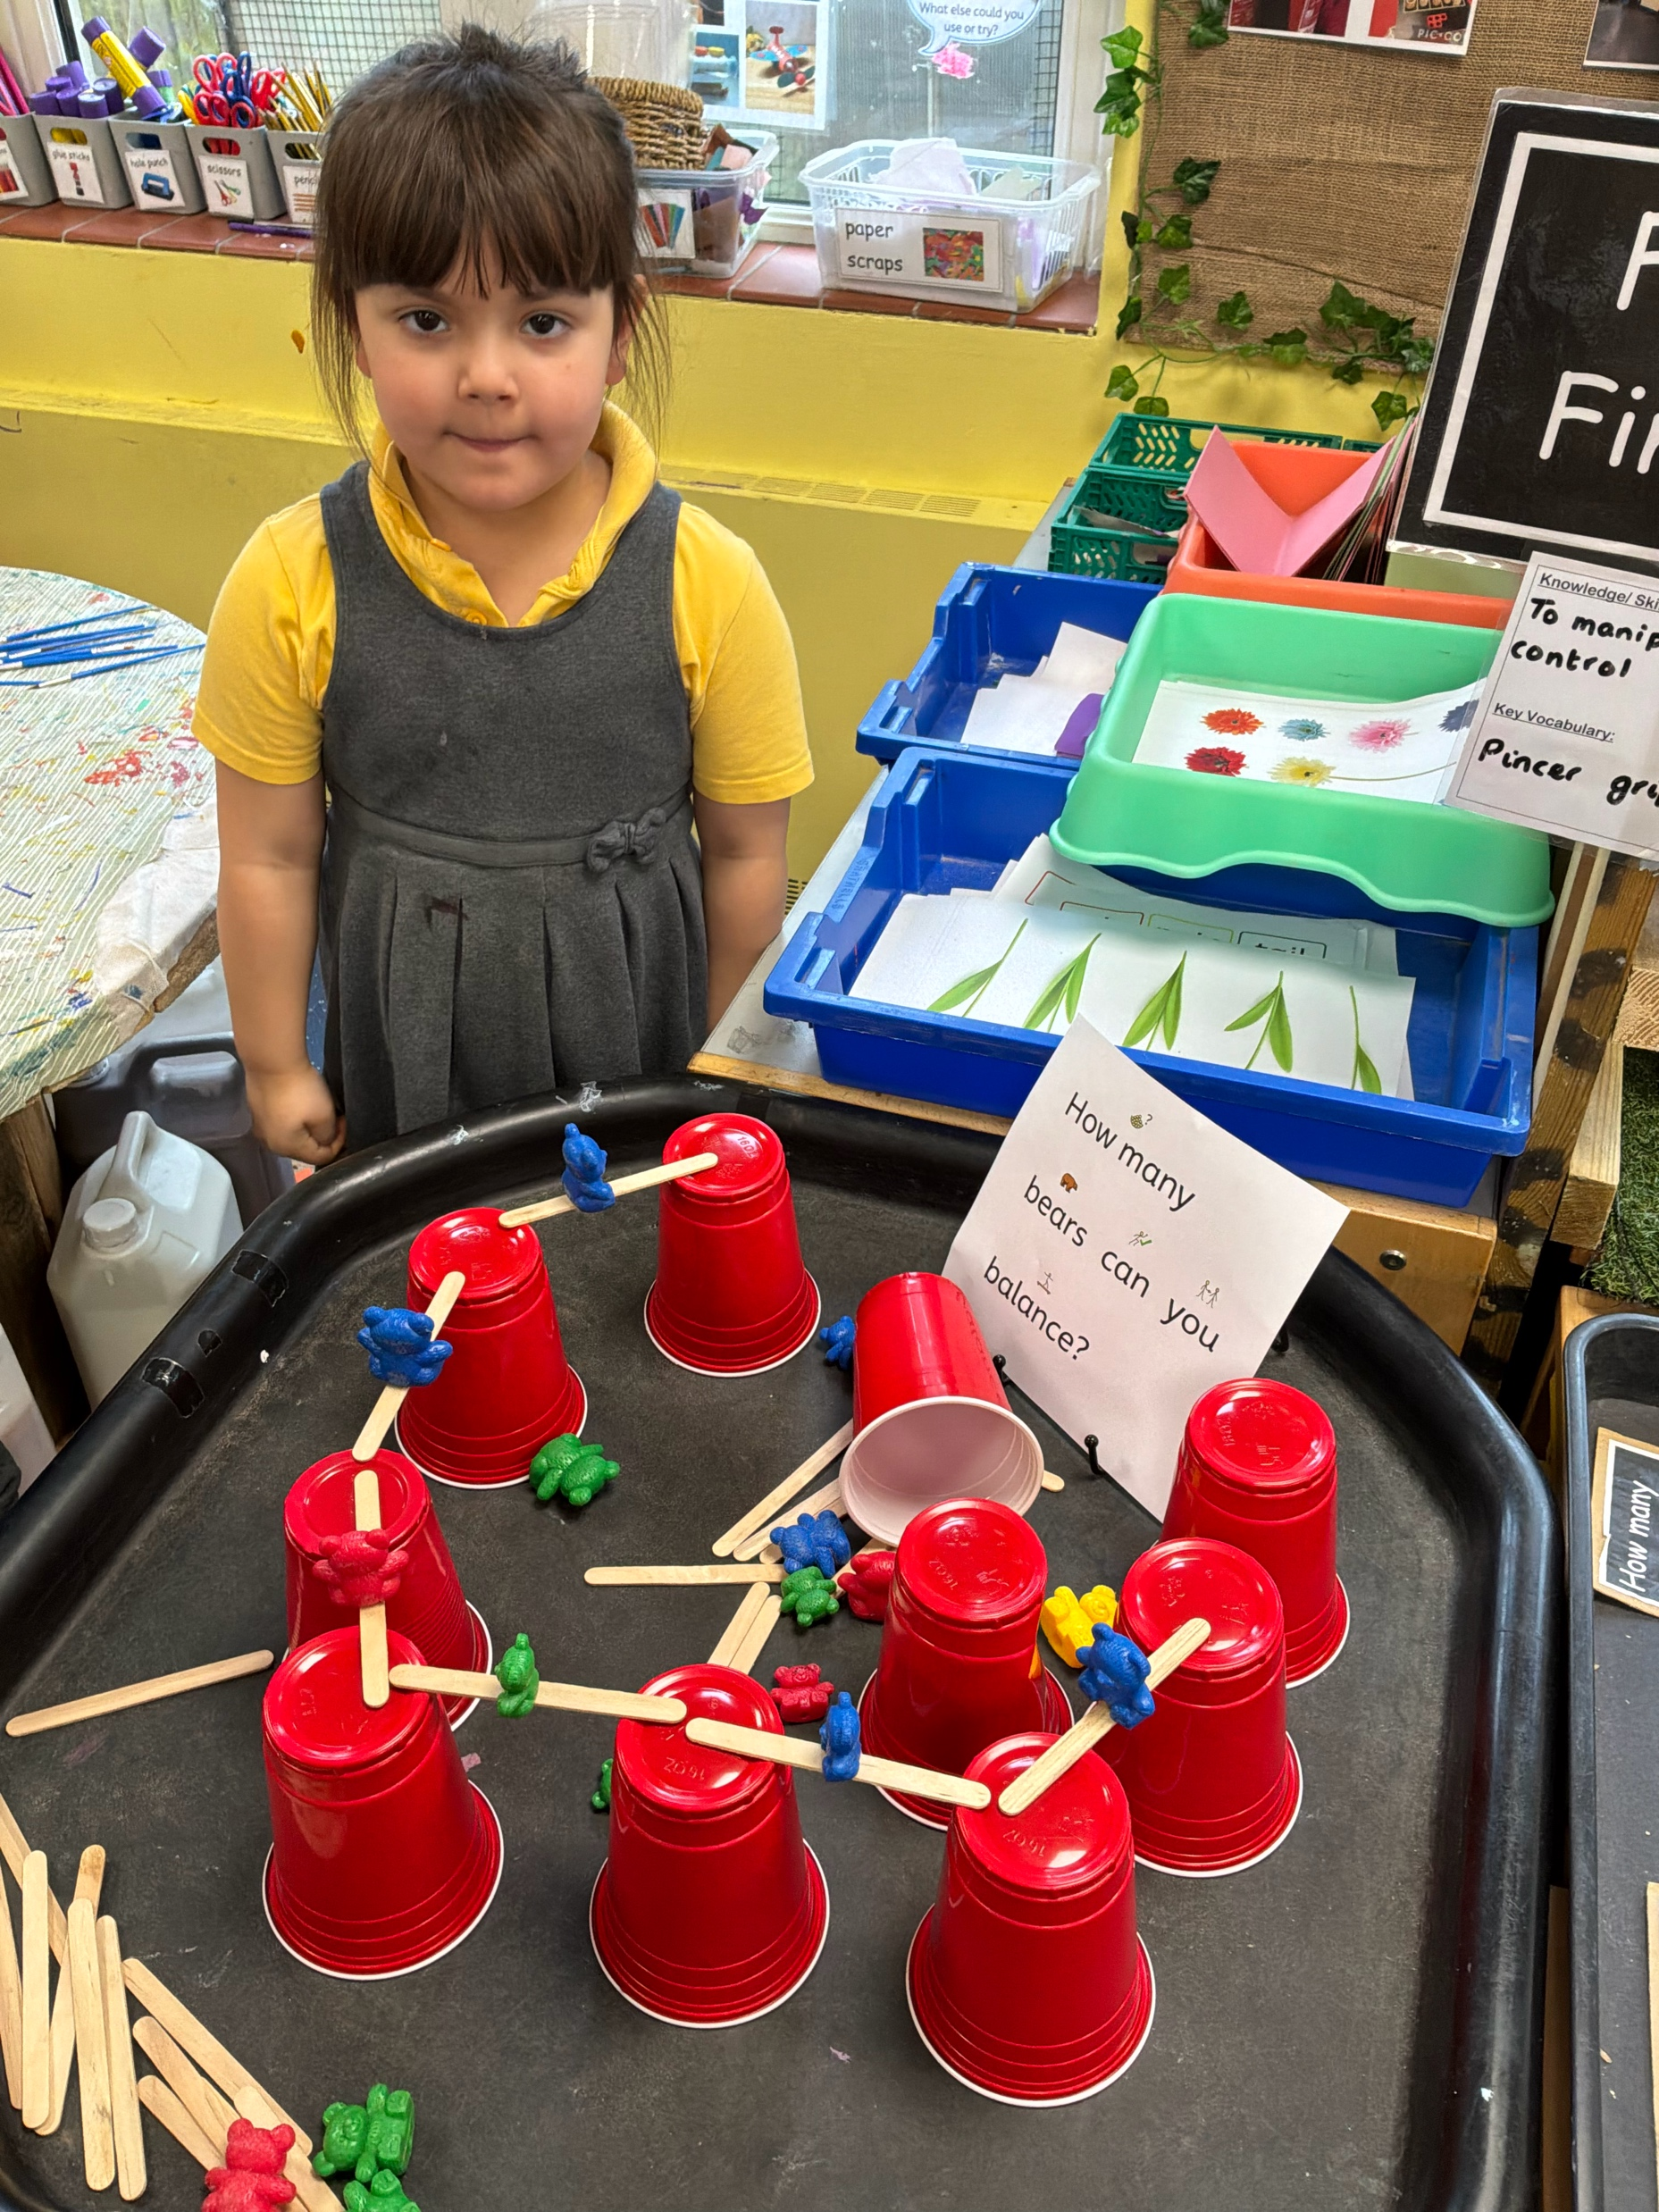
Opportunity to develop fine and gross motor skills, spacial awareness and hand-eye co-ordination through activities such as:
Balancing
Throwing & catching
Travelling in different ways and directions
Threading
Cutting
Painting
Chalking
Handwriting
PE – Your child will take part in PE twice a week. Please provide a named pair of pumps, white t-shirt and navy shorts in a pump bag.

Slide 7
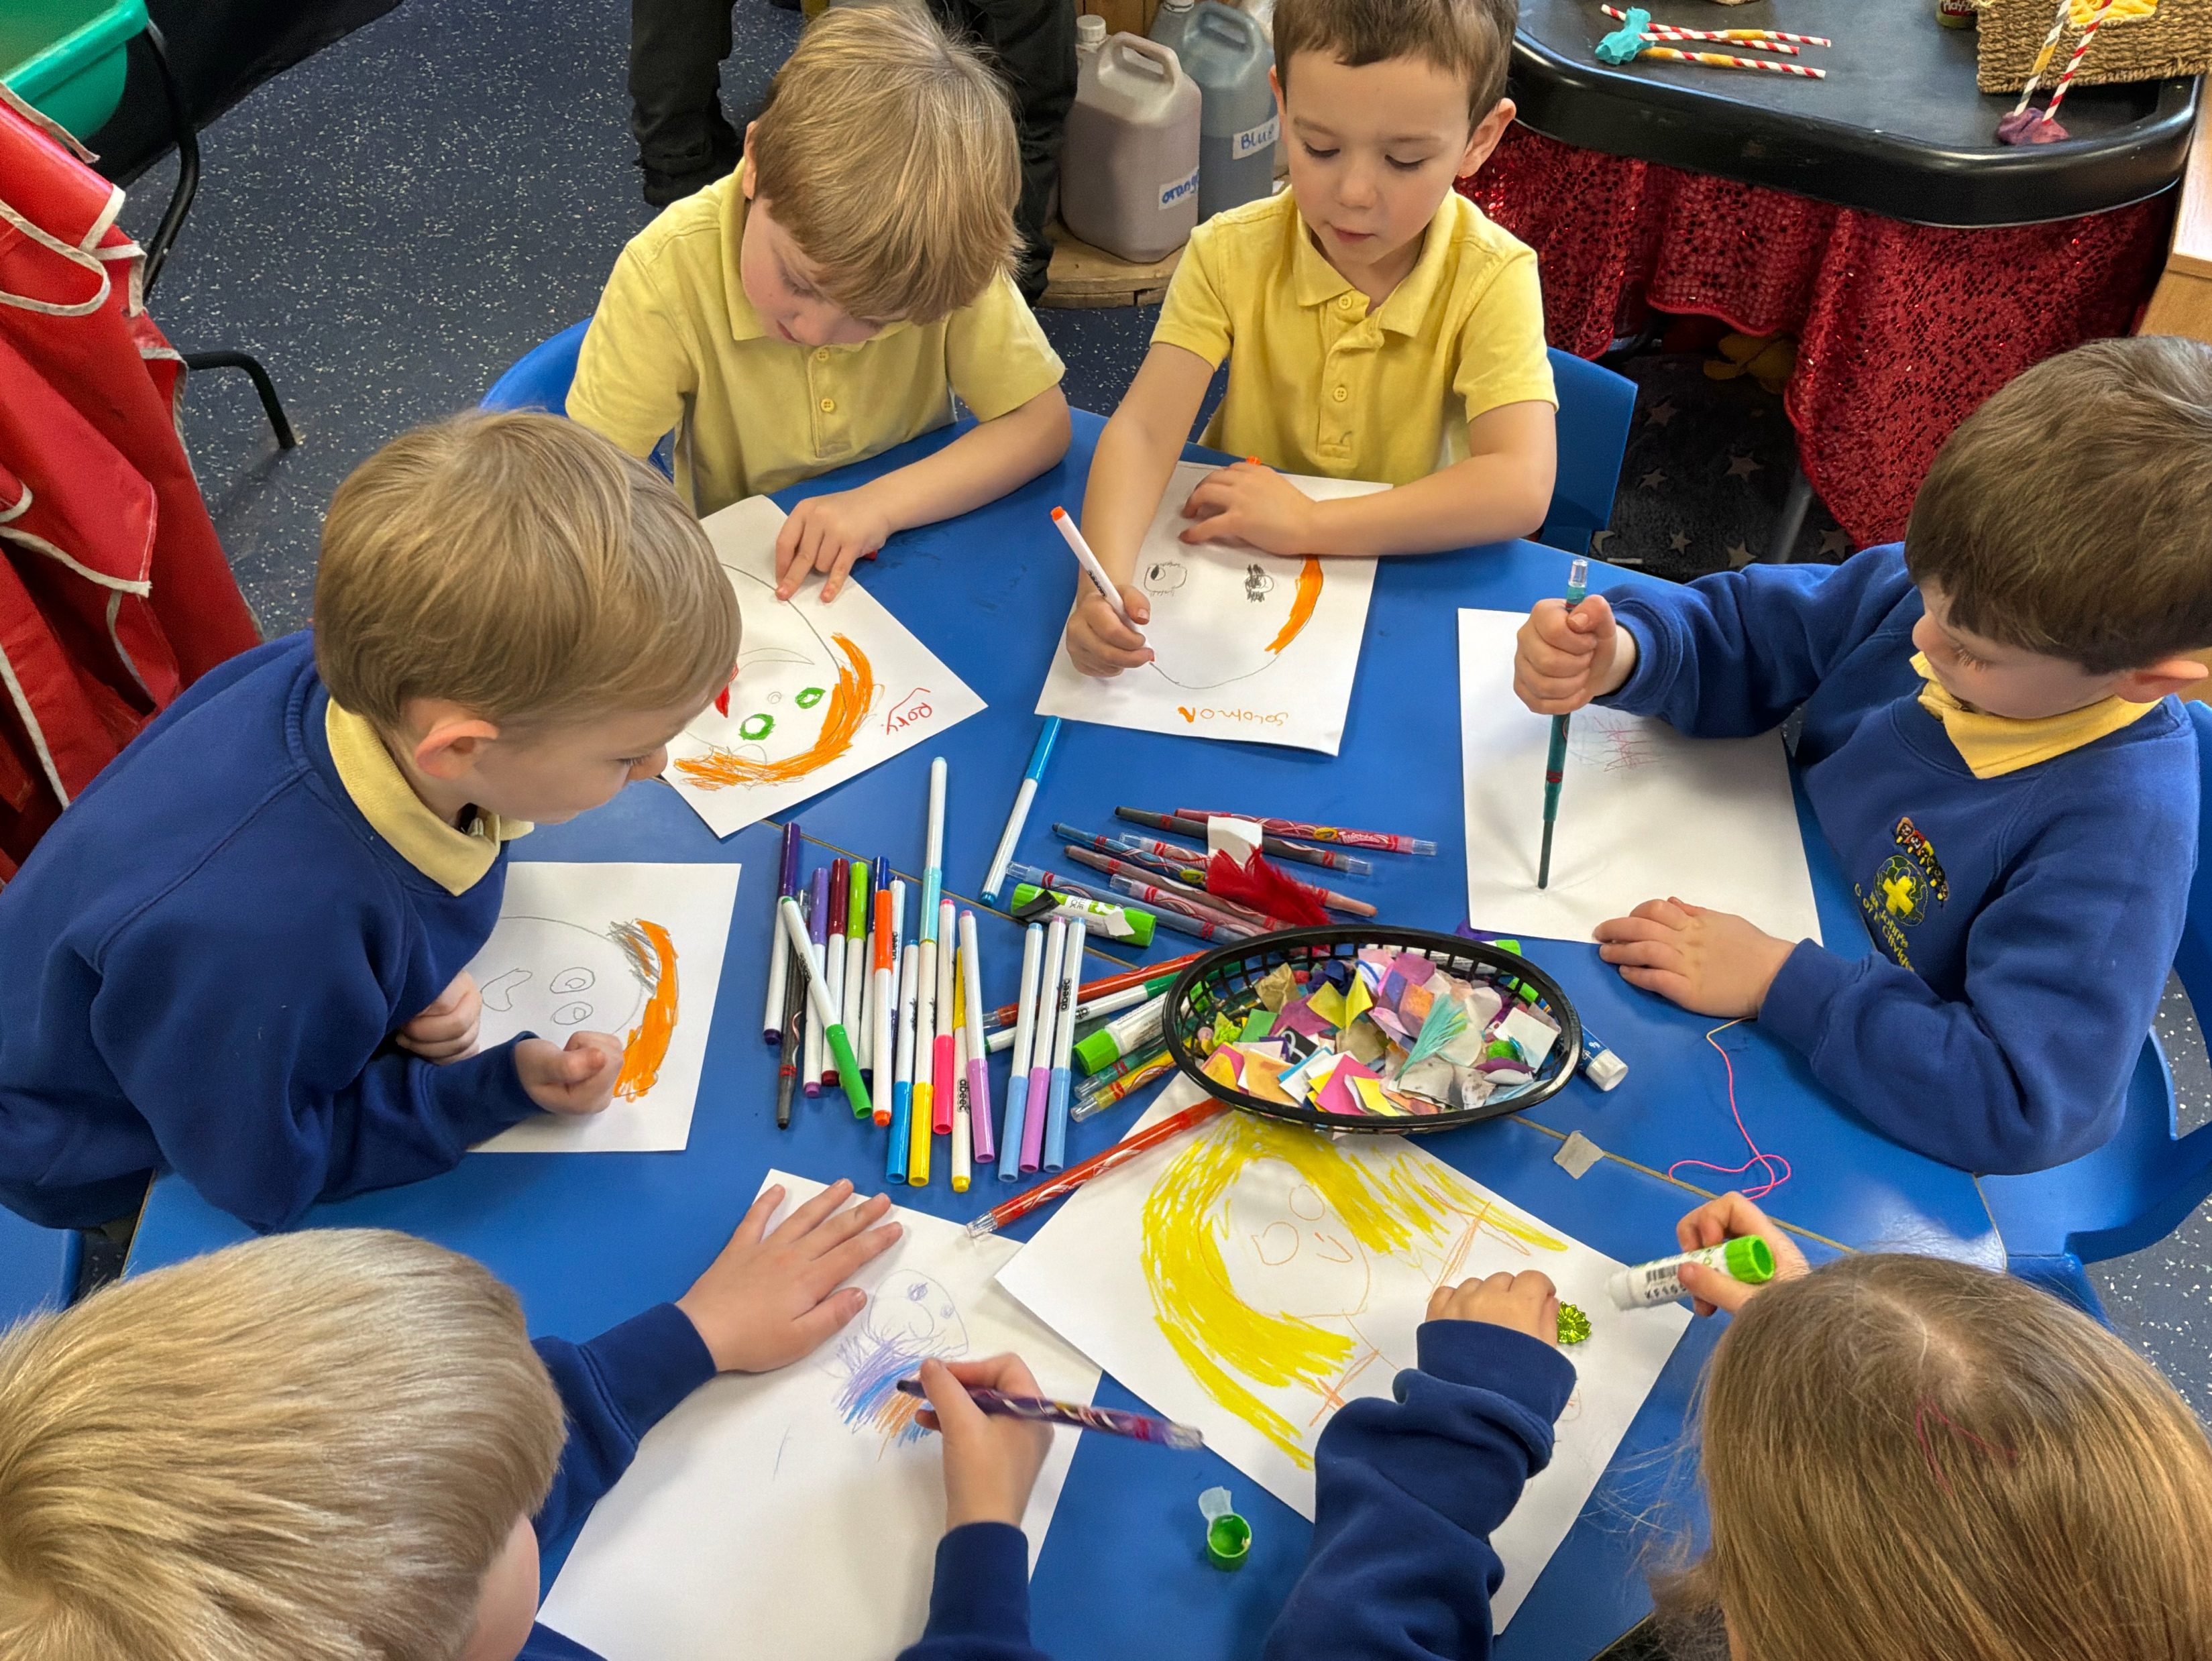
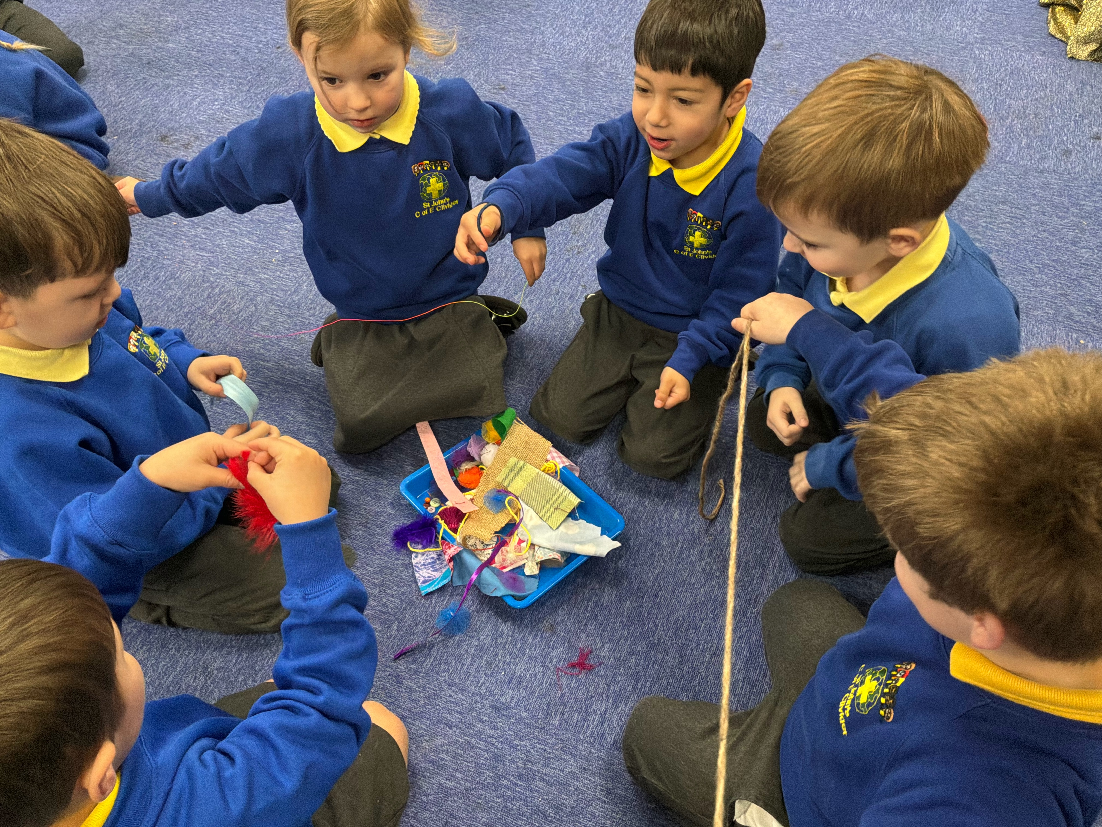
Communication and Language
Listening, Attention and Understanding
Speaking

Slide 8
Literacy

Slide 9
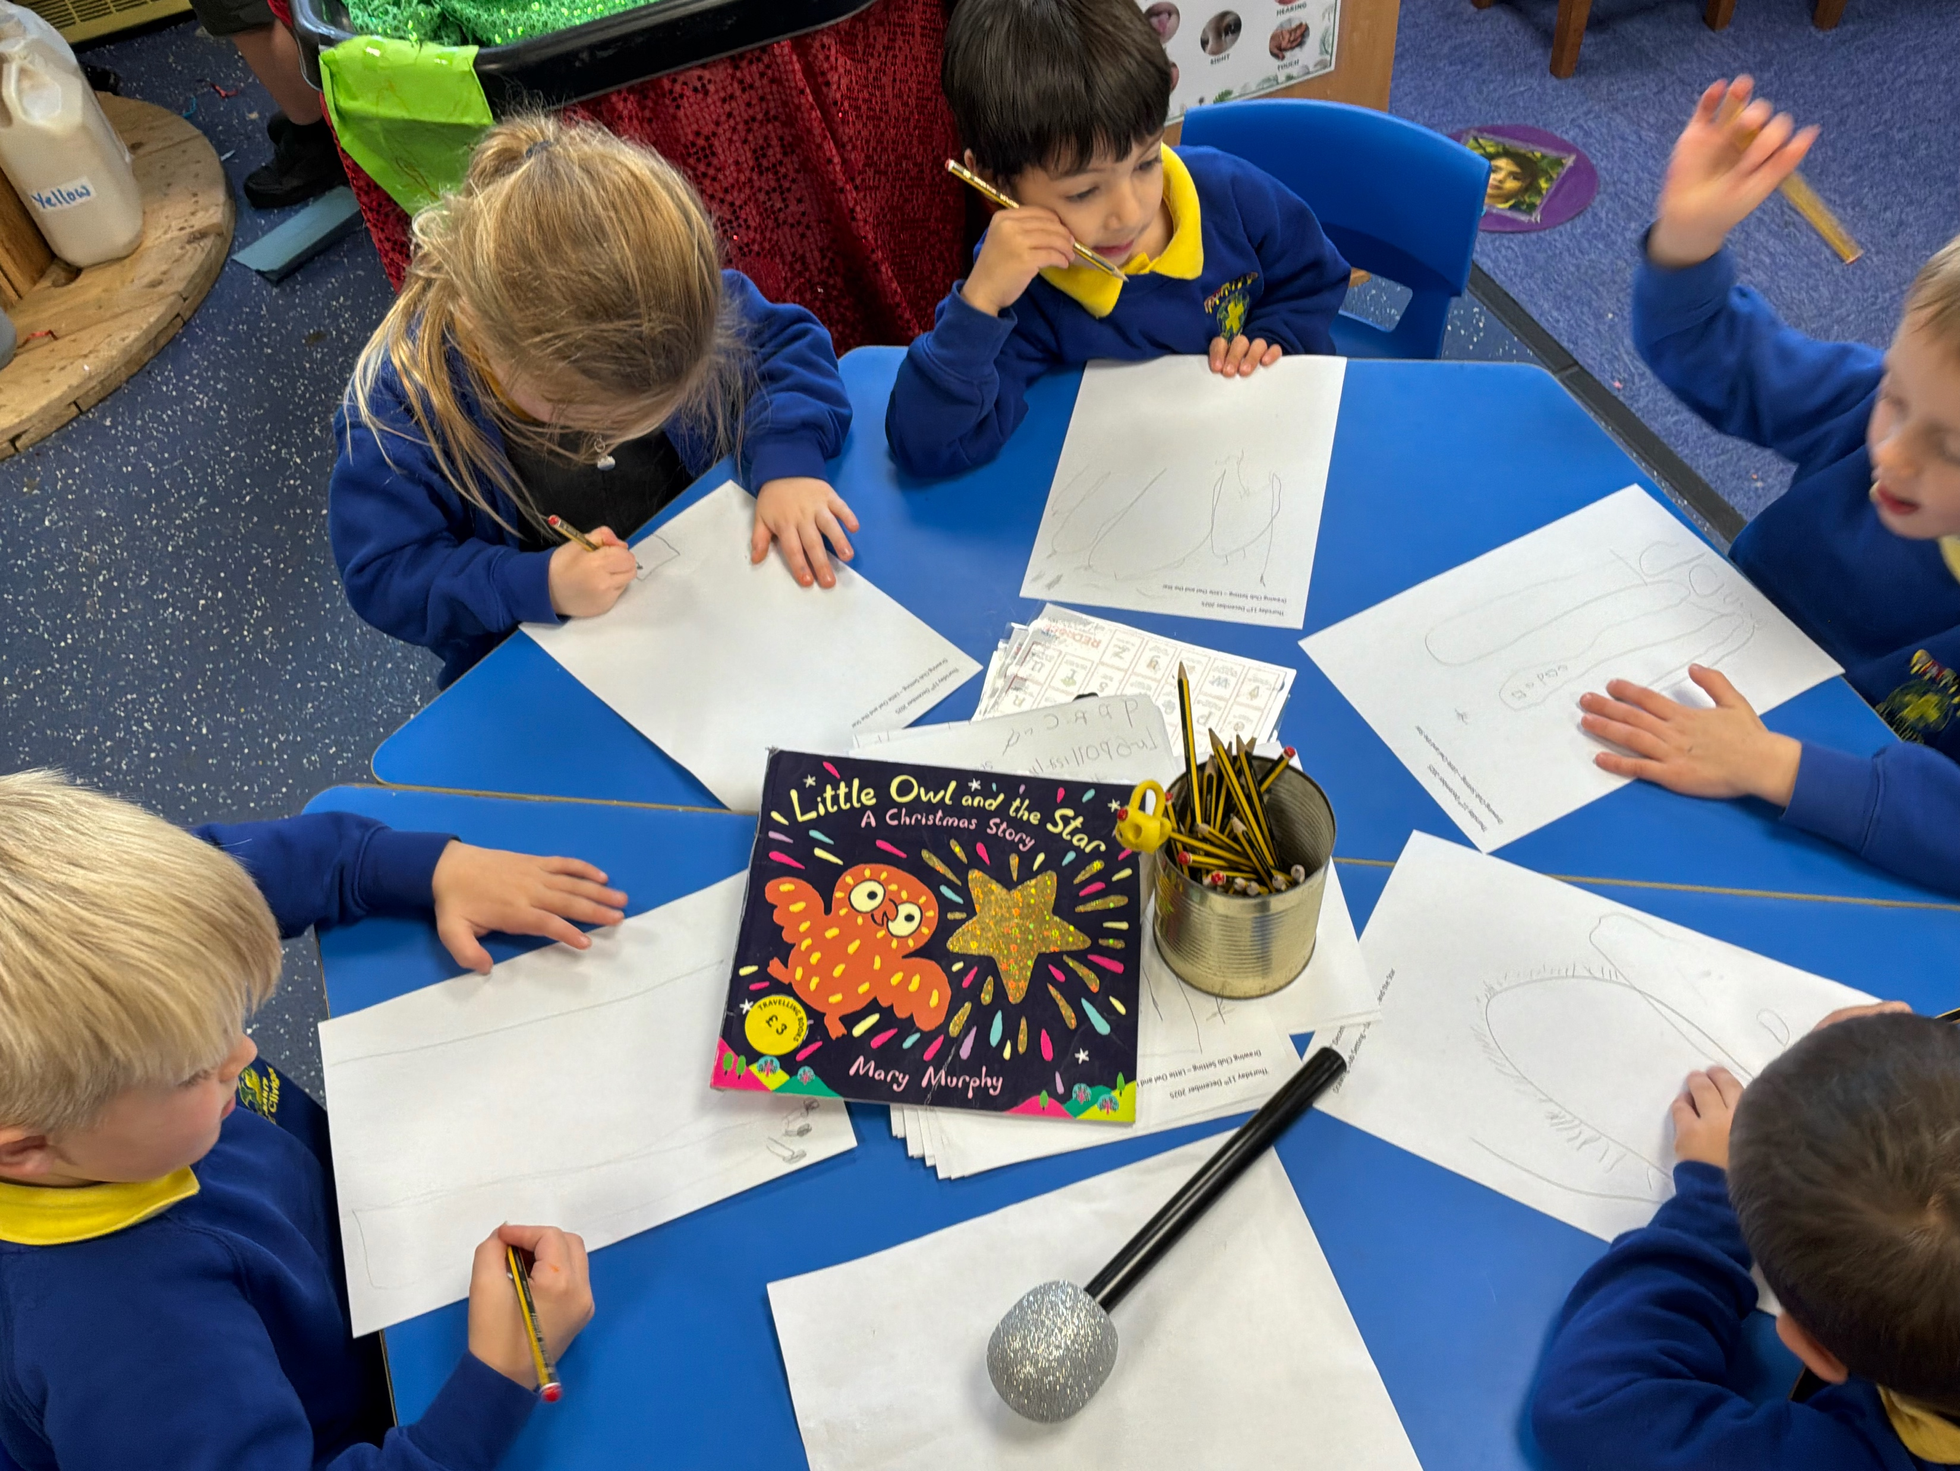
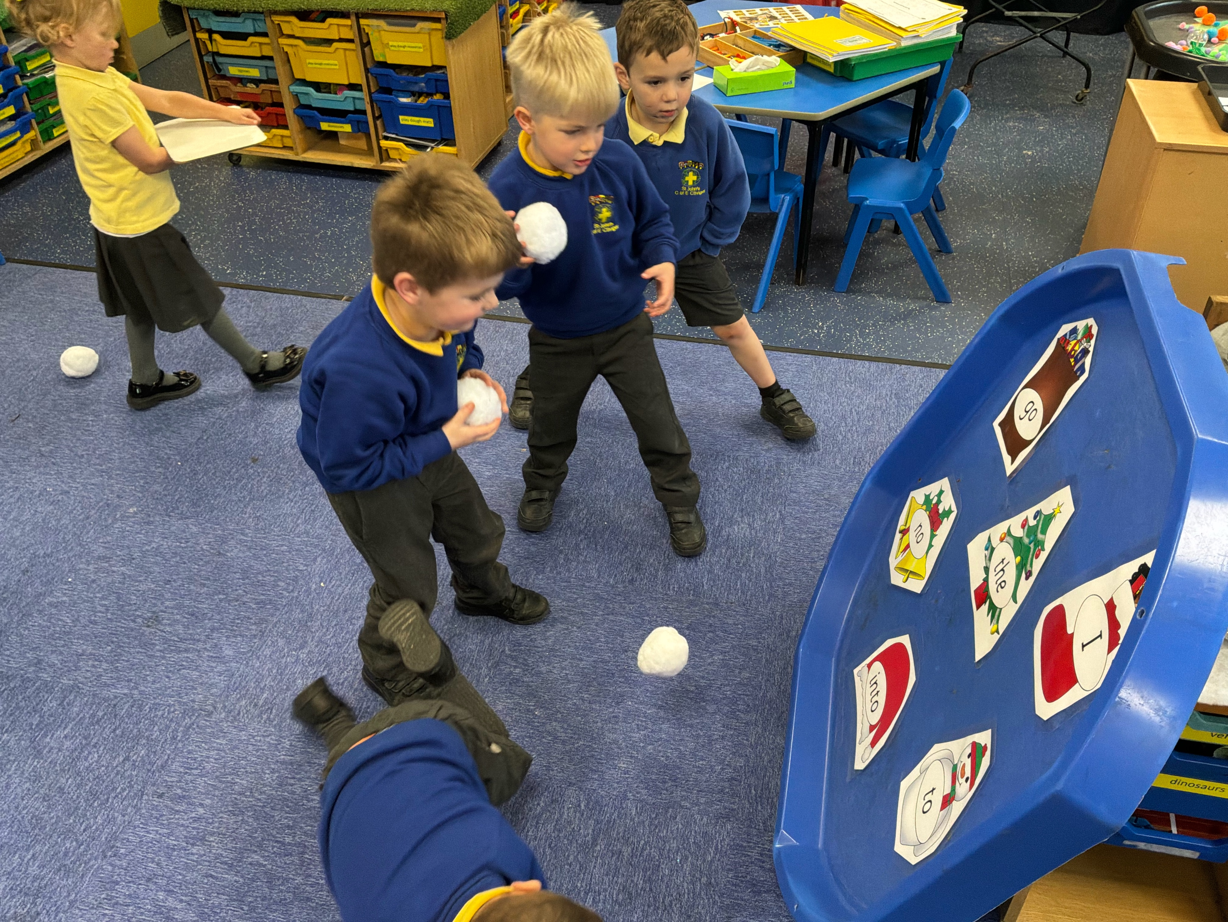
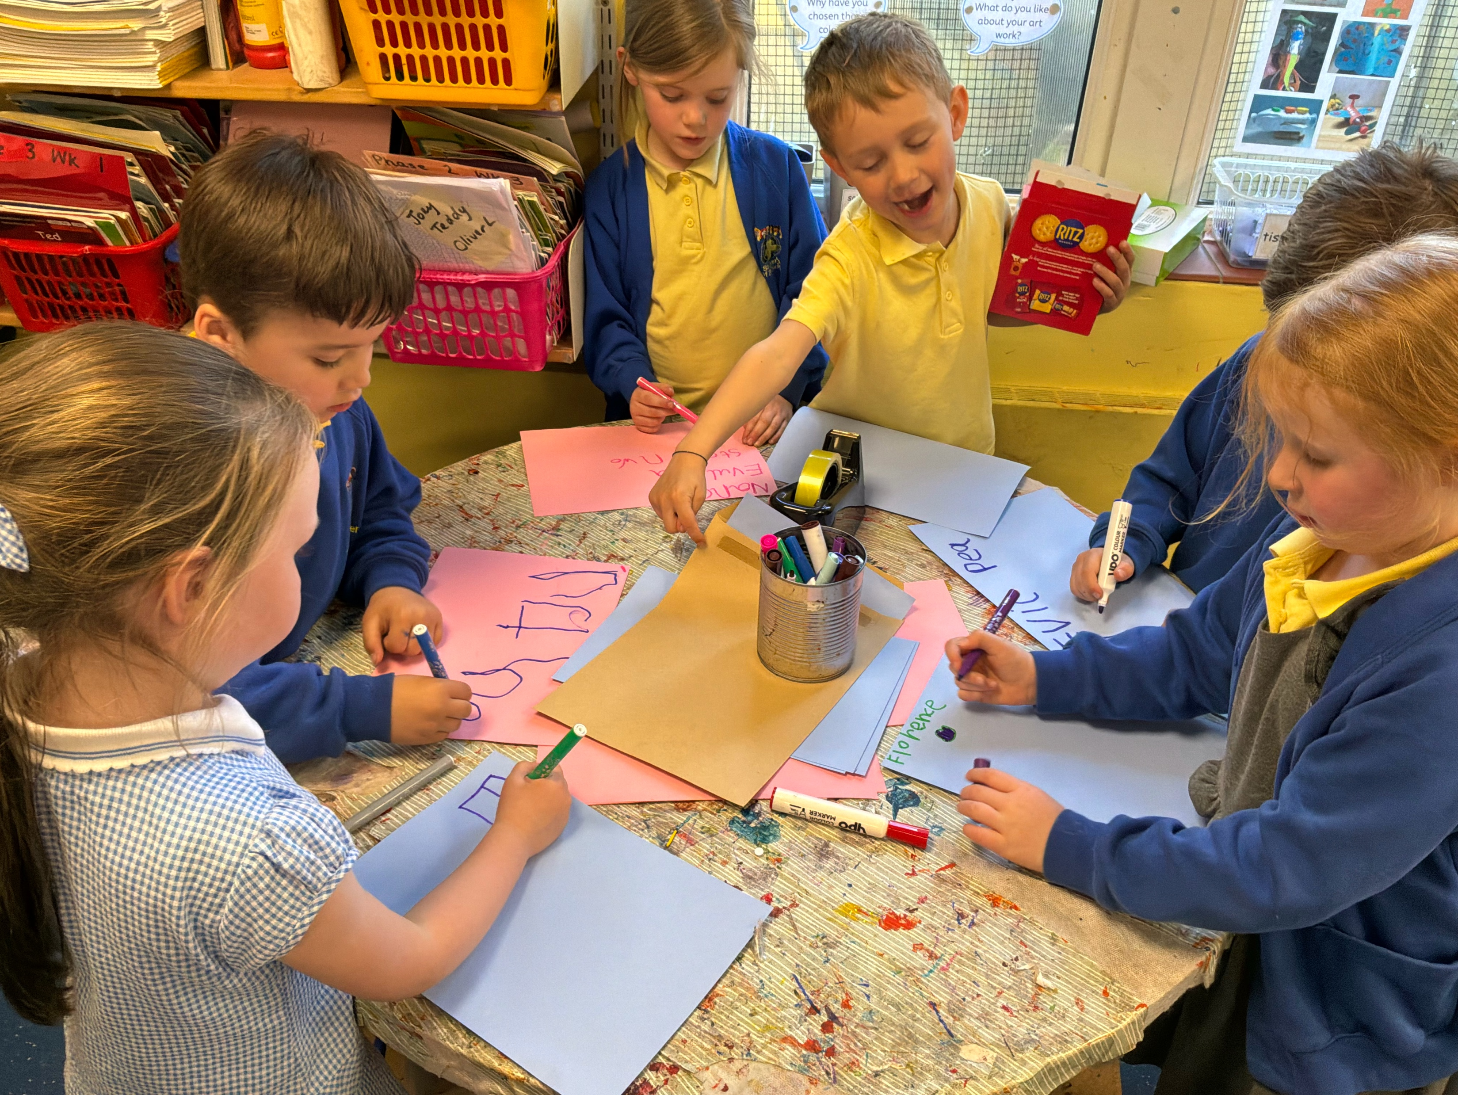
This incorporates:
Reading – Comprehension and Word Reading
Writing
Phonics – learning letter sounds

Slide 10
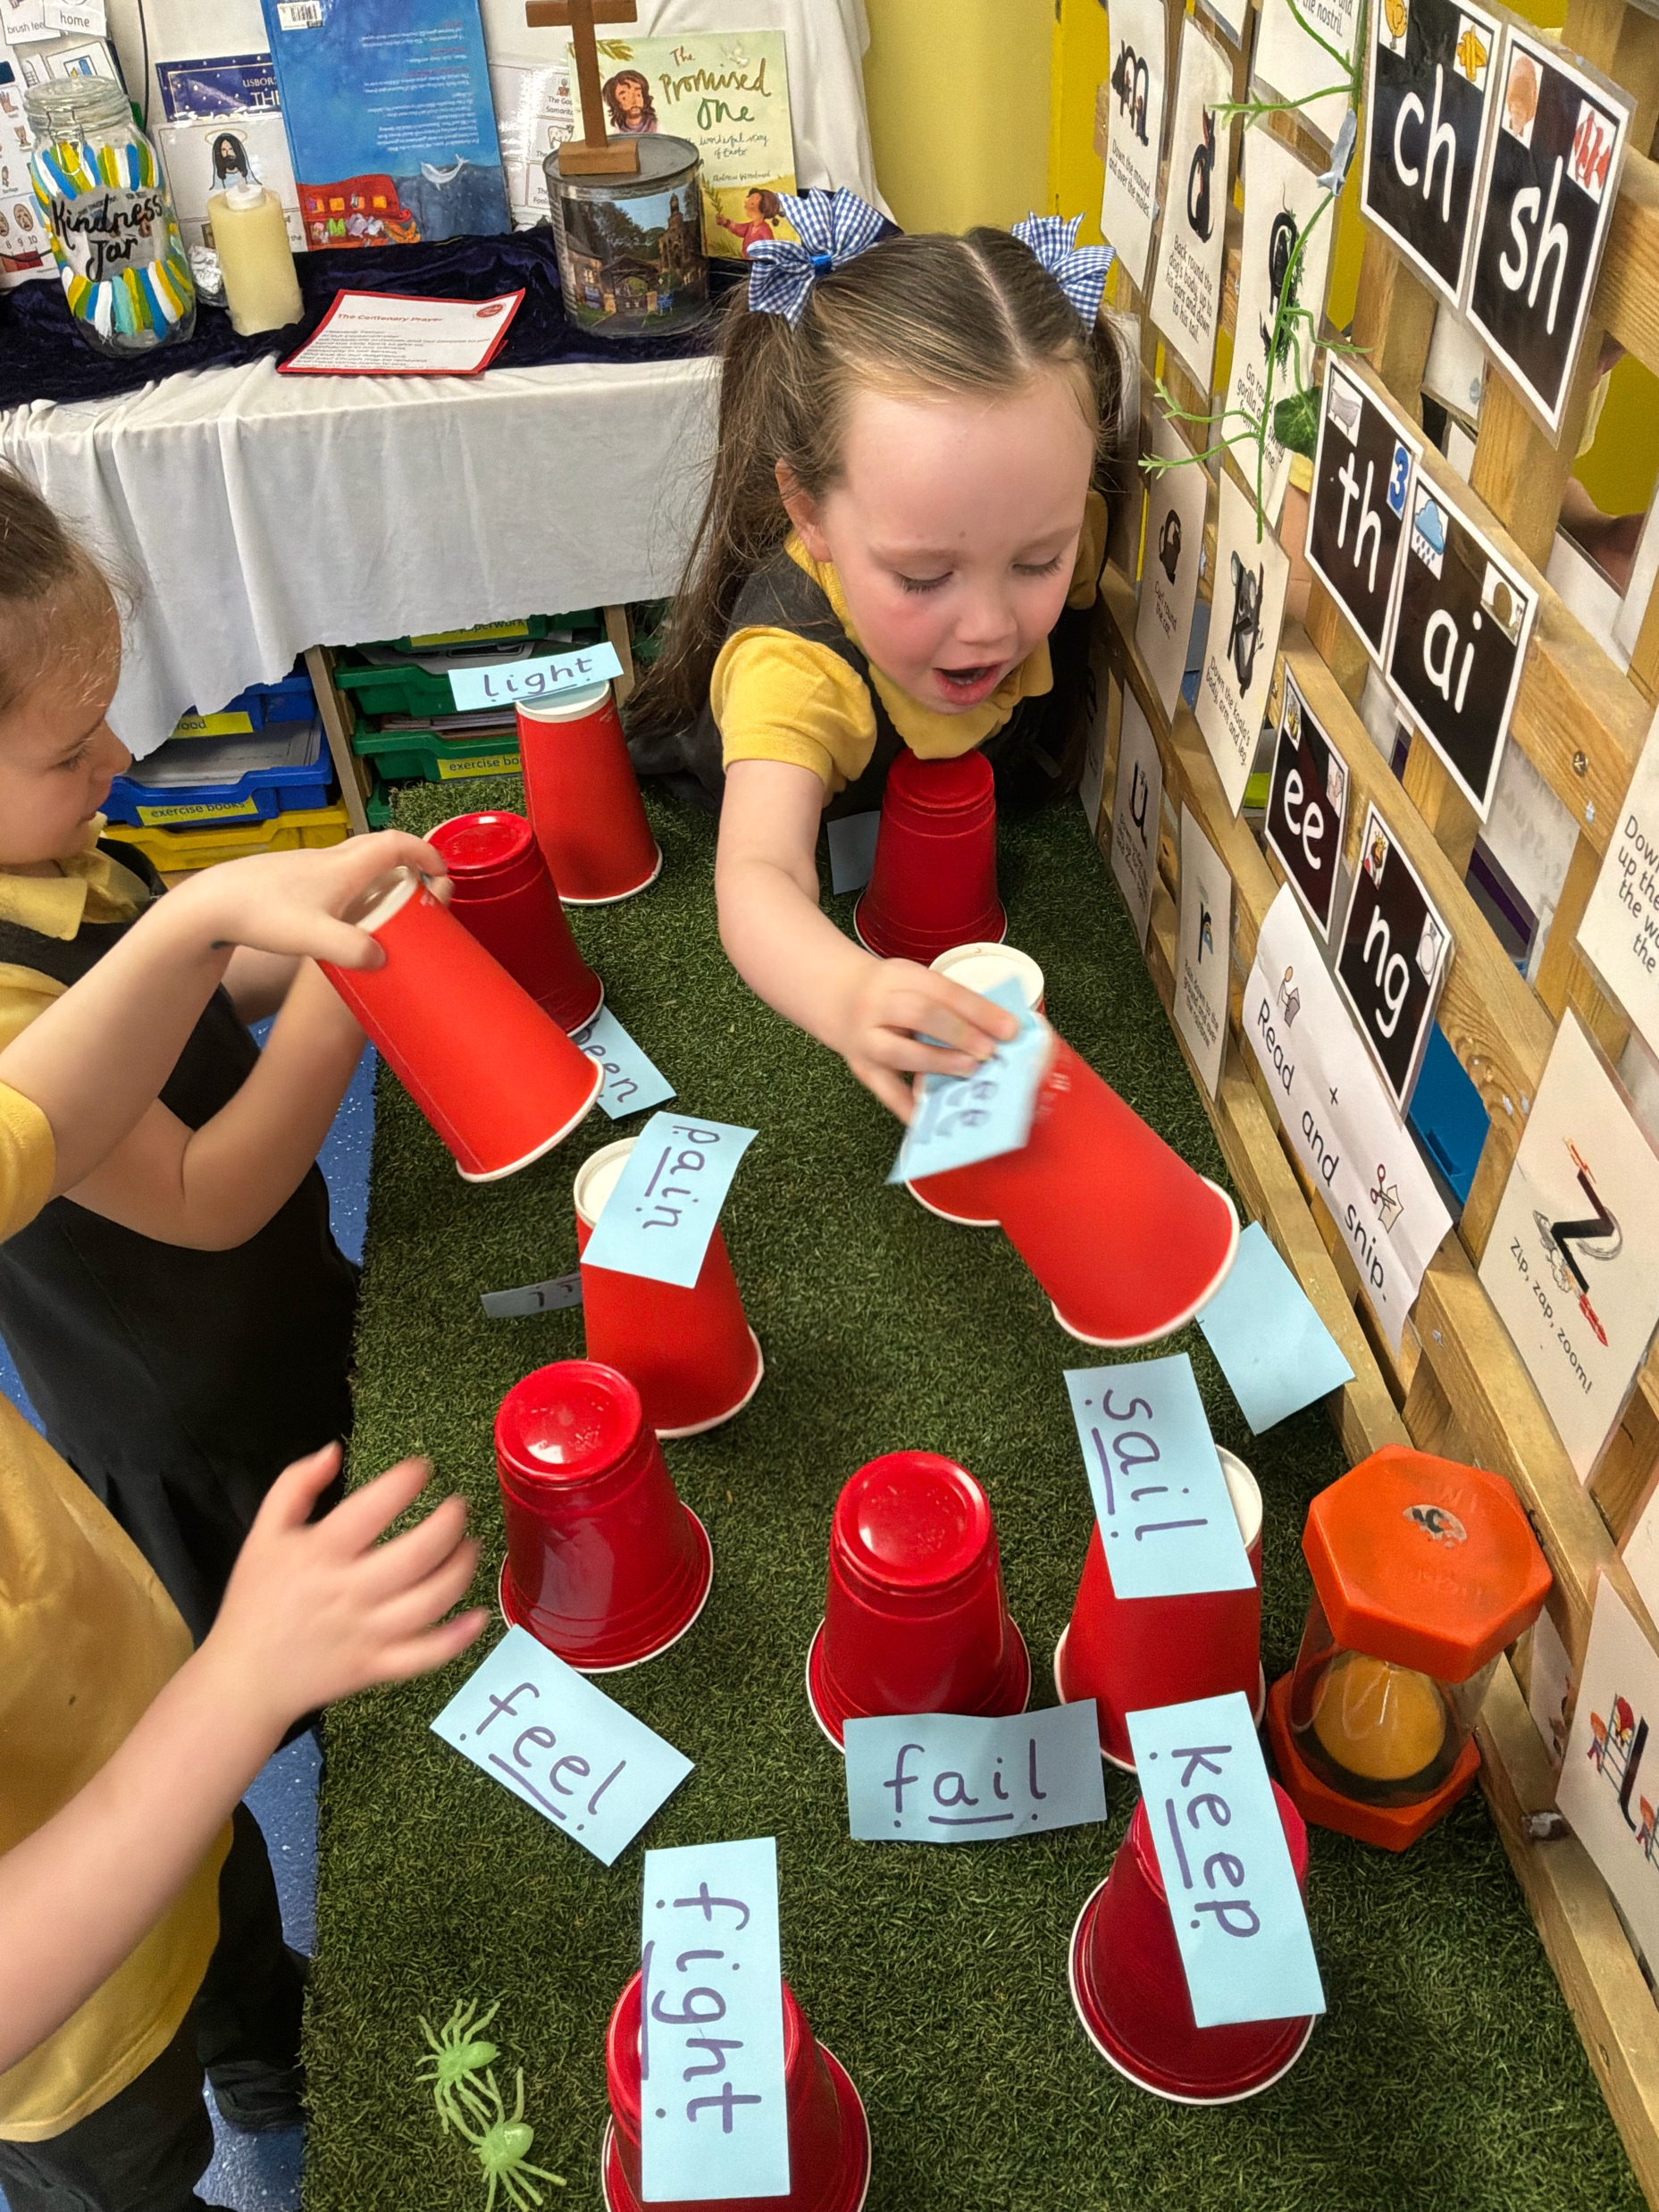
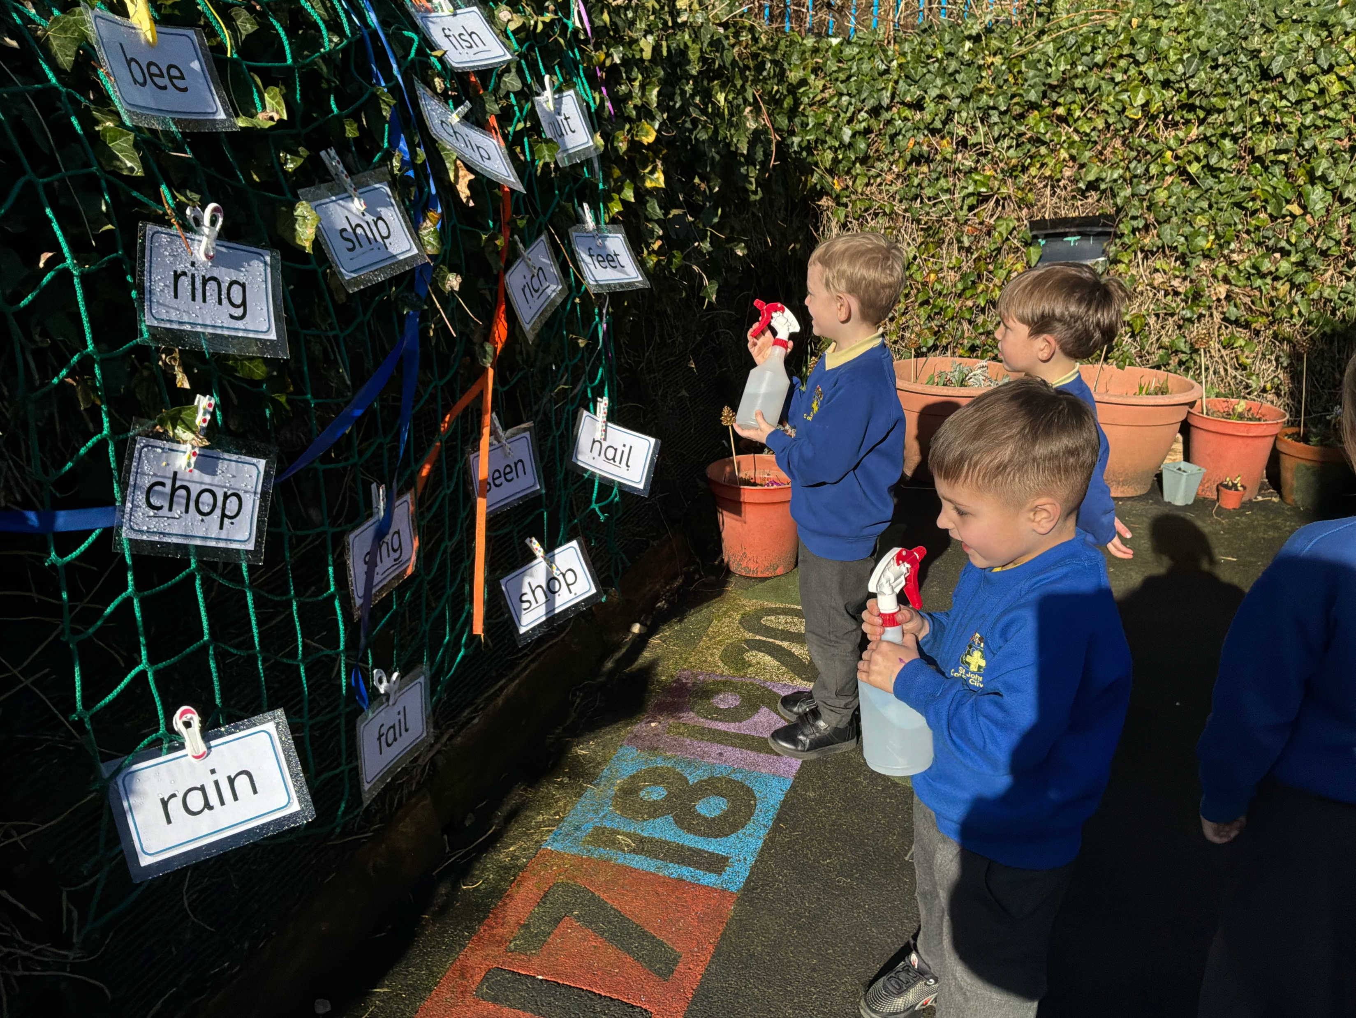
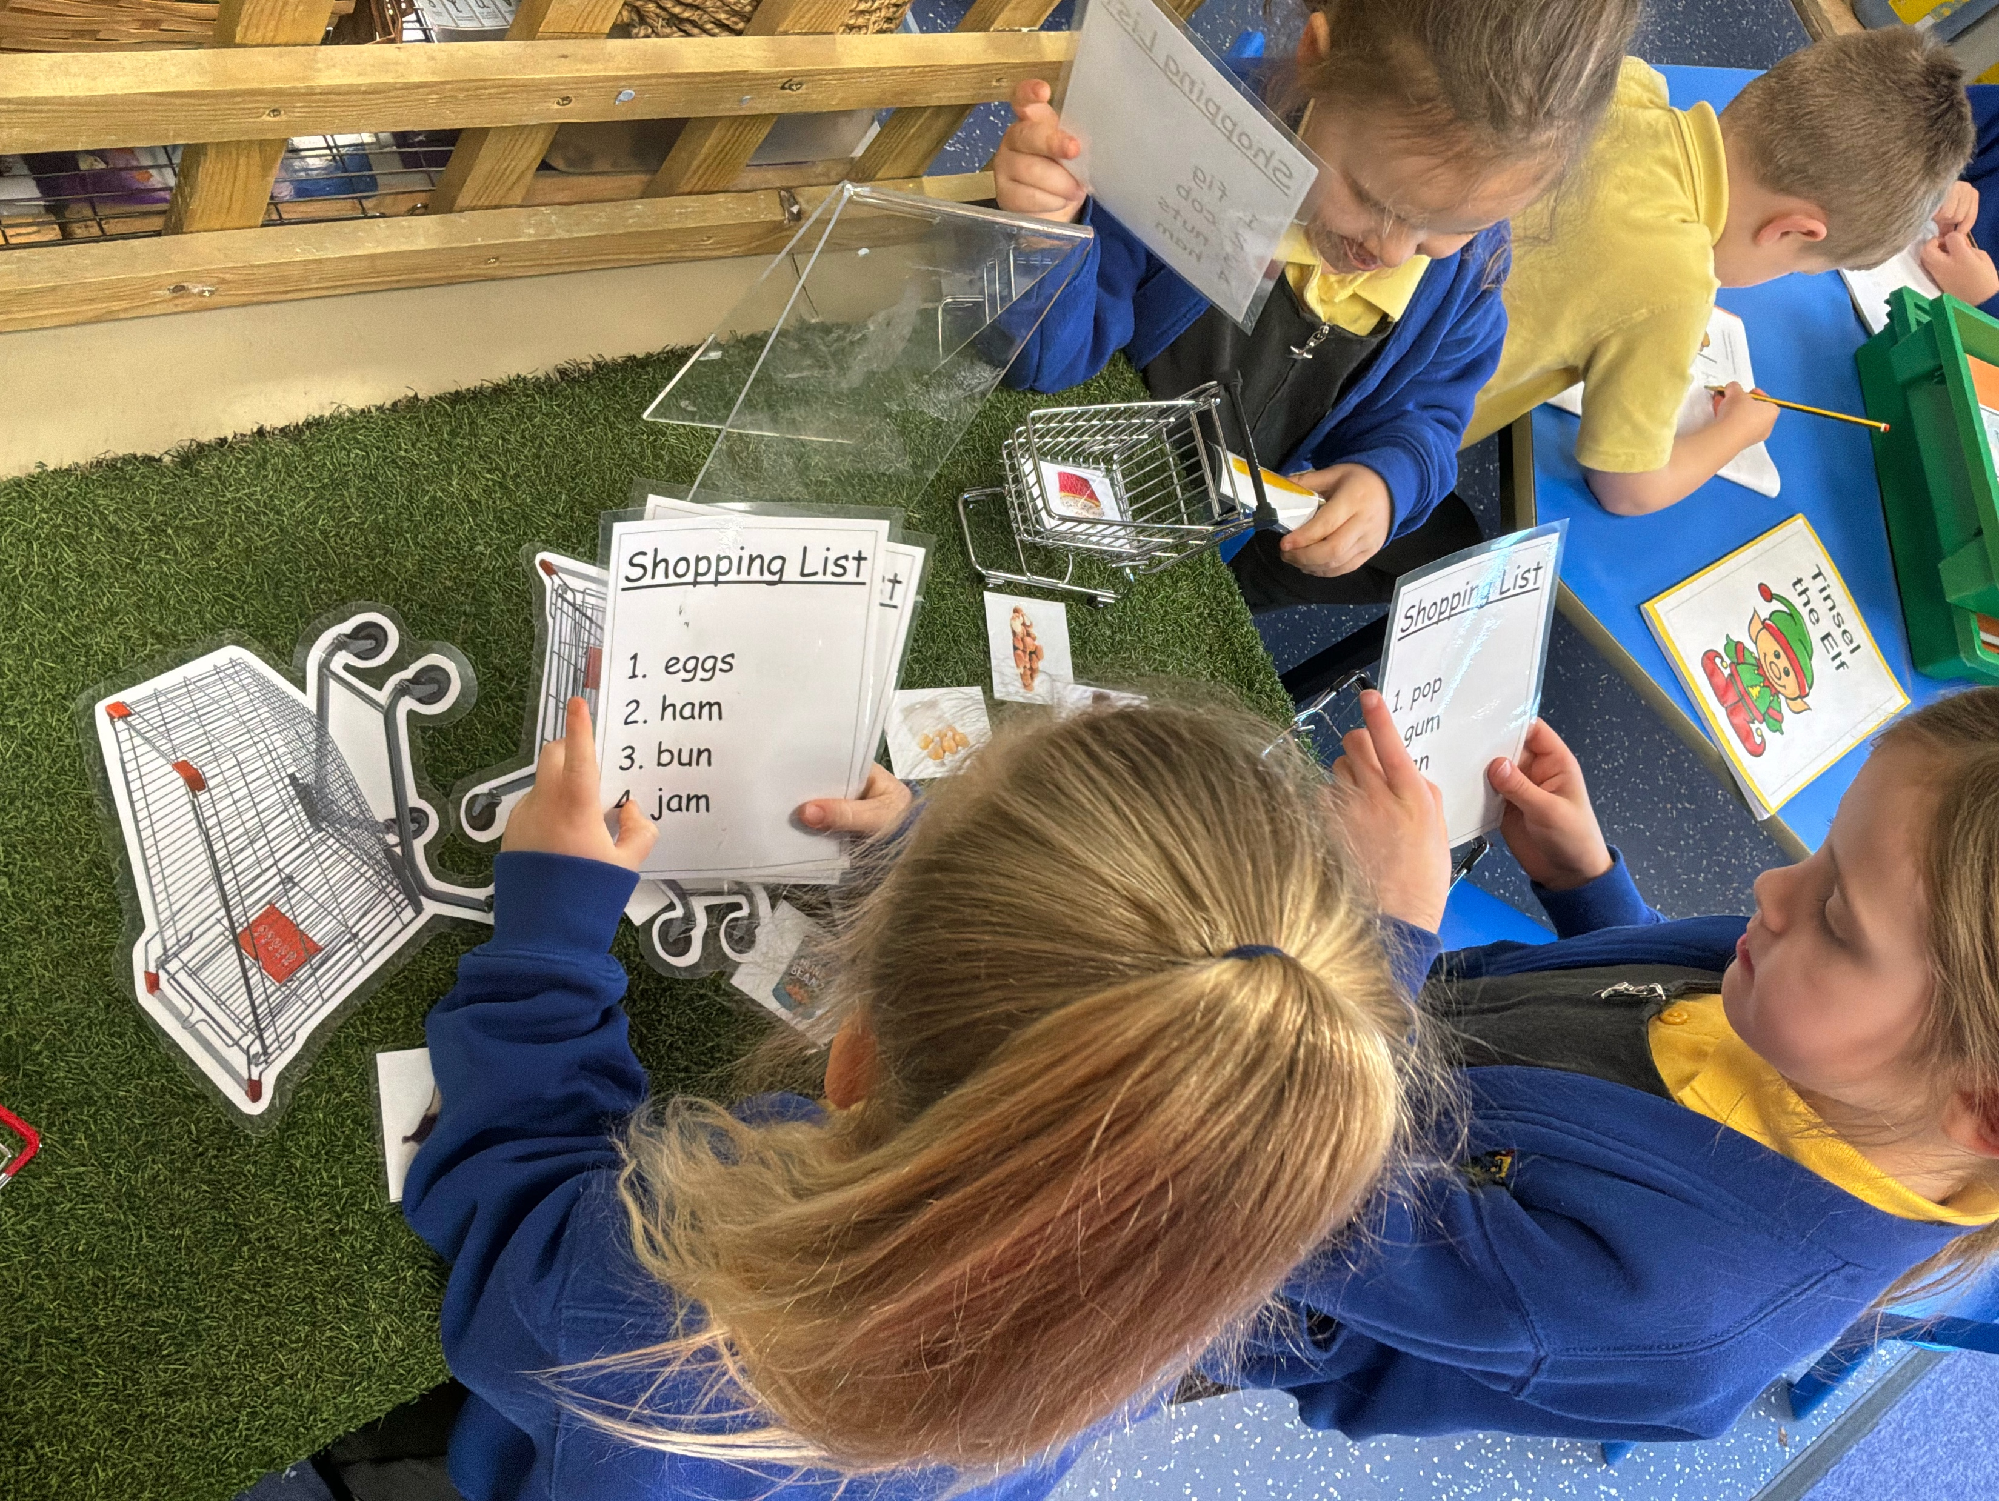
Phonics
The children follow the ‘Red Rose’ programme. They will take part in letter work every day. Children will bring home a reading book to match the phonemes (sounds)/ tricky words they are learning.

Slide 11
Mathematics
Number
Numerical Patterns

Slide 12
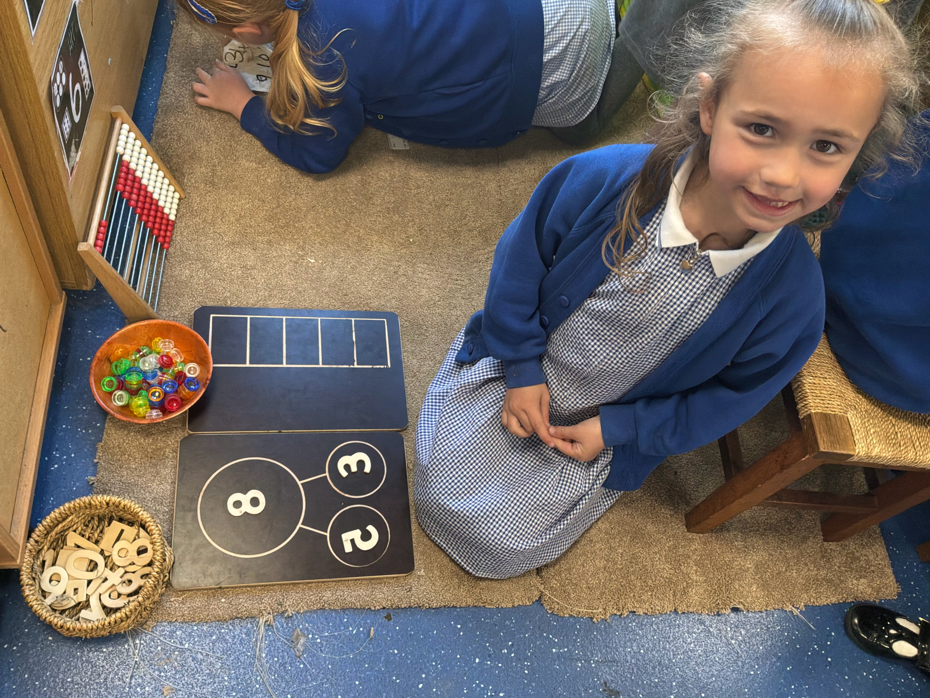
This includes:
Numbers to 10, including the composition of each number
Recognise quantities up to 5 without counting
Number bonds to 5 and beyond
Count to 20 and beyond
Compare quantities
Odd and even numbers
Doubling

Slide 13
Understanding the World

Slide 14
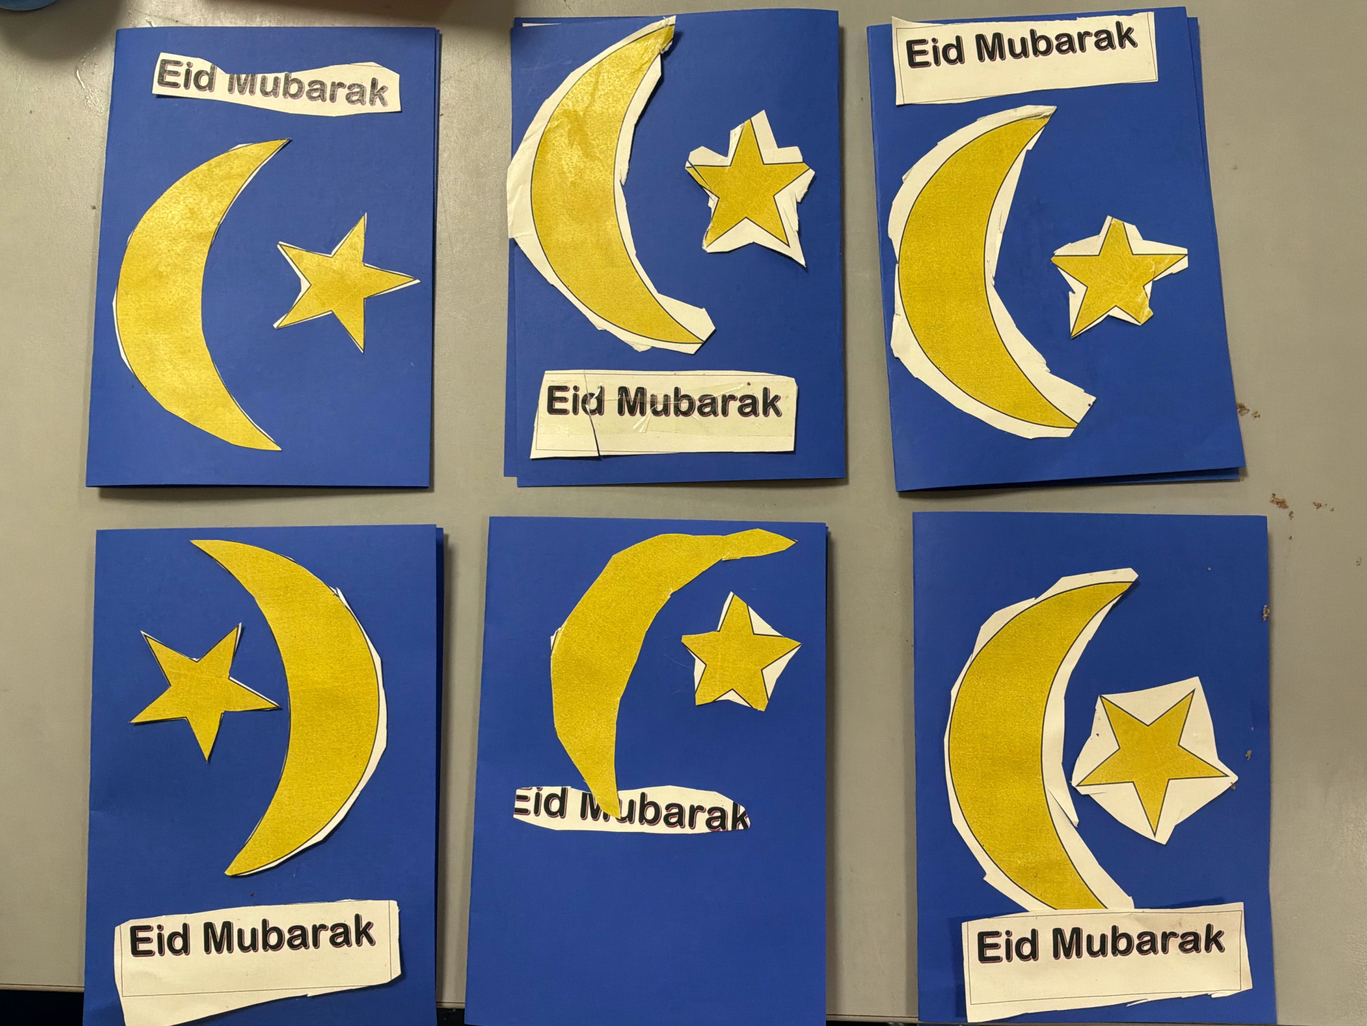
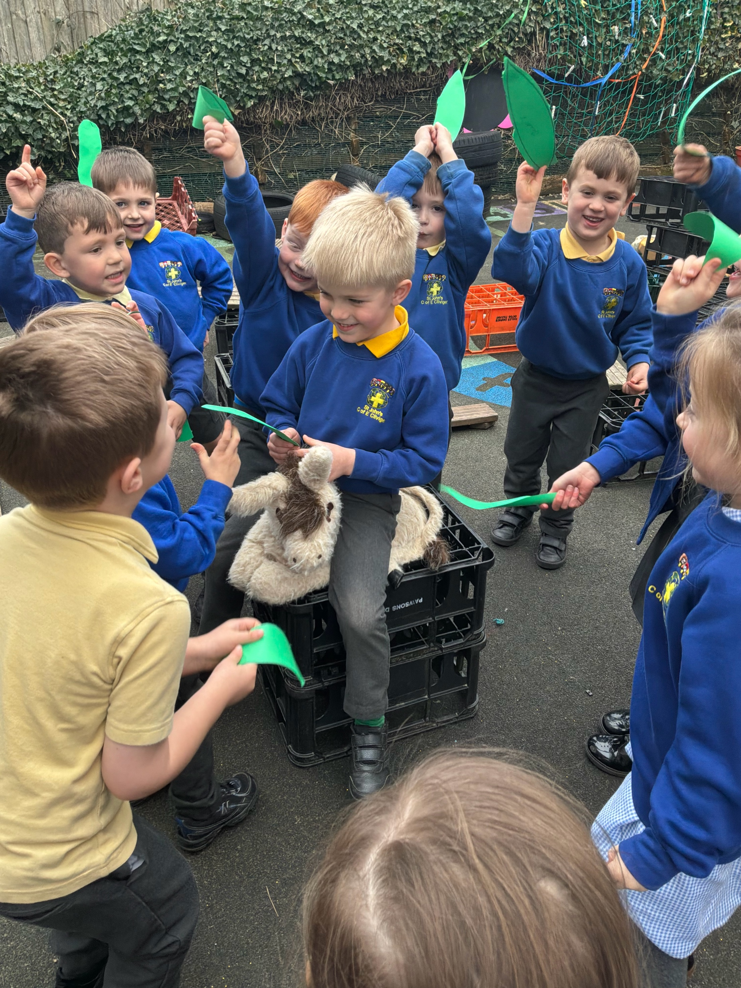
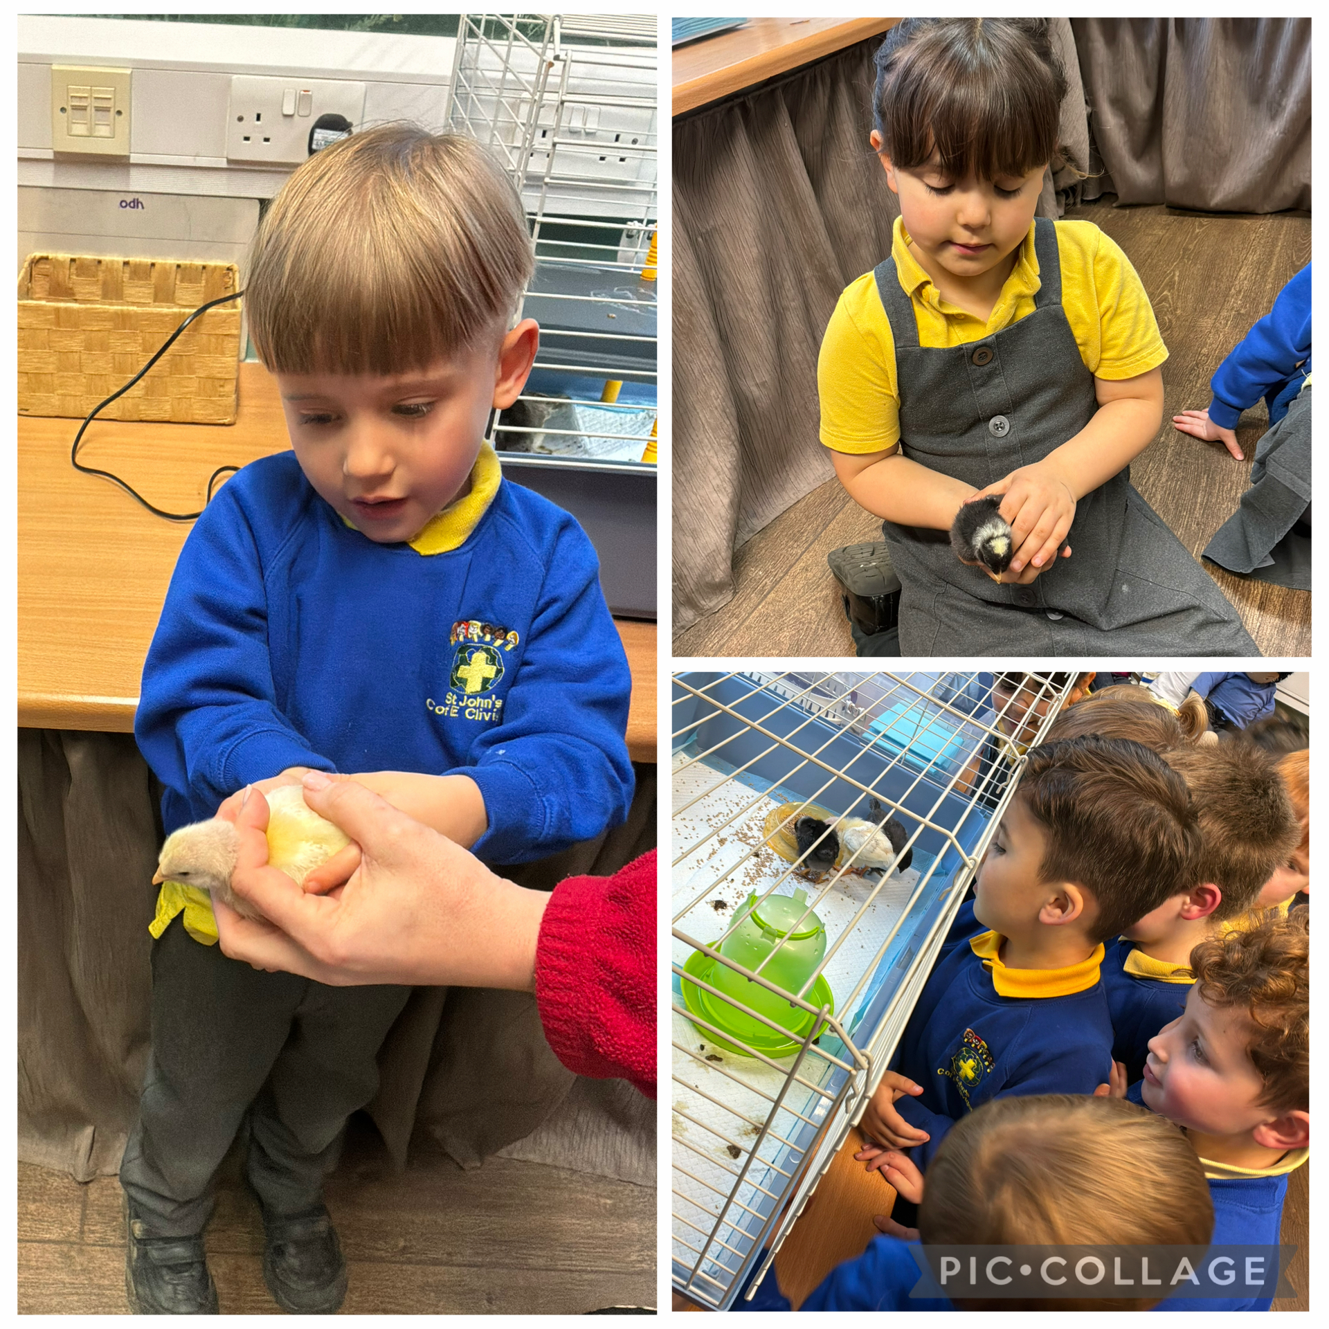
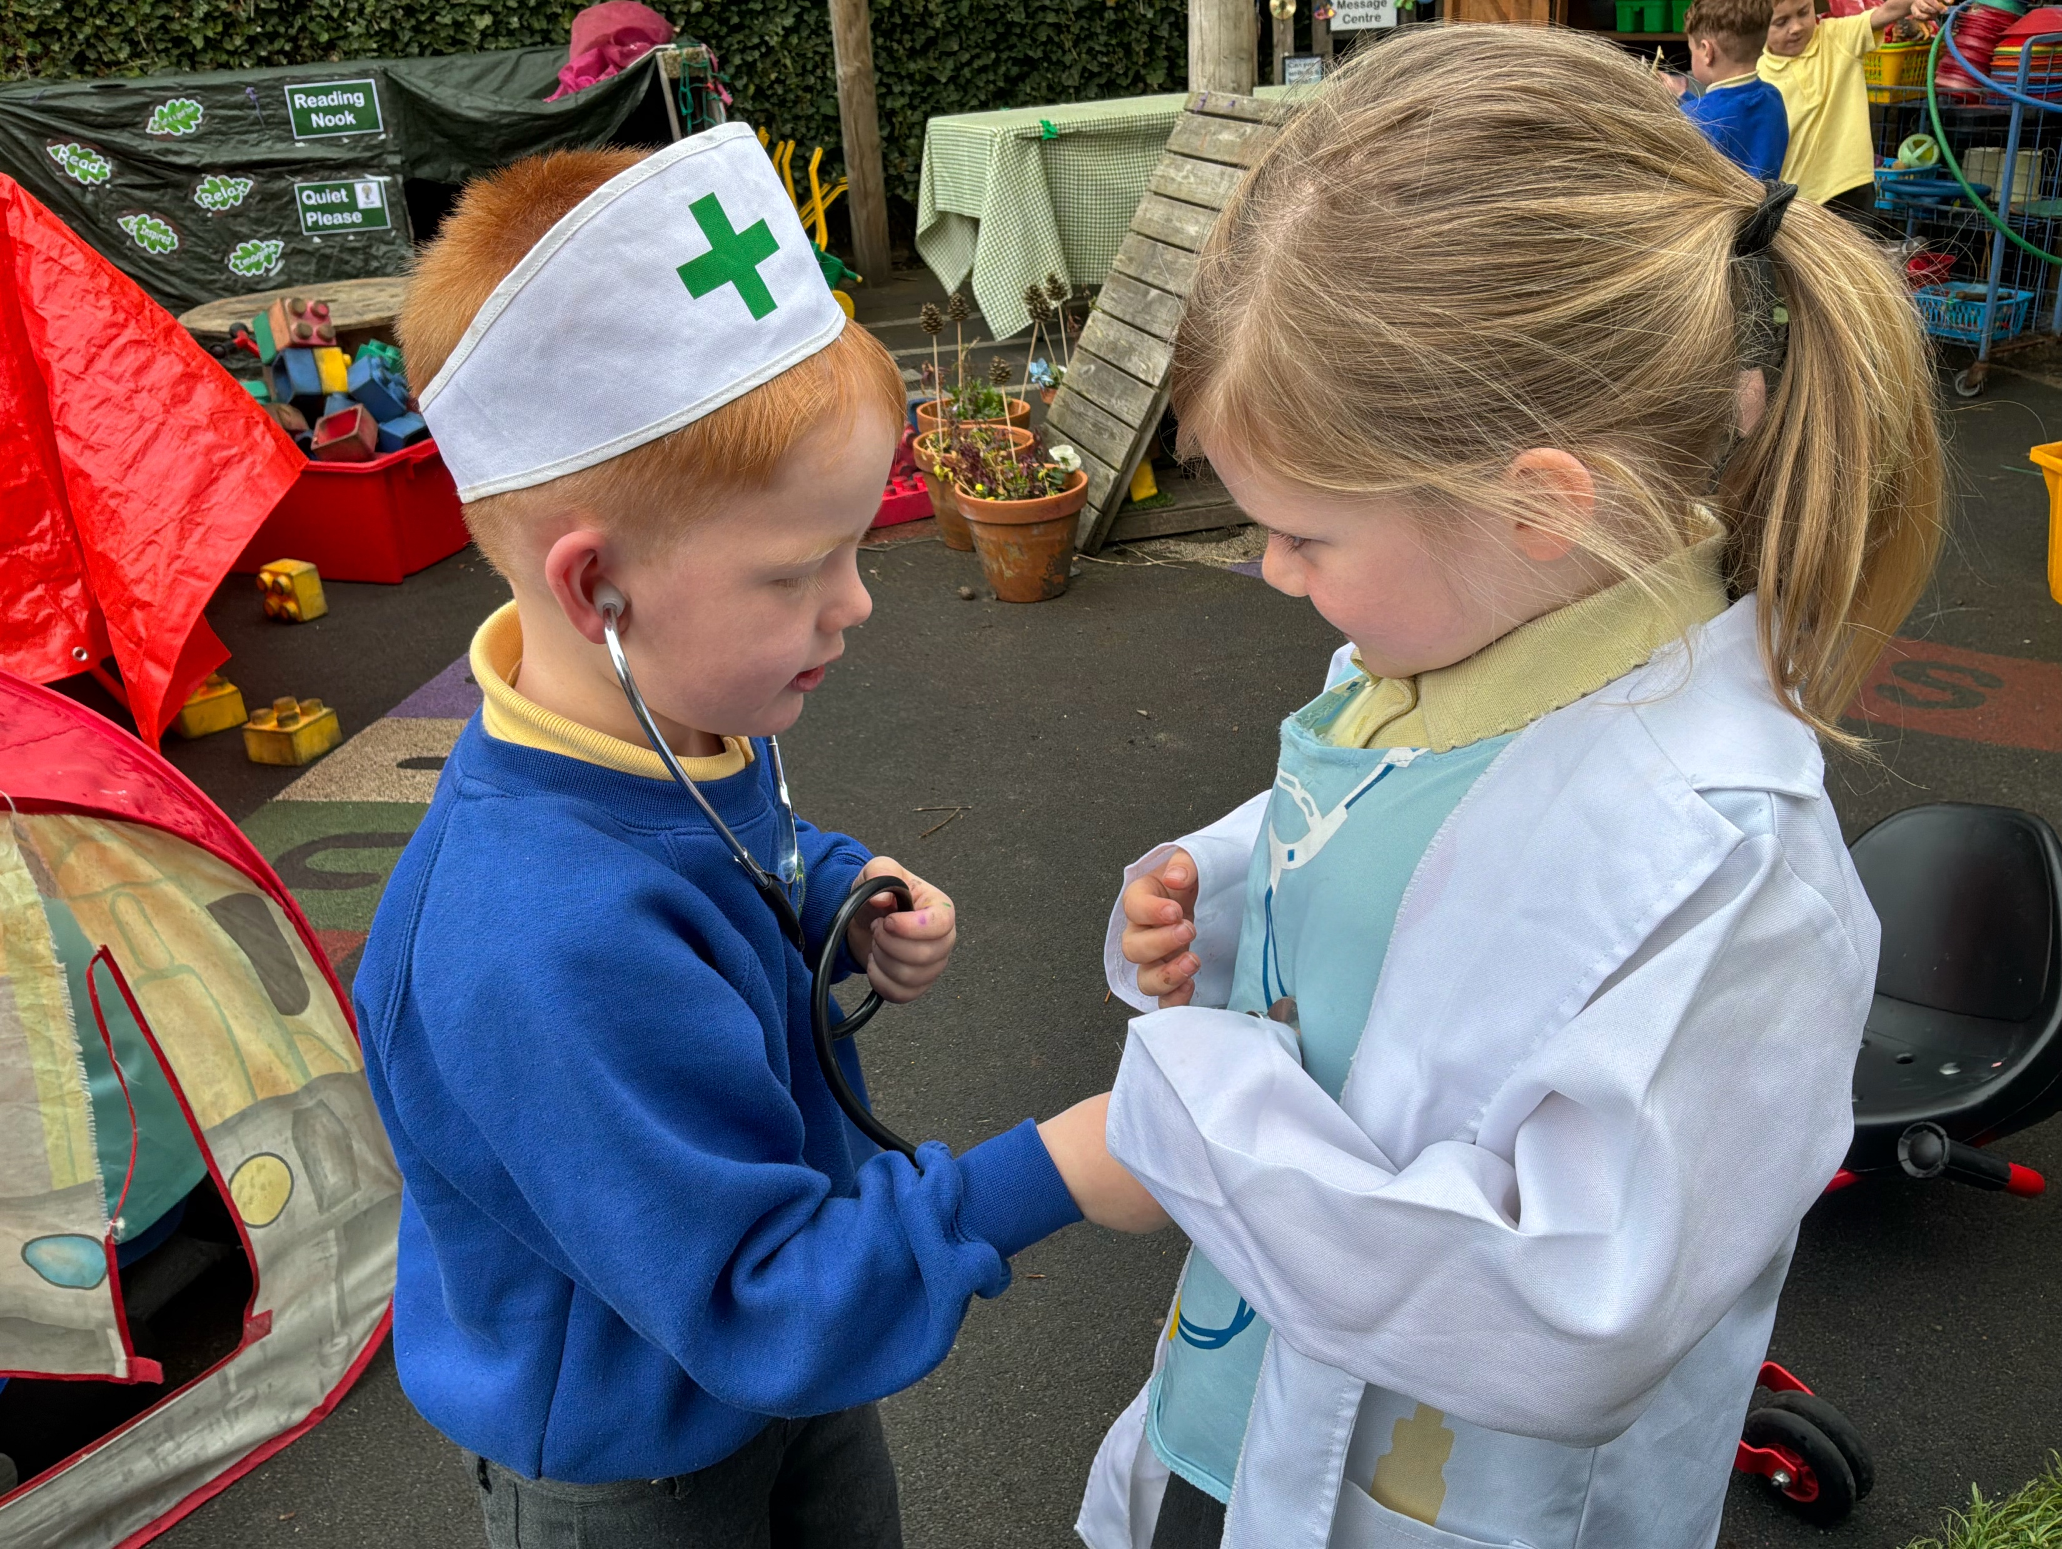
This includes:
Past and Present
People, Culture and Communities
The Natural World
Science
ICT
RE
History
Geography
This develops their ideas about the world around them through exploring, investigating & problem solving.

Slide 15
Expressive Arts and Design

Slide 16

Music
Dance
Art
D&T
Children will have opportunities to explore and use different media and materials, and will be encouraged to be imaginative.

Slide 17
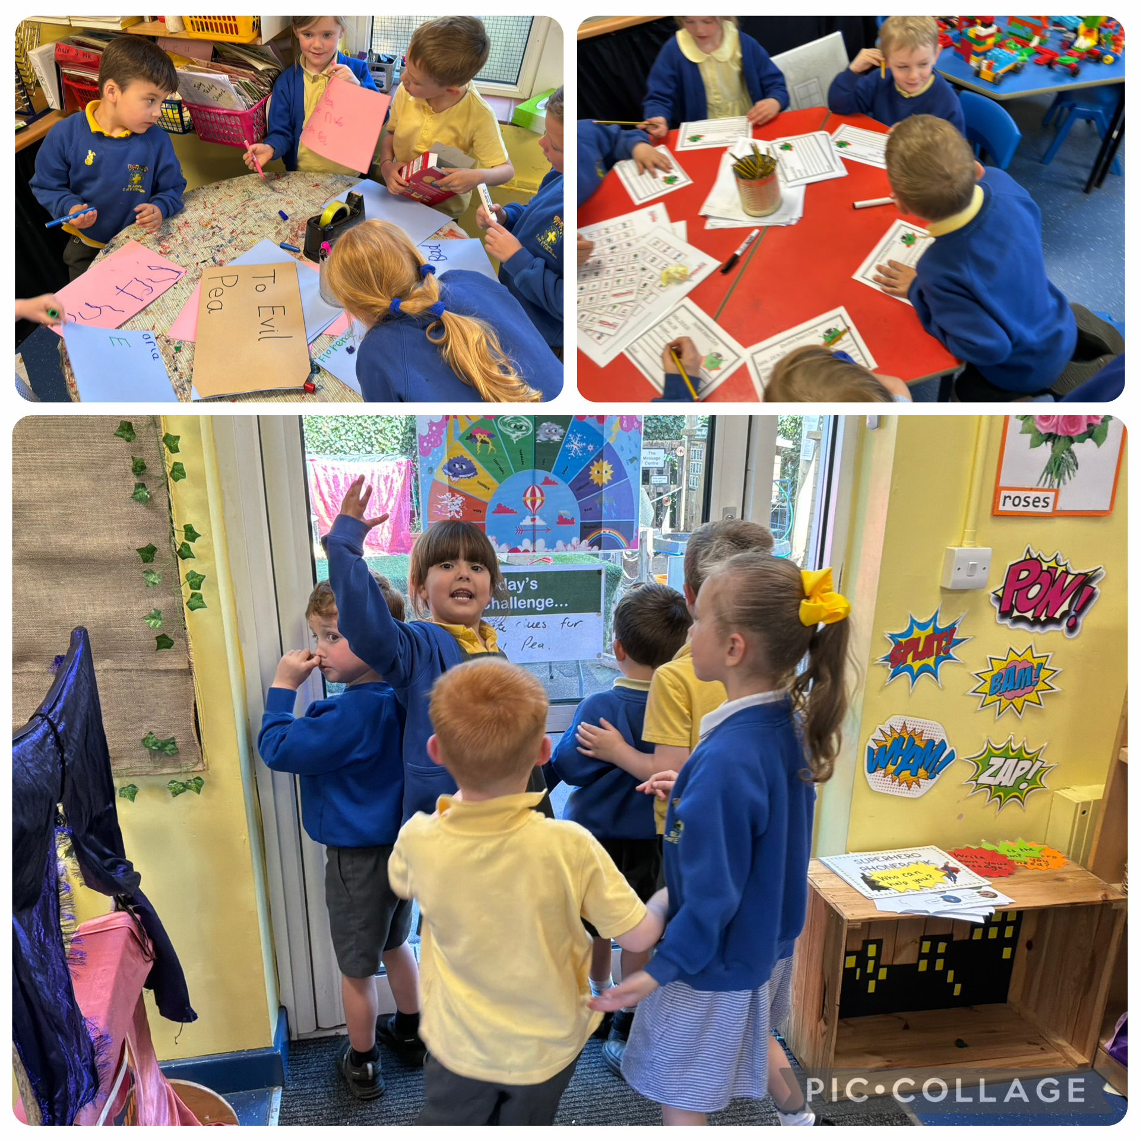
Classroom Organisation
The classroom has different areas which includes:
Writing
Reading
Numeracy
Play dough
Funky Fingers
Construction
Role Play
Sand
Water
There will be a mixture of whole class and small group learning. Other times your child will choose areas of the classroom to work in to challenge or consolidate their learning.

Slide 18
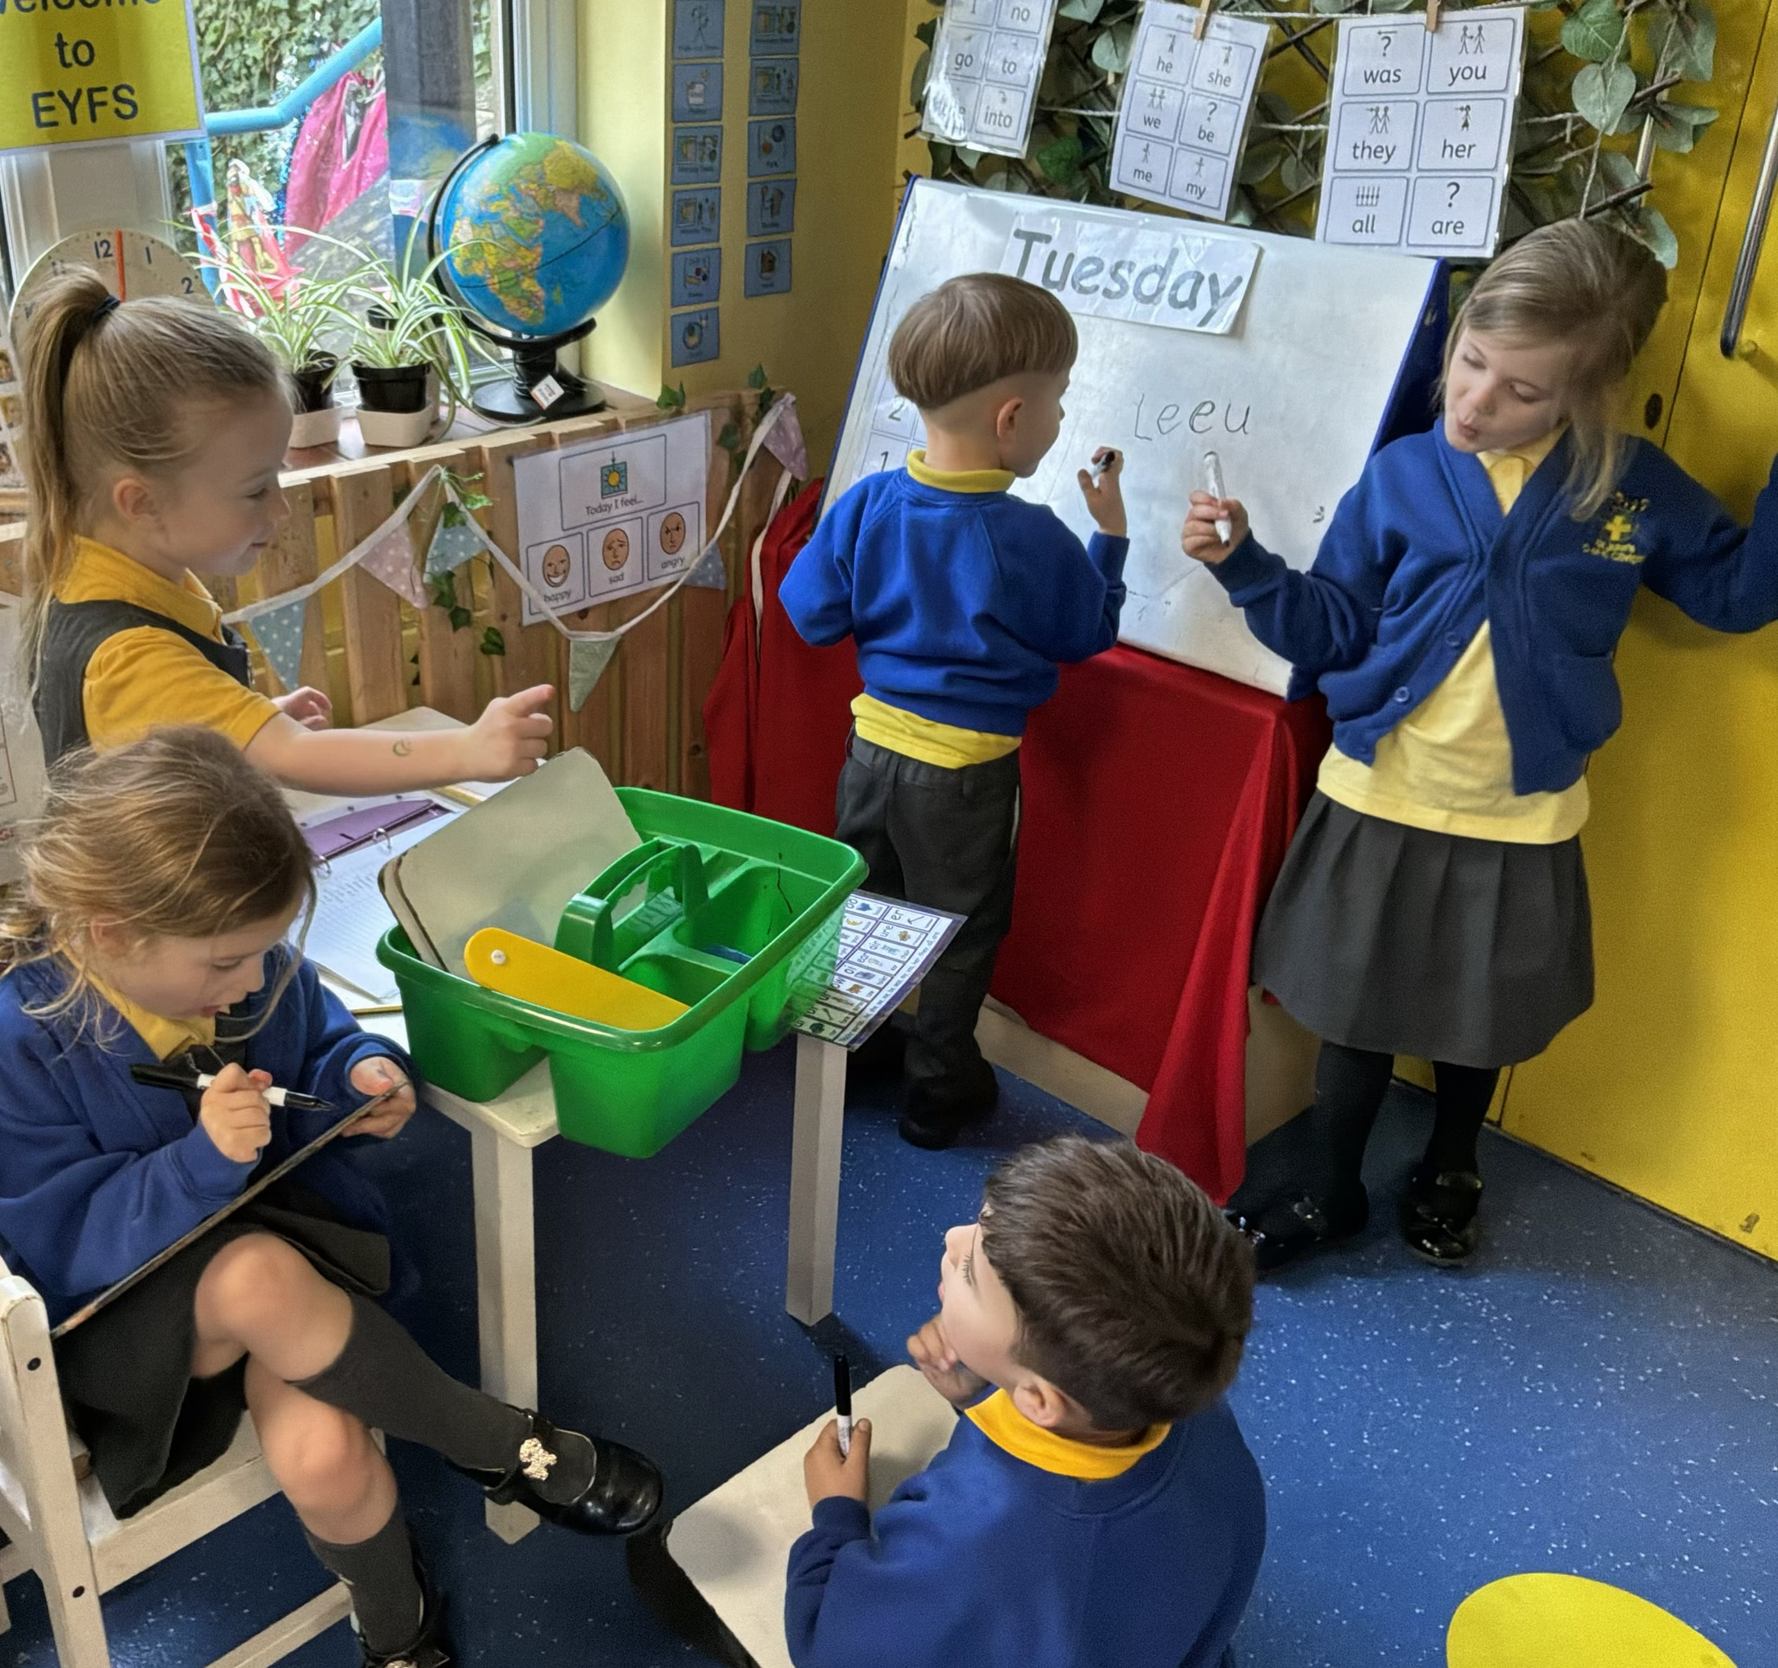
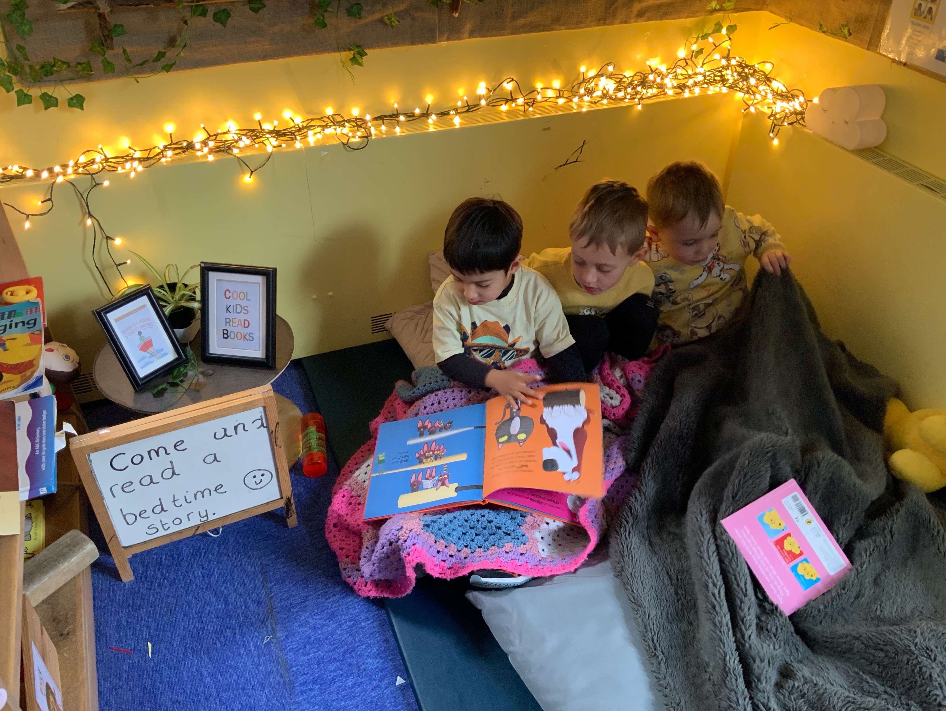
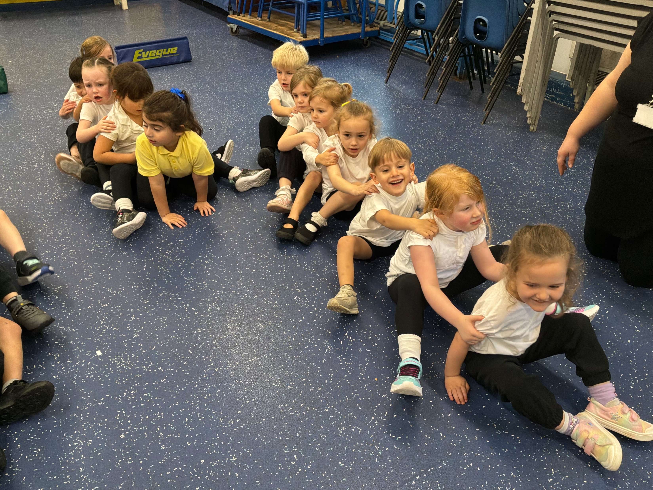
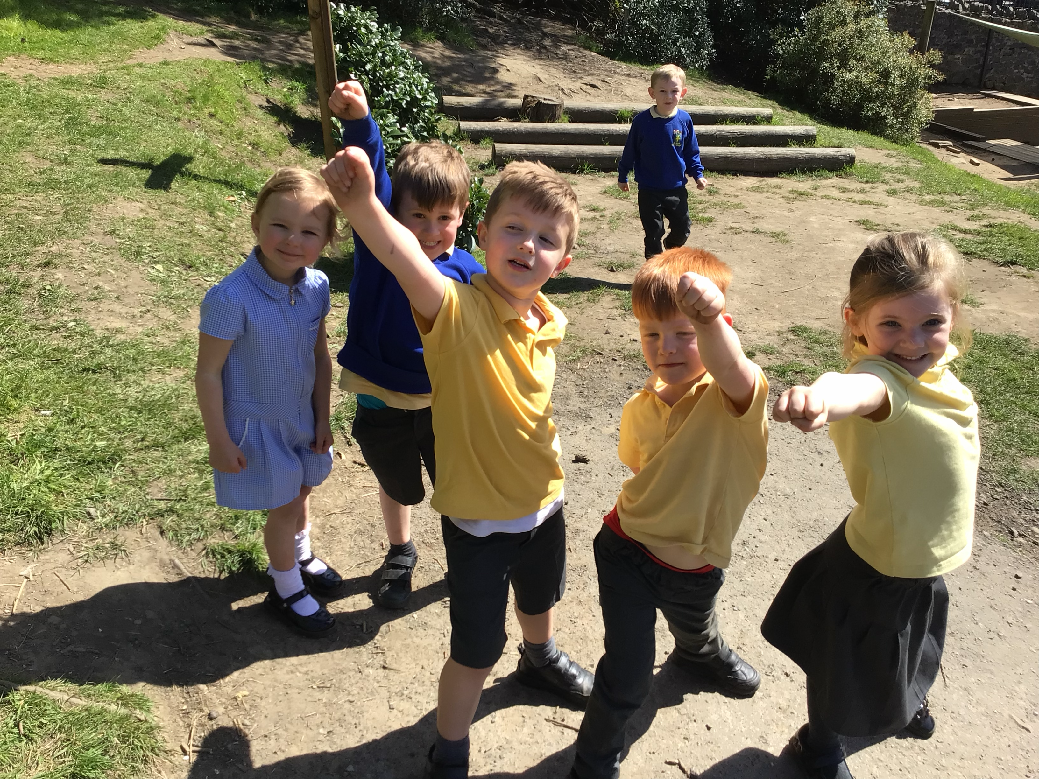
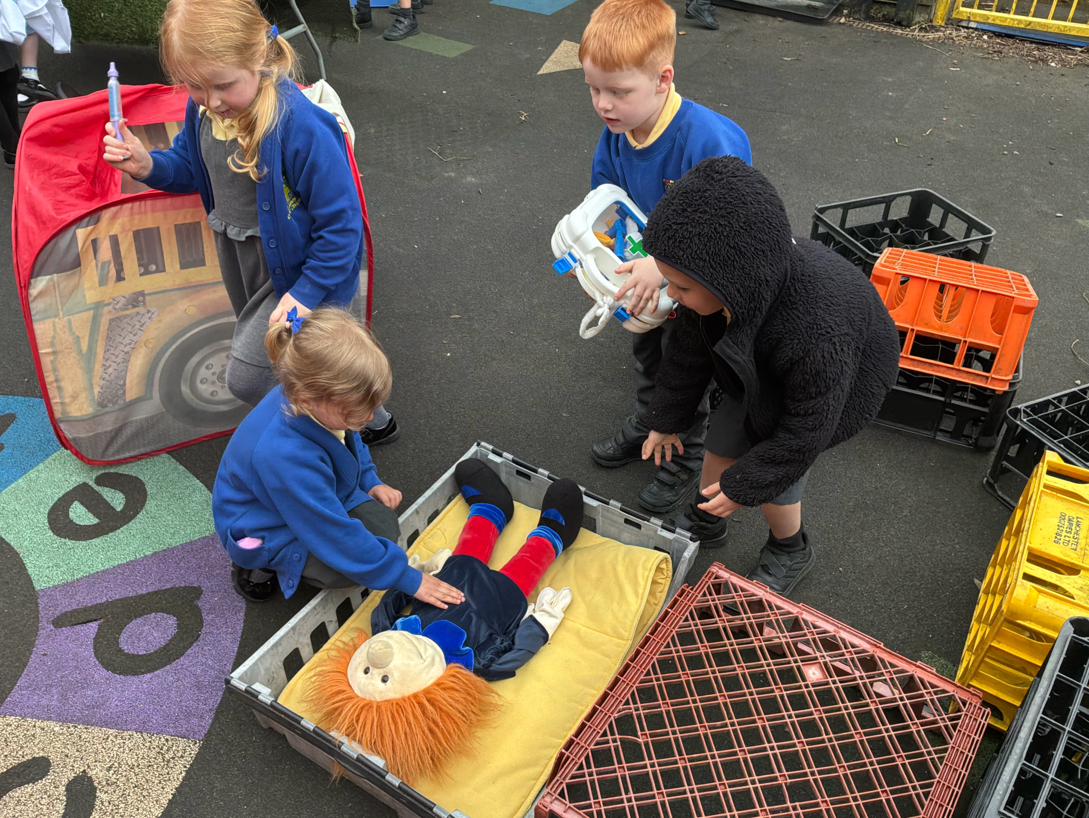
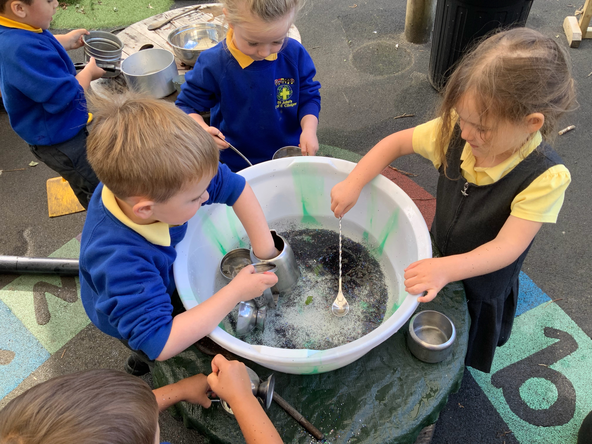
Learning will take play inside and outside.

