Slide 1

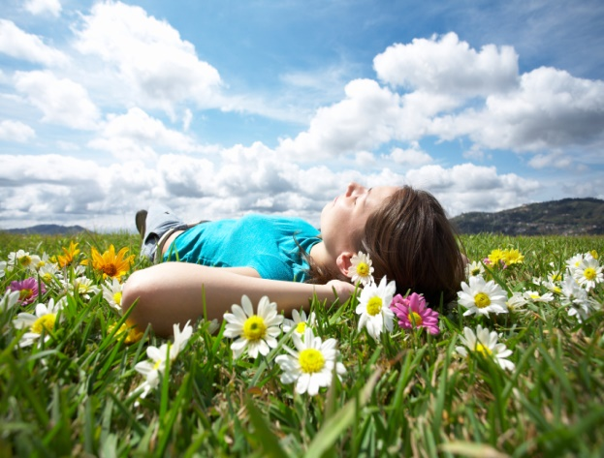

emotional well-being challenge card ONE
Habitats
When the weather is good, take a walk into your garden or on a local walk with an adult and see how many micro habitats you can find. Can you name any creatures that live there?
living room DISCO
Close the curtains, turn out the lights (or switch on your disco ball) and listen and dance to all your family’s favourite songs.
Hold a dancing competition.
Breathing
Try some breathing techniques together with your family. There are some good ideas here:
https://copingskillsforkids.com/deep-breathing-exercises-for-kids
Family
Make a card for a family member and post it to them – you might get one back?
Catch a ball
Get outside and play catch with someone from your household – can you get to 50?!

