Slide 1
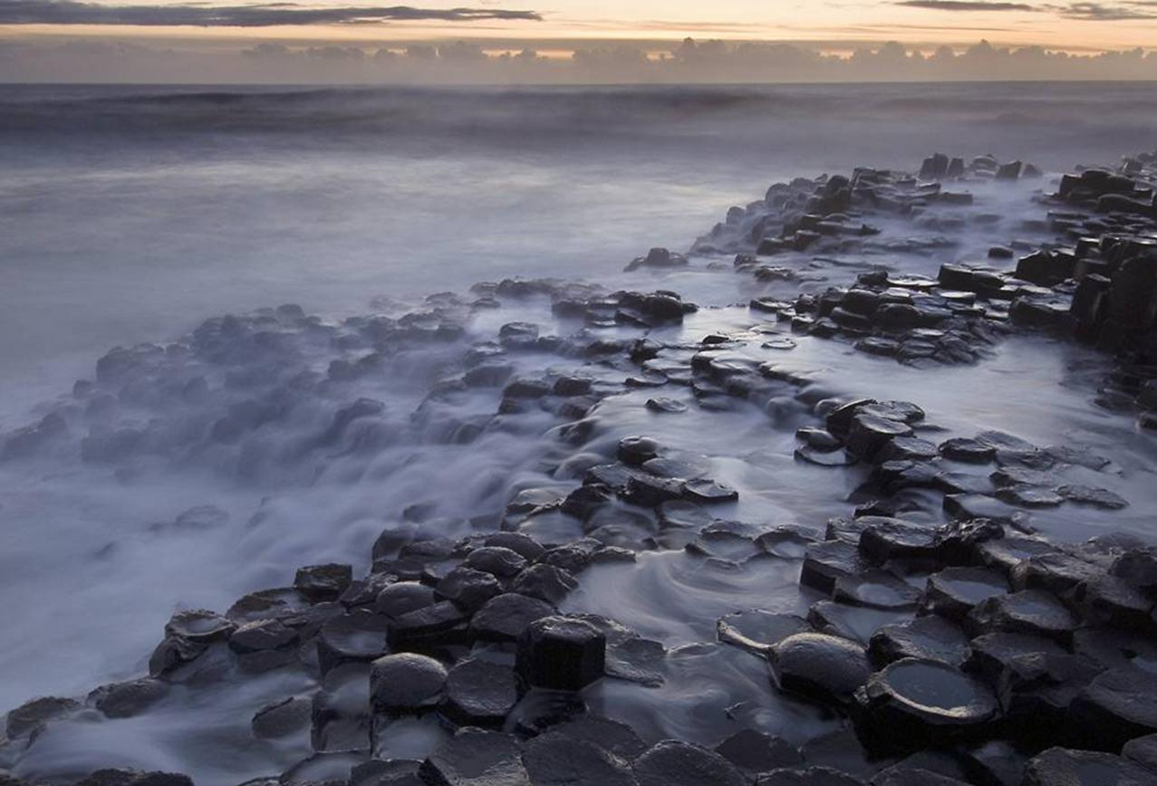
Maths in Nature
“The laws of nature are but the mathematical thoughts of God"
- Euclid

Slide 2
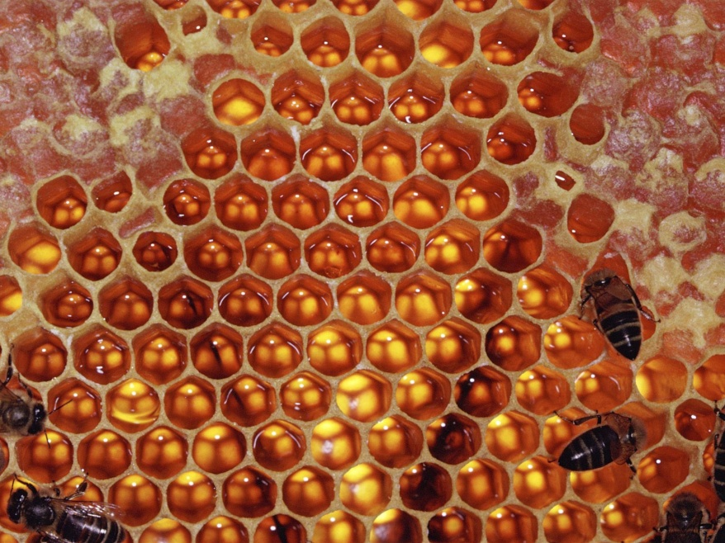
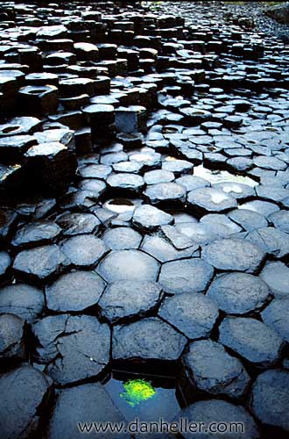
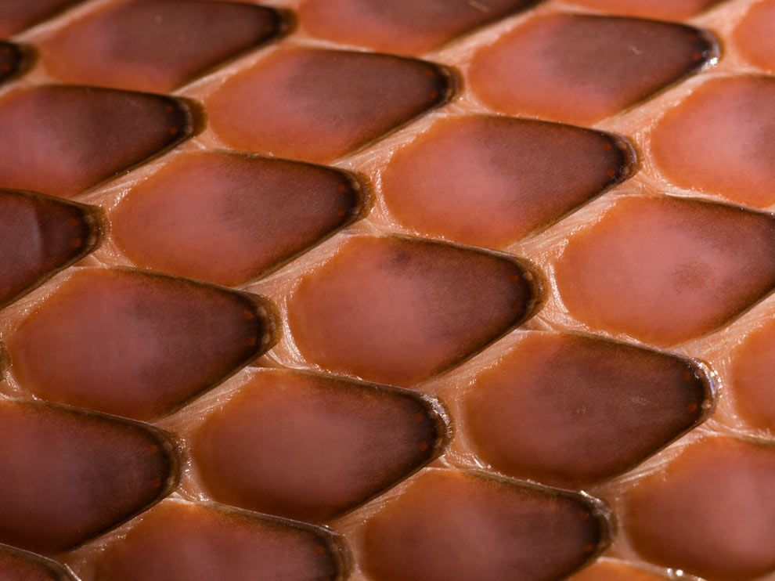
Bees form their honeycomb in the shape of hexagons.
Hexagonal Basalt columns at the Giants Causeway in Northern Ireland.
Hexagons
Scales on a Boa Constrictor.

Slide 3
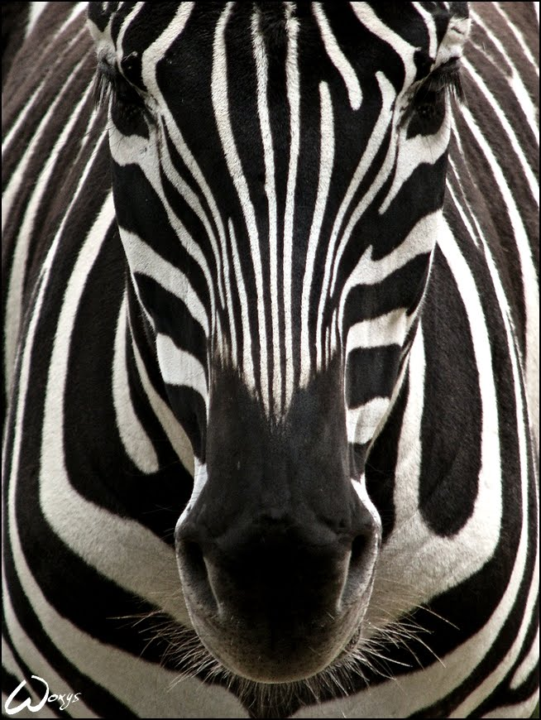
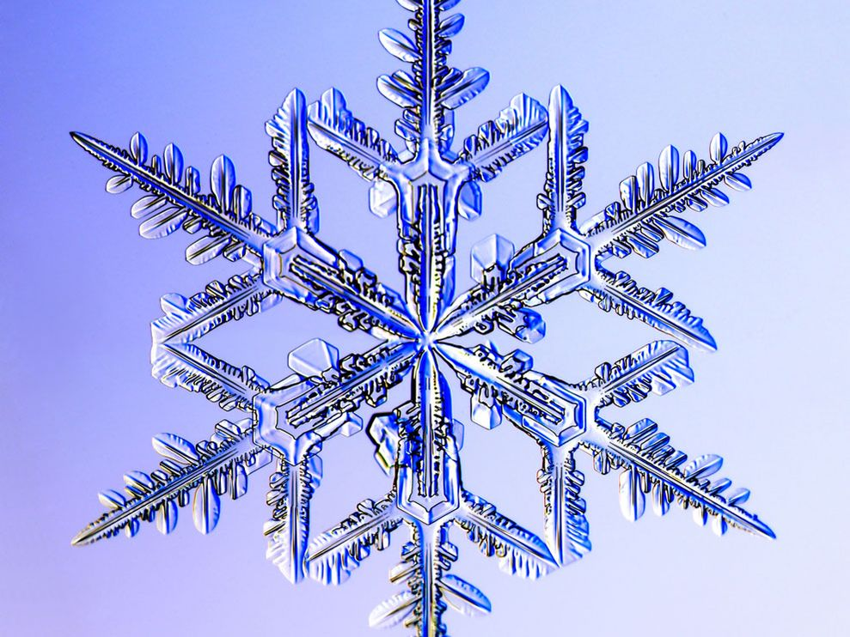
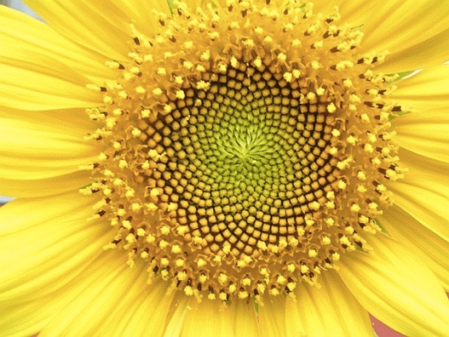

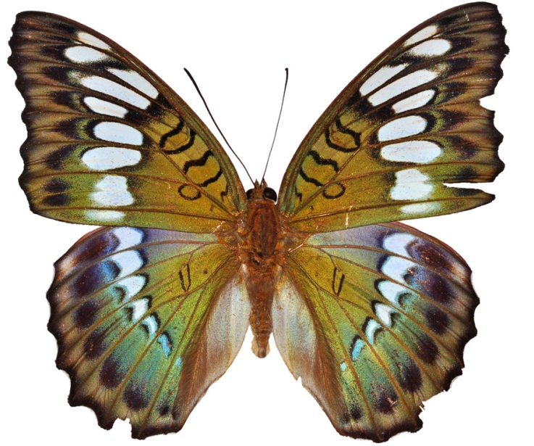
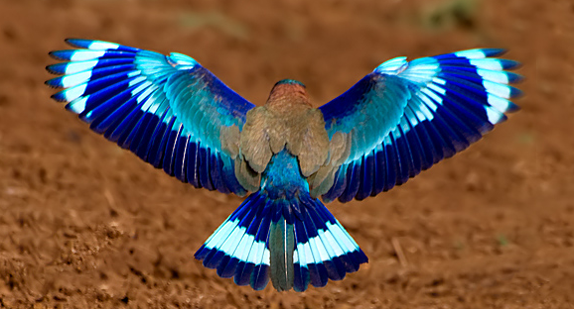
Symmetry

Slide 4
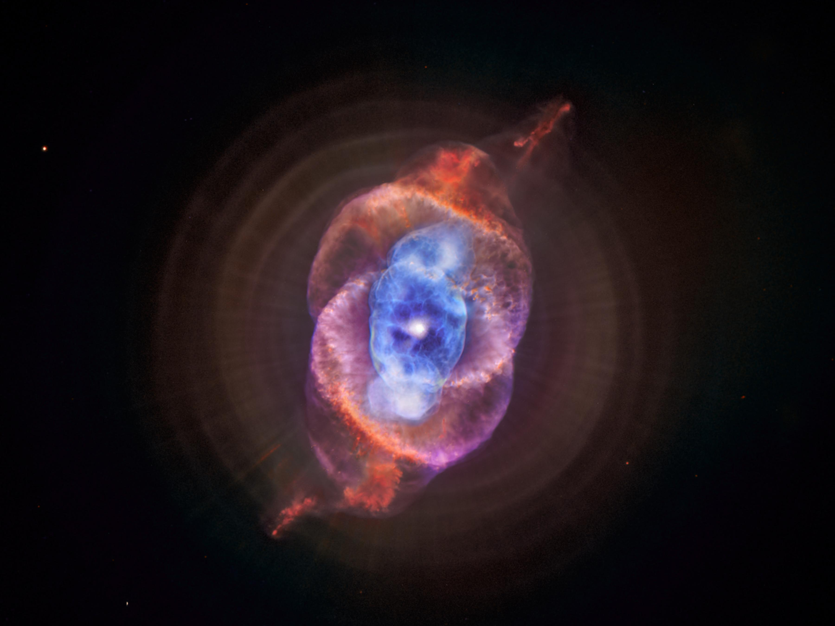
Big numbers in creation.
“He determines the number of the stars,
And calls them each by name,”

Slide 5

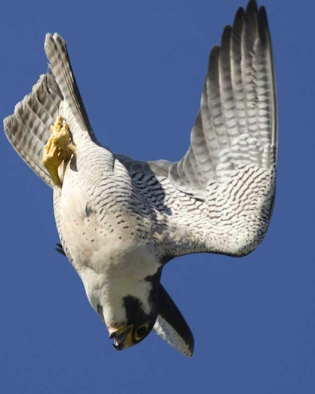
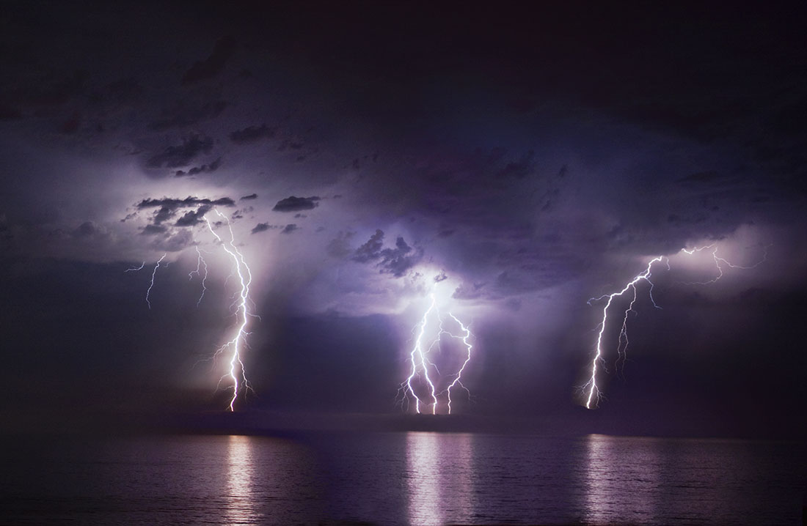
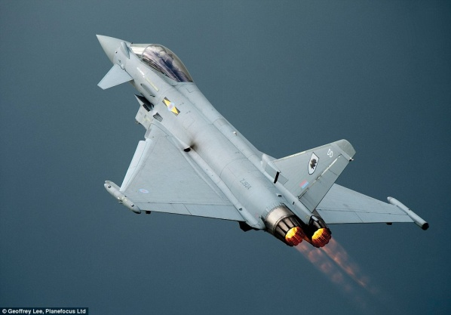
Speed
Usain Bolt travels over the 100m at 27.44 miles per hour.
Peregrine Falcon travels at about 200 miles per hour.
Sound travels at about
767 miles per hour.
A Eurofighter typhoon travels at 1320 miles per hour.
Light travels at
669,600,000 miles per hour.
THAT’s FAST !!!!
Light is the fastest stuff in the universe and at 186,000 miles per second it could travel around the Earth 7½ times in 1 second.

Slide 6
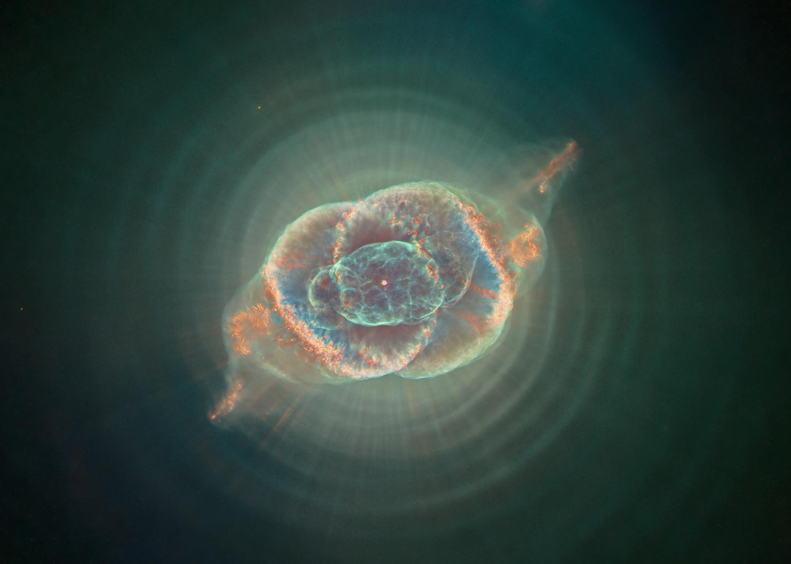
What is a light year?
The distance that light can travel in one year when it is travelling a186,000 miles per second, that’s
6 trillion miles!

Slide 7
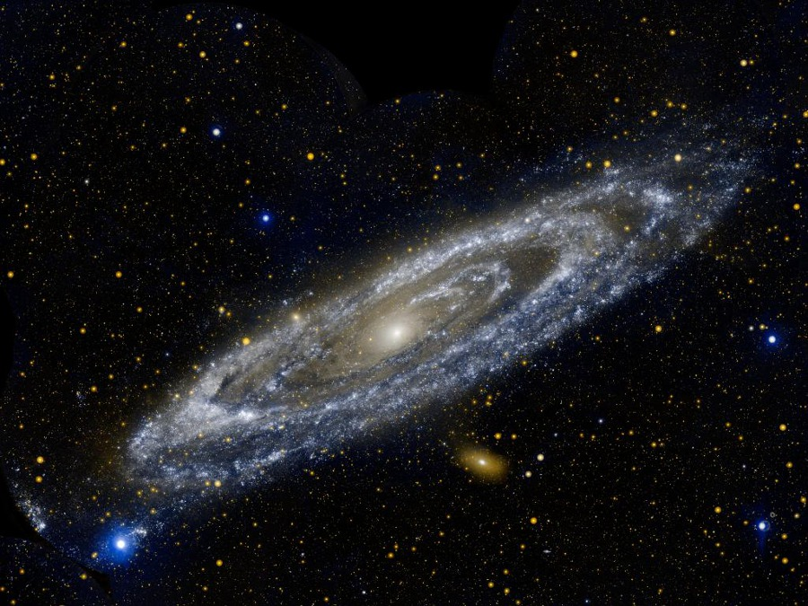
This is the Andromeda Galaxy, which contains approximately a trillion stars. It is estimated to be about 2.5 million light years away from us. That means you would need to travel at 186000 miles per second every second for 2 ½ million years to get to the centre of it.
The galaxy is believed to be 228,000 light years wide.

