Slide 1
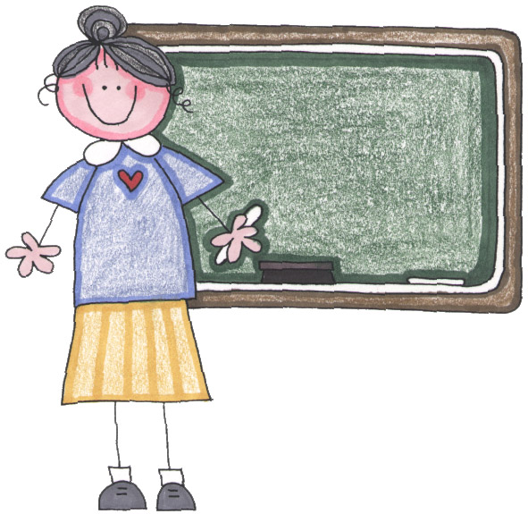
Meet the Teacher
Mrs Kenny & Mrs Pickup – Class Teachers
Mrs Stockburn - Teaching Assistant

Slide 2
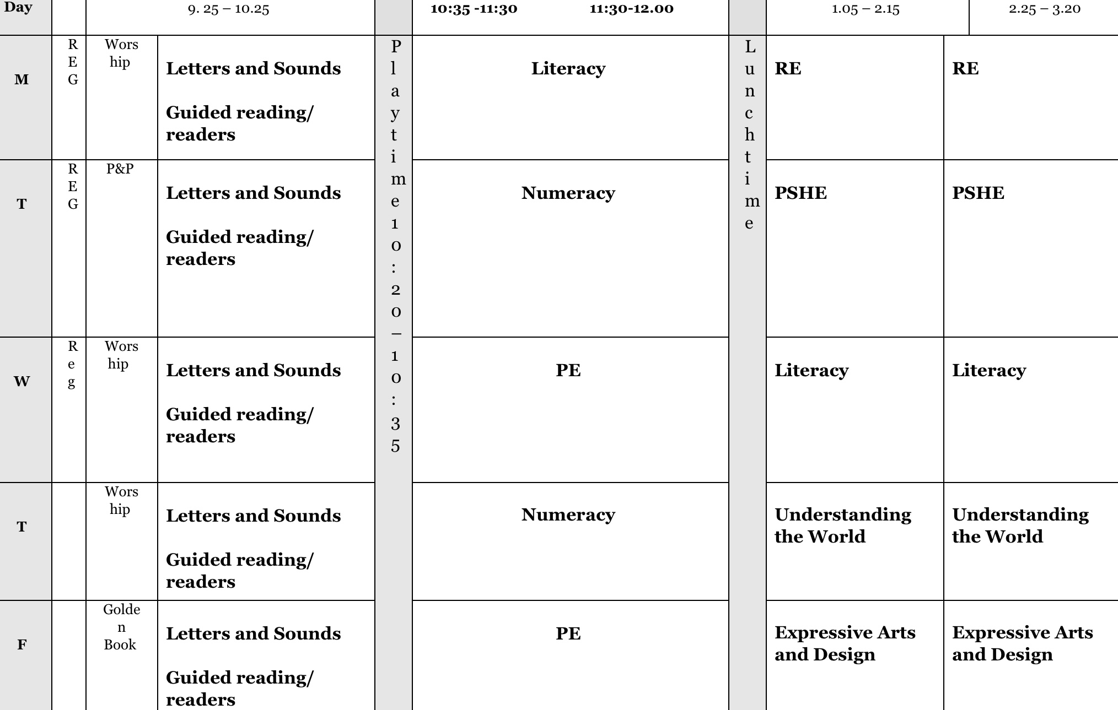
Weekly Timetable
This is a typical weekly timetable,
Notes:
Maths input everyday, guided reading everyday.

Slide 3
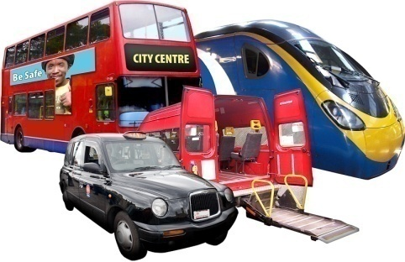

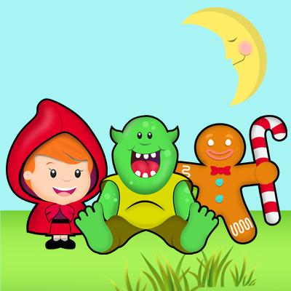
Class Themes
The Colour Monster
Stick Man
The Naughty Bus
Jasper’s Beanstalk
Supertato
The Gingerbread Man
Under ‘vocabulary mats’ on our class page you will find the key words covered in different subjects .
Notes:
Start each theme with a topic web

Slide 4
We follow the Foundation Stage Curriculum in Reception which is made up of 7 areas.
Personal, Social and Emotional Development
Literacy
Communication and Language
Mathematics
Understanding the World
Physical Development
Expressive Arts and Design
Notes:
Play based, free choice and structured activities, small and large group work.

Slide 5
Assessment
We will assess the children in the first few weeks of Reception class in order to plan for their needs.
The children will complete a statutory baseline assessment with the class teacher. More details can be found on our class page.
Children are assessed informally throughout the year with information gathered used to consolidate or challenge the children’s learning.
We also like to gather information from parents. If your child learns something new at home, complete the ‘I’m a star’ and bring it back to school – we will send these home soon. For example your child might count a group of objects correctly, write a word, ride a bike, use their manners, etc.
By the end of Reception, children are expected to be working within the early learning goals – these can be seen on our class page. Children who achieve the early learning goals will be ‘expected’ on their end of year report. Children working towards the early learning goals at the end of the year would be ‘emerging’.
Notes:
Parents drop ins

Slide 6
Examples of End of Year Achievements
To listen attentively and respond to what they hear
Participate in small group, class and one-to-one discussions
Demonstrate strength, balance, coordination when playing
Hold a pencil effectively in preparation for fluent writing
Begin to show accuracy and care when drawing
Be confident to try new activities and show independence, resilience and perseverance in the face of challenge
Explain the reasons for rules, and know right and wrong
Work and play cooperatively and take turns with others
Demonstrate an understanding of what has been read to them
Read aloud simple sentences and books that are consistent with their phonic knowledge, including some common exception words
Write simple phrases and sentences that can be read by others
Have a deep understanding of number to 10
Recall number bonds to 5, and some number bonds to 10
Explore and represent patterns within numbers up to 10
Know some similarities and differences between things in the past and now
Explore the natural world around them, making observations and drawing pictures of animals and plants
Sing a range of well-known nursery rhymes and songs

Slide 7
Key Worker
Your child will be assigned a key worker who they will spend time with each week to enjoy a speaking and listening activity. We will put this information in your child’s reading diary.

Slide 8
Curriculum Newsletter
This provides details of what the class will be covering this term.
Check ‘Weekly Activities’ on our class page for weekly activities so you can reinforce learning at home.
Check the class page for photographs and updates.
Notes:
Newsletters online every term

Slide 9

Reading
Reading books are sent home every week on Tuesday and Thursday, please bring your child’s blue pace bag into school on these days only – school will provide each child with a blue bag.
Please comment on how your child has read, otherwise their book will not be changed.
Guided reading will be completed in class where the children are grouped by ability. Children can change groups throughout the year.
We will also read individually with the children every week using our reading books in school.
Daily phonic sessions will develop your child’s reading and writing skills. It is very important that you reinforce sounds and tricky words covered in class at home.
Practise segmenting words – this is chopping words up so cat = c-a-t, pig = p-i-g
https://home.oxfordowl.co.uk/reading/what-is-letters-and-sounds/ Follow this link to find out how to pronounce the individual letter sounds.
Please read at home for a minimum of 10 minutes a night.
Please make sure you do read the reading books with your child as reading is such an important skill which helps develop your child’s understanding in all other subject areas.

Slide 10

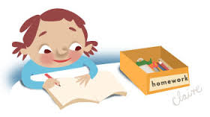
Homework
We will put any homework on our class page under ‘weekly activities’, so please check it regularly. Work completed at home does not need to come back to school unless we ask for it.
Please ensure your child reads their reading book.
Letters and tricky words to practise this term will be put under the ‘Phonics’ section.
A tricky word is a word which cannot be sounded out, but one they need to remember, e.g. the, go, no.
Notes:
Key words – practise at home, children not to write in homework diary. Guided reading activity

Slide 11
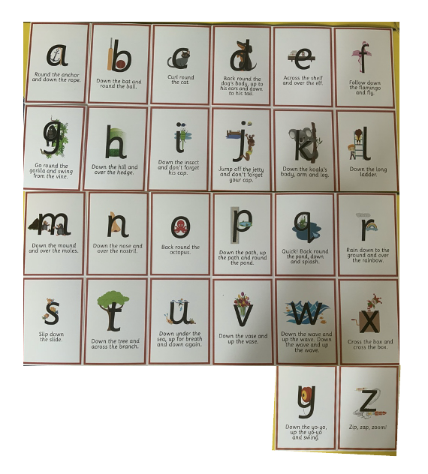
Handwriting
This is how we form the letters in our class
Notes:
Key words – practise at home, children not to write in homework diary. Guided reading activity

Slide 12




School Uniform
Please make sure that your child is wearing the correct school uniform.
All items of clothing need to be named, including shoes.
Shoes should be plain black and weatherproof (no canvas shoes or trainers please)
Please provide your child with a waterproof coat so the children can access the outdoor area in all weather.
No earrings, jewellery or colourful/ large hair accessories. Please ensure hair accessories are either blue or yellow to match our school colours.
Bring a coat to school every day.

Slide 13

PE & Games Kit
2 PE lessons each week – Wednesday & Friday
Children need a white T-shirt, blue or black shorts and a pair of trainers. These stay in school.
Practise getting dressed and undressed with your child at home. Also practise zipping coats.
Please name each item of clothing.
Later in the term children will come to
school in their PE clothes.
Notes:
Also practise zipping coat up

Slide 14
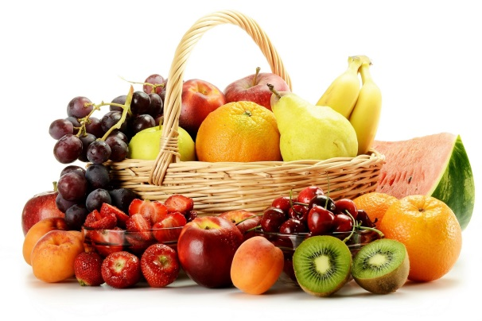
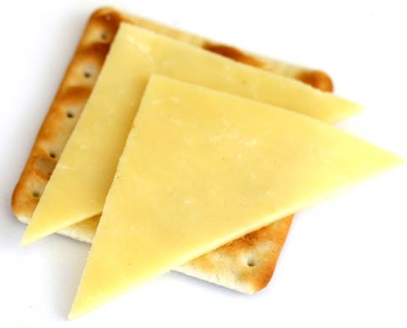
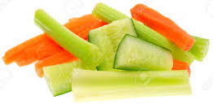
Snacks
Your child can bring a healthy snack for the morning. Please write their name on.
Please cut grapes.
No snacks which contain nuts.
Children do not need to bring their snacks in a lunch bag as we have no space to store them, and they only need one snack.
Water bottles will be sent home every night to wash. Bring these back every day with just water in them, no juice.

Slide 15

Rewards
Raffle tickets
Monster Points & House Point Certificates.
Star of the week & golden book
Jar of Joy – the children get an afternoon of joy when they fill their pasta jar.
Stickers

Slide 16
Managing Behaviour
In the classroom we will manage behaviour through:
Using monster points and raffle tickets.
Promoting positive behaviour.
Praising children who go ‘above and beyond’ using our recognition board.
Having three simple rules – be kind & honest, try your best, & listen to others.
Having a calm environment where all children feel important and valued.

Slide 17

PPA Arrangements
Every other Wednesday afternoon the class will be taught Expressive Arts and Design by Miss Saunders, supported by
Mrs Stockburn.

Slide 18
E-safety
Please be aware of what your child is looking at online and what games they are playing.
Try to limit the amount of time spent on iPads, computers etc.

Slide 19

Class Charity
This year we will be supporting the RSPCA. We will hold activities to raise awareness throughout the year.

Slide 20

Emergency Contact Information
Please let us know of any changes as they arise.
Please let us know if another adult is picking your child up.

Slide 21
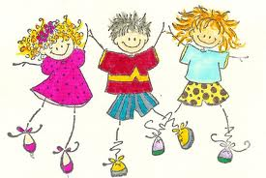
Key Events
In EYFS we have a parent drop-in each half term. You will be able to come and spend time with your child in class.
Family Fun Fridays
Please check the school website for upcoming events.
www.stjohnscliviger.co.uk
A weekly school newsletter is available online – please read it so you know what is happening in school.

Slide 22
Finally, if you ever have any worries or concerns, please come and speak to us. Email ourschool@cliviger.com
Mrs Kenny: Mon- Wed
Mrs Pickup: Thur - Fri

Slide 23


