Slide 1
Numeracy Parents Meeting
1
2
3
λ
π
1
2
3
λ
π

Slide 2
Overview
It is important that children have a solid understanding of number,
Children will need lot of practical experience of maths involving physical things before moving onto more abstract concepts,
They will then start to use diagrams, jottings, marks etc to represent their maths,
They will need to be confident in using a range of mental, informal jottings and formal written methods to do calculations,
Once they understand a range of strategies they need to be able to select and apply their maths to problem solving.

Slide 3
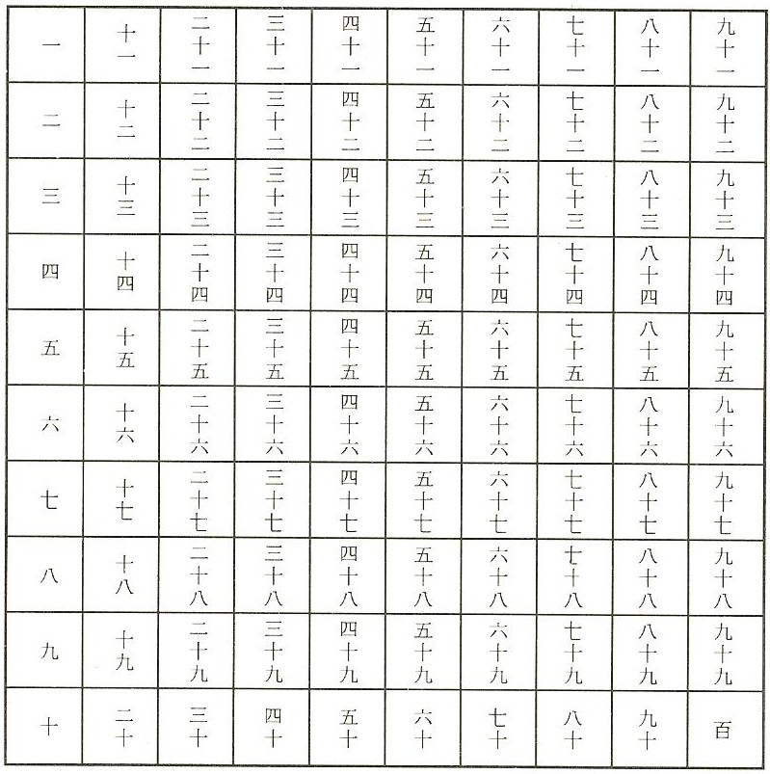
An understanding of number
What does
this symbol
mean?
+
10 !
Which is the biggest number?
1, 2, 3, 4, 5, 6, 7, 8, 9,

Slide 4

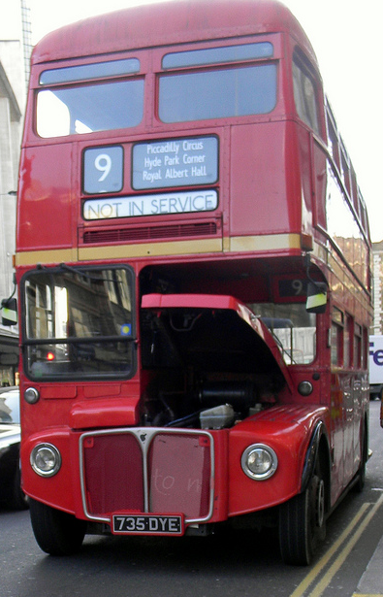
An understanding of number
What does the number 9 mean?
4, 5, 6, 7, 8, 9, 10, 11
9 footballs
The number after 8 and
before 10.
An arbitrary name
for something

Slide 5
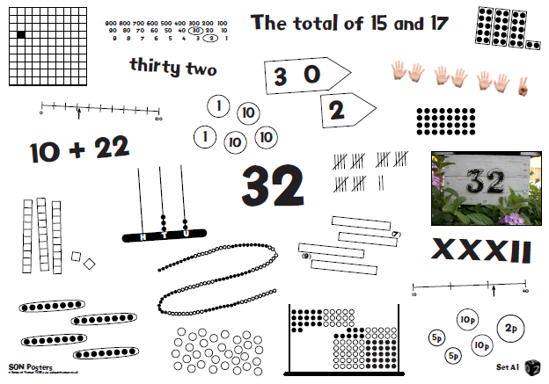
An understanding of number
How do we represent 32?

Slide 6

Using apparatus/equipment
In the infants the children will often have access to practical equipment (cubes, counters, base ten equipment etc) to show the value of what they are working out.
3 + 2 = 5
Counting is fundamental to successful addition as is the correspondence of the object to the number name.
They will start to develop ways to record their calculations using pictures.
Making 6
6 = 1 + 5
6 = 2 + 4 ...etc

Slide 7
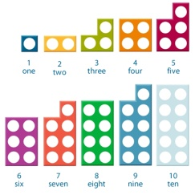
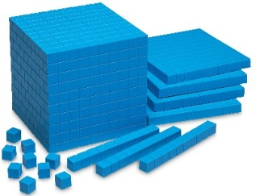
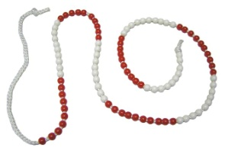
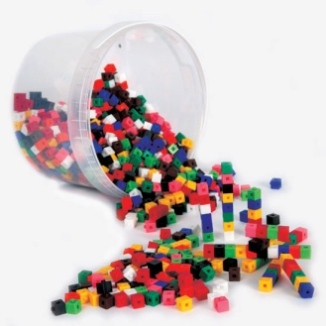
Types of equipment
Examples used in school:
Numicon,
Base ten equipment,
Beadstrings,
Cubes.
These can be used in various ways to show different concepts linked to the children’s maths. i.e.
Number bonds, addition/subtraction, difference, doubles, place value, calculation, compliments, counting, multiplication,
counting, fractions, ratio, area, volume.

Slide 8
Importance of mental maths skills
and regular practice
Important skills that the children will need to be progressively more fluent in as they move up the school.
e.g.
Counting on/back (in 1, 2, 5, 10, 0.1, ½ , ¼ , 25 etc),
Number bonds to.... 10, 20, 17, 100, 1, 0.1 etc,
Addition/subtraction of one, two digit numbers,
Doubling/halving,
Times tables and division facts,
Multiply/divide by 10, 100, 1000 etc,
Derive related facts,
3+7 =10
7+3 =10
10-7 =3
10-3 =7
30 + 70 =100
100- 70 =30
300 +700 =1000
0.3 + 0.7 = 1.0
7+13 =20
0.03 + 0.07 =0.10
63 +... =70
630 +....=700
£6.30 +..... = £7.00
£10.00 – £6.30 = £3.70
7-10 = -3
3-10 = -7
20-13 =7
20-7 = 13
17+3 =20

Slide 9
The real world!
In order to help your children, regular practice of mental maths will benefit them. However, opportunities in everyday activities will also enable the children to see a context for their maths.
For example:
Calculating change when shopping,
(money recognition, number bonds to 100)
Baking,
(estimation, using scales on measuring equipment, ratio, calculation)
Identifying numbers outside,
(odd/even door numbers, speed limits are multiples of ten, roman numerals on clock faces)
Catching a bus or train,
(reading clocks, digital time, timetables, time differences)
Spotting shapes on the built environment/nature,
(look for symmetry, acute/obtuse/right angles, parallel/perpendicular lines)
DIY!
(accurate measurement)

Slide 10
Images and informal jottings
59
+10
+10
+4
35
45
55
59
3/12 = ¼ = 25%
Ratio 2 : 3

Slide 11
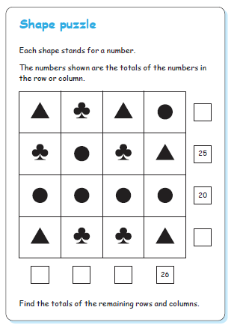
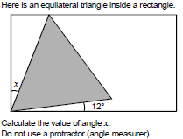

Written methods
Progressions in written methods are on the schools website.
Problem solving
Involving:
Word problems,
Logic or shape puzzles,
Spotting patterns and
generalising,
Reasoning,
What is the rule for this sequence and what would be the missing number?
....., 4, 7, 11, 18, 29, 47

Slide 12
Useful websites
www.mathsweek.org.nz/
Loads of interactive games that can be pitched across KS 1, 2, 3.
www.mathsisfun.com/
Good explanations of lots of concepts, and some tricky puzzles/ investigations.
www.primaryhomeworkhelp.co.uk/maths/
Woodlands school site that has loads of good stuff on.
www.gamepuzzles.com/pparlor/puzzleparlmm.html
Shape puzzles that are quite tricky.
www.nrich.maths.org/frontpage
A wide range of different types of investigations and open ended activities that go beyond the primary age range.

