Slide 1
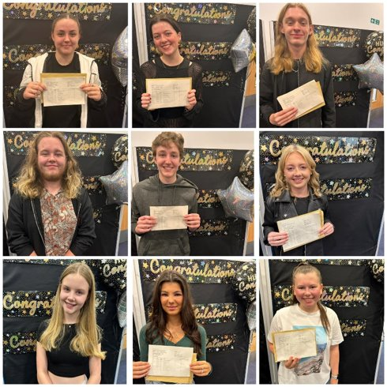

Slide 2
Around 220 days until the first GCSE exam

Slide 3
Outline of session:
Brief overview of our academic success
Key information about the new specifications
Information about how we are preparing and supporting your child in their final year, especially with regards to the forthcoming mock examinations
Some strategies / guidance about how you can help support your child at home

Slide 4
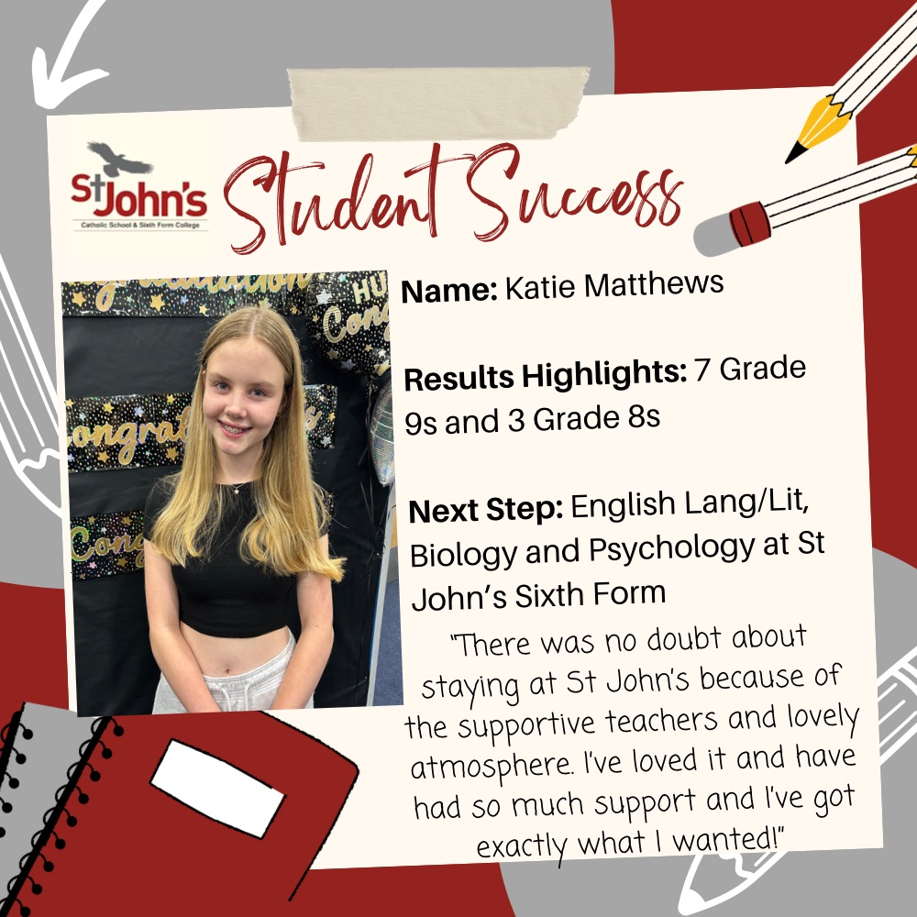
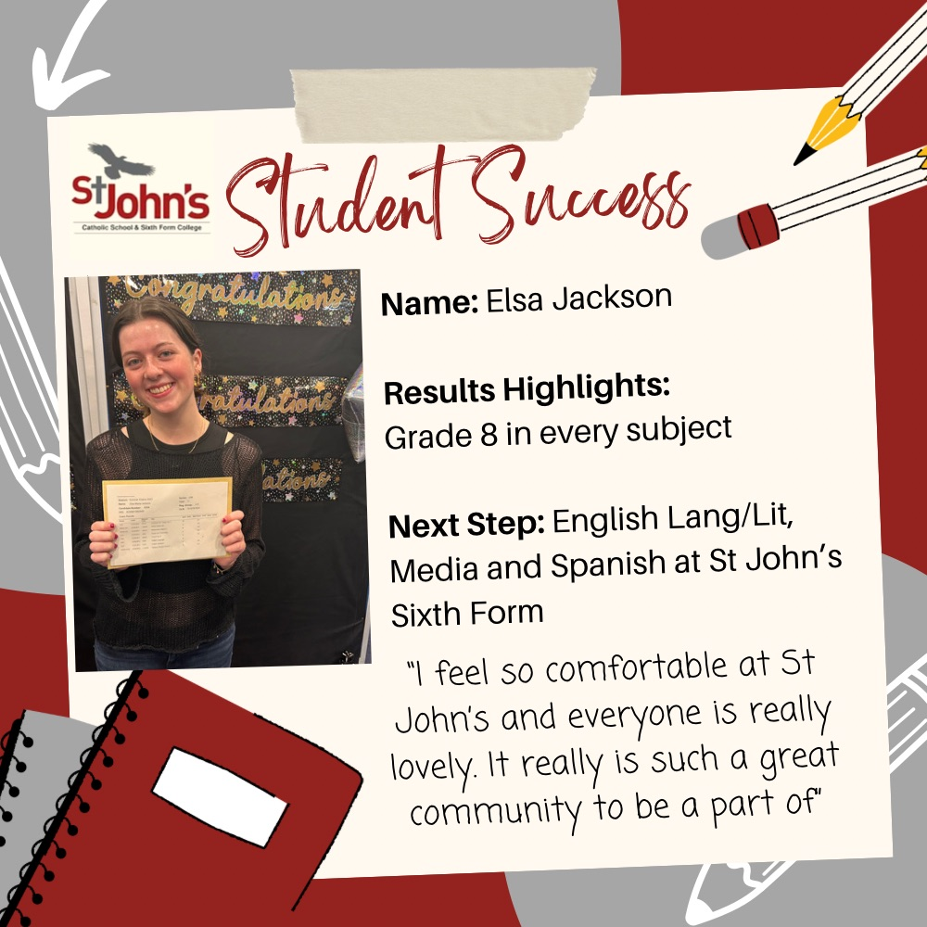
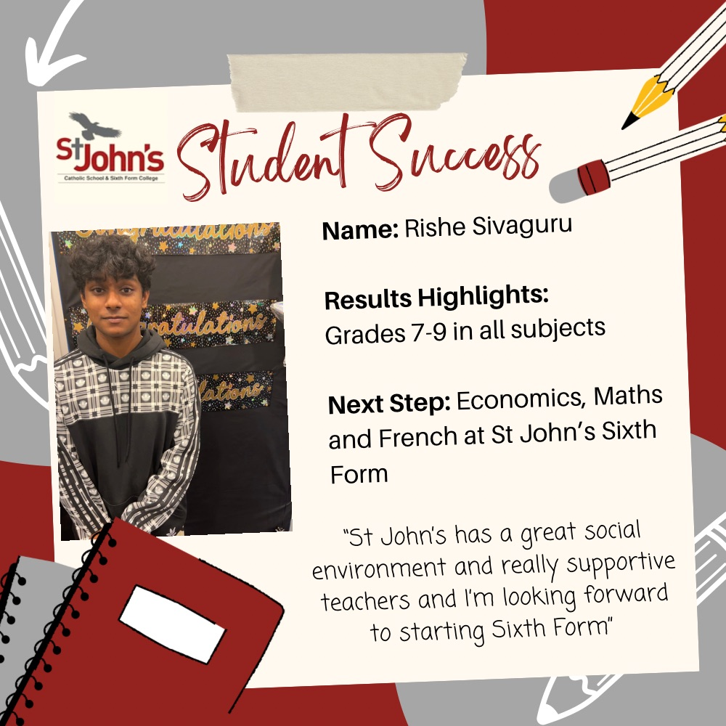
Achievement & Success

Slide 5
Achievement & Success
79% achieved 4+ in English
73% achieved 4+ in Maths
Photography 95%, PE 89%, Spanish 77%, Computer Science 75%
Attendance at 98% or above students achieved almost half a grade more than expected
Attendance at less than 92% students achieved almost half a grade less than expected

Slide 6
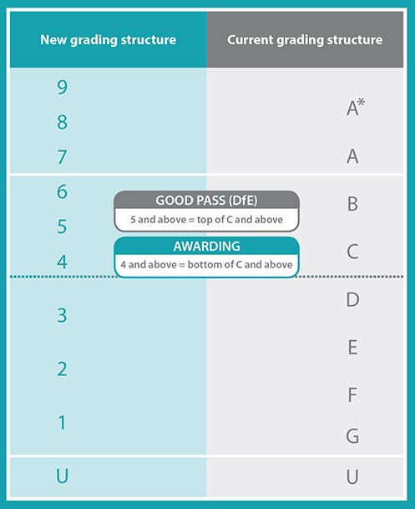
The GCSE Specifications
All GCSEs in England have a 9 to 1 grading scale.
Grade 9 is the highest grade and is awarded to fewer students than the previous A*.
The old and new GCSE grading scales do not directly compare but there are three points where they align:
the bottom of grade 7 is aligned with the bottom of grade A
the bottom of grade 4 is aligned with the bottom of grade C
the bottom of grade 1 is aligned with the bottom of grade G

Slide 7
What is the first milestone in preparing our students for their GCSEs?

Slide 8
Year 11
GCSE Mock Examinations
Monday 30th October

Slide 9
Year 11 GCSE Mock Examinations
6 Week Plans
Every assessment this year is an opportunity for students to:
    identify any gaps in their knowledge
    provide focus areas for their revision
    practise different revision techniques
These mocks will also help teachers to identify gaps and adapt lessons to ensure students remember key learning

Slide 10
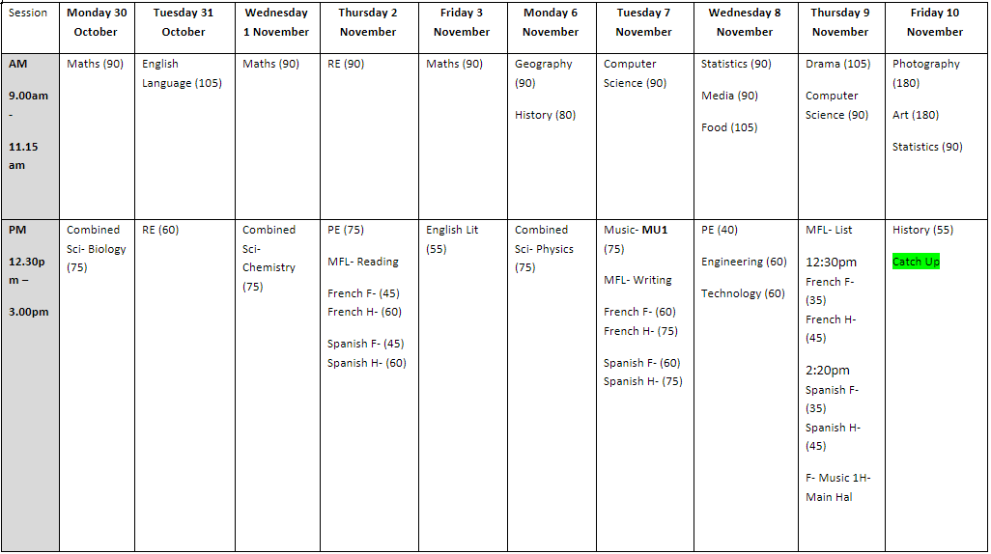
Mock exam timetable

Slide 11
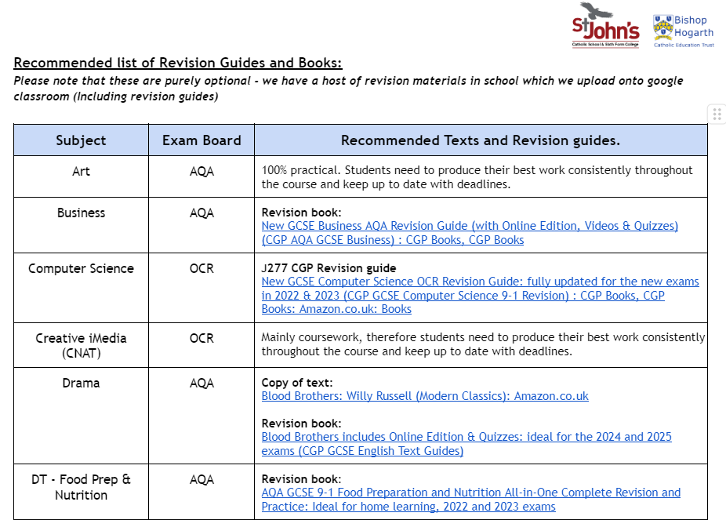
GCSE Exam Boards

Slide 12
Outstanding Teaching and Learning
Lessons taught with evidence informed practice
Intervention timetable
Mock examination booklet
Exam preparation assemblies
Half term revision support
Dedicated pastoral and SEMH support
Rewards
What does our school do to support your child?

Slide 13
Attendance
Attitude
Behaviour
Hard work
Organisation
Getting involved
How can students get there?

Slide 14
What can students do to achieve and exceed their potential?
Class Work
Specific Homework
Independent Revision
Holiday Homework
Lunchtime Intervention
After School Intervention

Slide 15
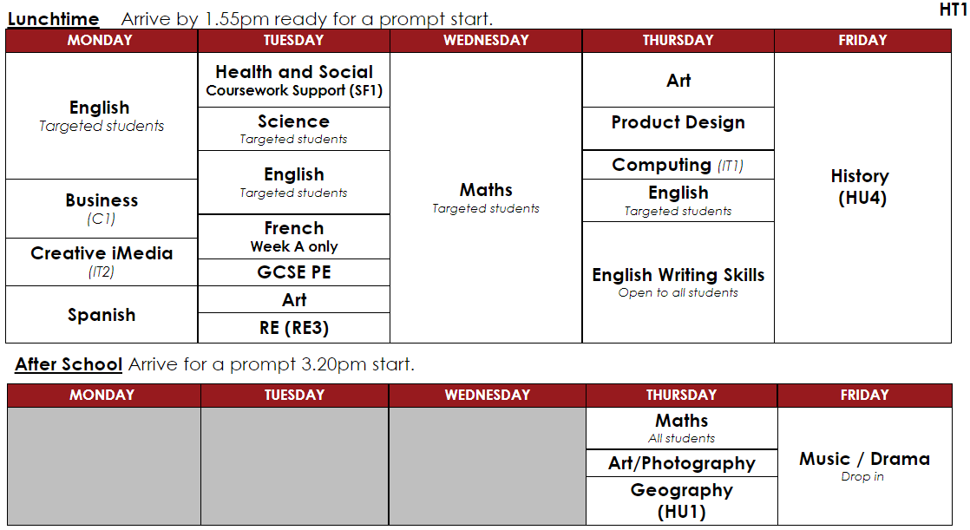

Slide 16
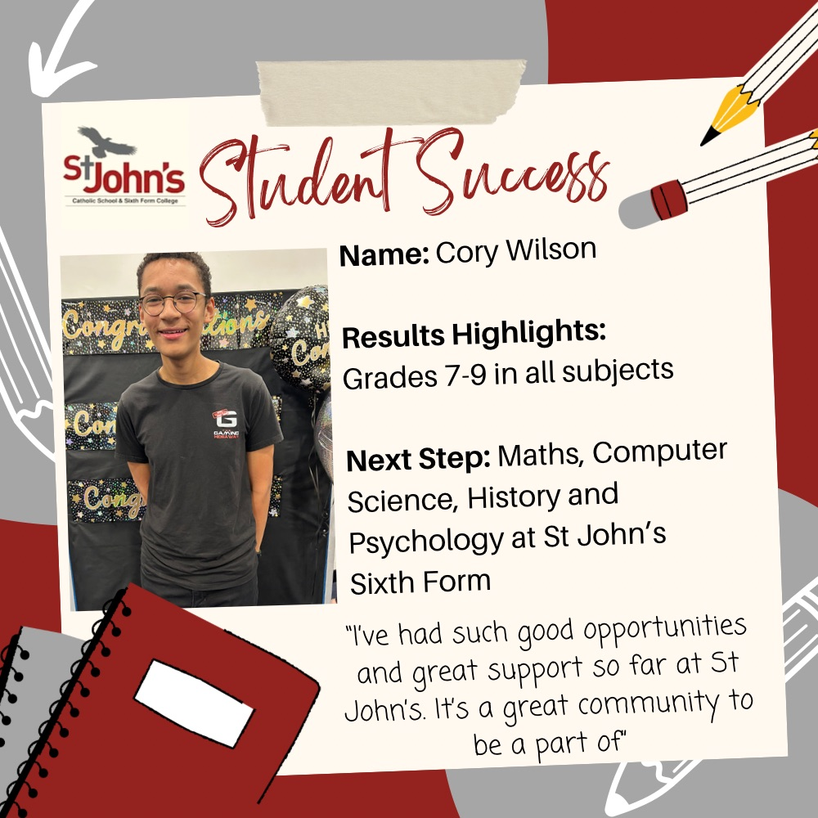
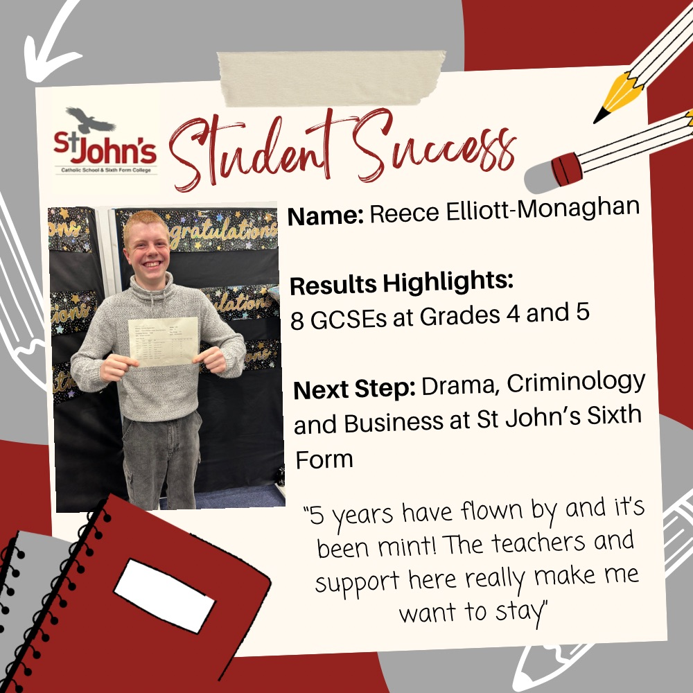
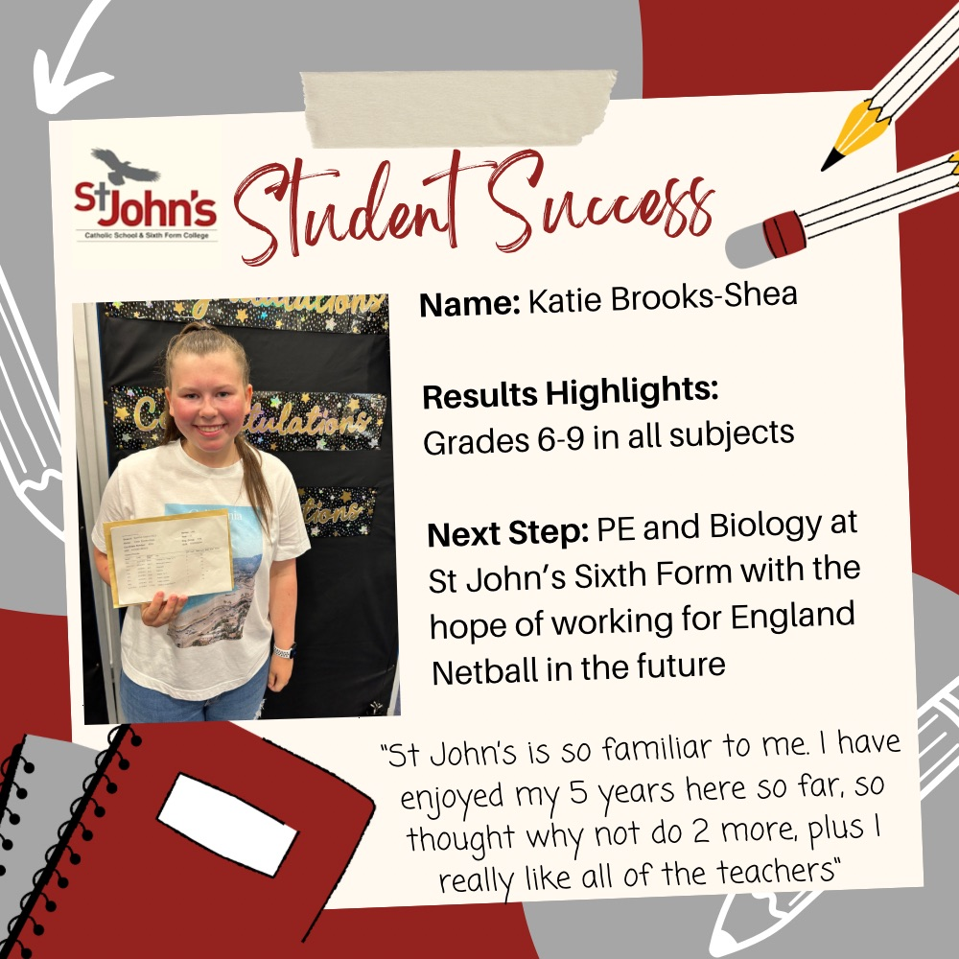
Why do we offer lunchtime and after school intervention sessions?

Slide 17
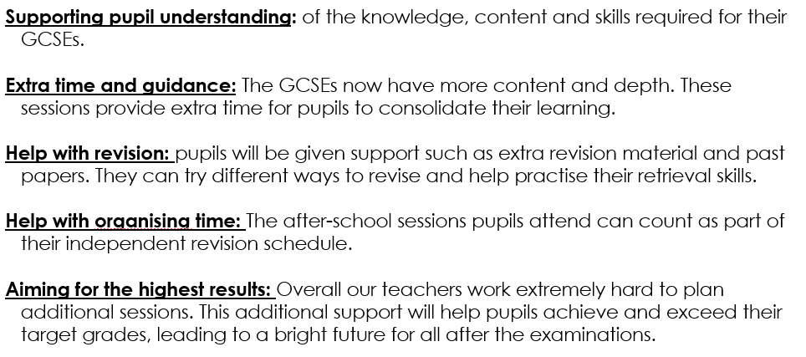

Slide 18
What do we expect of students?
Attendance: at ALL lessons and targeted intervention sessions. Reflects their own personal commitment and drive to achieving their true potential.
Punctuality: Arrive at all intervention sessions on time.
Excellent Attitude and Effort: Be positive and determined. Teachers are giving up their OWN time to support and help our students achieve their best.
Be Organised: The lunch time and afterschool timetable is in the mock exam preparation booklets, displayed in the Y11 pastoral rooms.

Slide 19
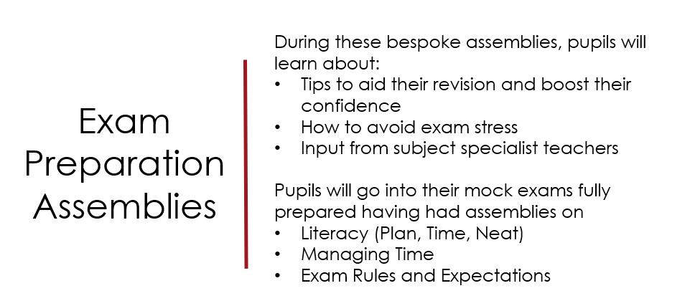

Slide 20
Pupils will also have the opportunity to:
Create their own personal revision timetable
Practice a range of revision techniques
Practice healthy behaviours to support their wellbeing
Exam Preparation

Slide 21
Rewards are given based on:
Attendance
Punctuality
Behaviour
Work rate
Hard work deserves reward!

Slide 22
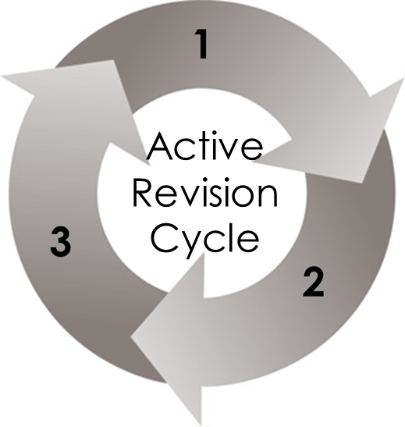
How should students revise?

Slide 23
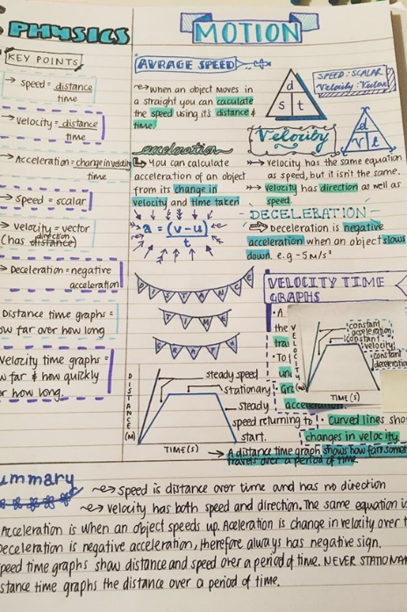
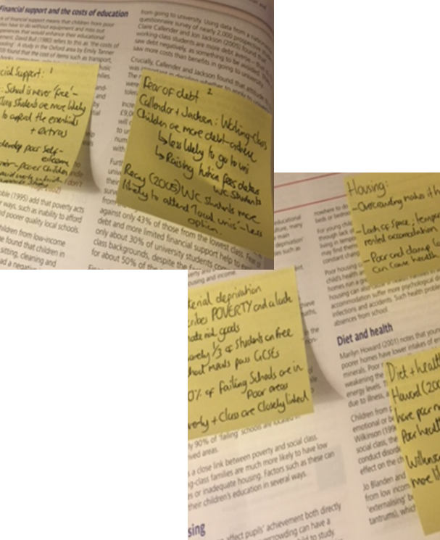
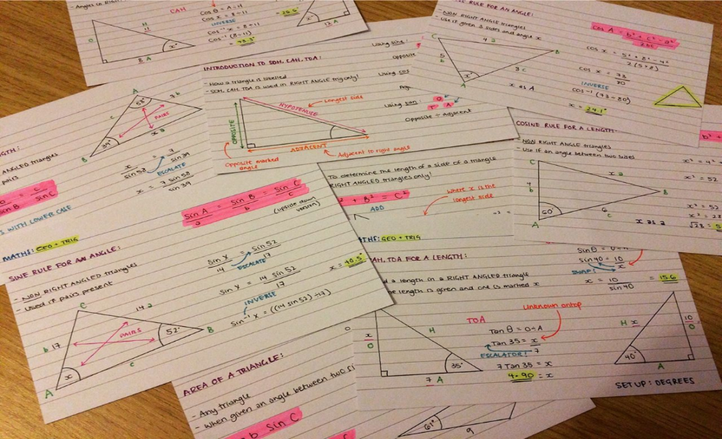
What effective revision techniques can students use?

Slide 24
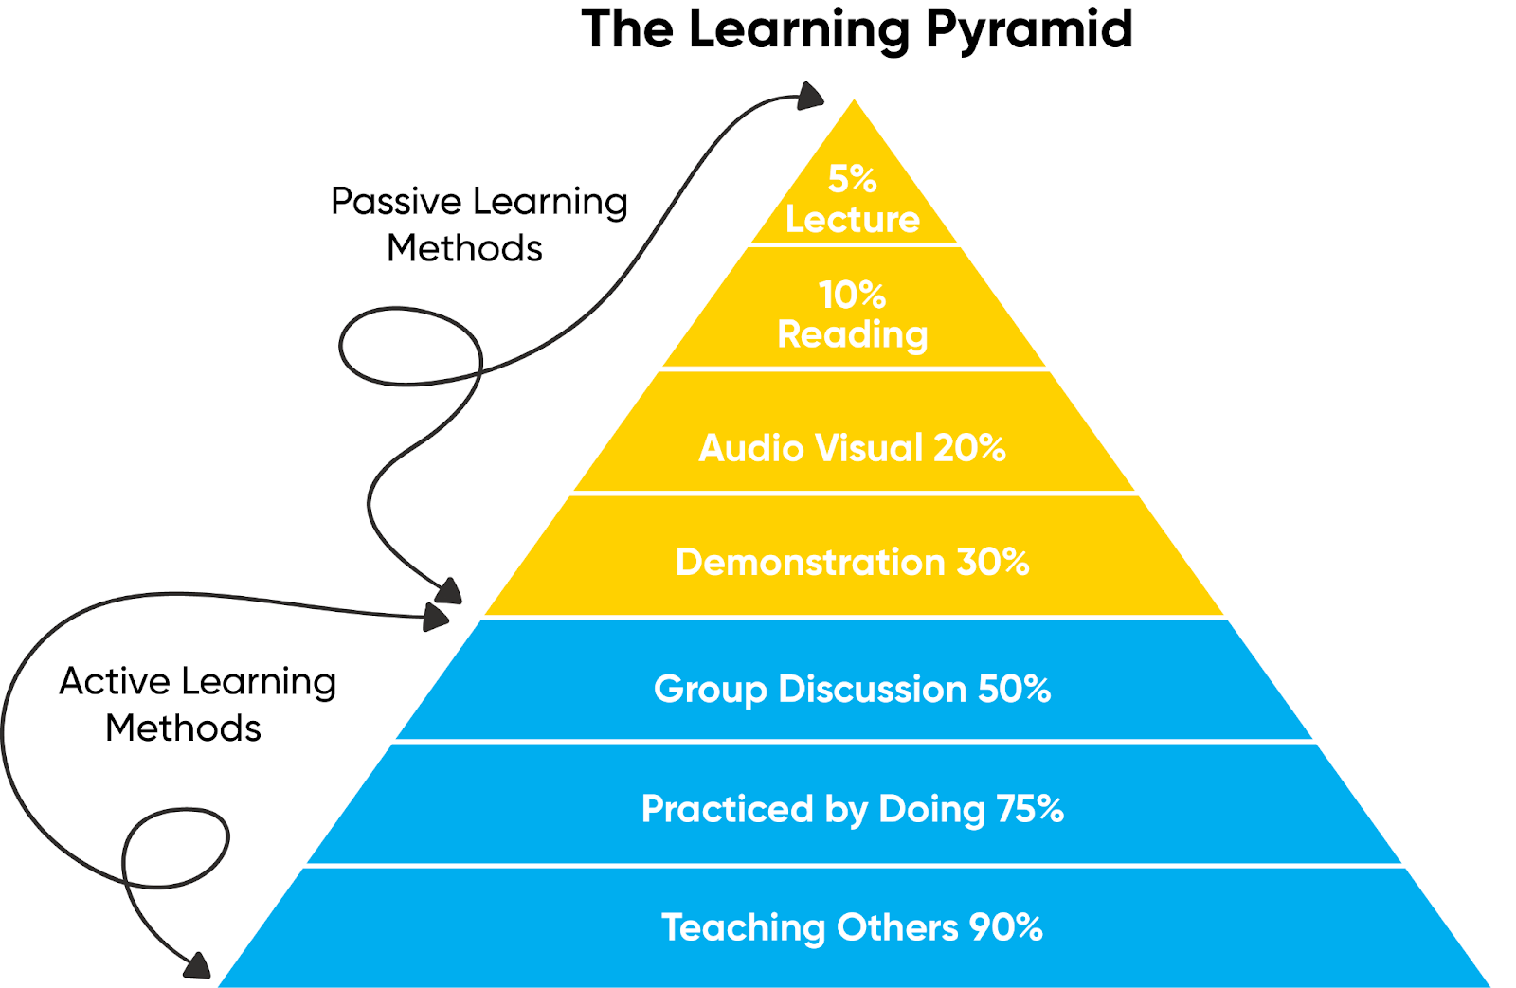
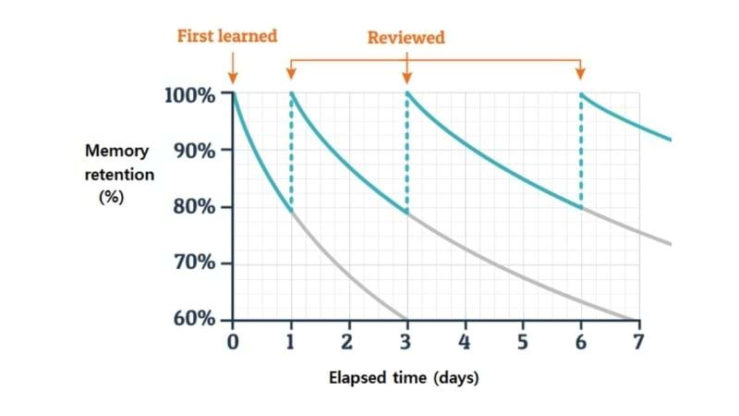
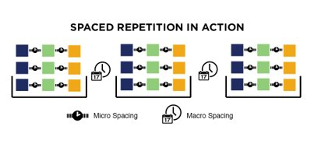

Slide 25
Will support students with:
Revision
Preparing well
Organisation
Confidence
Feel relaxed and calm
Enjoy
Mock Exam Preparation Booklet

Slide 26
Mock Exam Preparation Booklet
The mock exam preparation booklet has the following information:
Revision Timetable
The Importance of Revision
Revision Tips
Plan Time Neat
Revision Techniques
Managing Your Wellbeing
Prayers

Slide 27
Half Term Exam Preparation
Please support your child in ensuring this revision work is completed and to the best of their ability.
Please encourage your son / daughter to use the revision planner in their mock preparation booklet to organise their time and revision over half term.

Slide 28
Question Level Analysis: Specific topics/questions showing areas of strength and areas for development
Final set of Mock Exams: January 2024
Following the November Mock Examinations

Slide 29
Looking after our students

Slide 30
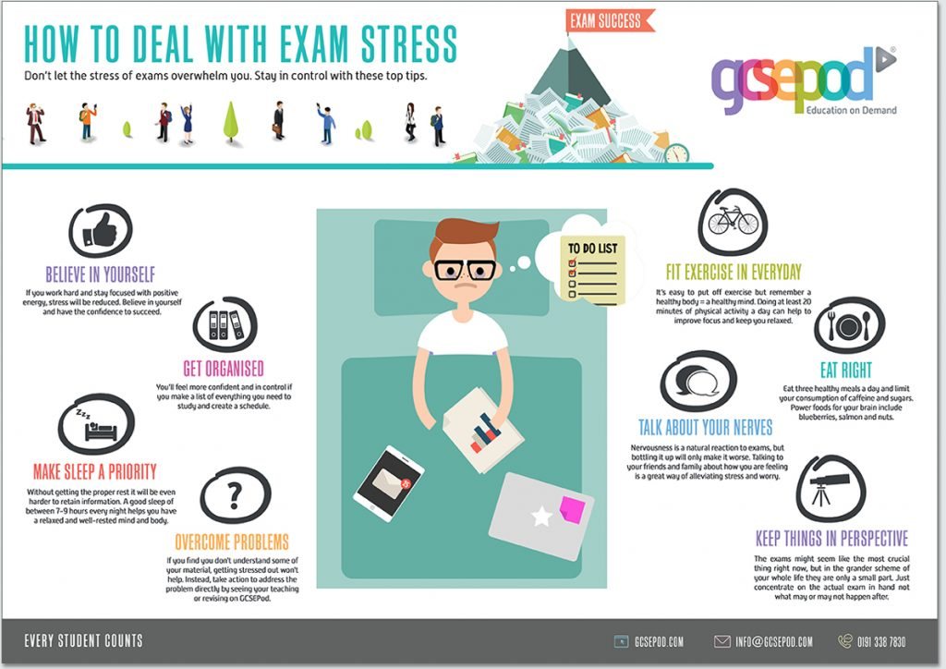

Slide 31
Thank you for your continued support!

