Slide 1

Japanese Tsunami Project
Year 6 geography transition project

Slide 2
Where is Japan?
Objectives/End Points
Pupils will be able to:
Locate Japan on a world and global scale
Identify the national features of Japan (Islands, Cities, Oceans/Seas)
Describe a place such as Japan using key locational evidence/geographical terminology
First though, lets watch a short video to give us an idea of what Japan is like.
https://www.youtube.com/watch?v=5ZeSaDfjTG0 Write down 8 interesting facts about Japan from this video.

Slide 3
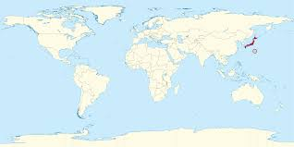
Use an atlas to find the UK and Japan on a world map.
Q: Which Hemisphere is Japan found in and in which continent?
Label the latitude and longitude for the city of Tokyo, which is the capital of Japan

Slide 4
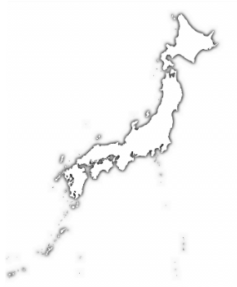
On a separate map of Japan label the 4 main islands of Japan – Hokkaido, Honshu, Shikoku and Kyushu.
Now label the cities of Sapporo, Sendai, Tokyo, Yokohama, Kobe, Kyoto, Hiroshima and Nagasaki.
Q: Are the main cities on the East or West of Japan
Finally label the pacific Ocean, the East China Sea and the sea of Japan.
Notes:
Sendai was the centre of the Tsunami and the plate boundaries are found under the pacific ocean

Slide 5

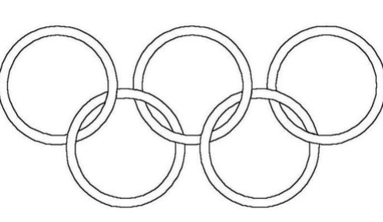
Now, either draw around your hand or use the Olympic rings; in each finger or ring write the following headings:
Hemispheres
Continents and Oceans
Latitude and Longitude
Islands,
Cities
‘Fascinating Facts’ on the palm or below the rings.
Now, write under each heading, the information you have learnt this lesson.
TASK: Use the geographical vocabulary you have learned today to write a paragraph to describe the location of Japan on a global and local scale. Make sure you include all of the information above

Slide 6
What is Japan like?
Objectives/End Points
Pupils will learn that:
• Most people in Japan live on coastal areas because the country is Mountainous and 0nly 14% of the land is suitable to live on
• Coastal areas in Japan are densely populated. Densely populated means many people in a small area. The opposite is sparsely populated where there are few people. So densely populated areas are cities and sparsely populated areas are rural, countryside areas
• Different islands have different physical features
• Japan has a unique culture
Notes:
Japan is on 3 plate boundaries and is on a destructive plate boundary so over 80% of the land is mountainous and this is caused when the plates are dragged about by the forces inside the earth. You will learn about this later on. Almost all of the flat land is by the coast, which is why all the cities you labelled last lesson are on the coast, but this caused huge problems during the Tsunami as you will discover.

Slide 7
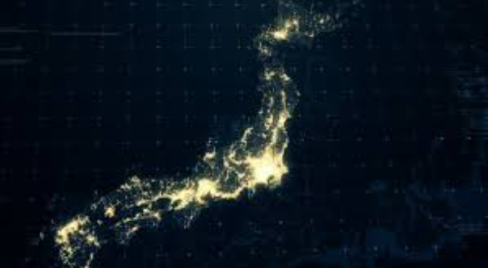
This is a map of Japan at night. What do you think the white bits are?
Notes:
This is map showing the electric lights generated by homes, offices, street lights and cars

Slide 8
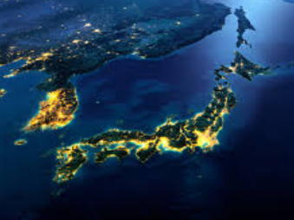
Here we can see the lights more clearly. Why do you think there is such a large cluster where the arrow is pointing?
Notes:
This is Tokyo

Slide 9
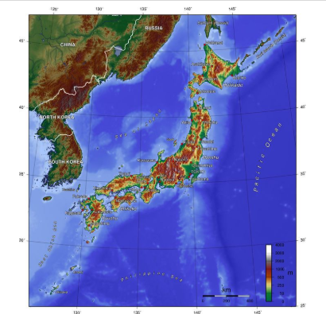

Look at the topographical map and compare to the photograph. What are the brown/green bits? Why is Japan only lit up around the edges?
Notes:
Topograpical maps use shapes to show a feature. The brown areas are mountains and the green areas are flat land. How does this link to the location of the cities you did last lesson? i

Slide 10
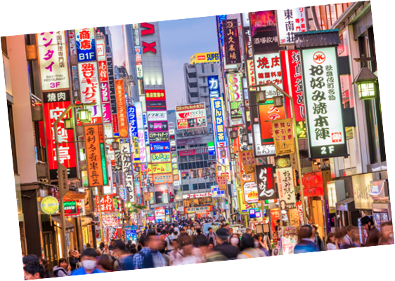
Describe this place? Is it urban or rural, densely populated or sparsely populated. Would you like to visit here?
Notes:
This is Tokyo, densely populated city on the west coast of Honshu isalnd

Slide 11
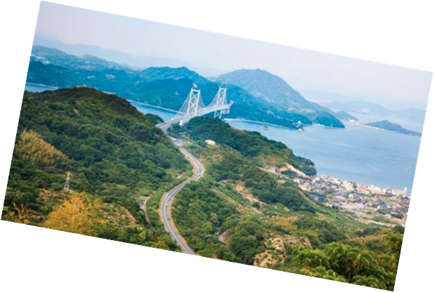
Describe this place? Is it urban or rural, densely populated or sparsely populated. Would you like to visit here?

Slide 12
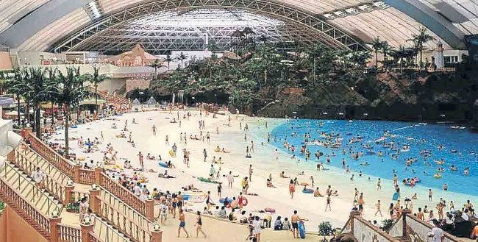
Describe this place? Is it urban or rural, densely populated or sparsely populated. Would you like to visit here?

Slide 13
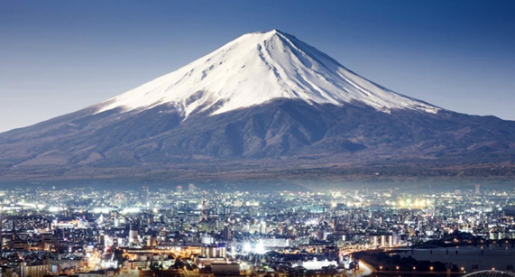
Describe this place? Is it urban or rural, densely populated or sparsely populated. Would you like to visit here?

Slide 14
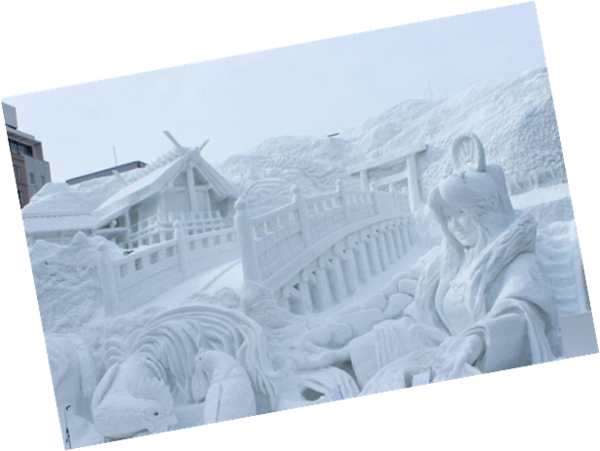
Describe this place? Is it urban or rural, densely populated or sparsely populated. Would you like to visit here?

Slide 15

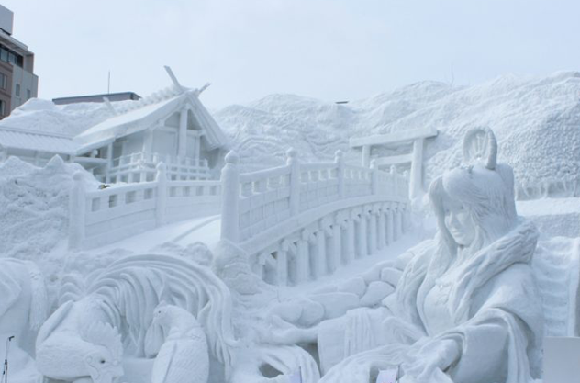
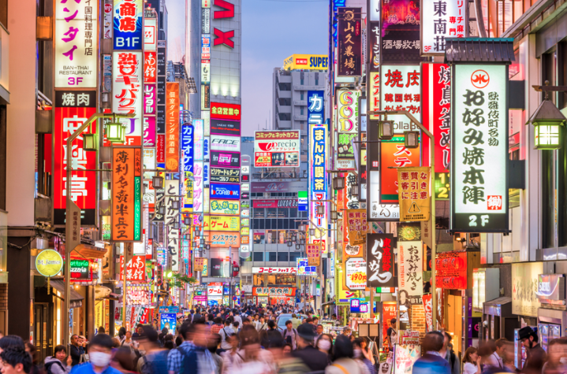
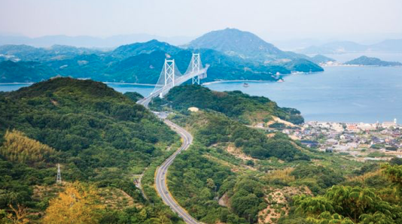
TASK
On your map of Japan, match these images to an area on the map where you think you are most likely to find them. One of the places is Mt Fuji, one is Tokyo, one is an indoor beach near Tokyo, one is the Sapporo snow festival and one is a bridge in Sendai province

Slide 16
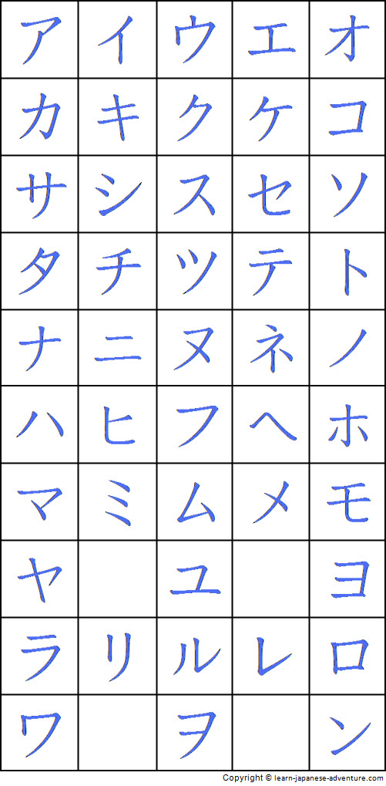
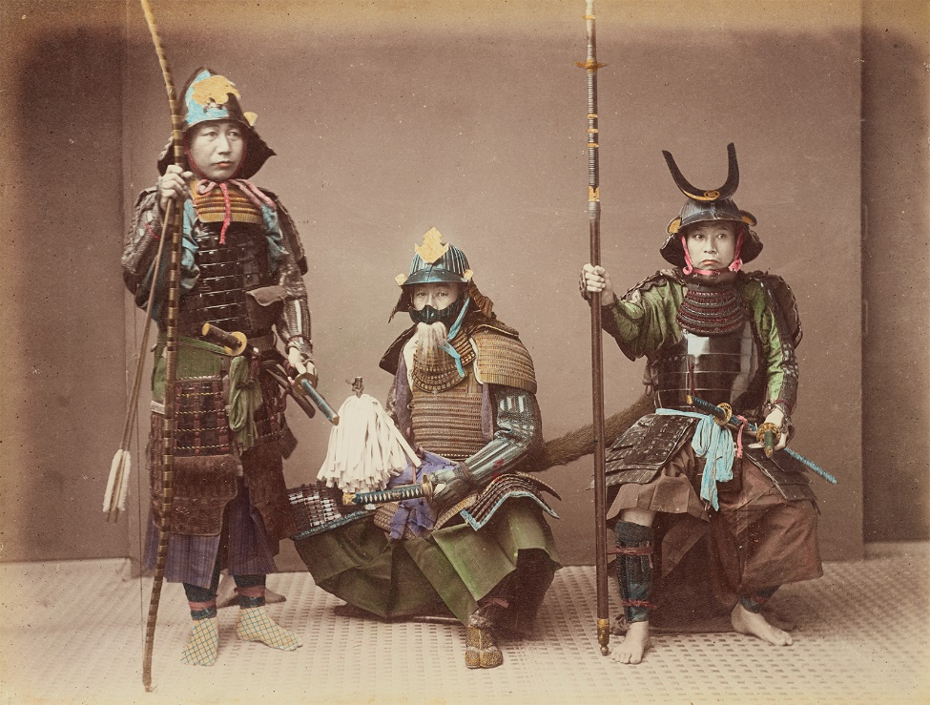
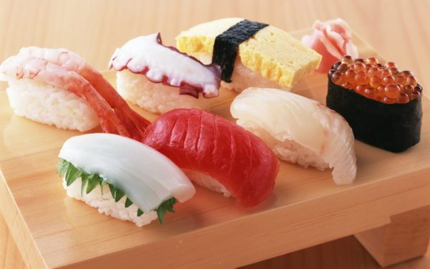
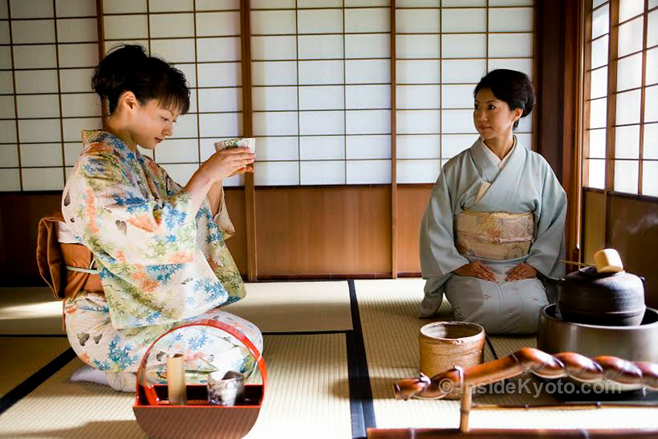
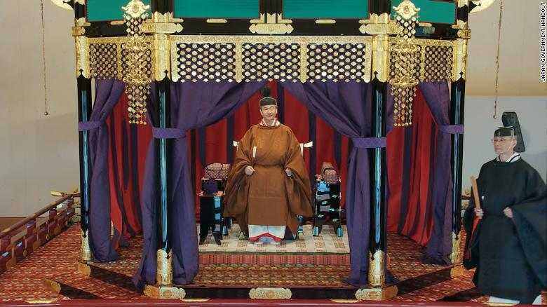
And finally, can you work out what each of these are
Notes:
Top left = samurai warriors, top middle = sushi, op right = Japanese writing, bottom left = tea ceremony, bottom right = the enthronement of Emperor Naruhito

