Slide 1

What were the responses to the Japanese tsunami?
Objectives/End Points
Pupils will learn that:
Responses can be categorised into immediate and long term responses
There are different roles involved in responding to a Tsunami
Each role has a different responsibility in helping solve the responses
Immediate responses
Help that is received within 24-48 hours (1-2 days) of the disaster happening
Long – term responses
Help that is received within weeks to months of the disaster happening

Slide 2
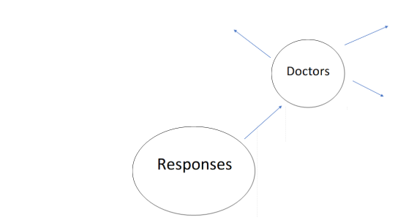
Who would be involved in the emergency response?
Create a spider diagram or think of the people that would help in the aftermath of a disaster. You could also list these.
Example

Slide 3
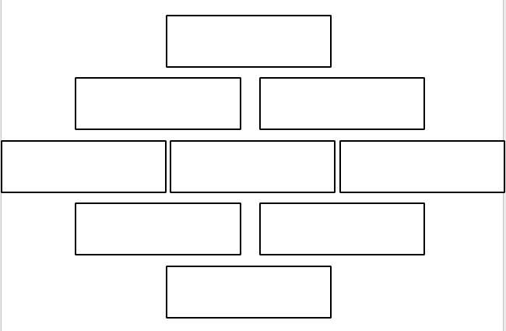
Roles involved in the emergency response
Order the people involved from most important to least important.
Write a paragraph to give reasons for your order especially your top and bottom choice. ​
Remember this is your own opinion so there is no wrong answer – however you need to be able to explain your choices. ​
Ambulance/Helicopter rescue ​
Police ​
Travel agents ​
Fire brigade ​
Builders ​
Aid workers/charities ​
Commercial brands ​
Government ​
Councillors
Diamond 9
You could structure this like a diamond 9 order if you would prefer

Slide 4
What do you think would happen in the first 15 mins after the earthquake?
Japan has the most advanced earthquake early-warning system in the world.
A nationwide online system launched in 2007, it detects tremors (small shaking in the earths crust/ground), calculates an earthquake's epicentre (where the earthquake is felt on the ground) and sends out brief warnings from its 1,000-plus seismographs scattered throughout the country, one of the most earthquake-prone nations on the planet.
Seismographs – Advanced pieces of technology that can create a graph showing the movement of the ground from earthquakes and tremors

Slide 5
Tsunami warnings take longer because more calculations are involved. A regional tsunami warning was made nine minutes after the quake struck. In the areas hardest hit by the tsunami, residents probably had only about 15 minutes of warning.
What do we think would happen in those 15 minutes?
Emergency is declared
Sirens sound
Police drive around with loudspeakers to issue warnings
All TV channels stop and issue warnings
270,000 people were evacuated and sent to higher ground
Due to the nuclear power plant at Fukushima a nuclear emergency was declared.
Helicopters were sent in to rescue stranded survivors
UNICEF provided food and shelters in the form of tents
USA sent aid (help like medicines, food, water and shelters)
Roads were cleared of debris (bricks and mud)
$1.1million clothes from Gap.

