Slide 1

Welcome to Year 5!
Teacher: Mrs Thomas
Teaching Assistant: Mrs Gibbs

Slide 2
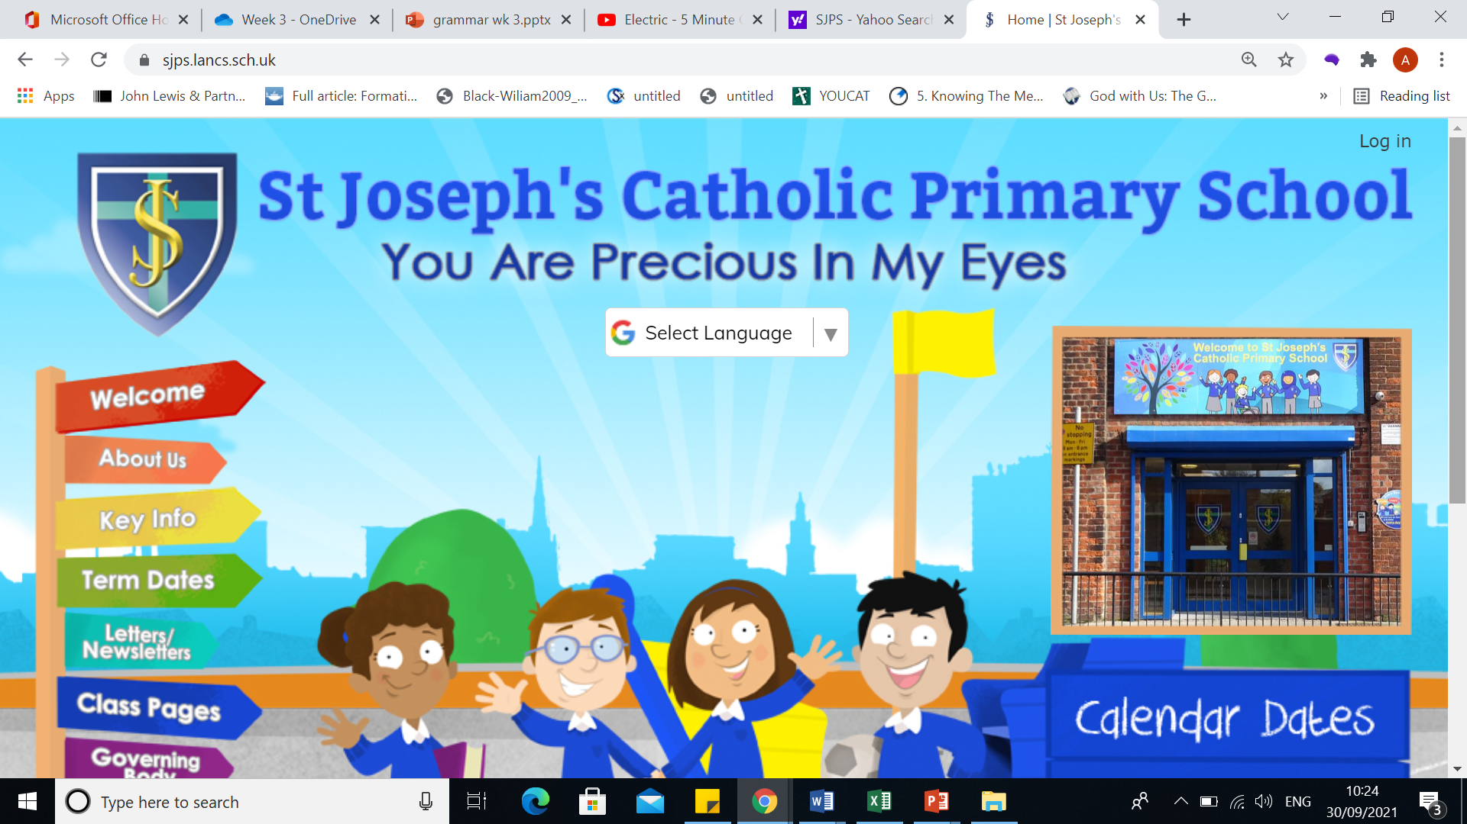
How to keep up to date:

Slide 3

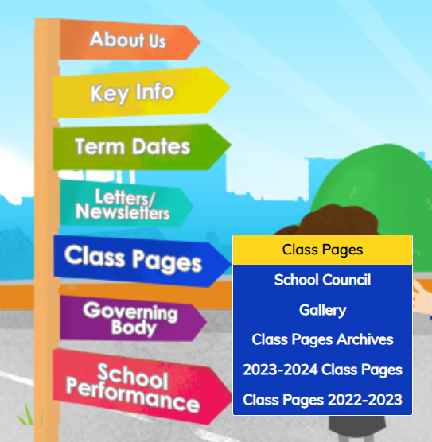
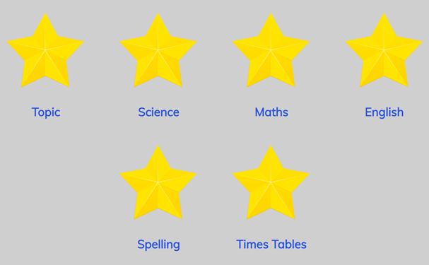

Slide 4


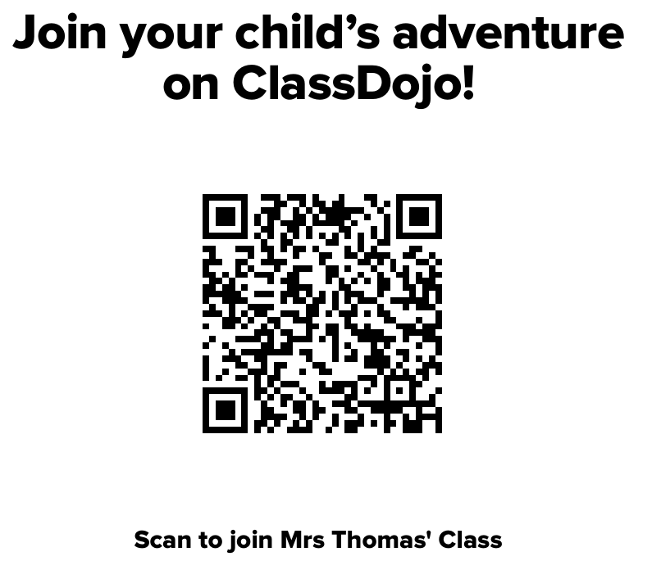
Download the Dojo app:
PLEASE SCAN IF YOU ARE NOT CURRENTLY CONNECTED.

Slide 5

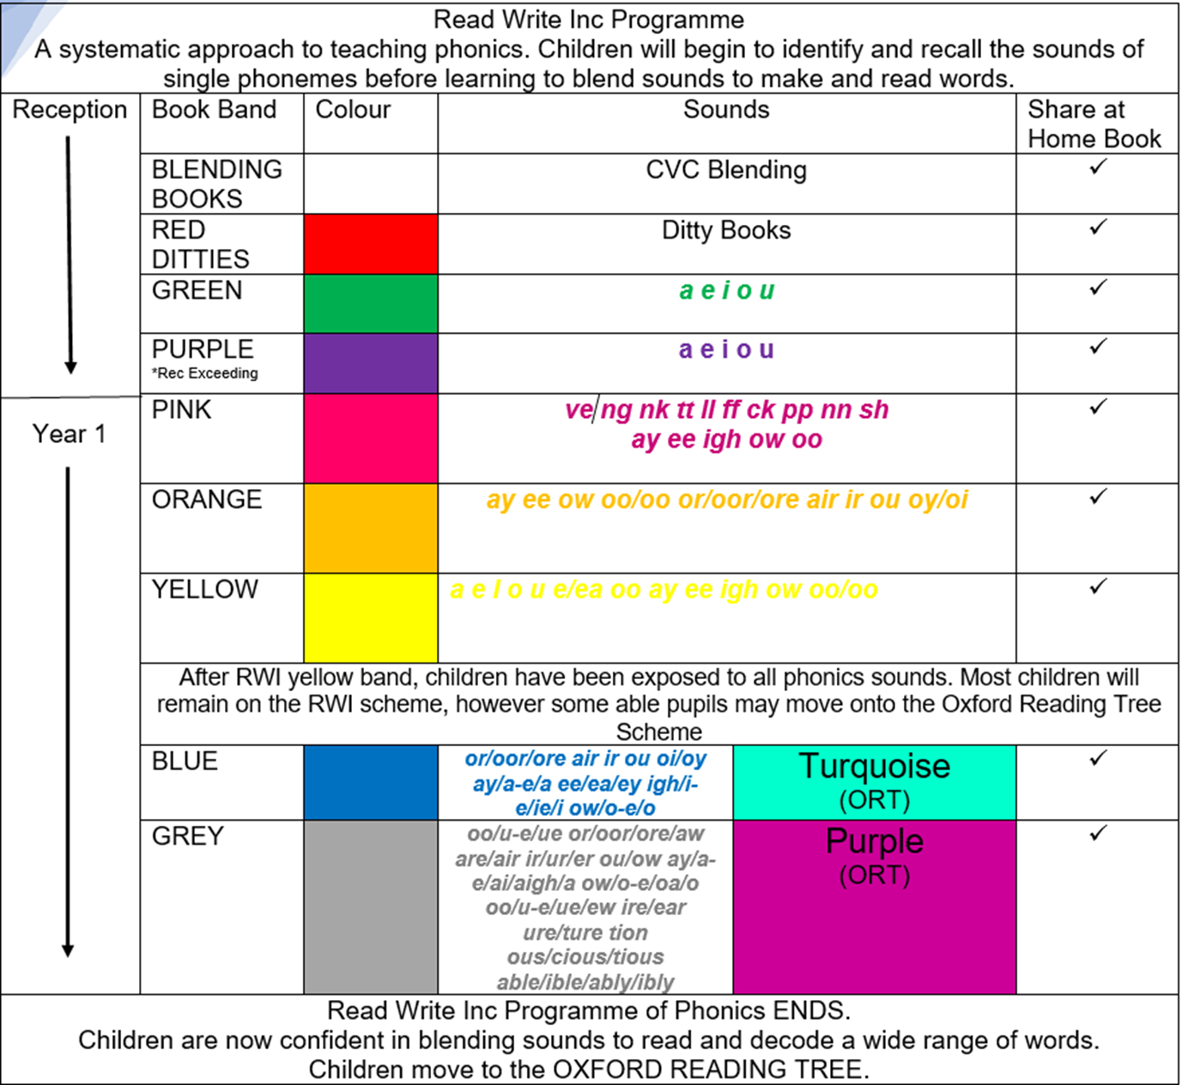
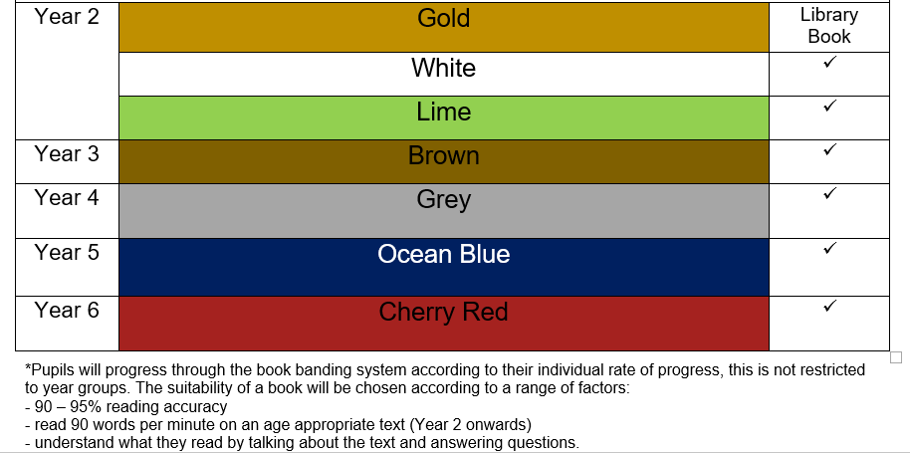
Reading

Slide 6
Reading Expectations at St. Joseph’s
We advise you read with your child every night and sign their reading diary (it is essential you read with them at least 3 times a week)
Bronze Reading awards (10 weeks where children have read at home at least three times in a week)
Silver (20 weeks)
Gold (30 weeks)
Reading for enjoyment (Rec + Y1 – share a story) (Y2 – Y6 library books)

Slide 7
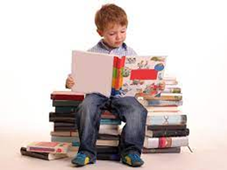

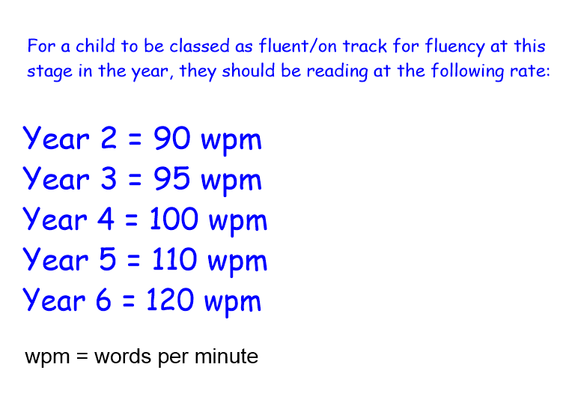
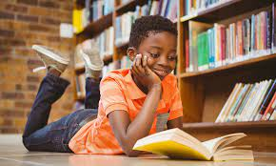
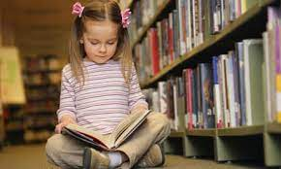
Fluent Readers
The ability to read a text at a comfortable pace, with accuracy and without hesitation.

Slide 8
How can I help my child become a fluent reader?
Read, Read, Read and Read again.The key to fluency is developing muscle memory for words, read with your child developing their familiarity with tricky words, phrases and vocabulary.
Model reading - read aloud to your child to provide them with a good example of fluent reading.
Find books that engage your child, reading should be interesting and if a book entertains your child they are more likely to persevere. One sentence of happy reading is worth more than a book of frustration.
Ask your child to follow their reading with a pen or finger. This is as children find decoding phases easier when they don’t lose their place as they read along with a piece of text.
Echo reading is a great strategy to try. Read the text aloud first, then have your child echo what you read afterwards.
Choral reading - reading together
Repeat - reread their favourite story or their favourite part of the book to develop confidence.

Slide 9




Novels this year

Slide 10

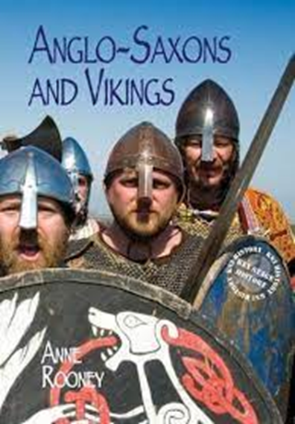
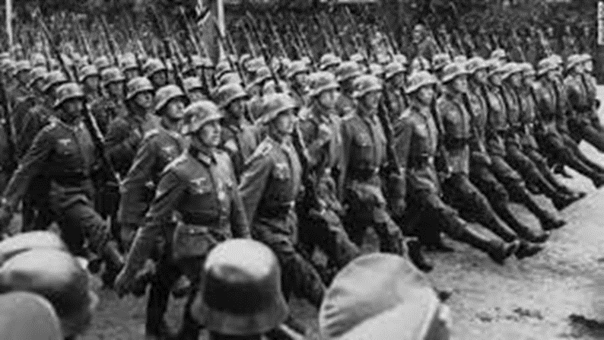
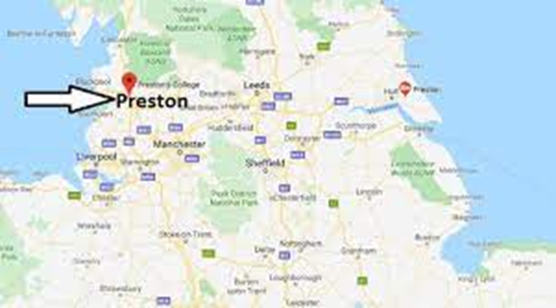

Our learning - Topic
National Study
WW2 and Preston at War

Slide 11
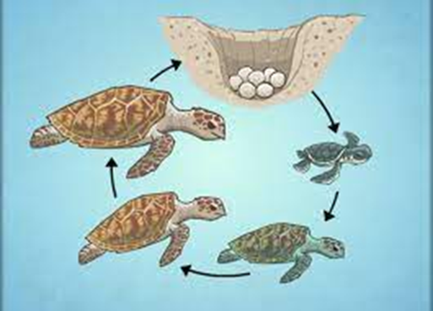



Our learning - Science

Slide 12
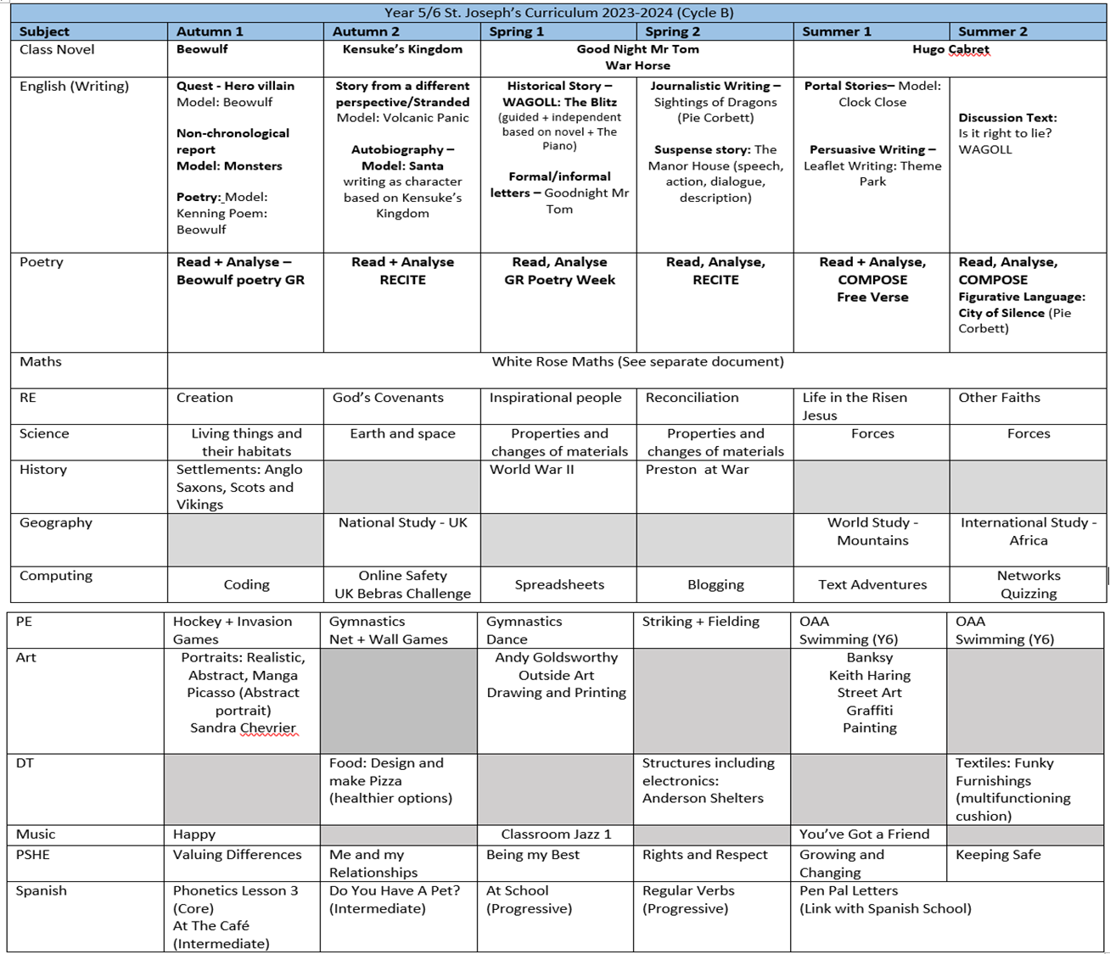

Slide 13

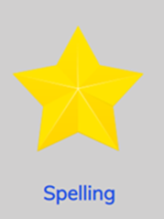
Homework is given out every Friday and is due back the following Wednesday.
Homework club will take place on a Wednesday lunchtime for children who are struggling with their homework.
Spellings are given out on a Friday and tested on
the following Friday. There is a spelling menu
on our class page to help with learning spellings.

Slide 14

P.E is every Monday morning with Miss Bell in the sports hall.
P.E kits should be kept in school and taken home at half term.

Slide 15
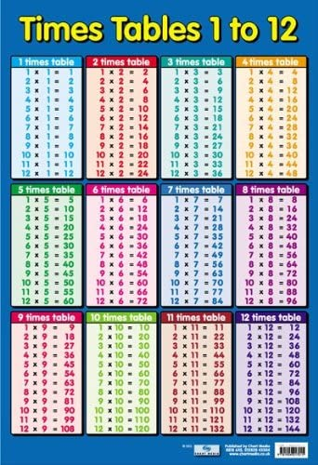


Times Tables

Slide 16
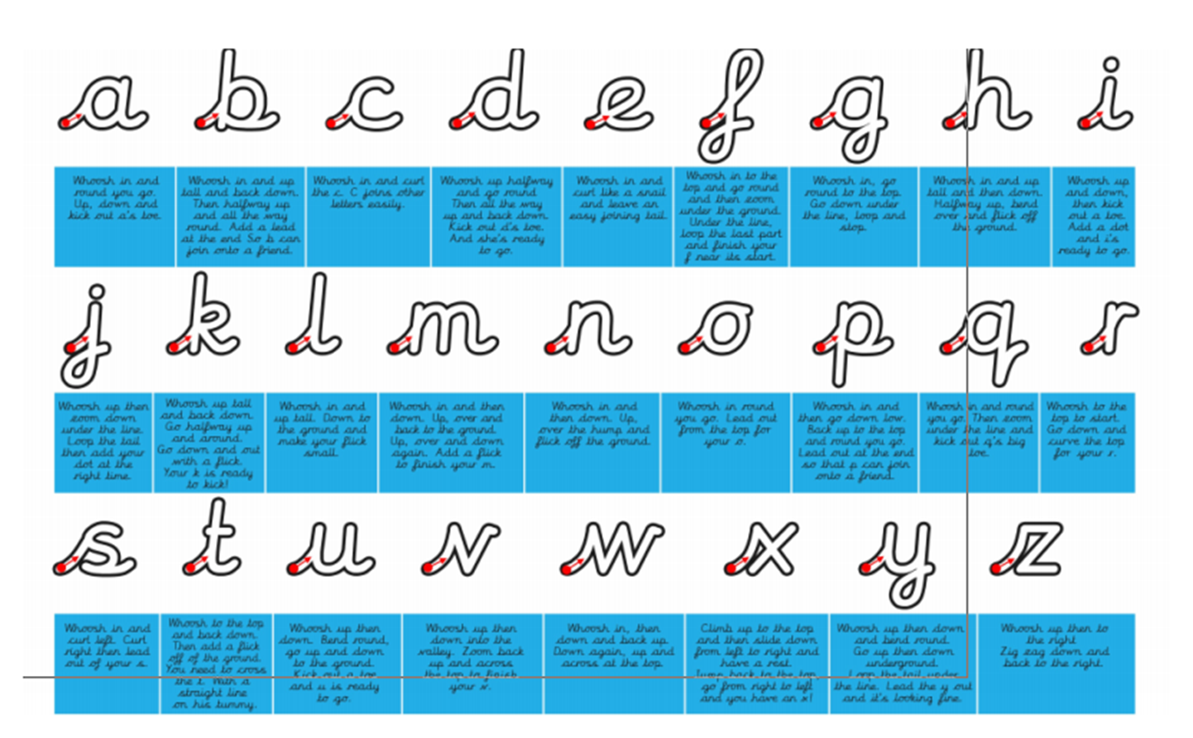
Handwriting

Slide 17
Key Dates
Family Bingo Night: 9th October
Autumn Disco: 23rd October
Cinema Trip: 19th November
Pantomime: 8th December
Parents Evening: 26th November
Carol Service: 16th December

Slide 18
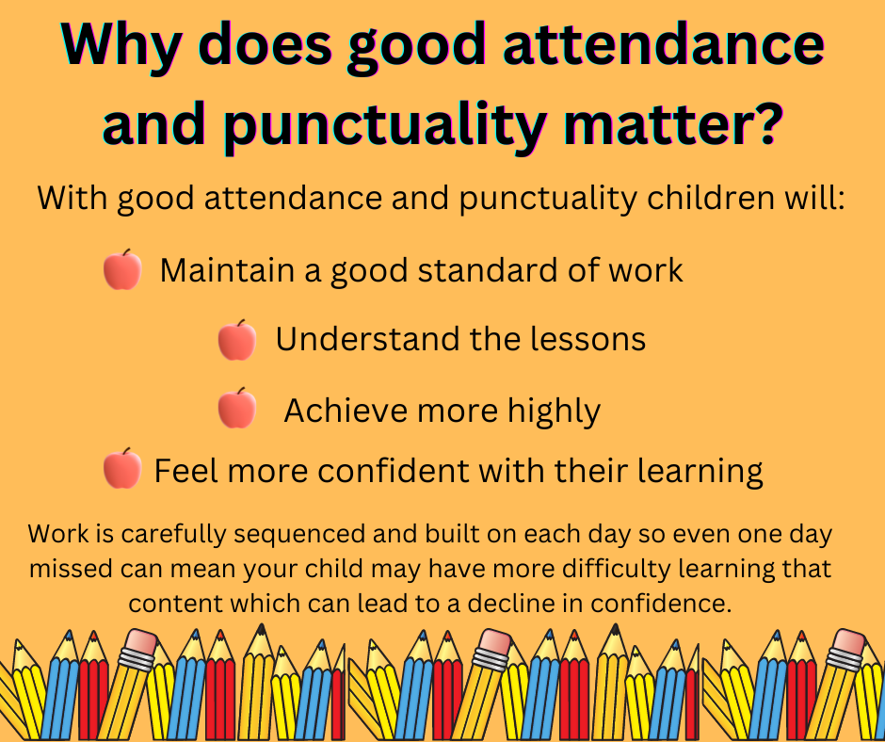
Attendance and Punctuality

Slide 19


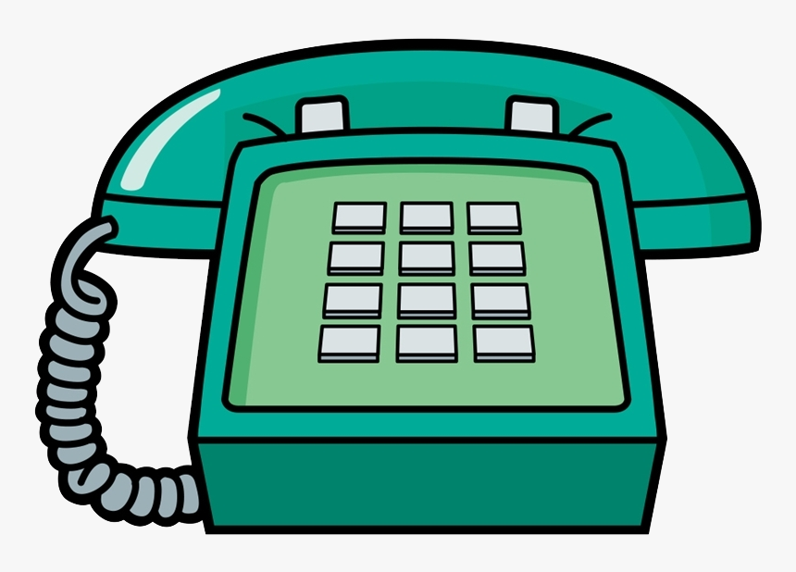
Communication

