Slide 1

Reception
Mrs Darbyshire & Miss Potter
Miss Walmsley & Miss Steele

Slide 2
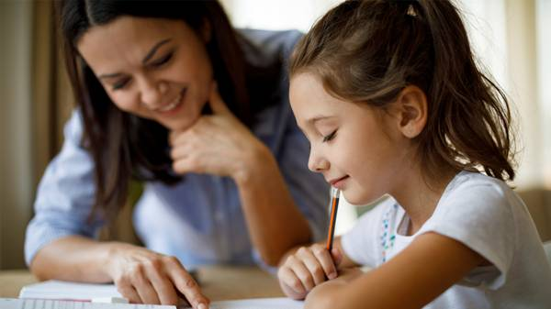
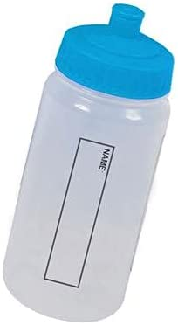

Parents information
Reading books should be brought to school everyday.
Your child can bring a water bottle into school with water only, no flavoured water or cordial juice.
Class Dojo is the main way of contacting your child’s teacher, please let me know if you do not have access to this.
Notes:
Have a homework
Reading record book

Slide 3
Information
Milk and fruit is provided. Cool milk will need to be paid for from the week after your child’s 5th birthday.
Please pick your reception child up at 3.15pm before older siblings.
Bring a coat everyday, as we play out in all weathers.
Earrings-only stud earrings are allowed and not to be worn on P.E. days
Please name all clothes especially coats and jumpers. It is important for P.E. as well as the children get changed so clothes get mixed up.

Slide 4

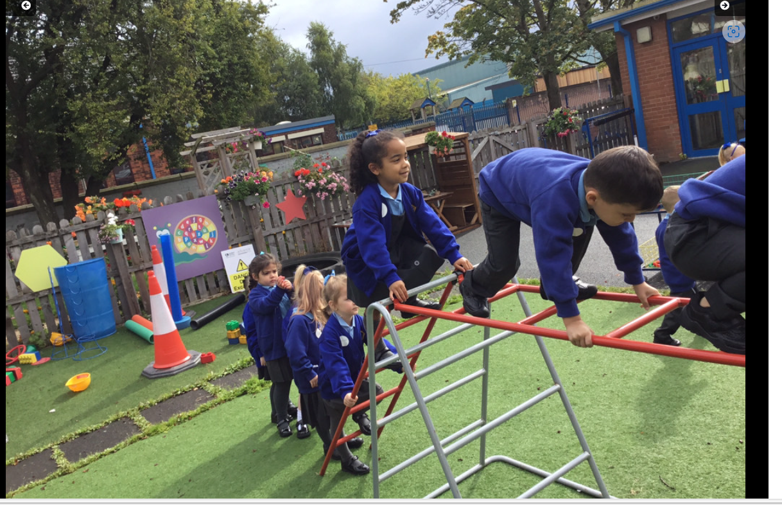

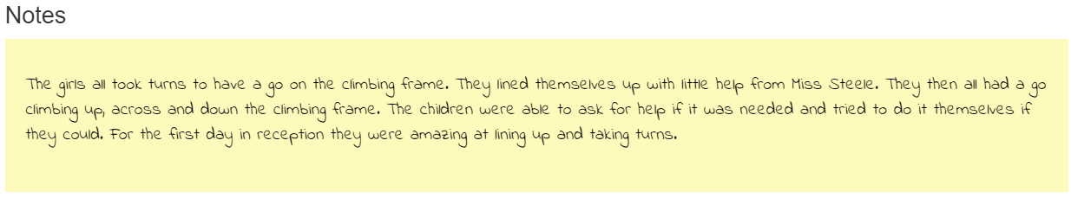

Slide 5

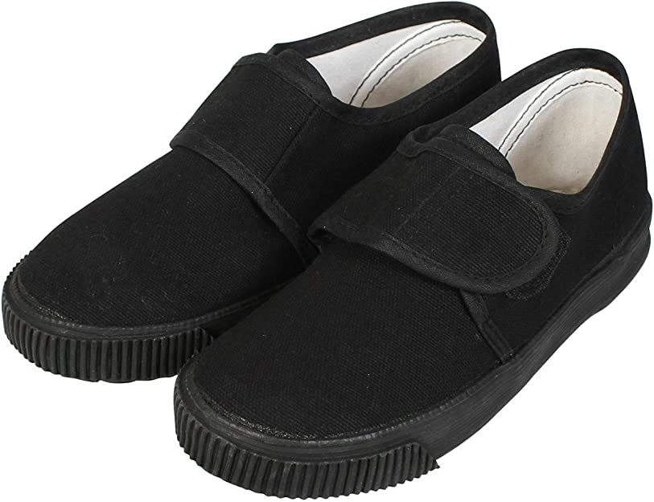
P.E.-Is on a Thursday
Black or navy blue shorts
Black PE pumps
Children need a coloured top for P.E. in their team colours.
Your child needs to practice getting dressed and undressed at home to help us with P.E.

Slide 6

Curriculum News
We are going to have a fabulous year learning about many interesting topics. I am sure the children will enjoy them.
Autumn Term –Who am I?
How do we celebrate?
Spring Term –Can you tell me a story?
What makes the natural world special?
Summer Term – What do you want to be when you grow up?
Who lives in the sea?

Slide 7
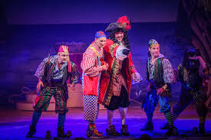
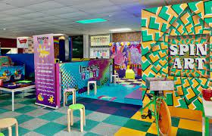
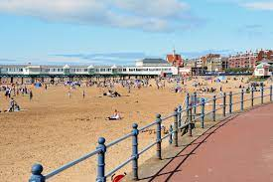

Trips
Cinema Trip-Autumn 2
Pantomime Trip-Autumn 2
Imagine That-Spring 2
Beach Trip-Summer 2

Slide 8

Reading
It is an expectation at St Joseph’s that the children read every night at home.
We also read in school with the children, at least three times a week.
Please read at least 2 pages of your child’s book with them every night.
We will be sending home 2 books. One phonics book and one library book, which is a sharing book.
New reading challenge-children have to read at home at least 3 times in a week to get their card signed. The children will get a prize after they get their card signed 10 times.

Slide 9
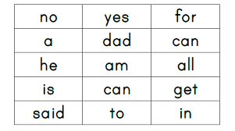
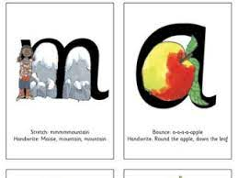
Sounds & key words
We will be sending home the sounds we are learning in school, once the children know all the sounds they will then get tricky words as well to practice.

Slide 10
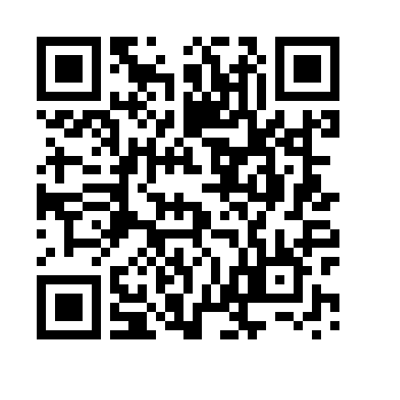
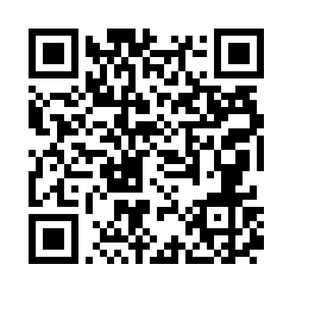
Fred Games – Fred’s Fridge
Set 1 Phonics - P
We will send a QR code home and display it on the window of EYFS for each new sound we teach.
Children can watch the sound to practice the sound we have learnt that day at home.
Parents can watch or let children watch and join in on their own.
The quicker they learn all the set 1 sounds the quicker your child will get a book with words.

Slide 11
Maths
Children will learn to read, write, count and match quantities to 10 and 20.
Children will learn 1 more/ 1 less than a number.
Add simple number sentences
Subtract simple number sentences
Count forwards and backwards
Recognise 2D shapes

Slide 12


Attendance and Punctuality
Attendance and punctuality is vital to aid your child’s learning.​
The children need to be at school every day and be here on time.
There are also various punctuality awards for the classes who are on time the most each term.
School starts at 8.45am and finishes at 3.15pm

Slide 13
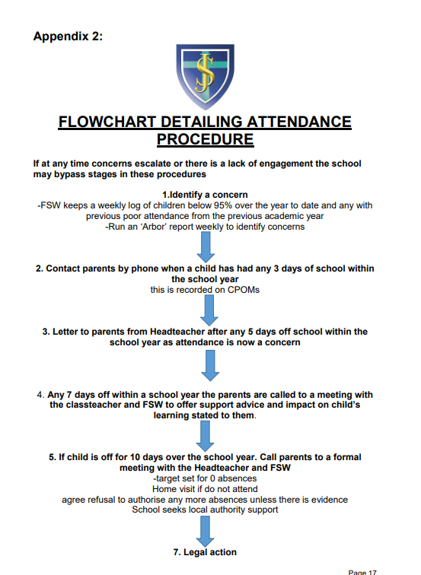

Slide 14
Additional Information
As previously discussed, the easiest and quickest way to contact your child’s teacher is on Class Dojo. If you have any further questions please send them to the class teacher on Class Dojo.
We will notify you of your child’s class and teacher by September 30th.
We are very excited for a fun year filled with lots of smiles and lots of learning!
Mrs Darbyshire & Miss Potter

Slide 15
Any Questions?

