Slide 1

Meet the Teacher
Mrs Newton
Class Teaching Assistant:
Miss Cole

Slide 2
Phonics/Guided Reading
Phonics scheme we use to teach the children is called: Read Write Inc
When the children are ready they will move away from phonics teaching onto guided reading.
Children have 40 minutes a day in their phonics/guided reading group.
Streamed to meet their current reading ability.

Slide 3
Support Your Child’s Reading
The best way to support your child is to read with them regularly- at least 3 times a week.
Children will bring home a reading book everyday.
Children still engaging in phonics will bring 2 books home.
You must read with your child at least 3 times a week and sign their reading diary.
Children can change their reading book once they have read it confidently with an adult.

Slide 4
Homework
Homework will be given out on a Friday and will be expected to be returned the following Wednesday.
The children will normally receive a piece of English or Maths. Please make sure your child completes this to the best of their ability and it is handed in on time.
Extra homework practice –Number bonds, counting in 2s,5s and 10s and reading each night.

Slide 5
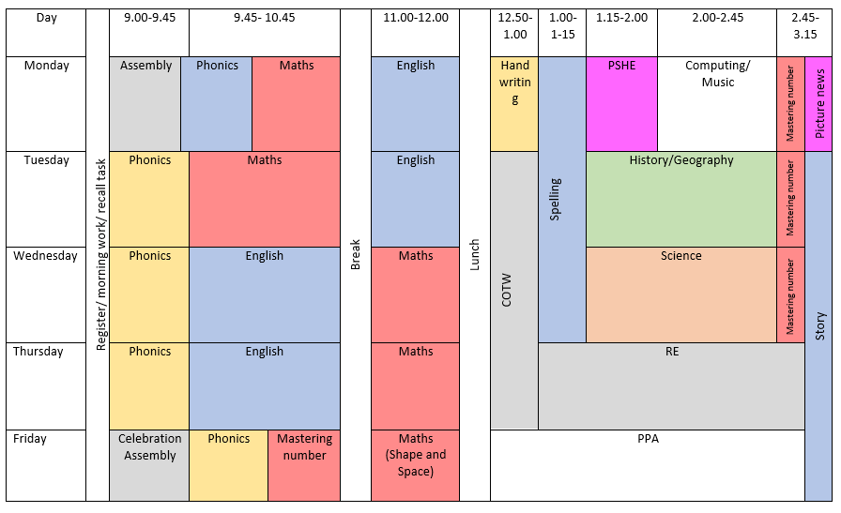
Timetable of the week

Slide 6
PE
Every Friday afternoon with Miss Bell
Children will need their full PE Kit in school to participate in lessons.
* Shorts
House Colour Top
Black Pumps
Please can all earrings be removed for P.E. lessons

Slide 7
Curriculum Information
Autumn Term 1- Coasts and Local area study
Enrichment: Local walk, Life Education Visit
Autumn Term 2- Castles and the Royal Family
Enrichment Visitor: Bug Man visit to school.
Christmas Nativity Show, Cinema and Pantomime

Slide 8
Curriculum Information
Spring Term 1-Continents and Oceans
Enrichment:, Poetry Challenge
Spring Term 2- Flights through time
Enrichment- Visit to a Castle
Summer Term 1- A study of a different country (China)
Enrichment- sports day
Summer term 2- Victorian Seaside Holidays
Enrichment: Visit to Fleetwood Museum.

Slide 9
Science Curriculum Information
Autumn Term- Animals (including Humans)
Spring Term- Materials and their Properties
Summer Term- Plants

Slide 10

Reading
At St. Joseph’s we believe that reading is the key to success and in order to achieve this, we need TEAMWORK. It is vital we work together so every child leaves primary school as a fluent reader.
Please read with your child every night for at least 10 minutes and sign the reading diary.

Slide 11
Lunches, Snacks and Water
Your child is entitled to a free dinner – If they wish to change their mind from packed lunch all they need to do is let me know when I do the dinner register in the morning.
All children will get a piece of fruit at play time.
Please can children bring their own named water bottles in-please can this just be water and not juice.
Sign up for milk through cool milk website. https://www.coolmilk.com/

Slide 12
Rewards and Sanctions
Everybody at St Joseph’s believes in praising
positive behaviour and hard work!
House points
Parent dojo set up.
Stickers
Star of the day

Slide 13
Rewards and Sanctions
Traffic light system
Verbal warning
Name put on amber
Name on red
Child will spend time in another classroom for a short time.
Loosing all or some of playtime
Letters and chats with parents if happens three times.

Slide 14
Attendance
Attendance and punctuality is vital to aid your child’s learning at school.
They need to be at school on time at 8:50a.m.
If they miss days or even a few minutes this has a detrimental effect as they find it difficult to catch up.
It also has a negative impact on the other children in the class as it becomes a distraction if your child walks into the class late.

Slide 15
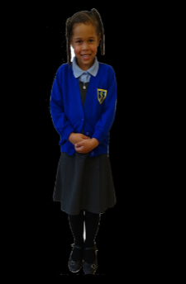
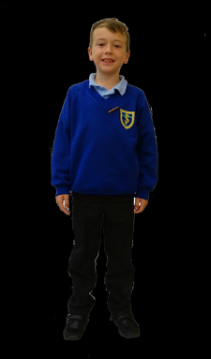
Uniform
The school uniform gives our children a sense of shared identity and helps them look smart and tidy. The uniform consists of:
Blue school sweat shirt with logo (They can be purchased from the uniform shop)
Pale blue polo shirt (These can be purchased from any shop – the supermarkets are usually good value for money.)
Grey school trousers, skirt or pinafore dress (Can be purchased from any shop.)
Grey socks – boys, grey or white socks or tights – girls
Black school shoes
Children who do not wear the correct school shoes will be provided with a pair of black PE pumps to change into during the school day

Slide 16

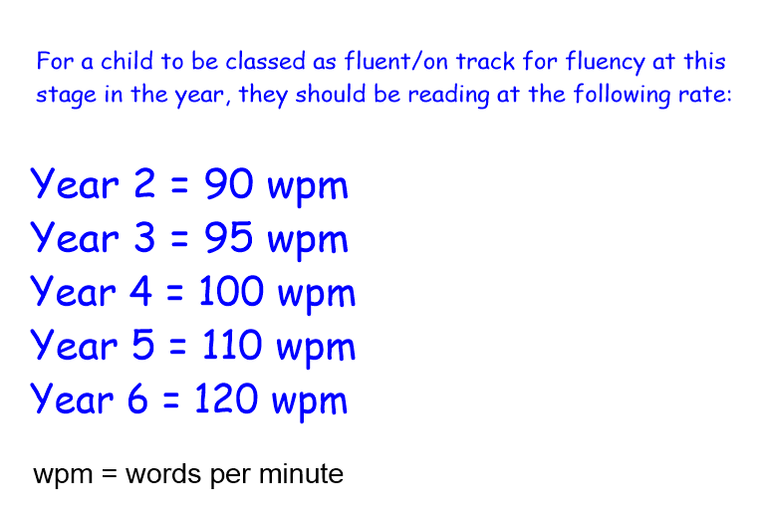


Slide 17
If you have any questions, I am always around at the end of the school day or you can contact me by using Class Dojo.

