Slide 1
Meet the Teacher
Year 1A
Teacher: Mrs Barraclough
Teaching Assistant: Mrs Majeed

Slide 2
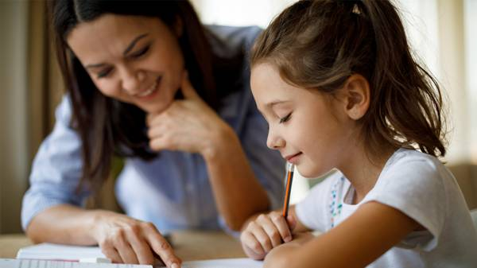
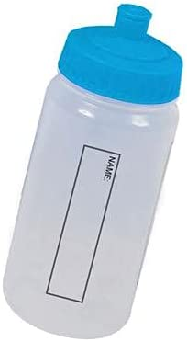

Parents information
Homework is sent home every Friday and should be returned by the Wednesday of the following week.
Your child can bring a water bottle into school with water only, no flavoured water or cordial juice.
Class Dojo is the main way of contacting your child’s teacher, please let me know if you do not have access to this.
Children must bring in a change of clothes for after school clubs. If you sign up for an after school club you will receive a slip to say that you child has been selected to attend.
Notes:
Have a homework
Reading record book

Slide 3
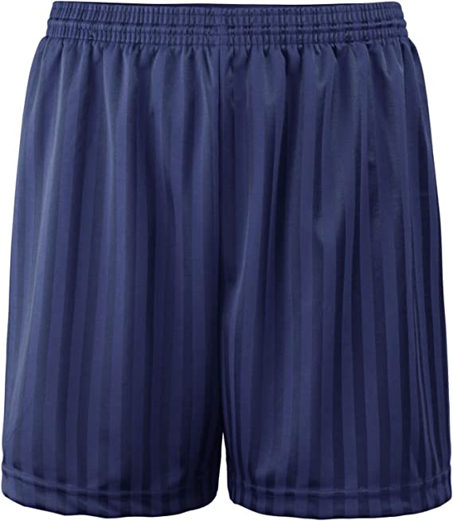
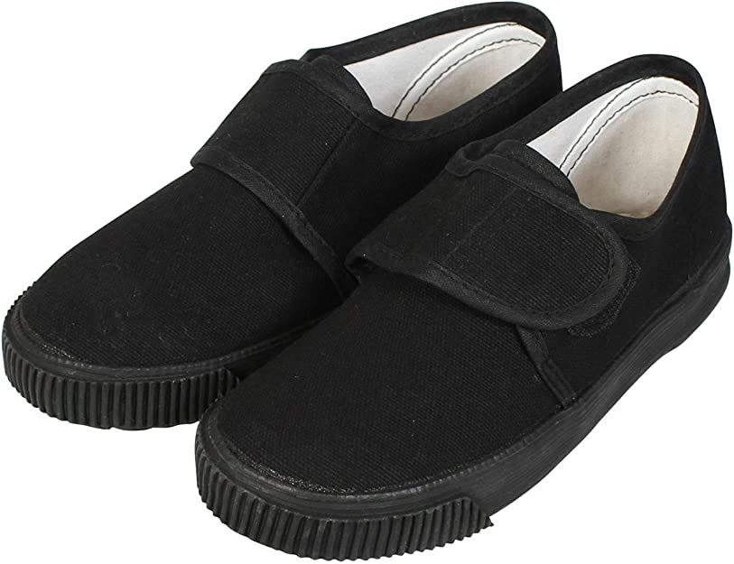
P.E.-Is on a monday
All children should have a bag containing their PE kit. This should be kept in school during the term. It can come home at half-term for washing. The PE kit requirements are shown below:
house coloured T-shirt- available from Bang Bang
Black or navy blue shorts
Black PE pumps

Slide 4
Topics
In Year 1 we learn about lots of different things! Our topics for this year are:
Autumn 1 – Our school and our local area
Autumn 2 – The Great Fire of London
Spring 1- Around the World-Hot and Cold Countries
Spring 2- Toys
Summer 1 – The UK
Summer 2 – Florence Nightingale

Slide 5
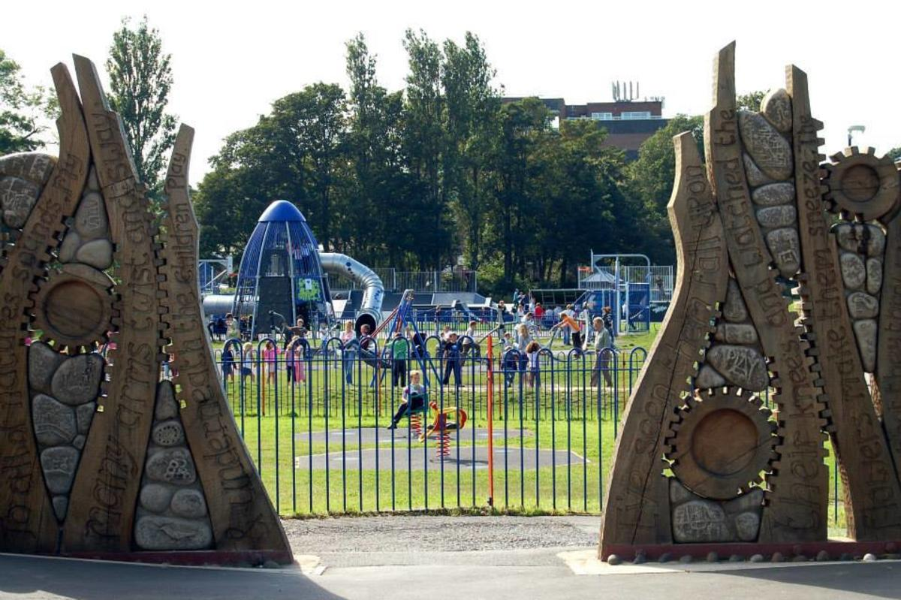


Trips
Throughout the year we will be going on different trips and we will also have some visitors in school. These are all linked to our curriculum.
Autumn- Cinema and Pantomime Spring – Martin Mere

Slide 6

Reading
It is an expectation at St Joseph’s that the children read every night at home.
We also read in school with the children, at least three times a week.
Please read at least 2 pages of your child’s book with them every night.
We will be sending home 2 Read Write Inc. books-one which they have already read in school to
develop fluency with reading and another at the same level which is a home reading book. These books will
both be linked to the phonic sounds that they are learning in school.
New reading challenge-children have to read at home at least 3 times in a week to go up the beanstalk
The children will get a prize after they have moved up the beanstalk 10 times.

Slide 7
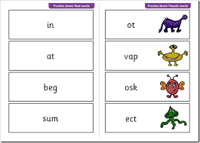
Phonics
On the week commencing 8th June 2026, the year 1 children will be tested on their phonics skills. This is done with a familiar adult to check their recognition of sounds and their ability to read words.

Slide 8
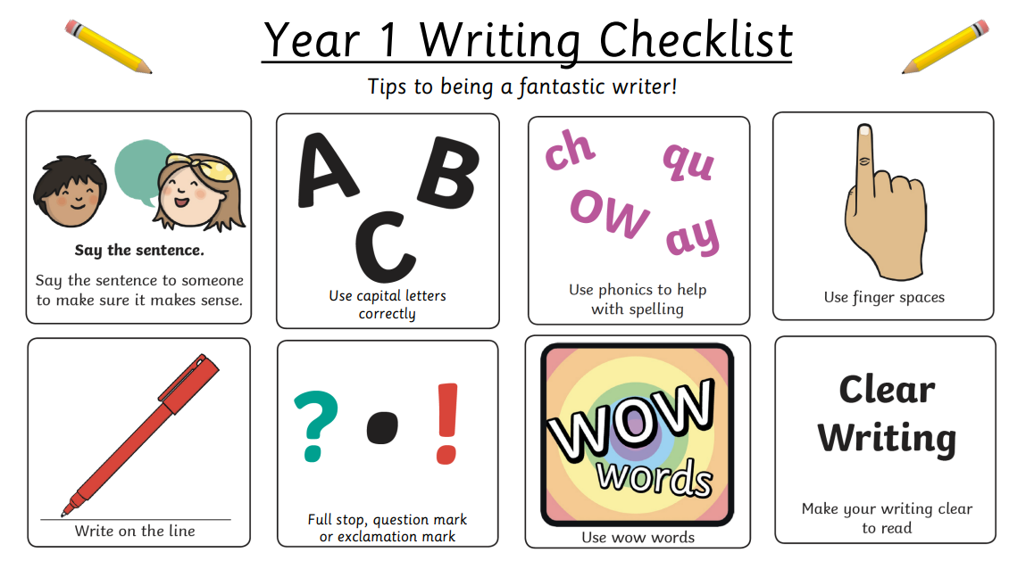

writing
In year 1-we work hard with our handwriting and presentation of work.
We work on writing sentences with details adding adjectives,
conjunctions and verbs.
We learn to spell common exception words
correctly.

Slide 9
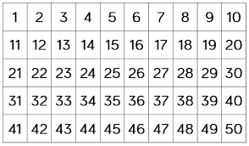
Maths
By the end of year 1-we work with numbers up to 100. We have to be able write the numbers and make the different numbers.
We add and subtract with numbers up to 20.
We learn to write the words for the number names up to 20.
www.topmarks.co.uk
www.ictgames.com

Slide 10


Attendance and Punctuality
Attendance and punctuality is vital to aid your child’s learning.​
The children need to be at school every day and be here on time.
The doors open at 8.40 and the register is done by 8.50, after this time your child
will get a late mark.
There are also various punctuality awards for the classes who are on time.
Please ensure that you contact the school office if you child is ill and unable to attend school.

Slide 11
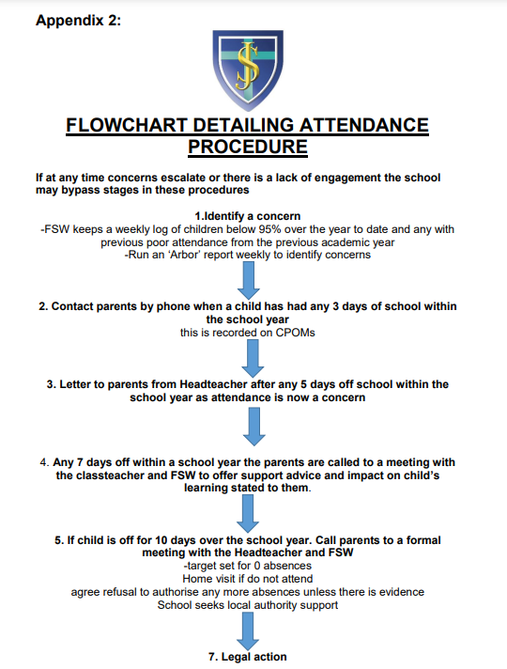

Slide 12
How can you help?
Read with your child every night.
Help with their homework
Send P.E. kit in ready for Monday.

Slide 13
Additional Information
As previously discussed, the easiest and quickest way to contact your child’s teacher is on Class Dojo. If you have any further questions please send them to the class teacher on Class Dojo.
We are very excited for a fun year filled with lots of smiles and lots of learning!
Mrs Barraclough & Mrs Majeed

