Slide 1

Year 3B
Mr Wignall and Mrs Beg

Slide 2

Rules of the Classroom
Classroom rules were created together with the children.
We have high expectations of everyone.
We believe that calm classroom is a productive classroom.

Slide 3
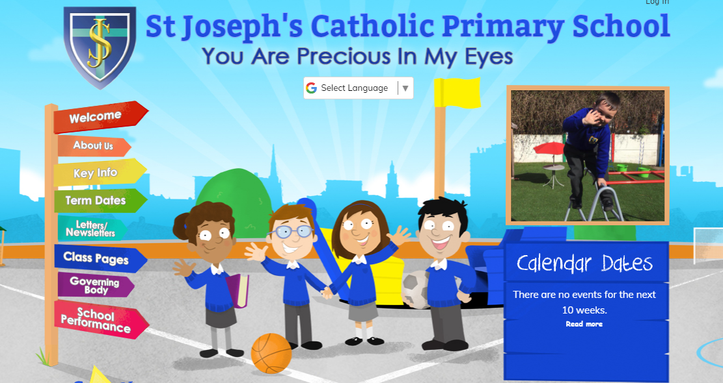
Keeping Up to Date

Slide 4


Slide 5
Curriculum News
We are going to have a fabulous year learning about many interesting topics. We are sure the children will enjoy them. We will also be going on trips throughout the year.
Autumn Term – The Great Stone Age & Village Settlers
Rocks, soils and fossils & Forces and magnets
Spring Term – The Romans & Our European neighbours
Animals – skeleton and movement & Light and shadows
Summer Term – Preston on the move & Climate zones
Plants & Health and Nutrition

Slide 6
English
This year our focus is on Reading. Please read with your child every night even for just 5 -10 minutes and remember to sign their ‘Reading Record Book’. With just this little bit of support it will do wonders in helping your child’s learning.

Slide 7


Slide 8


Slide 9
Maths
Knowledge of the times tables are a useful tool to learn as in Year 4 they will have to complete a Statutory Multiplication Tables Check.
Once mastered they will be able to apply and use this skill across other aspects of maths.
Each morning as a starter the children will answer a quick quiz so please practice with them.

Slide 10
Homework
Every Friday homework will be given out and expected to be returned by the following Wednesday at the latest.
The homework set will usually be based on the work covered by your child in the week, so it will be not be something new for your child.
We will be available at break times to help explain again if there are any misunderstandings.

Slide 11
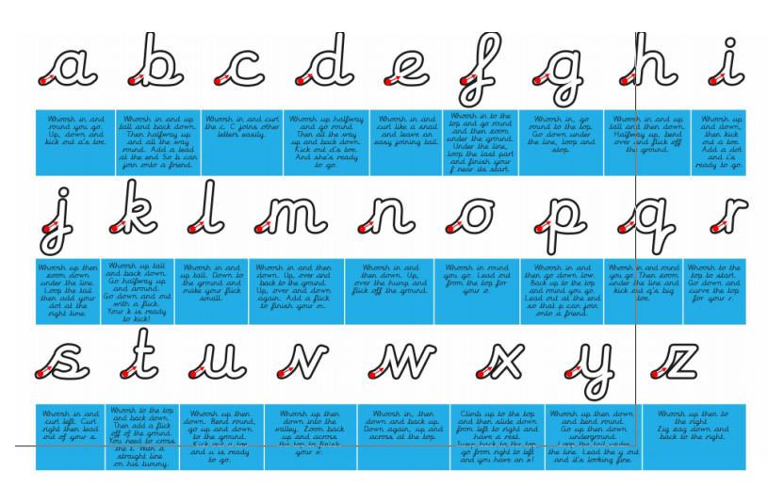
Handwriting

Slide 12
P.E. Kit & After School Club
In Year 3 during the Autumn Term they will have PE on a Thursday PM. A full P.E. uniform is a requirement in order to participate. It consists of their house t-shirt, black shorts and black pumps. Year 3 will also be swimming this year.
If your child belongs to an after school sports club an additional sportswear needs to be brought to school on that day. This prevents the P.E. kit being left at home as the P.E. kit can then remain in school for the duration of the school term.

Slide 13



Rewards and Sanctions
Team Points

Slide 14
Rewards & Sanctions
Class dojo points are given out for wonderful work, great manners and good behaviour.
All classes use the traffic light system for behaviour. This resets at lunchtime and at the start of every day.
Detentions are infrequent and usually issued only in serious situations.
If something is bothering your child at school, please encourage them to speak to a trusted adult.

Slide 15



Inside a Lunch Box
If you are sending in a packed lunch for your child, can you please consider healthy options. (eg: sandwich, piece of fruit, vegetables, yoghurt, healthy snacks and a low sugar drink). NO fizzy drinks are allowed.

Slide 16
Birthdays
As we are a Healthy School we cannot allow sweets and cakes to be brought into school for your child’s birthday. This might appear to be unfair or unreasonable but if each child was to do this for their birthdays – that would be 23 times the children will be taking /eating sweets and cakes.

Slide 17
Attendance & Punctuality
Attendance and punctuality is vital to aid your child’s learning at school.
They need to be at school on time at 8:45a.m.
If they miss days or even a few minutes this has a detrimental effect as they find it difficult to catch up.
It also has a negative impact on the other children in the class as it becomes a distraction if your child walks into the class late.

Slide 18
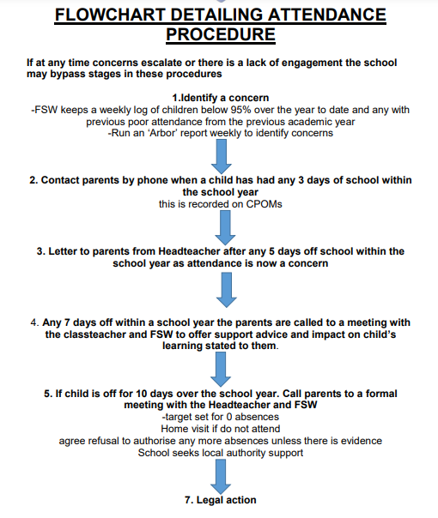

Slide 19
Any Questions ?

