Slide 1
Welcome to Year 4B!
Teacher: Miss Heys
Teaching Assistant: Miss Lowe

Slide 2
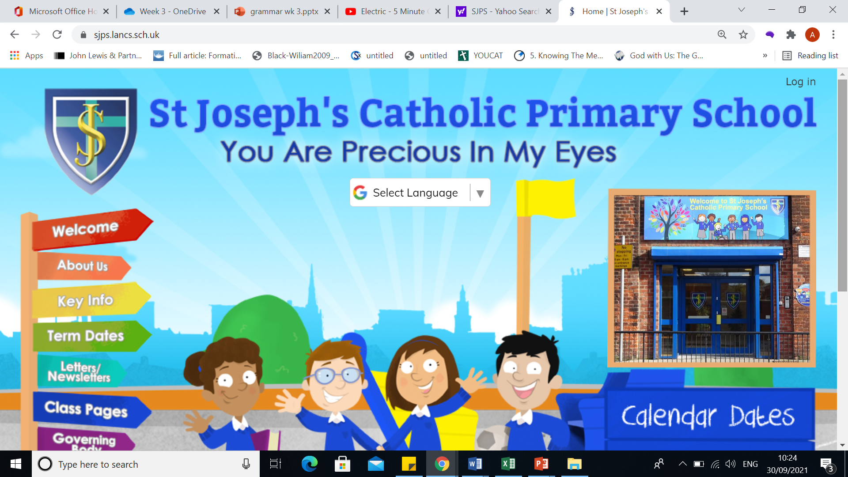
How to keep up to date:

Slide 3

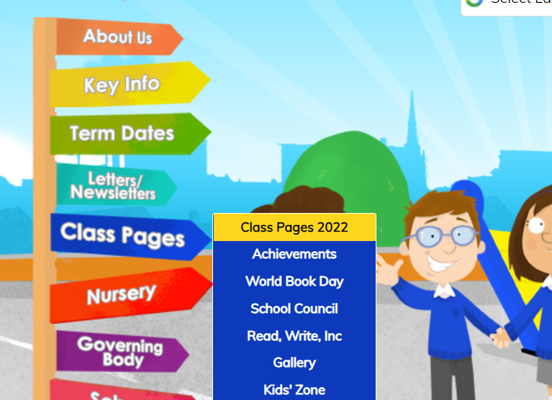
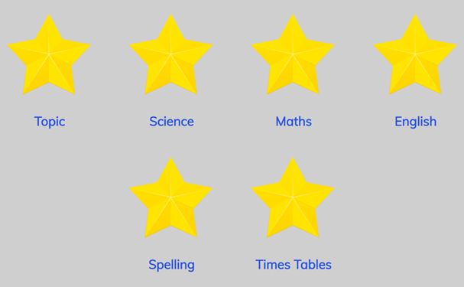

Slide 4


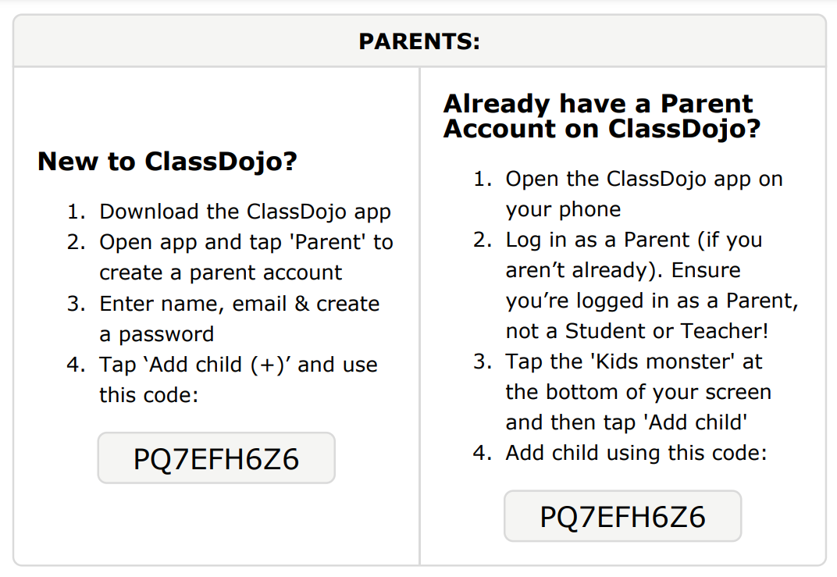
Download the Dojo app:

Slide 5
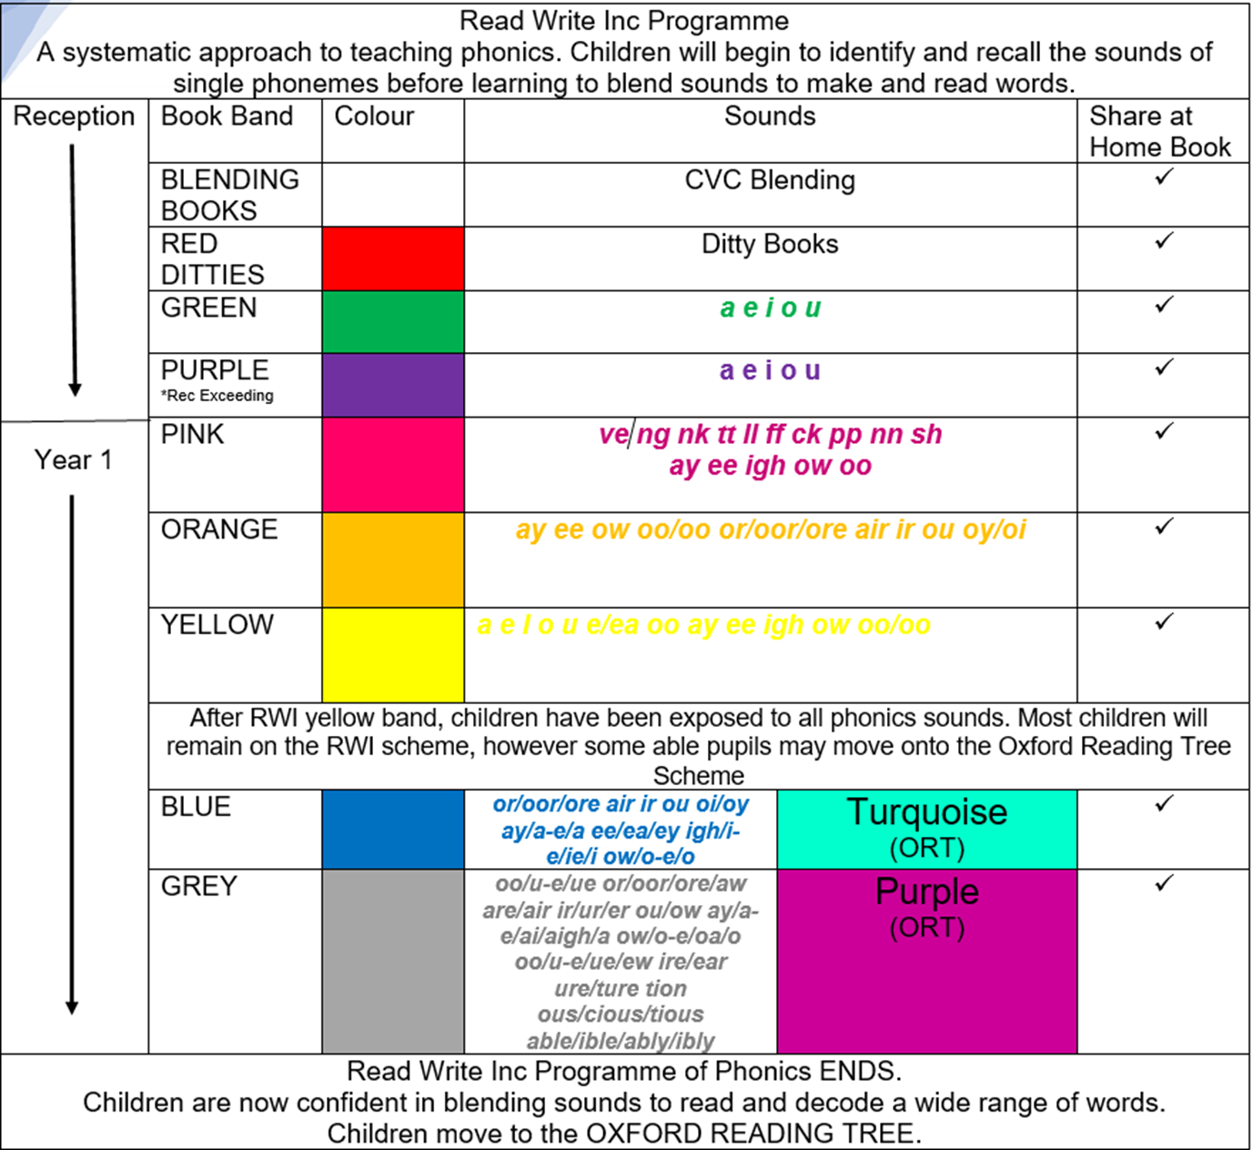

Reading

Slide 6
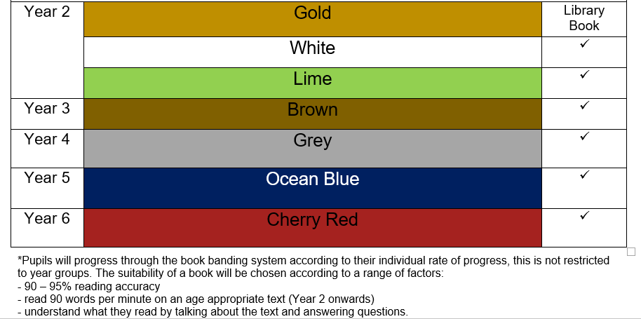

Slide 7
Reading expectations at St Joseph’s
We advise you read with your child every night and sign their reading diary (it is essential you read with them at least 3 times a week)
Bronze Reading awards (10 weeks where children have read at home at least three times in a week)
Silver (20 weeks)
Gold (30 weeks)
Reading for enjoyment (Rec + Y1 - share a story) (Y2 - Y6 library books)

Slide 8
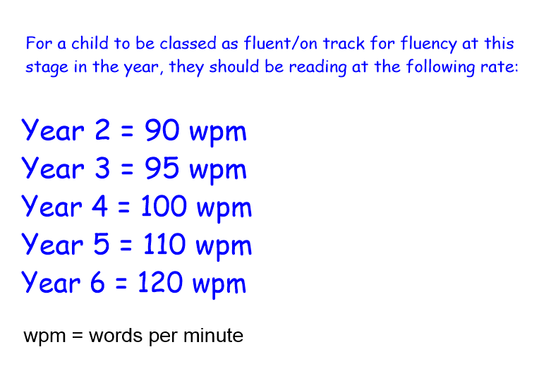
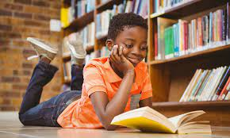
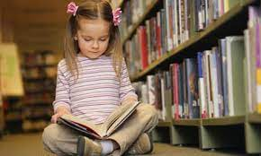
Fluent Readers
The ability to read a text at a comfortable pace, with accuracy and without hesitation.

Slide 9
How can I help my child become
a fluent reader?
Read, Read, Read and Read again. The key to fluency is developing muscle memory for words, read with your child developing their familiarity with tricky words, phrases and vocabulary.
Model reading – read aloud to your child to provide them with a good example of fluent reading.
Find books that engage your child, reading should be interesting and if a book entertains your child they are more likely to persevere. One sentence of happy reading is worth more than a book of frustration.
Ask your child to follow their reading with a pen or finger. This is as children find decoding phases easier when they don’t lose their place as they read along with a piece of text.
Echo reading is a great strategy to try. Read the text aloud first, then have your child echo what you read afterwards.
Choral reading – reading together
Repeat – reread their favourite story or their favourite part of the book to develop confidence.

Slide 10






Novels this year

Slide 11
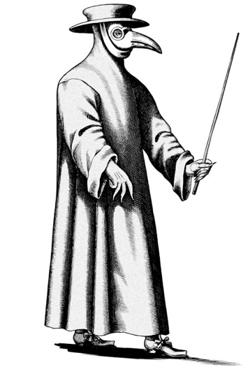
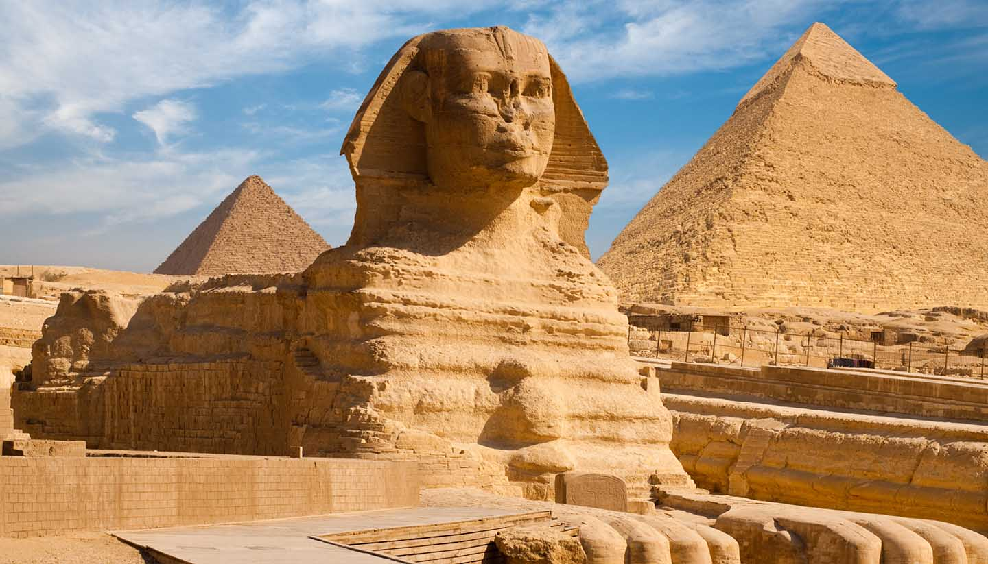
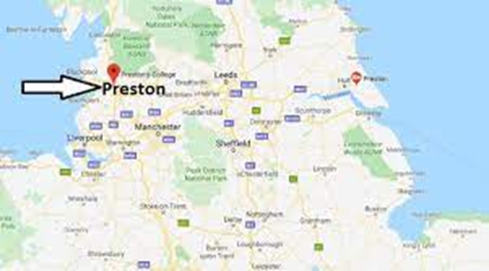
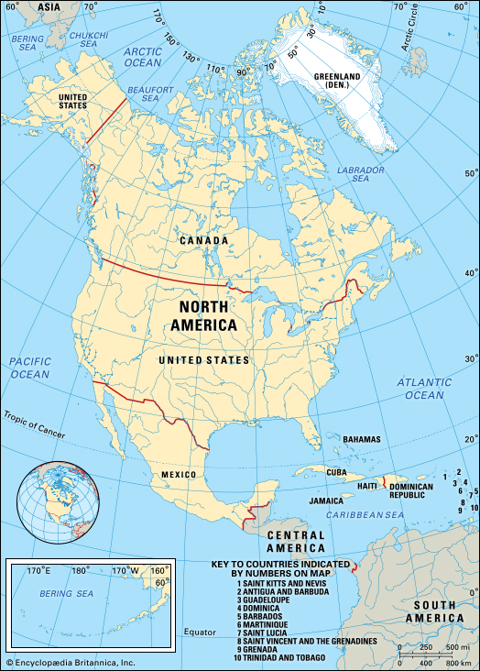

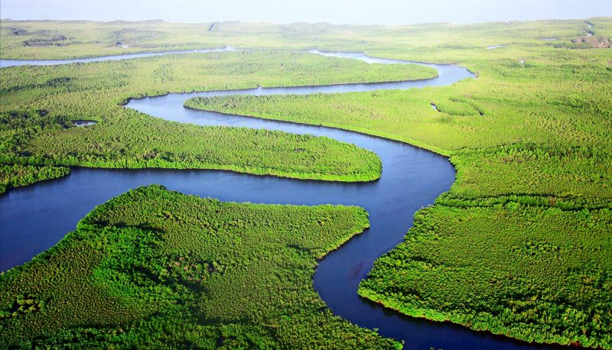
Our learning - Topic

Slide 12
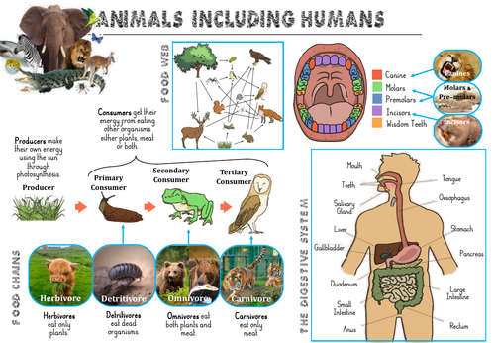

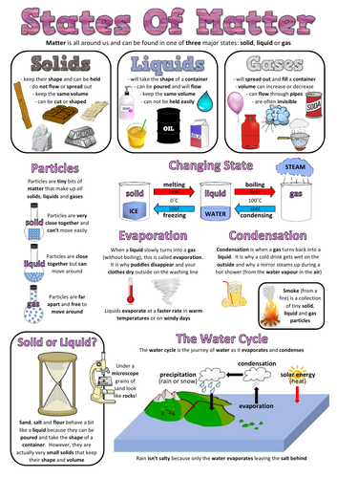
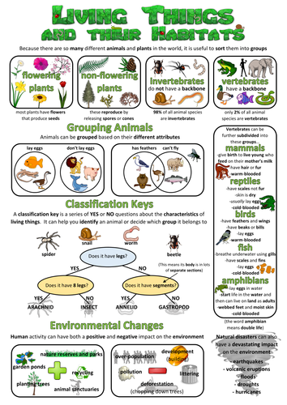

Our learning - Science

Slide 13

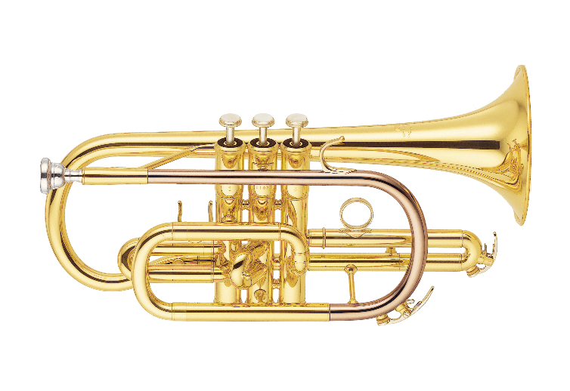
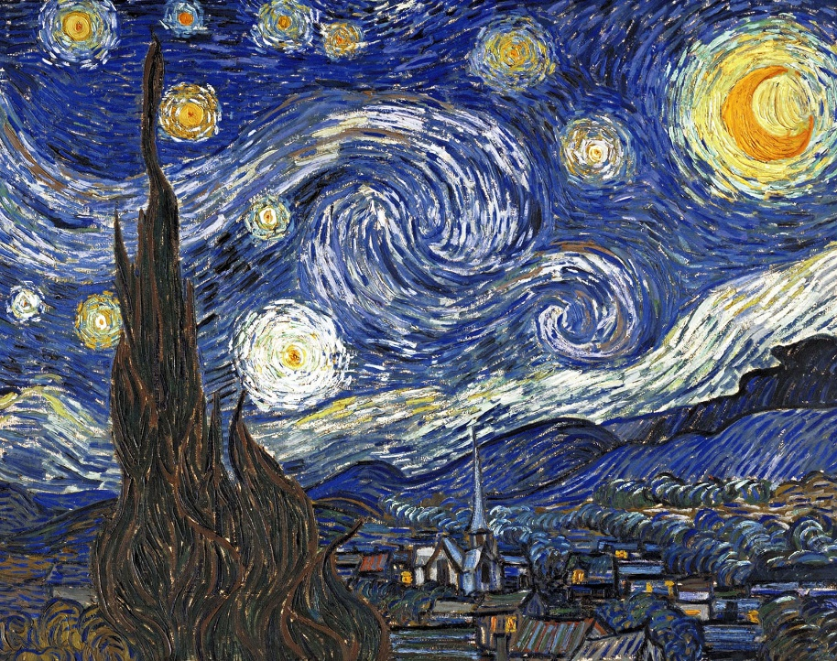

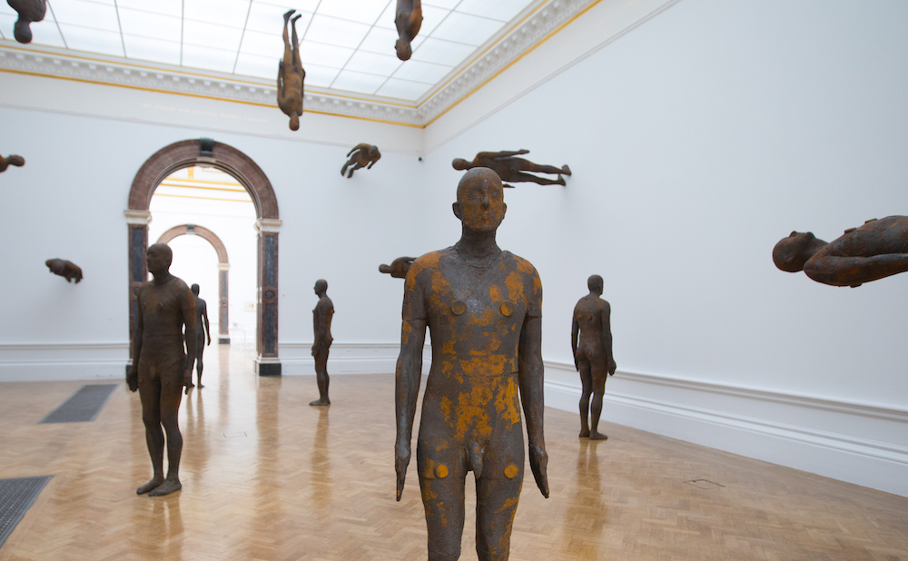
Our learning
Antony Gormley
Vincent van Gogh
Alma Thomas

Slide 14

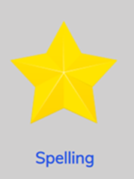
Homework is given out every Friday and is due back the following Wednesday.
Homework club will take place on a Wednesday lunchtime for children who are struggling with their homework.
Spellings are given out on a Friday and tested on
the following Friday. There is a spelling menu
on our class page to help with learning spellings.

Slide 15


The children are swimming this term, they will need their swimming kits each Thursday.
P.E will begin after Christmas on a Thursday afternoon with Miss Bell in the sports hall.
P.E kits should be kept in school and taken home at half term.

Slide 16
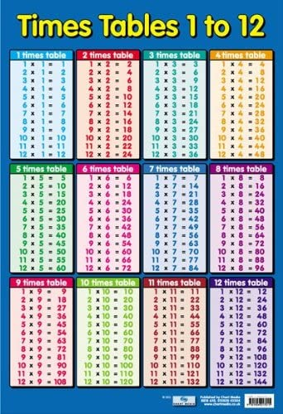

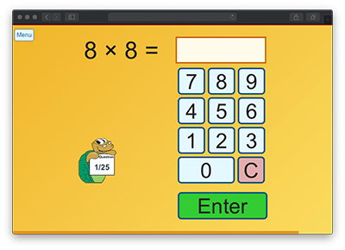
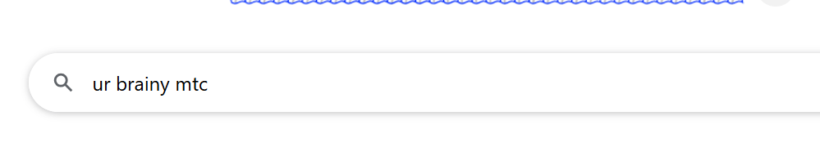
Times Tables

Slide 17
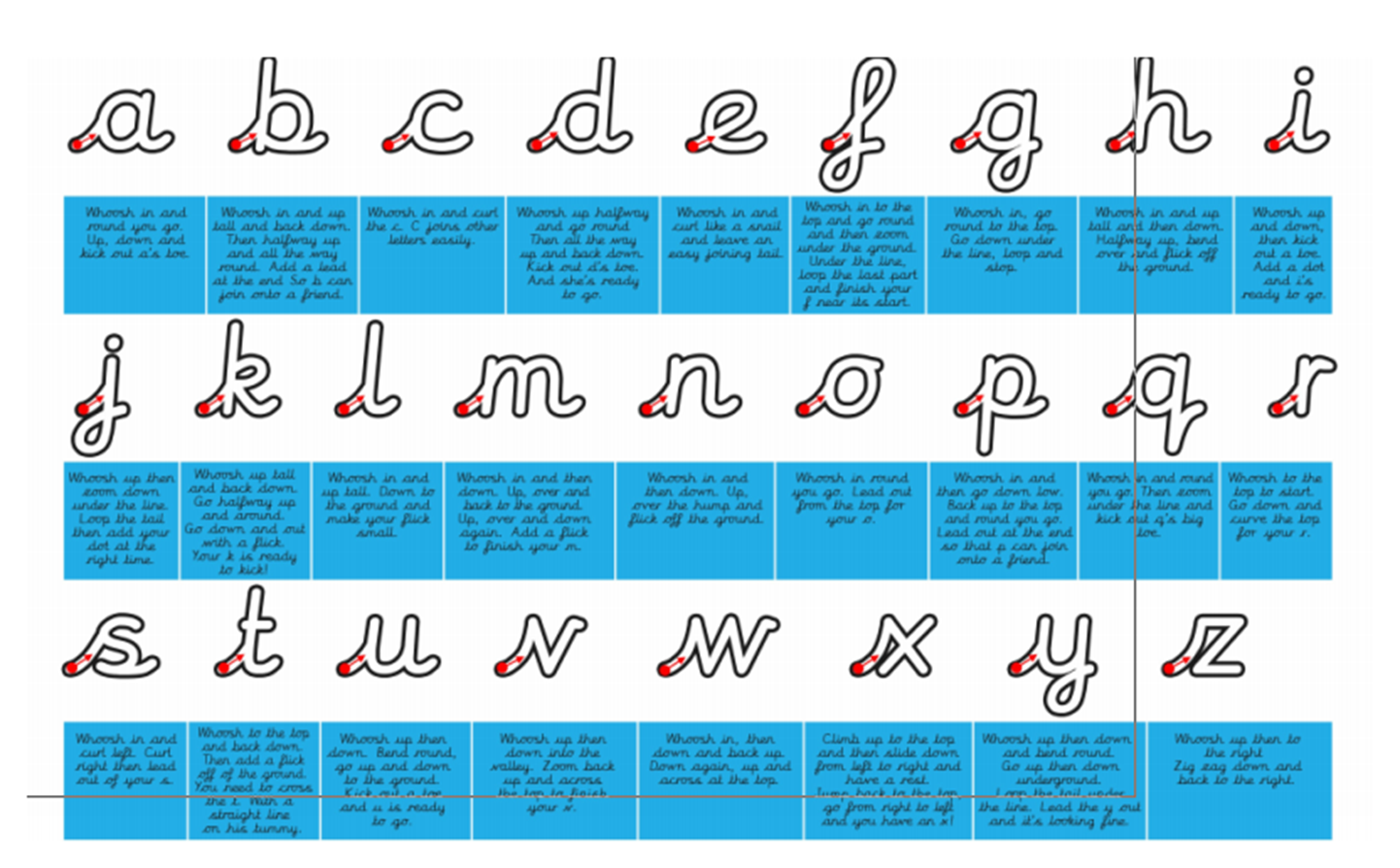
Handwriting

Slide 18
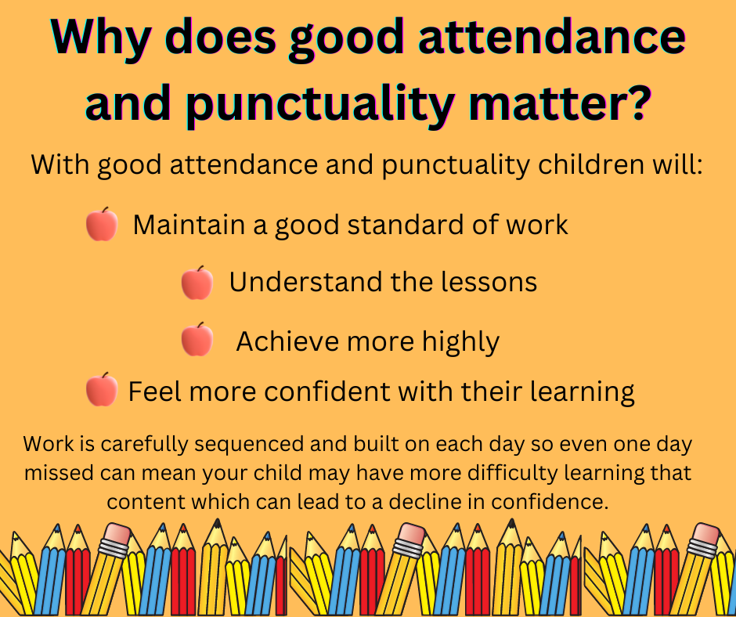
Attendance and Punctuality
Attendance should be at least 97% - this is equal to 6 days off throughout the whole of the school year!
All absences need to contact the office!

Slide 19


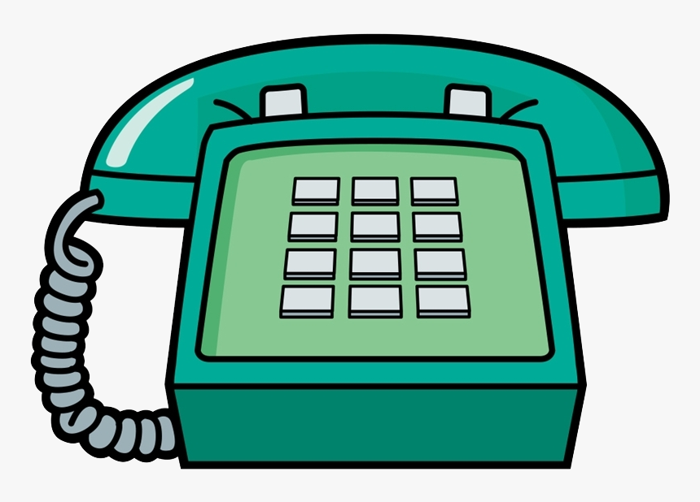
Communication

Slide 20
