Slide 1
33rd Sunday in Ordinary Time
Monday 13th November 2023

Slide 2
My question to you from last week…
How can we be ready?

Slide 3
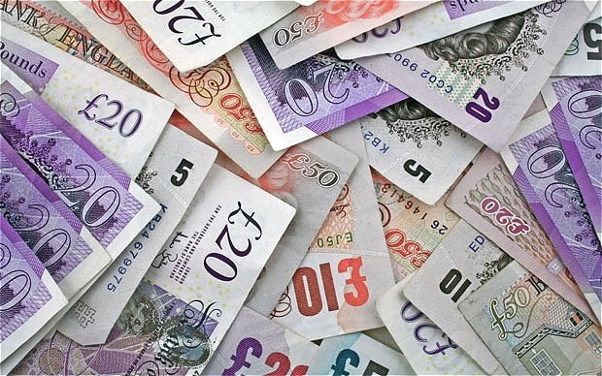
Matthew 25:14-30

Slide 4
What do you think about this parable?
I always struggled with this parable until I started teaching.

Slide 5
Our gifts, or talents, are given to us for the service of others.
Therefore, if we don’t use our gifts wisely, we won’t be rewarded.

Slide 6
However, if we celebrate and use our God given talents, then we will be rewarded.

Slide 7
We have to remember that our faith is not something that is passive. Our faith needs to be shown actively.

Slide 8
For next week - My question to you…
How can we show our faith actively?

Slide 9
Stay awake xx, be ready xx. You do not know the hour when the Lord is coming.
Stay awake xx, be ready xx. The Lord is coming soon!
Alleluia, alleluia! The Lord is coming soon! xxx Change your lives, he’s coming.
The one who will baptise with the Holy Spirit.
Change your lives, he’s coming. The Lord is coming soon!
Go back, tell John
All that you have heard and seen me doing.
Go back, tell John The wonders that you see!

Slide 10
November prayer
Eternal rest grant unto them , O Lord,
and let perpetual light shine upon them.
May the souls of the faithful departed, through the mercy of God, rest in peace.
Amen

