Slide 1
Christ the King
Monday 20th November 2023

Slide 2
From last week, my question to you was…
How can we show our faith actively?

Slide 3
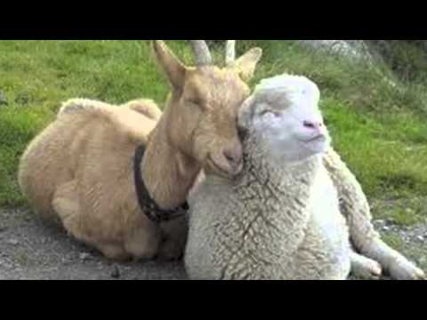
Matthew 25: 31-40

Slide 4
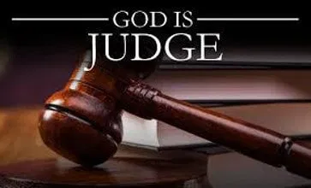
So, this is about judgement day where we are judged just like the sheep and goats in the reading.

Slide 5
In last week’s assembly I urged you to use the gifts that you have been given. And, to use the gifts for the service of others. Especially who?

Slide 6
Everyone who is in need of our help! Jesus even tells us in the reading, “When you do these things for any of my brothers and sisters in need, you do it to me.”

Slide 7
We will be judged on how we use our talents to build God’s kingdom, here and now. Our faith needs to be shown actively, but do not look for a reward!

Slide 8
For next week - My question to you…
What will our reward be?

Slide 9
November prayer
Eternal rest grant unto them , O Lord,
and let perpetual light shine upon them.
May the souls of the faithful departed, through the mercy of God, rest in peace.
Amen

