Slide 1
Advent: a time of waiting
Monday 4th December 2023
Notes:
Yesterday was the 1st Sunday in Advent
Advent: a time of waiting
1st part of Advent: is about waiting for Jesus Christ to come again as he has promised

Slide 2

Advent wreath
Light the Advent candle two
Think of humble shepherds who
Filled with wonder at the sight
Of the child on Christmas night.
Chorus:
Candle, candle burning bright
Shining in the cold winter night
Candle, candle burning bright
Fill our hearts with Christmas light.

Slide 3
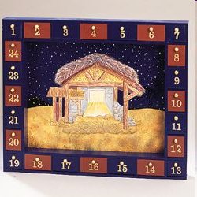
Counting down the days
Gospel reading taken from:
Mark 1: 1-8

Slide 4




What type of person would wear this…

Slide 5
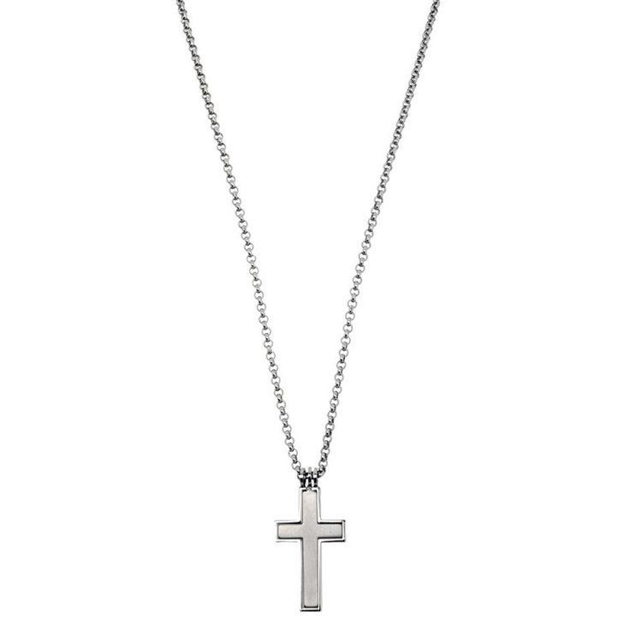
What type of person would wear a…

Slide 6
It can be difficult for us to know how to follow Jesus, so God sends us helpers.
From the reading in the Bible, we learn that God sent John the Baptist as a helper to prepare the way for Jesus.
John taught the people the importance of being sorry for their sins and he baptised those who were truly sorry for their sinful ways.
Importantly, John told the people to look for another who would be greater than he was. That person was Jesus.

Slide 7
During Advent, we ask God to forgive our sins and look for ways that we can be better followers of Jesus. What are some things we can change in our lives to better follow Jesus?
When we do these things, we become like John the Baptist and invite others to follow Jesus.
Let’s all choose one thing that we will do this week to change our lives so that we are better followers of Jesus.

Slide 8
Lord Jesus,
John the Baptist went ahead of you and proclaimed the good news of your coming.
Encourage us to receive You with joy as our saviour, and faithfully follow you.
Amen

