Slide 1
Solidarity and Peace
Collective Acts of Worship

Slide 2
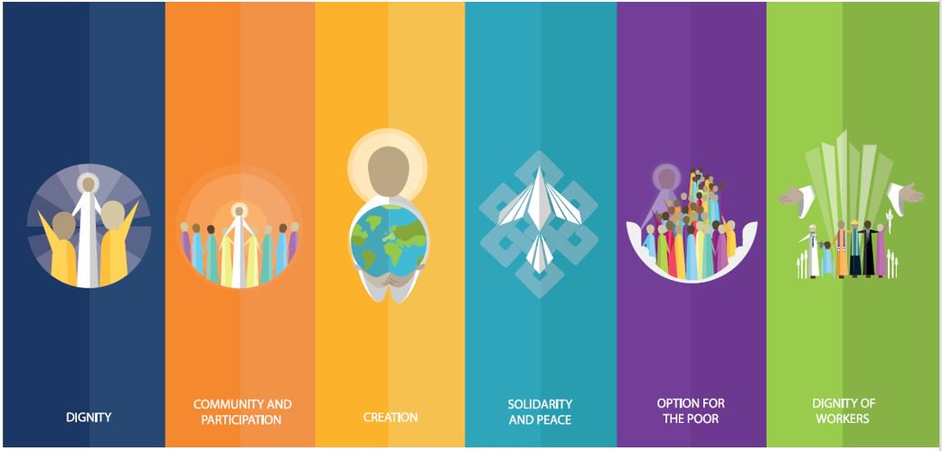
Starter

Slide 3
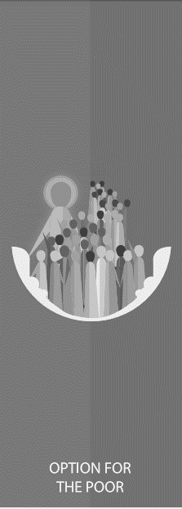
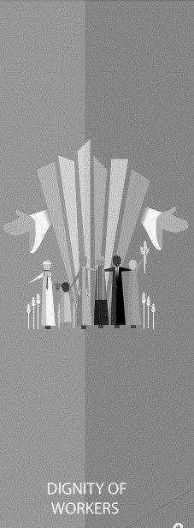

Slide 4
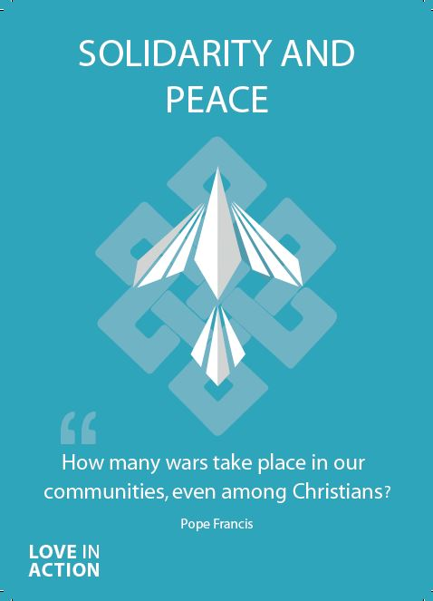
Solidarity and Peace
God has created us to live peacefully with one another. Sadly, this is often not the case and many people live lives that are not peaceful, due to the actions of others.
God calls us to be peacemakers in the world – to stand in solidarity with those in need.

Slide 5
Solidarity and Peace
‘The paths of peace are paths of solidarity, for no one can be saved alone. We live in a world so interconnected that, in the end, the actions of each person affect everyone.’
Pope Francis

Slide 6
Solidarity and Peace
Think of a time when someone helped you feel at peace.
How did that feel?
What could you do to promote peace in your school?

Slide 7
Solidarity and Peace
Let us now listen to the Word of God.
Mark 1:14-20
Repent and believe the Good News.

Slide 8
Solidarity and Peace
Throughout this topic, you will look at passages from scripture and as a class discuss the meaning of them.​
How do the following passages relate to Solidarity and Peace?

Slide 9
Solidarity and Peace
‘Live in harmony with one another. Do not be proud, but associate with those in need.’
Romans 12:16

Slide 10
Solidarity and Peace
‘I appeal to you, brothers, by the name of our Lord Jesus Christ, that all of you agree, and that there be no divisions among you, but that you be united in the same mind and the same judgment.’
1 Corinthians 1:10

Slide 11
Solidarity and Peace
‘If one person suffers, all suffer together; if one member is honoured, all rejoice together.’
1 Corinthians 12:26

Slide 12
Solidarity and Peace
‘Bear with each other and forgive one another. Forgive as the Lord forgave you. And over all these virtues put on love, which binds them all together in perfect unity.’
Colossians 3:13-14

Slide 13
Solidarity and Peace
What do these bible passages tell you about how we should spread peace?
How do we know that God wants us to act in this way?

Slide 14
Solidarity and Peace
Let Us Pray…

Slide 15
Solidarity and Peace
We pray for those who are unable to live lives of peace.
O God, help us to stand in solidarity with them.

Slide 16
Solidarity and Peace
We pray for those in power, that they may make the right choices to better promote peace in our world.
O God, help those in power to serve their people.

Slide 17
Solidarity and Peace
We pray for those who cannot speak for themselves.
O God, help us to recognise what we can do for others.

Slide 18
Solidarity and Peace
We pray that everyone in our world may one day be able to thrive, not just survive.
O God, help us to spread Your love.

Slide 19
Solidarity and Peace
Loving God,
We come together to thank you for our human family. You created our world so that we may live in harmony with one another.
Help us to follow the example of Your Son, Jesus Christ, by spreading Your peace and by standing in solidarity with those who cannot speak for themselves.

Slide 20
Solidarity and Peace
Amen

Slide 21
Solidarity and Peace
Bind us together, Lord,
Bind us together with cords that cannot be broken.
Bind us together, Lord,
Bind us together, Lord
Bind us together with love.
Notes:
Using the Prayer Toolkit model, the mission ‘tasks’ on the following slide can be amended or supplemented as required.

Slide 22
Solidarity and Peace
There is only one God,
There is only one King;
There is only one Body,
That is why we sing:
Notes:
Using the Prayer Toolkit model, the mission ‘tasks’ on the following slide can be amended or supplemented as required.

Slide 23
Solidarity and Peace
Notes:
Using the Prayer Toolkit model, the mission ‘tasks’ on the following slide can be amended or supplemented as required.

Slide 24
Solidarity and Peace
Fit for the glory of God,
Purchased by His precious blood;
Born with the right to be free,
Jesus the victory has won.
Notes:
Using the Prayer Toolkit model, the mission ‘tasks’ on the following slide can be amended or supplemented as required.

Slide 25
Solidarity and Peace
Notes:
Using the Prayer Toolkit model, the mission ‘tasks’ on the following slide can be amended or supplemented as required.

Slide 26
Solidarity and Peace
We are the family of God,
We are the promise divine;
We are God’s chosen desire,
We are the glorious new wine.
Notes:
Using the Prayer Toolkit model, the mission ‘tasks’ on the following slide can be amended or supplemented as required.

Slide 27
Solidarity and Peace
Notes:
Using the Prayer Toolkit model, the mission ‘tasks’ on the following slide can be amended or supplemented as required.

Slide 28
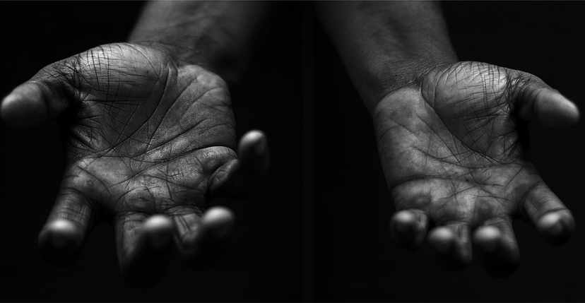
Solidarity and Peace
Your Mission
Notes:
Using the Prayer Toolkit model, the mission ‘tasks’ on the following slide can be amended or supplemented as required.

Slide 29
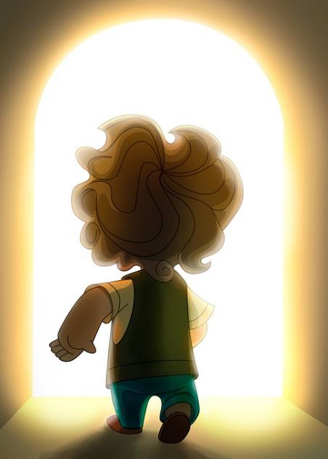
Solidarity and Peace
Find out more about St John Paul II and his calls for World Peace.
Research:
World Day of Peace (1st January). International Day of Human Fraternity (4th February).

Slide 30
Care of Creation

