Slide 1
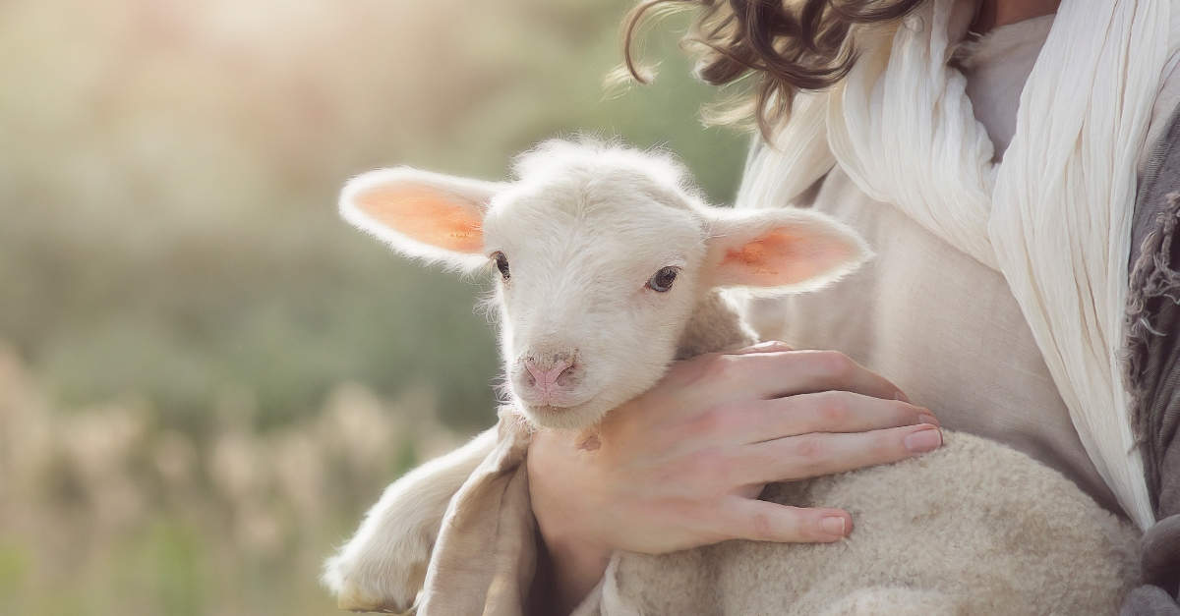
4th Sunday of Easter
Monday 19th April 2021

Slide 2
Jesus is Risen Alleluia, Alleluia! We look forward to Class 4S recounting the resurrection on Friday morning.

Slide 3
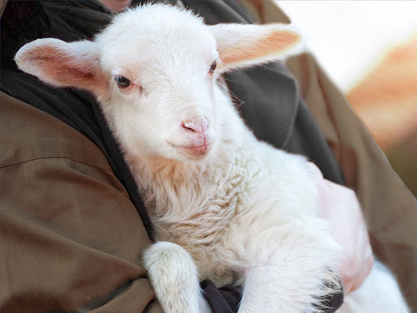
John 10: 11-18 “The good shepherd is one who lays down his life for his sheep.”

Slide 4
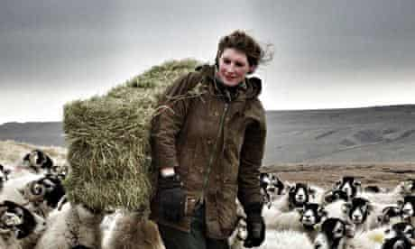
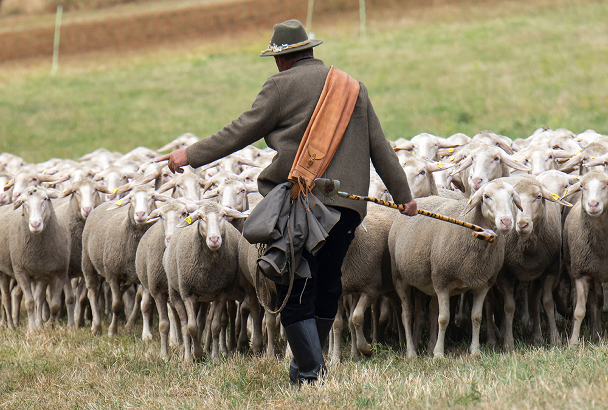
Shepherds know their sheep and the sheep know their shepherds.

Slide 5
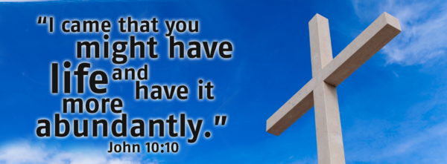
John 10:10 - I have come so that you may have life, and have it to the full!

Slide 6
Let’s reflect on this…Life to the full.

Slide 7
Who do you think you are?

Slide 8
Because you are God’s gift to the world…..
You know you are deeply and personally loved.
Because you are deeply loved…
You respond by loving yourself and can risk sharing that love with others.
Because you share that love…
Your life is “vibrant” fulfilled and you are a Ten Ten person!

Slide 9
If you don’t recognise yourself as God’s gift to the world:
You are not secure that you are loved.
You become like a sheep, following leaders sometimes good, sometimes bad.
You are scared to take risks, what will others think, what will they say?
Your life, lived in fear, is a life without fulfilment.

Slide 10
Be a Ten Ten person!

Slide 12
Blessed Joseph,
We ask you to be like a father to us. Guide us and ask God to give us hope and courage, and to keep us safe from harm.
St. Joseph, pray for us.
Amen

