Slide 1
24th Sunday in Ordinary Time.
Monday 11th September 2023

Slide 2
Matthew 18: 21-35 “I do not tell you to forgive seven times, but seventy times seven.”

Slide 3
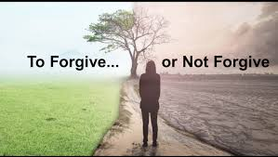
To be a good person is to show mercy

Slide 4
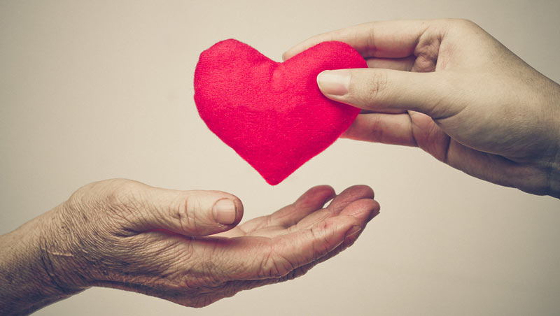
To be a good person is to show mercy
How often should I/we forgive?

Slide 5
Peter tried to put a number to the number of times he thinks we should show forgiveness.
Did the king do that?
Does God do that?

Slide 6
My question for you…
Can you show forgiveness 490 times or 77 times?
What does it really mean?

Slide 7
Let us finish with a prayer, showing mercy unto others as our Lord has shown mercy on us…

Slide 8
Our Father, who art in heaven, hallowed be thy name; thy kingdom come, thy will be done on earth as it is in heaven. Give us this day our daily bread, and forgive us our trespasses, as we forgive those who trespass against us; and lead us not into temptation, but deliver us from evil. Amen

