Slide 1
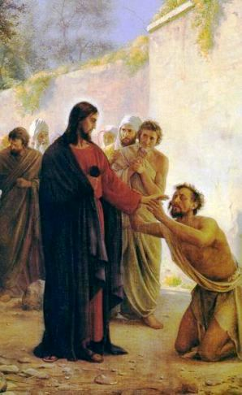
6th Sunday in Ordinary Time
Monday 5th February 2024

Slide 2
From last week…
How can we make time to rest and pray?

Slide 3
Mark 1: 40-45 “The leprosy left him at once and he was cured.”

Slide 4
The man with leprosy knew that Jesus could cure him. “I do want to cure you.” “Now don’t tell anyone about this.” God gives us the choice to act in ways that help others.

Slide 5
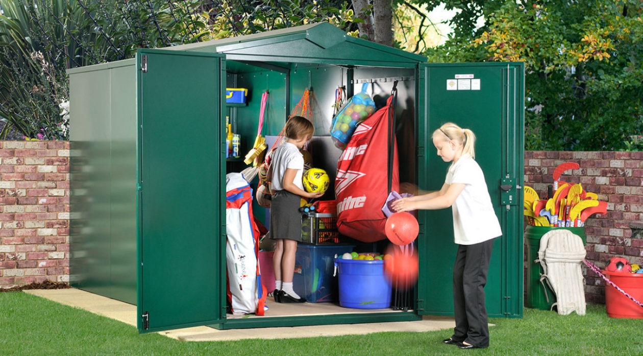
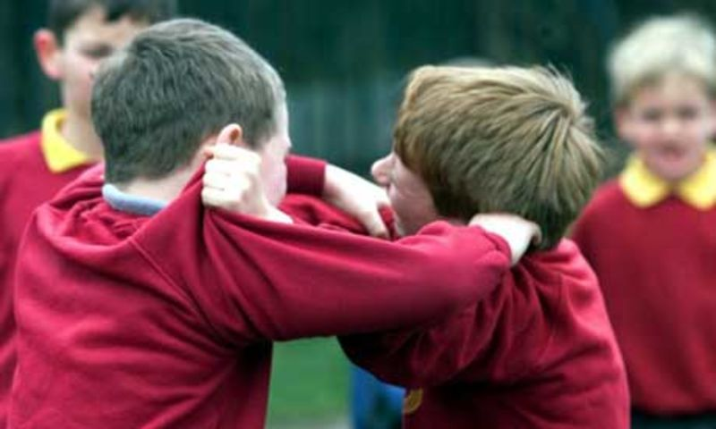
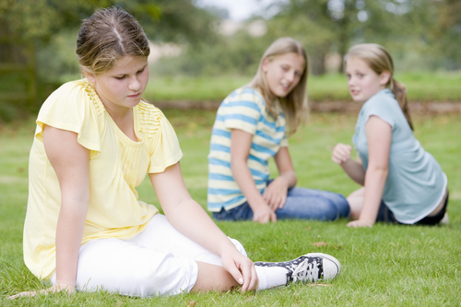

Slide 6
For next week - My question to you…
How can we make good, loving choices?

Slide 8
Dear Lord,
Fill our hearts with your love. Inspire us to help others as best we can, as often as we can.
Amen.

