Slide 1
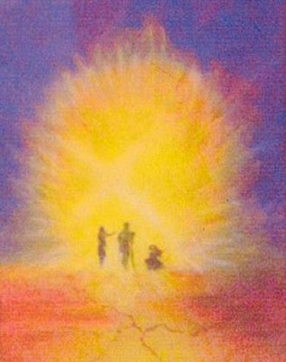
2nd Sunday of Lent
Monday 19th February 2024

Slide 2
Mark 9: 2-10 “This is my beloved Son. Listen to him.”

Slide 3
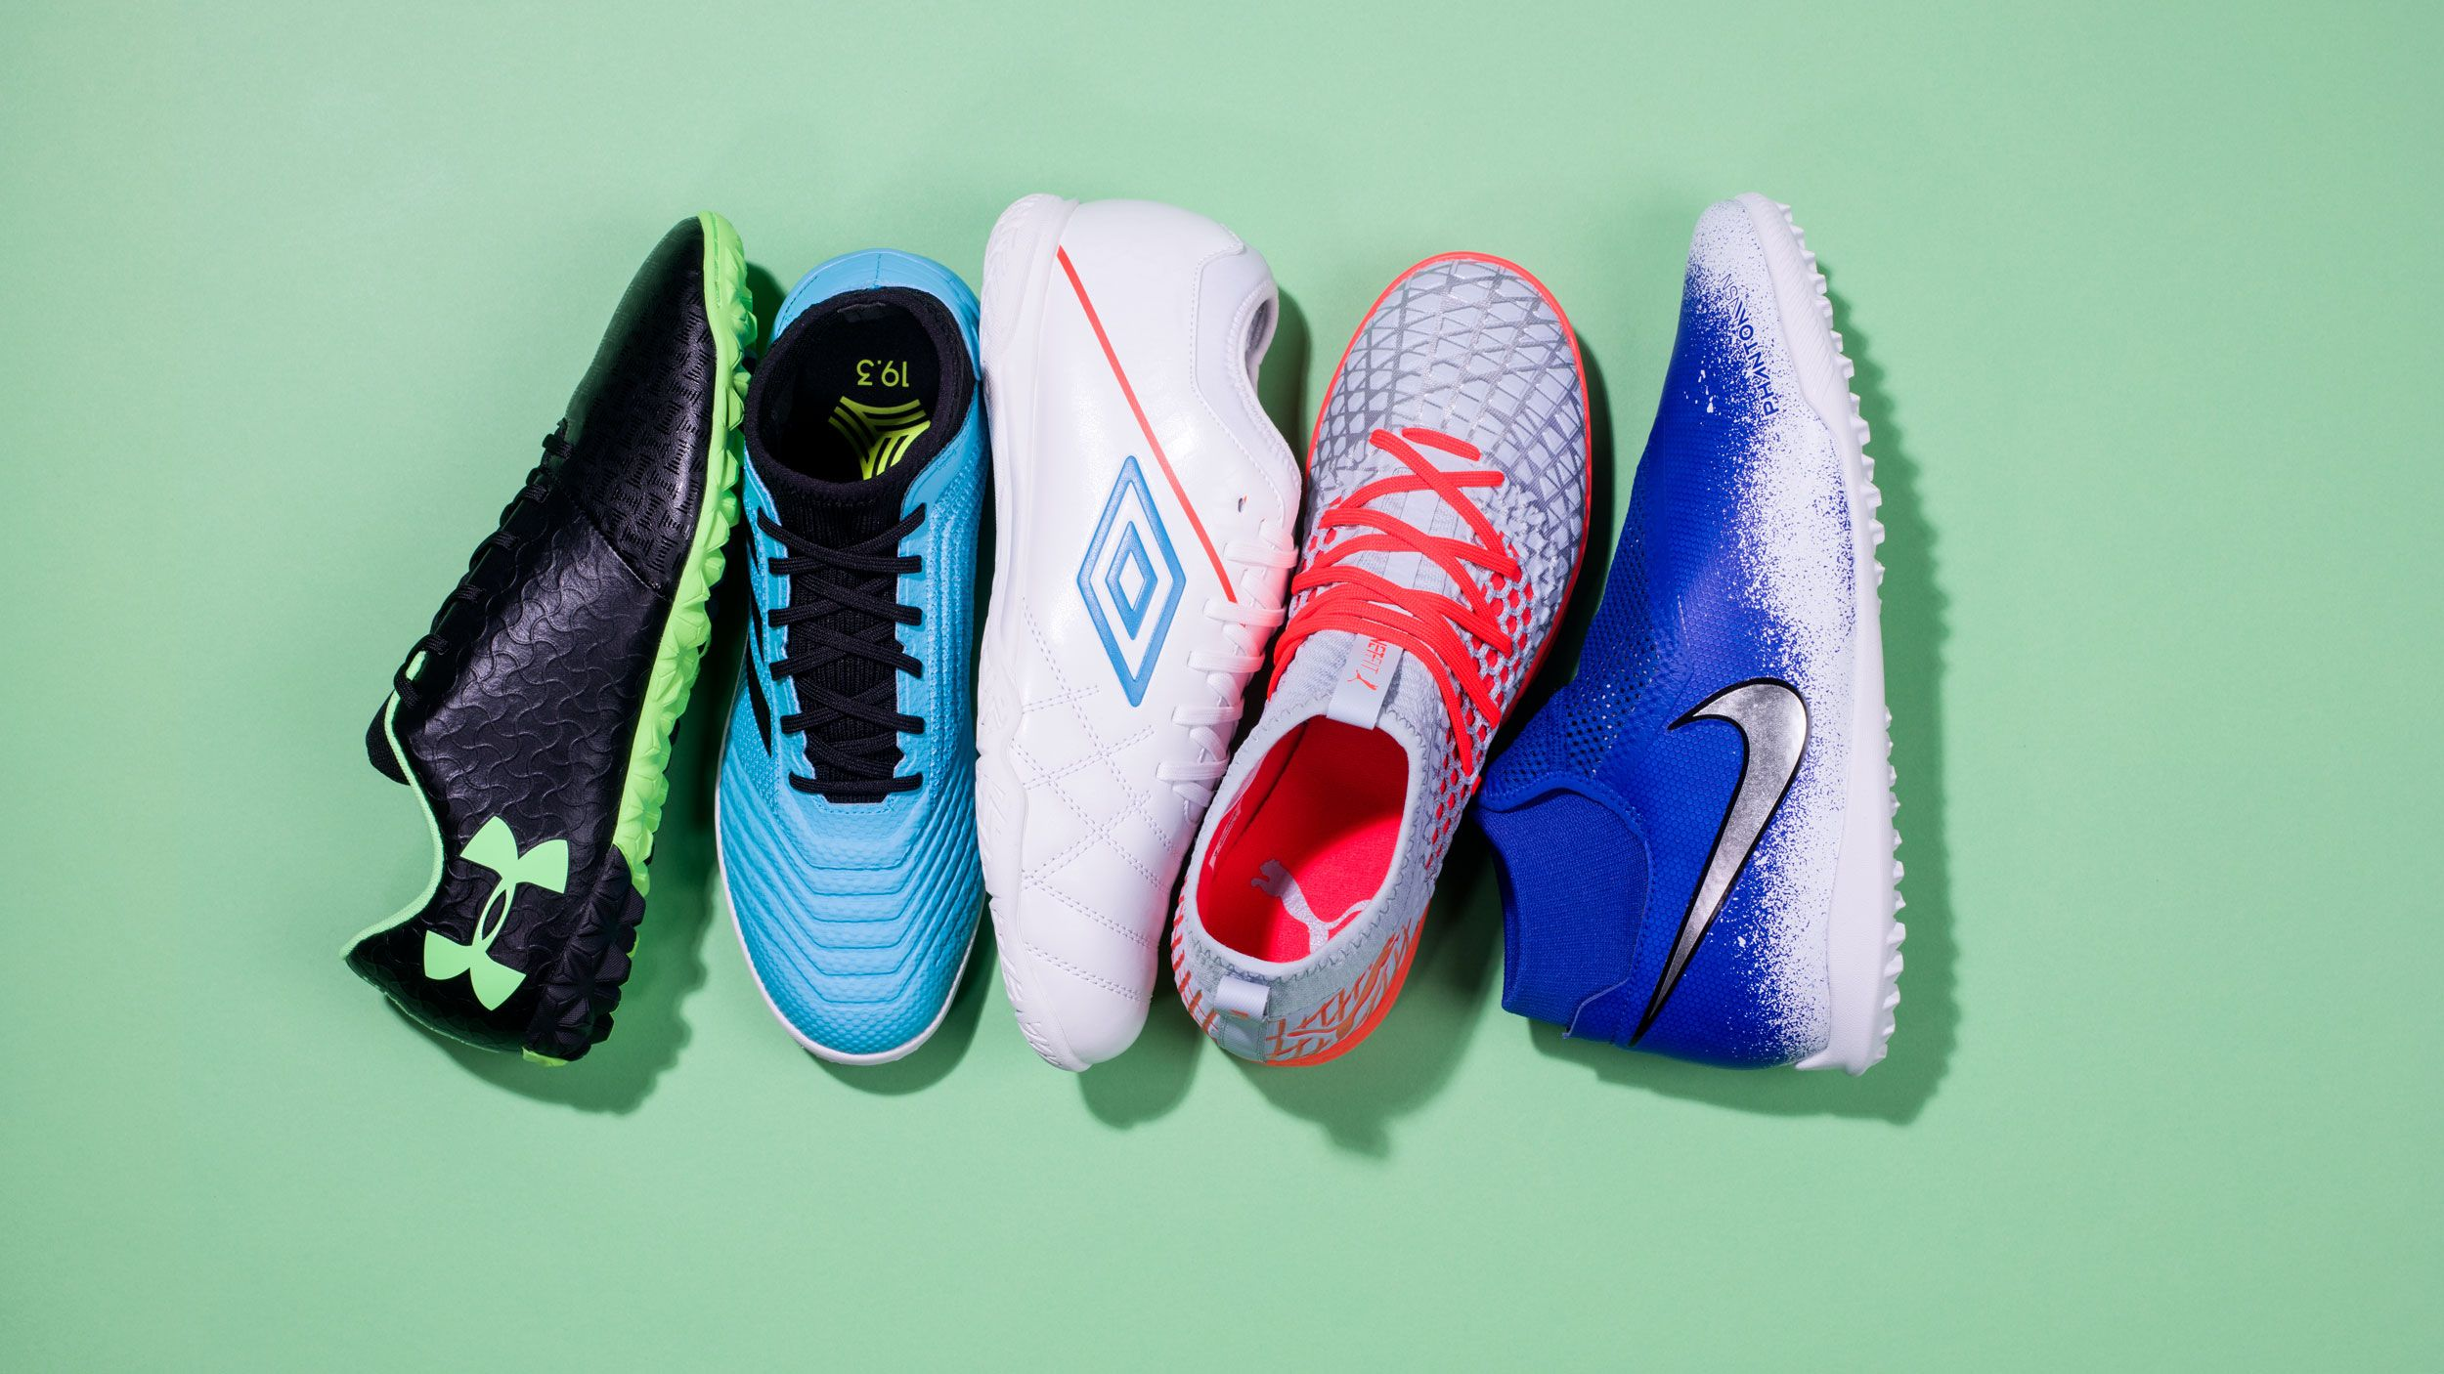
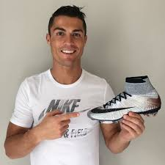

Slide 4
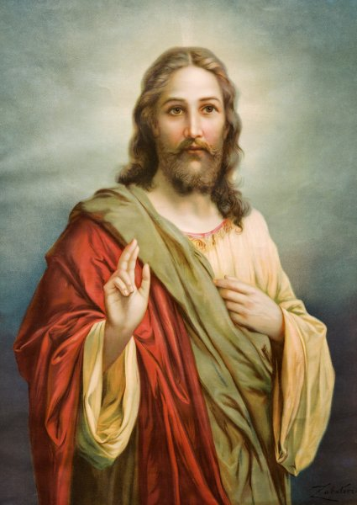
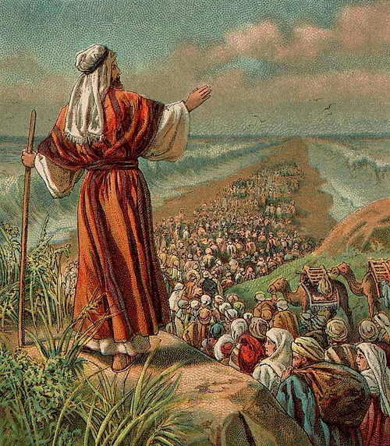
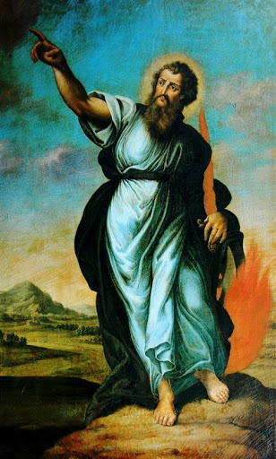

Slide 5
Questions for us…
When did you recognise Jesus as God’s son?
What will you do to build God’s kingdom here today?

Slide 6
Make a difference during Lent
Individual acts of charity - Mission Together collection.
Take time to look and reflect on Way of the Cross images on the staircases.
Time for private prayer and reflection.

Slide 7
But above all else…
Look for opportunities to be kind!

Slide 9
Heavenly Father,
As we make our journey through life, let us open our lives to Your light so that we might do great things for You.
Amen

