Slide 1
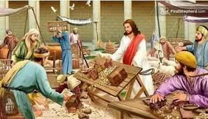
3rd Sunday of Lent
Monday 26th February 2024

Slide 2
John 2: 13-22 “Tear down this temple, and I will raise it up in three days!”

Slide 3
How did Jesus teach?
Through story telling - often called parables.
Through sermons – just like Fr Cristiano does today.
Through example - He made a point of living the way He wants us to live.
Through miracles - miracles demonstrated Jesus was sent by God.
Through foretelling – talking about something that will happen in the future.

Slide 4
“What gives you the right to do this? What sign can you give us?”
“Tear down this temple, and I will raise it up in three days!”
“It took us 46 years to build this temple! And you think you can raise it up in three days?”

Slide 5
The temple Jesus was talking about was his own body. And later when He was raised from the dead, his disciples remembered that He had said this and they believed in him.

Slide 6
Make a difference during Lent
Individual acts of charity - collection boxes.
Take time to look and reflect on Way of the Cross images on the staircases.
Time for private prayer and reflection.

Slide 7
But above all else…
Look for opportunities to be kind!

Slide 9
Lord,
We look to You as we make our journey through life, let us open our lives to Your light so that we might do great things for You.
Amen

