Slide 1
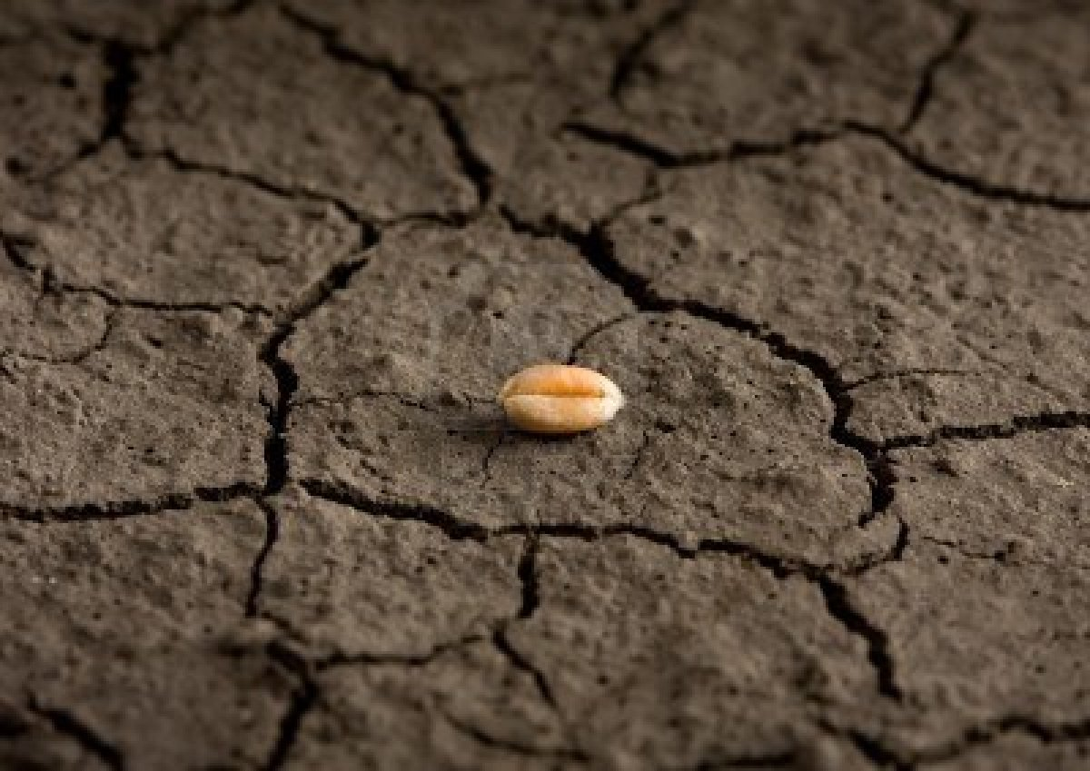
5th Sunday of Lent
Monday 11th March 2024

Slide 2
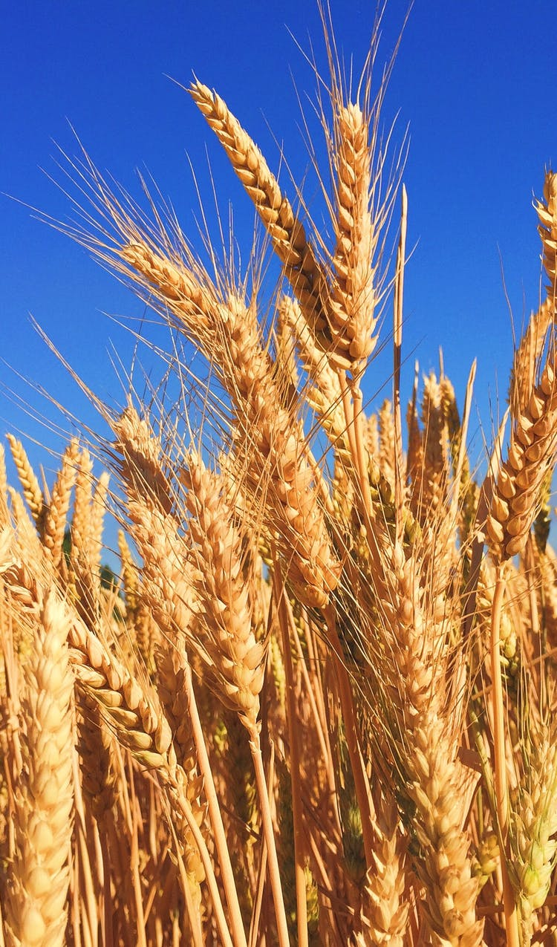
John 12: 24-25, 32-33

Slide 3
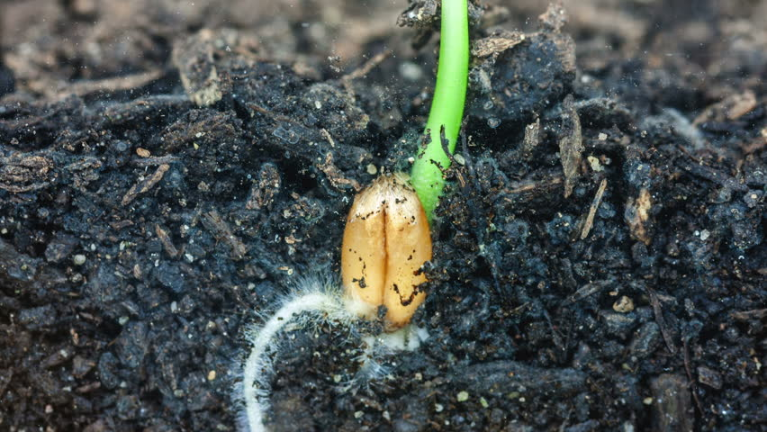
Jesus says that a grain of wheat remains a single grain unless it is buried and grows into a rich harvest.
What do you think Jesus means by that?

Slide 4
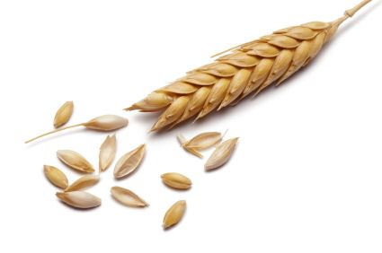
One tiny seed can produce a very big plant.
Our actions, even if we do just one little thing, can also make a very big difference.

Slide 5
What will you do this week to make a difference?

Slide 6
Make a difference during Lent
Individual acts of charity - collection boxes.
Take time to look and reflect on Way of the Cross images on the staircases.
Time for private prayer and reflection.

Slide 7
But above all else…
Look for opportunities to be kind!

Slide 9
Dear Lord,
Fill us with your love and mercy and show us how to make a difference to the lives of our brothers and sisters. Help us to put the needs of others ahead of our own needs.
Amen.

