Slide 1
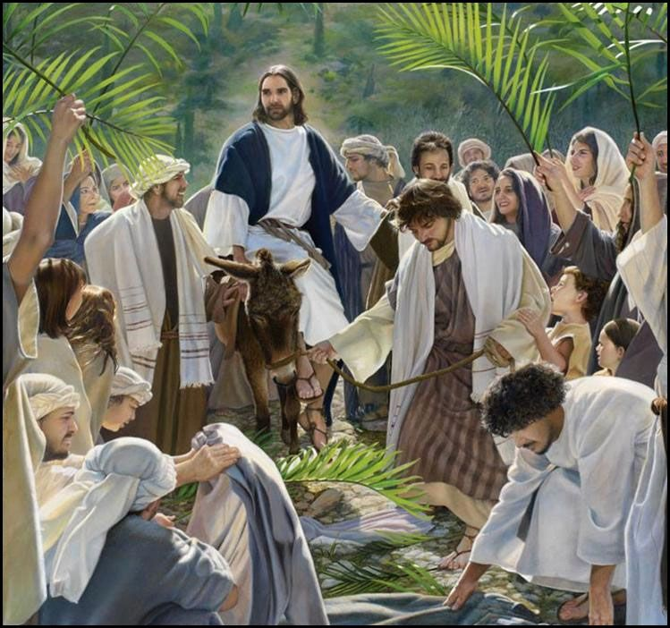
Palm Sunday
Monday 18th March 2024

Slide 2
Mark 11: 1-10 “Blessed is he who comes in the name of the Lord!”

Slide 3
As Jesus rode into Jerusalem, the crowds cheered him as their king and lay down palm leaves and their coats.
The people did not understand the type of king that Jesus was.

Slide 4
What did the people shout as Jesus rode the colt?
Hosanna…It means, “Save us.”

Slide 5
The people wanted to be saved from the harsh rule of the leader.
Jesus came to save people for his kingdom, the Kingdom of Heaven.

Slide 6
Make a difference during Lent
Individual acts of charity - collection boxes
Take time to look and reflect on Way of the Cross images on the staircases
Time for private prayer and reflection

Slide 7
But above all else…
Look for opportunities to be kind!

Slide 9
Dear Lord,
Help us to listen to your words. Help us to choose to do the right things with our lives so that we too can get an invitation to your Kingdom. Amen.

