Slide 1
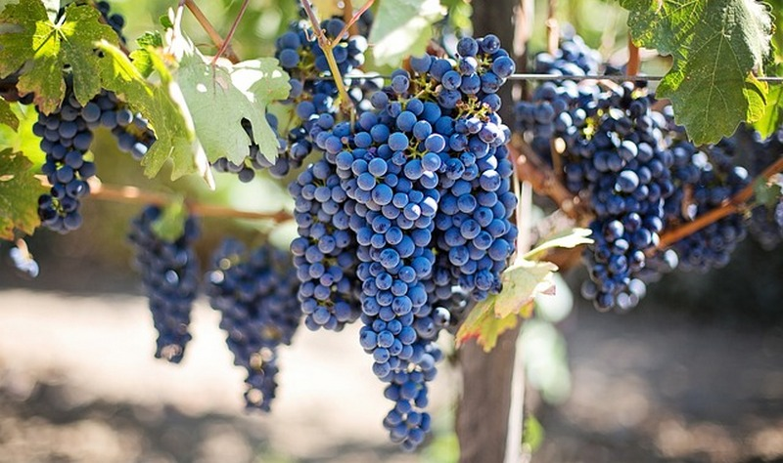
5th Sunday of Easter
Monday 26th April 2021

Slide 2
John 15:5-8 “Whoever remains in me, with me in him, bears fruit in plenty.”

Slide 3
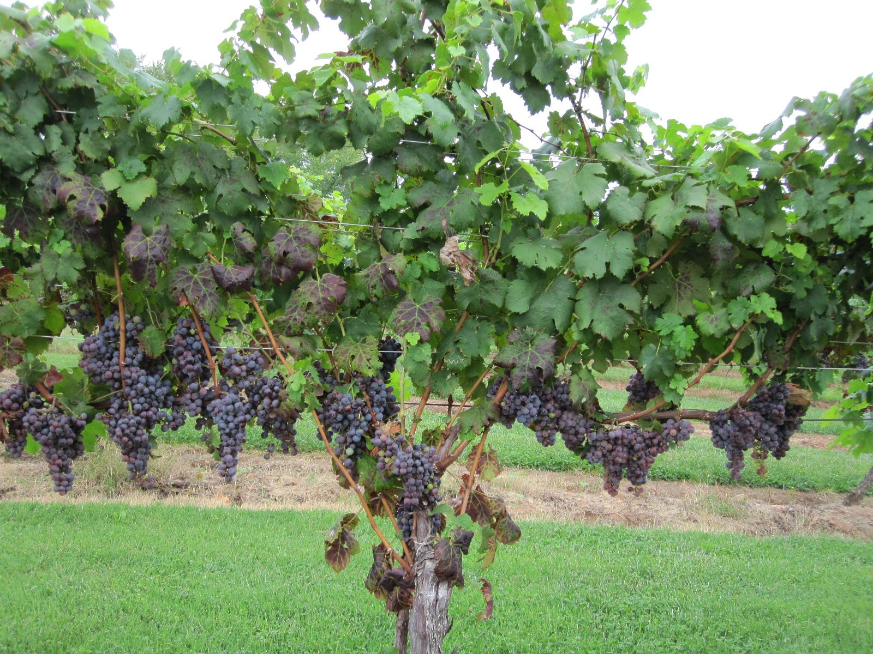
Who is the vine grower?
Who is the vine?
Who are the branches?

Slide 5
Blessed Joseph,
We ask you to be like a father to us. Guide us and ask God to give us hope and courage, and to keep us safe from harm.
St. Joseph, pray for us.
Amen

