Slide 1
Holy Week - The most important week in the Church year
Monday 25th March 2024

Slide 2
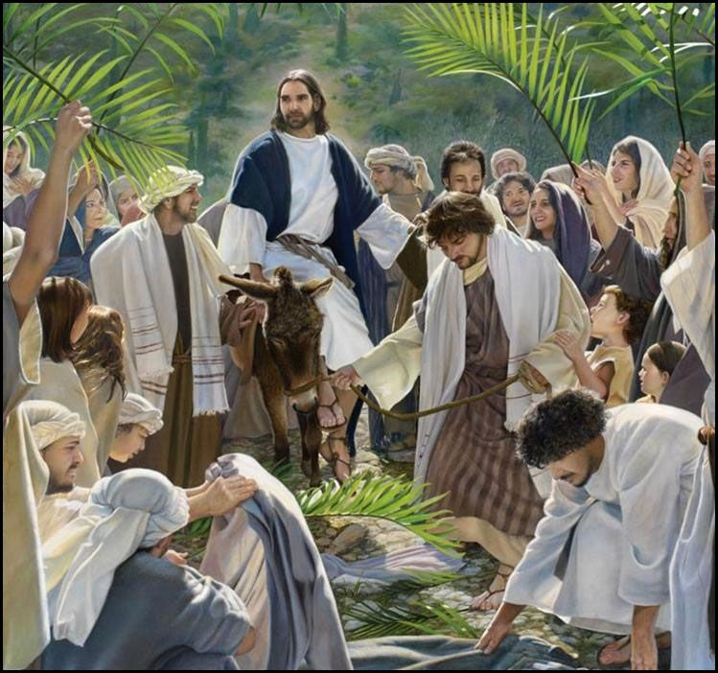
Palm Sunday - The people of Jerusalem celebrated wildly when Jesus rode through the crowds. The crowds thought Jesus was coming to save them as a new king.

Slide 3
Maundy Thursday The Last Supper Jesus praying in the garden of Gethsemane Judas’s betrayal The arrest of Jesus Peter’s denial of Jesus Trial before the Jewish Authorities

Slide 4
Good Friday
Trial before Pilate
Crucifixion - Jesus was alone when he died on the cross. Before he died, Jesus cried out to God, asking why God had abandoned him. Jesus felt completely alone as he died
Burial

Slide 5
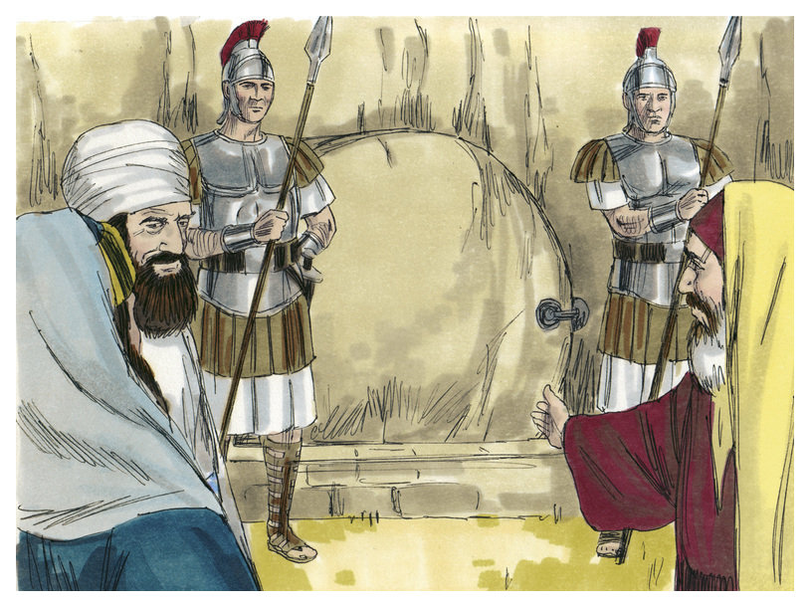
Saturday - Watch at the Tomb

Slide 6
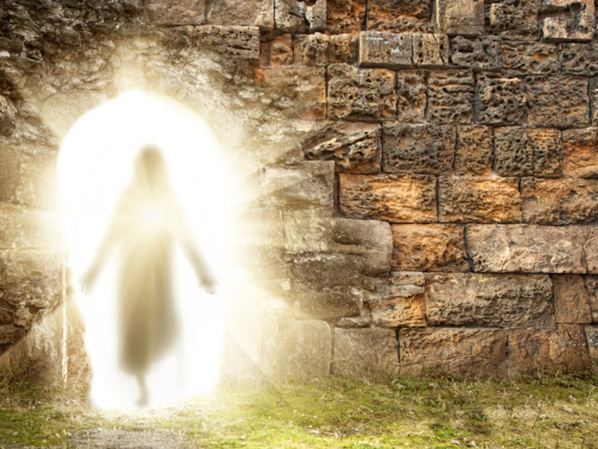
Sunday - The Resurrection

Slide 7
But above all else…
Look for opportunities to be kind!

Slide 9
Dear Lord,
We pray that during Holy Week we begin to understand how much Jesus loves us all.
Amen

