Slide 1
25th Sunday in Ordinary Time.
Monday 18th September 2023

Slide 2
From last week – what does this mean?
Can you show forgiveness 490 times or 77 times?

Slide 3
Matthew 20: 1 - 16 “Why be envious because I am generous?”

Slide 4
Fair or unfair?

Slide 5
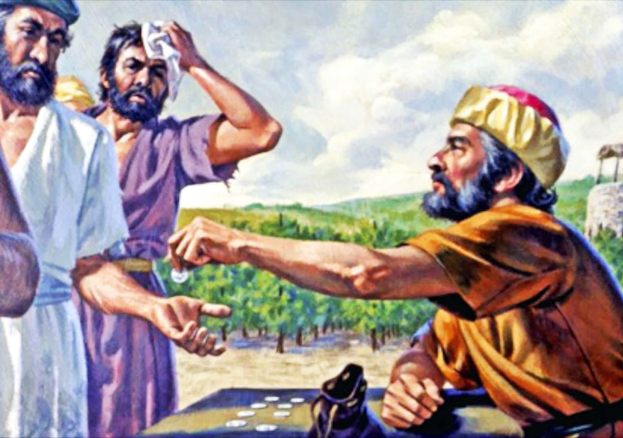
Who should get paid more - the men who work all day or the men who work for an hour? Discuss.

Slide 6
The landowner acted completely fairly.
He gave those who worked all day in the field their pay.
He also gave a full-day's pay to those who worked only an hour.
Who has been cheated?

Slide 7
No one was cheated because they all got what was agreed. It is us who think that it is unfair in a greedy, human way. Yes, the landowner was very kind and gave everybody the same amount but some got a better deal!

Slide 8
God is like that with us. He is abundantly generous. God really does not owe us anything but He offers us lots – the same to everyone. It is us who think that we are sometimes owed more than others but God loves us all equally.

Slide 9
For next week - My question to you…
Can you think like God and think generously?
What will you do freely from your own heart?

Slide 10
Blessed Joseph, We ask you to be like a father to us. Guide us and ask God to give us hope and courage, and to keep us safe from harm. St. Joseph, pray for us. Amen

