Slide 1
26th Sunday in Ordinary Time.
Monday 25th September 2023

Slide 2
From last week – what does this mean?
What have you done feely from your own heart?

Slide 3
How easy is it so say one thing and then do another?

Slide 4
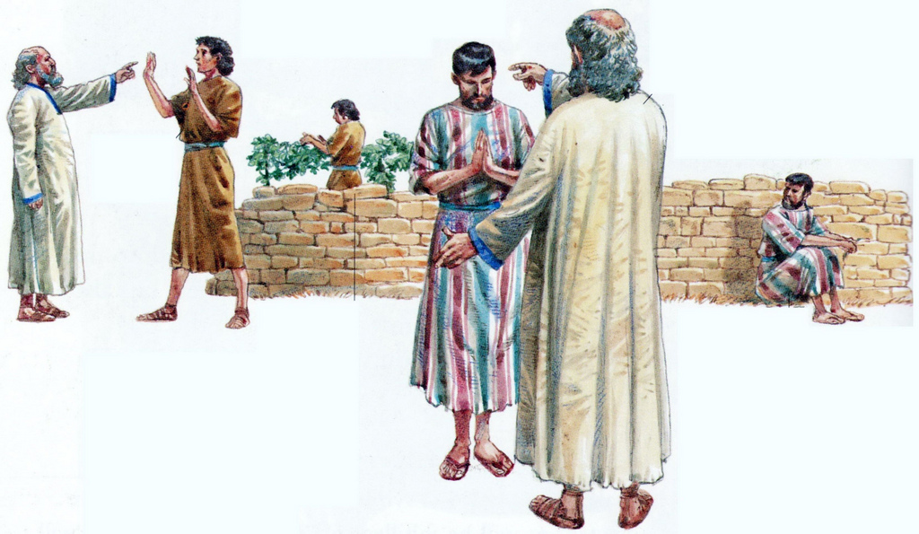
Matthew 21: 28-32

Slide 5
The father asked his two sons to work in the vineyard.
What did the first son do?
What did the second son do?
Which son did what his father asked?

Slide 6
Sometimes when we are asked to do something, we might say yes and then forget. Other times, we might have no plans to do what we are asked. We say yes, but we don’t mean it.

Slide 7
Jesus teaches us that our actions are as important as our words. We are called to love and obey God in our words and in our actions.

Slide 8
For next week - My question to you…
What commitments will you keep this week?

Slide 9
Blessed Joseph, We ask you to be like a father to us. Guide us and ask God to give us hope and courage, and to keep us safe from harm. St. Joseph, pray for us. Amen

