Slide 1
30th Sunday in Ordinary Time.
Monday 19th October 2023

Slide 2
From last week, my question to you was…
How can you give back to God?

Slide 3
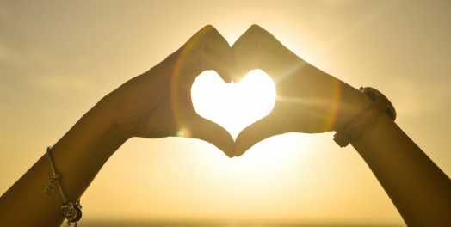
Matthew 22: 34-39 “You must love the Lord your God and your neighbour as yourself.”

Slide 4
Background information…
The Torah had over six hundred laws about how to live your life.
Some were totally impractical for ordinary people.
People were taught the better you kept the law, the better God loved you.

Slide 5
Jesus sums up all the laws…
You must love the Lord your God with all your heart, your soul and your mind.
You must love your neighbour, as you love yourself.

Slide 6
Dear Lord, Help us to remember that obeying Your simplest laws will make our world a better place. Amen

