Slide 1
31st Sunday in Ordinary Time.
Monday 30th October 2023

Slide 2
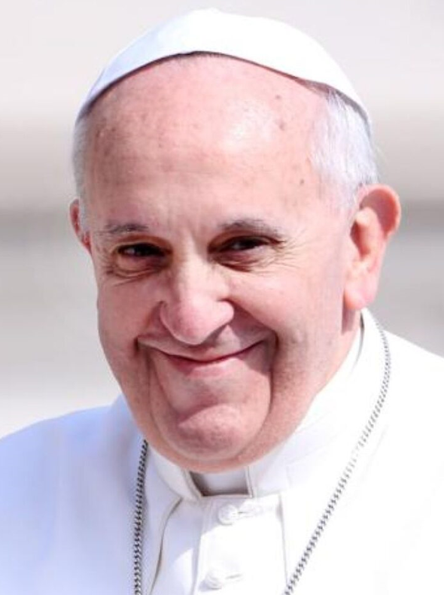
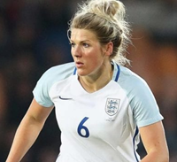
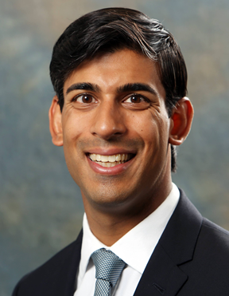
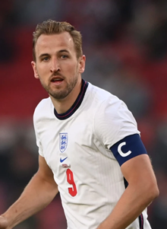
Who are these people?

Slide 3
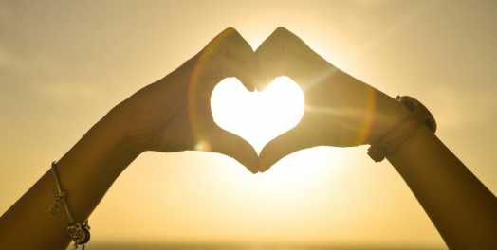
Matthew 23: 1-12 “They do not practise what they preach.”

Slide 4
What does Jesus tell the crowd about some of their religious leaders?
Why?

Slide 5
Jesus then tells the crowd what characteristic he looks for in a good leader.
What does he say?

Slide 6
For next week - My question to you…
How can we serve?

Slide 7
Take me, Lord, use my life in the way you wish to do.
Fill me, Lord, touch my heart till it always thinks of you.
Take me now, as I am, this is all I can offer.
Here today I, the clay, will be moulded by my Lord.

Slide 8
Lord, I pray that each day I will listen to your will. Many times I have failed but I know you love me still. Teach me now, guide me, Lord, keep me close to you always. Here today I, the clay, will be moulded by my Lord.

Slide 9
I am weak, fill me now with your strength and set me free. Make me whole, fashion me so that you will live in me. Hold me now in your hands, form me now with your Spirit. Here today I, the clay, will be moulded by my Lord.

Slide 10
Dear Lord, We pray for the wisdom to grow to be people who humbly serve others as Jesus taught. Amen

