Slide 1
Welcome to Year 3
3AR 3GS 3MS
‹#›

Slide 2
Year 3 Staff 2025-2026
3AR: Mrs Reddin
3MS: Miss Smith
3GS: Mrs Garcia/Ms Sasenarine
Team Leader
Mrs Reddin
Year 3 TAs
Ms Rowlands (HLTA)
Miss Szyszka (3GS)
Notes:
‹#›

Slide 3
Routines
The Junior gate will open at 8.35am. Soft start will be between 8.40 and 8.45. Registers will still be taken at 8.45.
Two break times at 10.25 (15mins) and 12.15 (1 hour, including lunch).
End of the day 3.15. Gate closes at 3:25
No parents in the building (before or after school) without an appointment.
Children will be expected to do things for themselves – dressing, ‘lost’ things, tidying the classroom etc.
No adult handwriting on homework, unless it’s a note for the teacher.
‹#›

Slide 4
Children will need:
Water Bottle (labelled)– kept at the side of the room
Comfortable space at home for doing their homework/reading- 20 mins for each subject and 15 ms reading a day (reading record to be signed once book is finished).
Reading book and Reading Record to be in school every day.
PE kits to be worn to school on their P.E days.
Plimsolls will need to be brought into school for indoor PE but these will be kept in their lockers.
Skipping ropes and sponge footballs are the only items that can be brought in to play with at break. Wednesday is no ball day.
Adult-sized old shirt/t-shirt for art activities.
‹#›

Slide 5

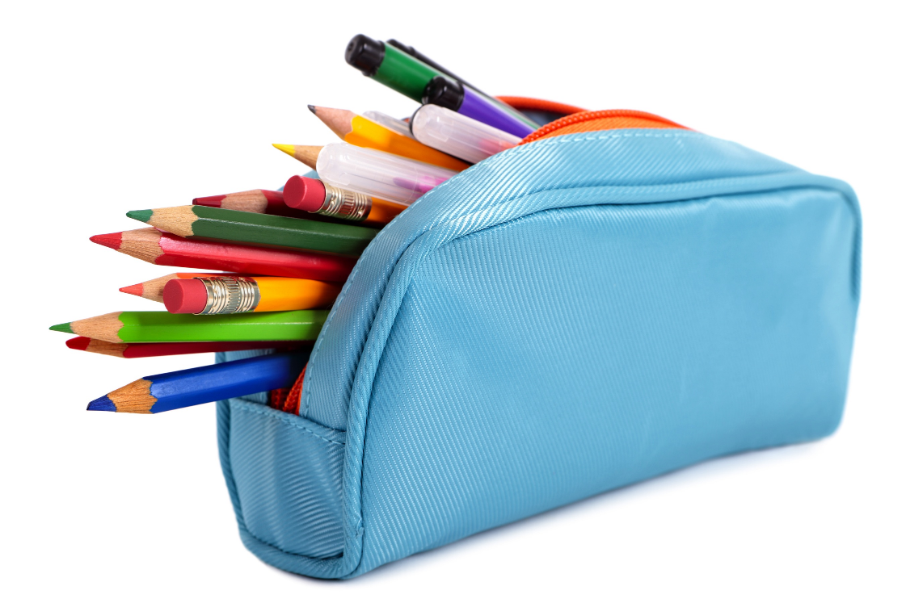
Pencil Cases
We do have equipment available, but it saves time if children are able to bring their own pencil case into school. We ask if possible, these can include:
Writing pencil
Pencil sharpener
Rubber
Glue Stick
Whiteboard Pen
Ruler
Red biro
Colouring pencils

Slide 6
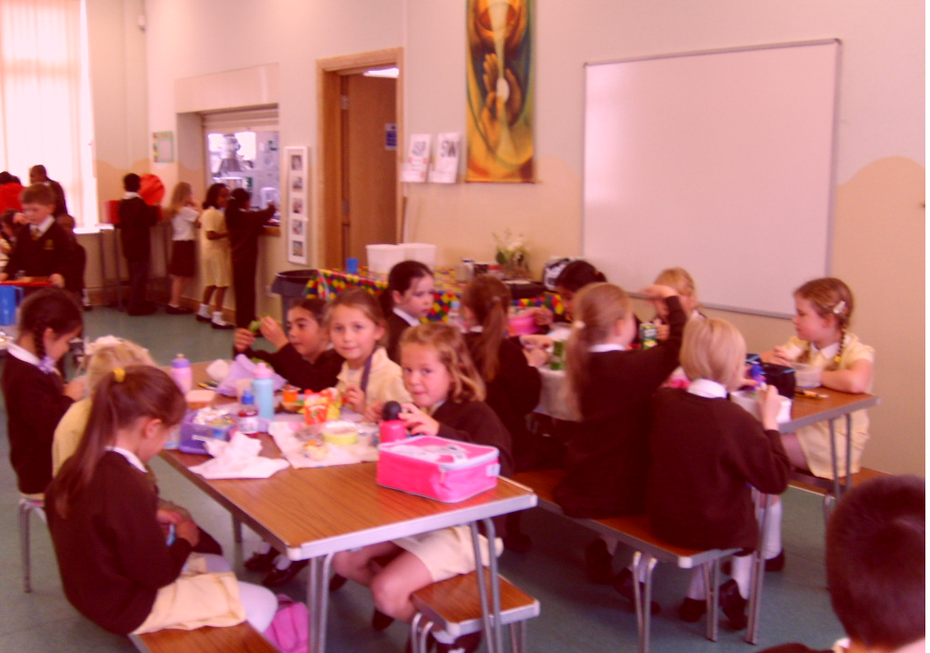

Healthy School
We are a healthy school. Please pack a healthy lunch, with a napkin.
Also encourage children to give out healthy/non-food treats for birthdays.
Children are no longer provided with fruit. Please feel free to give your child a piece of fruit each day to eat during Fruit and Milk time.
Breakfast is key and really makes a difference to the children’s learning.

Slide 7
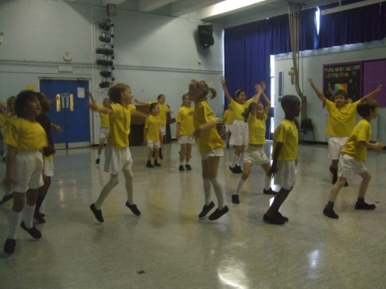
P.E days:
Twice a week –
3AR – Monday and Thursday
3MS – Monday and Thursday
3GS – Monday and Thursday
Fully labelled P.E. kit
black shorts / yellow t-shirt / black plimsolls
(socks for girls if they wear tights in winter)
St Joseph’s grey tracksuit
Plimsolls will remain in school as they need to be worn for indoor P.E.

Slide 8
Uniform reminders
Please remember…
-All children should be wearing black school shoes – No trainers!
Hair longer than shoulder length must be tied back and hair accessories should be school colours.
No jewellery (real or costume) with the exception of small gold or silver stud earrings.
No nail varnish
Toys must not be brought into school.
*
‹#›

Slide 9






Books we read in Year 3:
‘Stone Age Boy’ by Satoshi Kitanmura
‘George’s Marvelous Medicine’ by Roald Dahl
‘Ice Palace’ by Robert Swindells
Butterfly Lion by Michael Morpurgo
‘Marcy and the Riddle of the Sphinx’ by Joe Todd-Stanton
‘The Miraculous Journey of Edward Tulane’ by Edward Tulane
We do have some copies of these books in school, but it would be useful for children to have their own. Second hand is fine!

Slide 10
Topics in Year 3:
Science | History | Geography
Rocks Forces and Magnets Animals Including Humans Plants Light | Hanwell Past and Present Stone Age Egyptians | Climate Zones North America Rio and South-East Brazil

Slide 11

At Home:
Year 3 children are encouraged to read and discuss their reading every day for at least 15 minutes.
Please sign the Reading Record Book daily.
Children will change their own reading book during the school day as necessary. Once your child is on chapter books please encourage your child to bring in their own choice of reading book from home but please continue to log them in the reading record.
TTRS - Times Table Rock Stars – We encourage the children to do 5-10 minutes per day.
‹#›

Slide 12
Home Learning:
Home Learning books this year are green.
Home Learning will go out on a Friday due on the following Wednesday at the latest.
It will consist of: Spellings and then either English, Maths, R.E or the Broader Curriculum. It will either consolidate what has already been taught or will be preparation for what is about to be learned.
Spelling – a list will be sent out every week. The children’s task is to choose 5 words and put each word into a sentence to show their understanding. These sentences should be written into the green Home Learning book.
Spelling test will take place on a Thursday.
Please encourage your child to do this independently. Write your child’s class teacher a note if any help has been given.

Slide 13
Marking Policy:
All books will be marked in green by the teacher.
Highlight the objective
-green – Learning objective achieved
-yellow – Nearly there
-blank – Children may need a little more time or support to achieve the learning objective.
T (target), R(remember), Q(question), N.S. (next step)
Children will respond in red, this is encouraged on First Family Fridays to do at home.

Slide 14
Communication and concerns:
If you have a concern, please do not approach the teacher before the school day. Any queries, feel free to ask after school or send in a note with your child if that is more convenient. Teachers will be happy to give you a call or drop you an email.
For any general enquiries, please email the Year 3 teachers at: year3@stjcp.education All of the Year 3 teachers have access to this and we will answer you within 48 hours.
Please do not approach other parents but inform the class teacher.
Any meetings held will have two adults present.
*
‹#›

Slide 15
Roald Dahl Day
We will be celebrating Roald Dahl’s birthday on Friday11th September. In Year 3, our day will be focused around Fantastic Mr Fox.
We ask the children to come into school dressed as a Roald Dahl character of their choice.

Slide 16
Autumn Dates for your diary
Parents’ Evening: 15.10.26 - 4.30-7.00pm
Parents’ Evening: 20.10.26 - 3.30-6.00pm
Half Term: 26.10.26 - 30.10.26
3AR’s Class Collective Worship Assembly: 12.11.26
3MS’s Class Collective Worship Assembly: 19.11.26
3GS’s Class Collective Worship Assembly: 26.11.26
*
‹#›

Slide 17
If you have any questions please feel free to email us:
year3@stjcp.education
Thank you for watching!

