Slide 1
Advent: a time of Preparation and waiting
Monday 23rd November 2020
Notes:
Yesterday was the 1st Sunday in Advent
Advent: a time of waiting
1st part of Advent: is about waiting for Jesus Christ to come again as he has promised

Slide 2
Lectionaries and Cloths
We are finishing cycle A of the Gospel readings, moving on to cycle B. The readings also change from Matthew’s Gospel to Mark’s Gospel.
We are moving from ordinary time to Advent, so cloths and vestments move from green to purple.
Another year has passed, am I a better Christian? Am I more aware of God’s love?

Slide 3
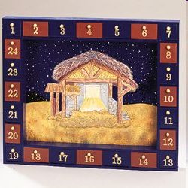
Counting down the days
Gospel reading taken from Mark 13:33-37

Slide 4
Gospel: Stay Awake
Imagine a messy classroom, difficult I know!
Your teacher asks you to tidy it up within 5 minutes, what do you do?
Imagine the same messy classroom, but this time your teacher asks you to tidy it by the time they come back. The teacher does not say when they will be back, what do you do?

Slide 5
When we don’t have deadlines, we sometimes act differently. Without a deadline, we might be tempted to play with a friend, chat with others or let ourselves be distracted by other things.
Jesus warned his disciples that they should always be ready!

Slide 6
Dear Jesus,
As we begin this season of Advent, we look forward to your coming. We do not know when this will be. Help us to prepare by always making sure that we do the right thing.
Amen

