Slide 1
Happy New Year!
Monday 4th January 2021

Slide 2
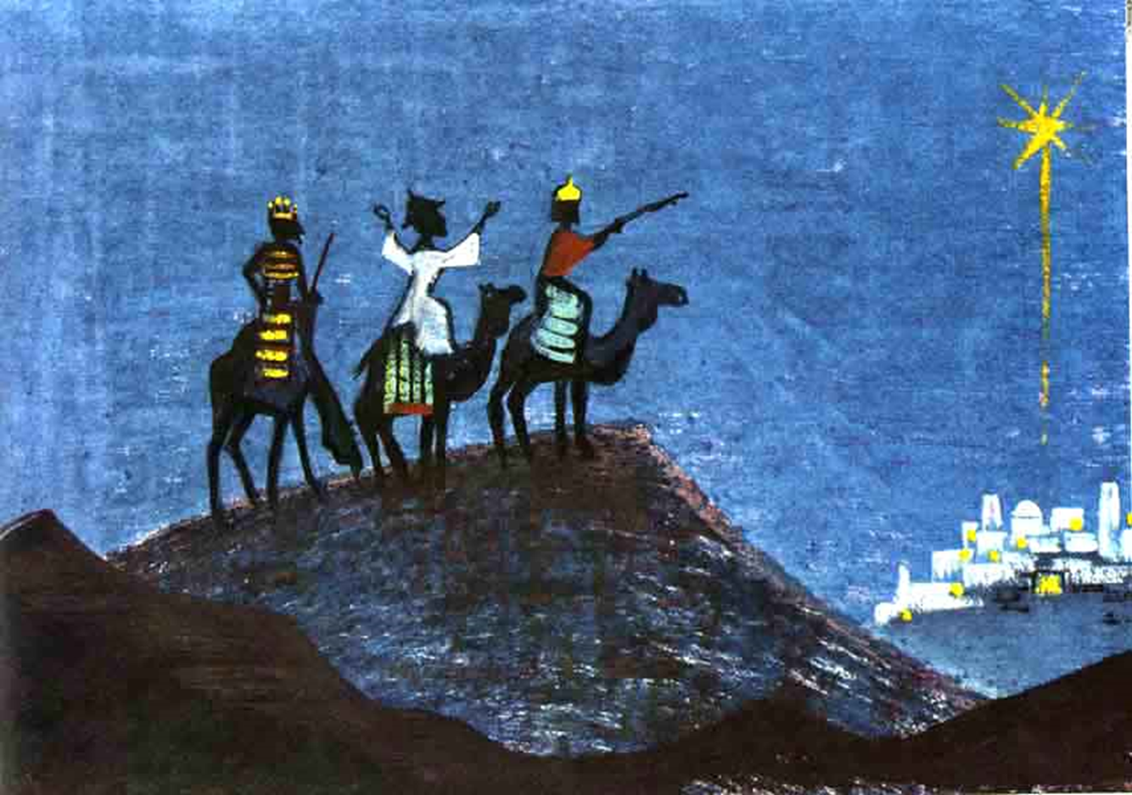

Slide 3
What did the Wise Men bring?

Slide 4
What did the Wise Men bring?
Gold
Frankincense
Myrrh
Why?

Slide 5
What would you bring to Jesus? Why?

Slide 6
The Wise Men found what they were looking for, by following a star.
How will you follow the Epiphany Star today in class, on the playground and at home?
New Year resolutions…

Slide 7
Dear Lord,
Help us to have as much faith as the wise men who followed your star to find Jesus. Lead us down the right paths and help us to recognise Jesus in the people that we meet as we travel through life.
Amen.

