Slide 1

St Joseph’s School emblem

Slide 2
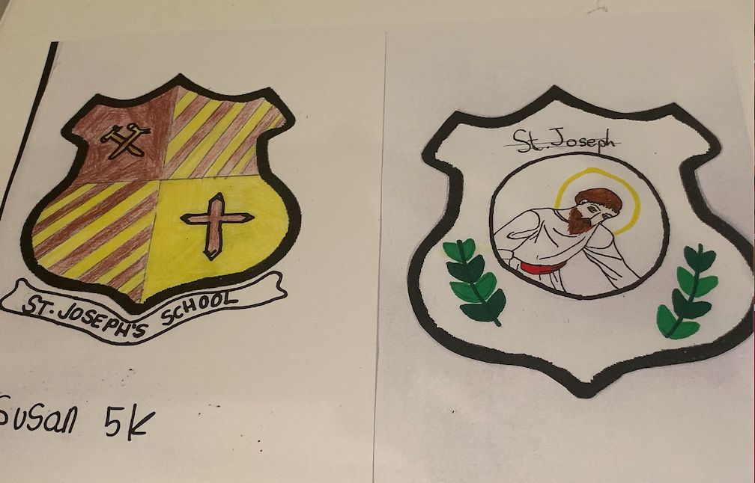
These are the two that we shortlisted.

Slide 3



We spoke about wanting to be different from other St Joseph’s School badges. Here are some examples of the other schools’ emblems closest to us and also a few examples further afield.

Slide 4




Slide 5
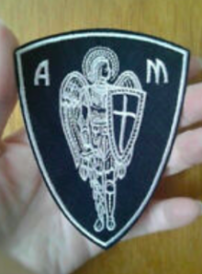

There are very few examples of school badges with figures on them (which may be a sign) but here are a couple. The first shows that more complicated figures are possible.

Slide 6
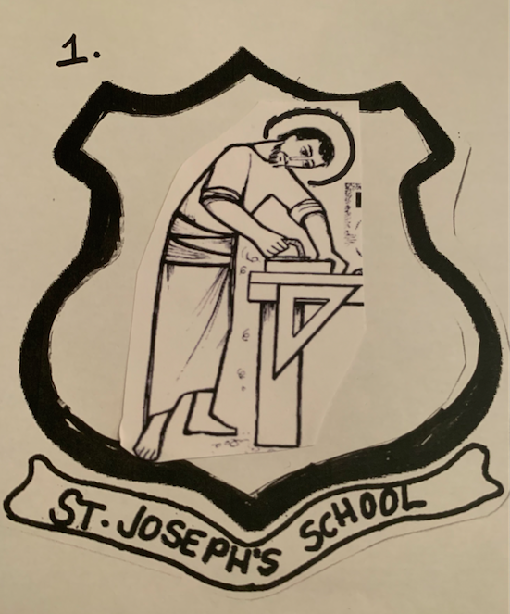
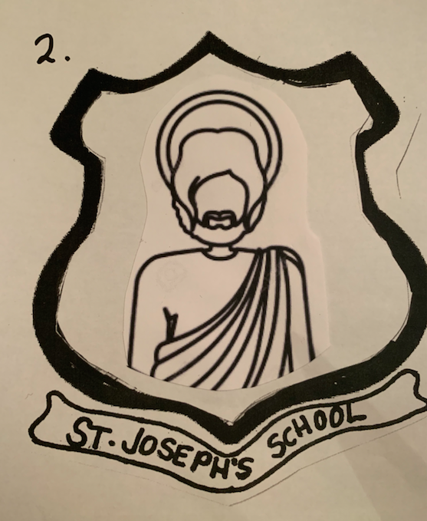
I am attaching mock ups of five emblems with differing pictures of St. Joseph. Some may be too detailed. The two simpler silouhettes (2 and 4) could do with some eyes.

Slide 7
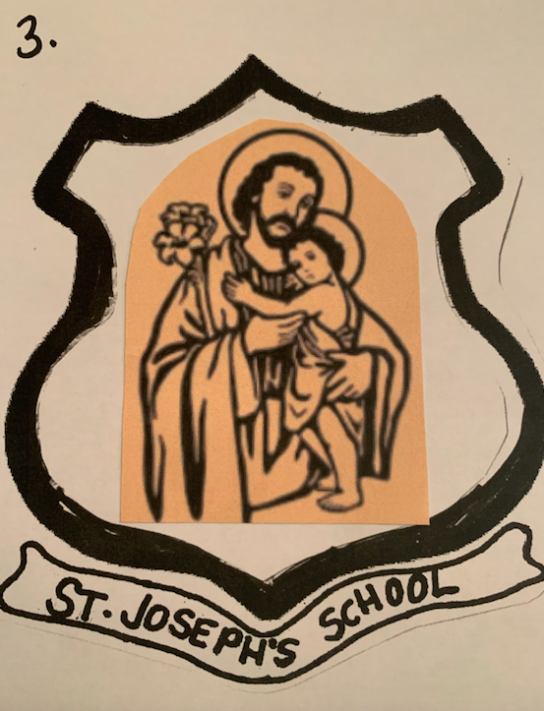
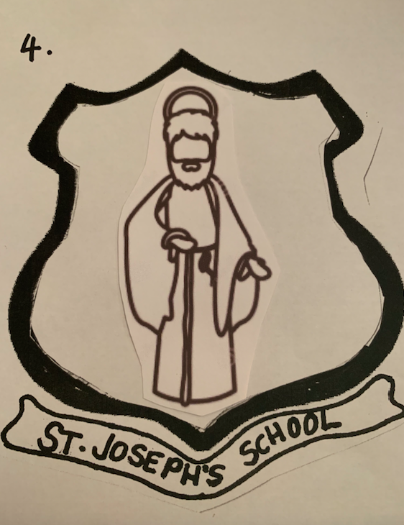

Slide 8
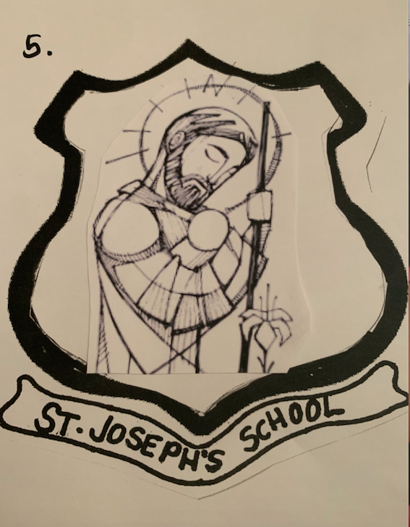

Number 5 is a Vector Art illustration so not sure if there would be copyright issues?
And finally, I wanted to include this example as a possible alternative format because we discussed whether to
have a circle or a shield
and it could work well with one of the simpler pictures (2 or 4)

