Slide 1

Year 11 Aspirations Interview 2026

Slide 2


What are Aspiration Interviews ?
Pupil also have the chance to discuss their PPE results and what this means for the course they will be taking post 16
Aspiration Interviews are practice interviews. They provide pupils with the opportunity to prepare for actual interviews in different settings
Help pupils prepare for the type of questions they might encounter in a real interview, allowing you to practice your responses.
Pupils receive constructive feedback on their performance. Including their communication skills, body language, overall presentation and their CV.

Slide 3
What are Aspiration Interviews ?
Confidence building. By practicing in a safe and supportive environment, pupils can build confidence in their ability to handle real interview situations.
Pupils can develop and enhance essential skills such as active listening, clear communication and effective self presentation
Experiencing an Aspiration Interview can help reduce anxiety and nervousness by providing a sense of what to expect in a real interview
Aspiration Interviews familiarise pupils with the interview process, including the format, types of questions, ad expectations of interviews

Slide 4

Year 11
Aspirations Interviews
Date: Friday 31 January 2026
Venue: St Josephs R C High School
Time: between 9:30 – 12:05

Slide 5

Success criteria
Learning intention
I will learn how to prepare for and take part in an Aspirations interview
I can prepare for an interview
I can be an interviewee
I can self- evaluate

Slide 6
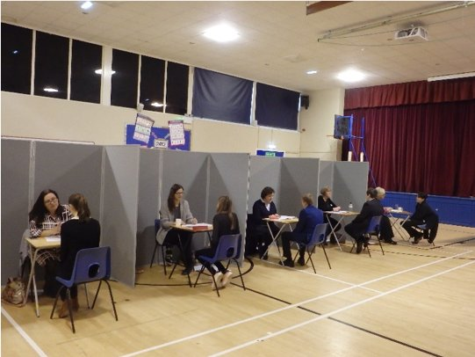
WHERE
LRC,Drama,Rm46,Rm47, Headteacher meeting room

Slide 7

Aspirations interview preparation
You need to complete a CV? You can do this by signing into your Unifrog account

Slide 8
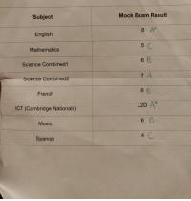
What else do I need ?
Take with you your PPE results( if you have received them)

Slide 9

What can I expect from my Aspirations Interview
Interviews can make even the most confident person nervous
The secret is to be as prepared as possible
An Aspirations interview is your chance to try out an interview in a school setting (even if you have had your college interviews every interview is different)
It helps you to figure out the best ways to answer typical questions
Correct uniform
CV
PPE results if you have them

Slide 10
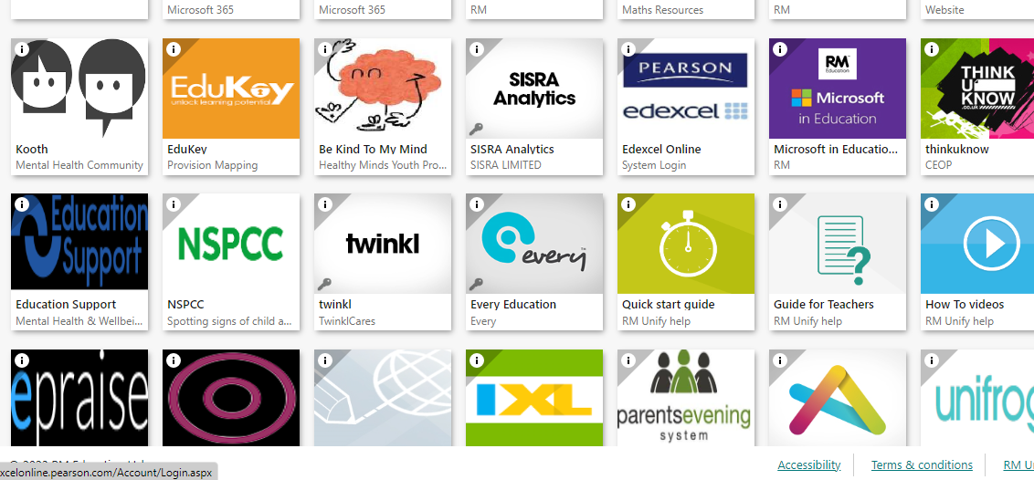
Access to CV builder on Unifrog
If pupils have forgotten how to access Unifrog they can follow these simple steps
Sign in to RM UnIfy
Click the Unifrog link - put in their school email address
Click on forgotten password
Go back into RMUNIFY – click on their email link
Find Unifrog and press reset password
Go back to Unifrog and put in both school email address and new password and save
Scroll down to CV resume - complete and print
This information was sent by Mrs Hancock on
Epraise

Slide 11
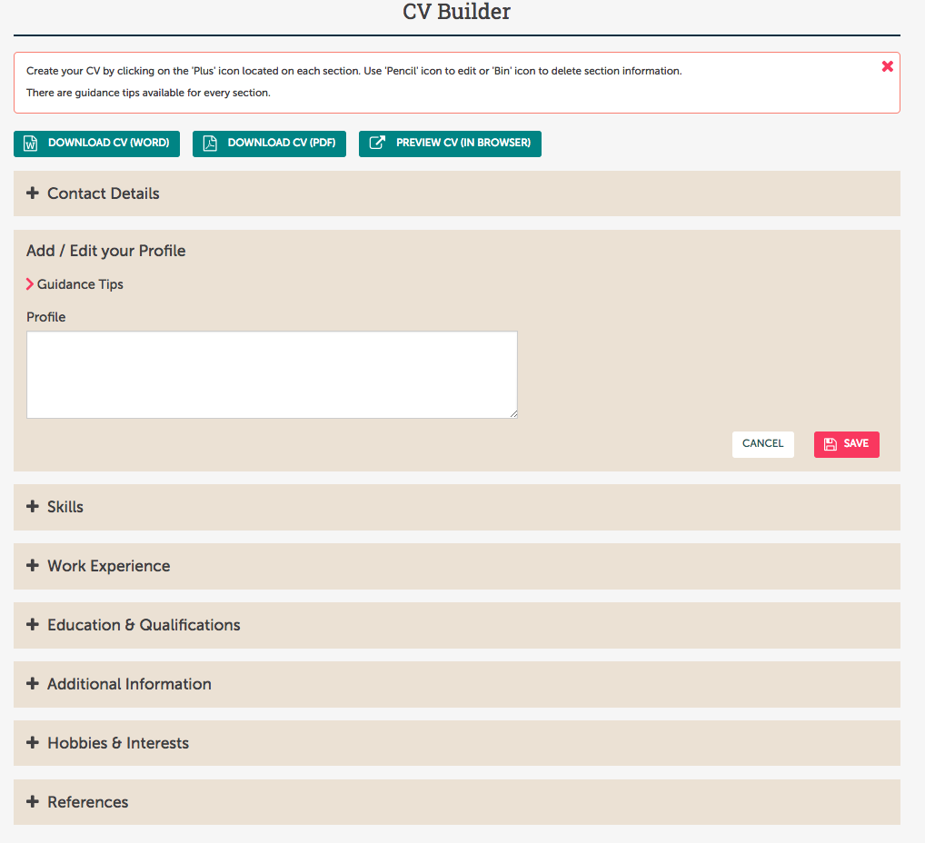
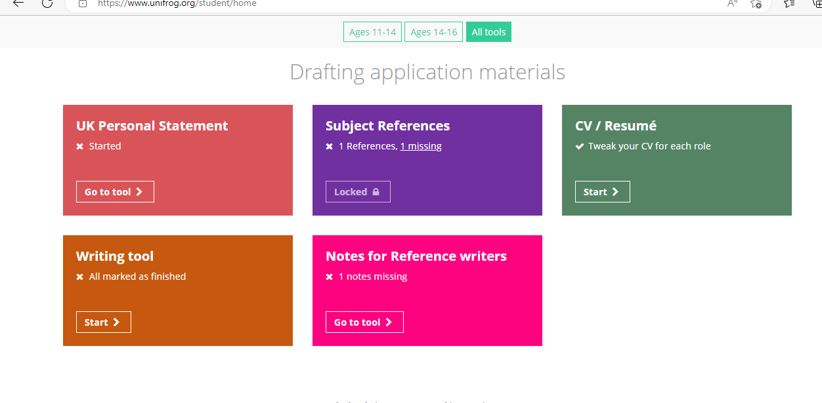
Scroll down to the box that say CV/Resume click

Slide 12
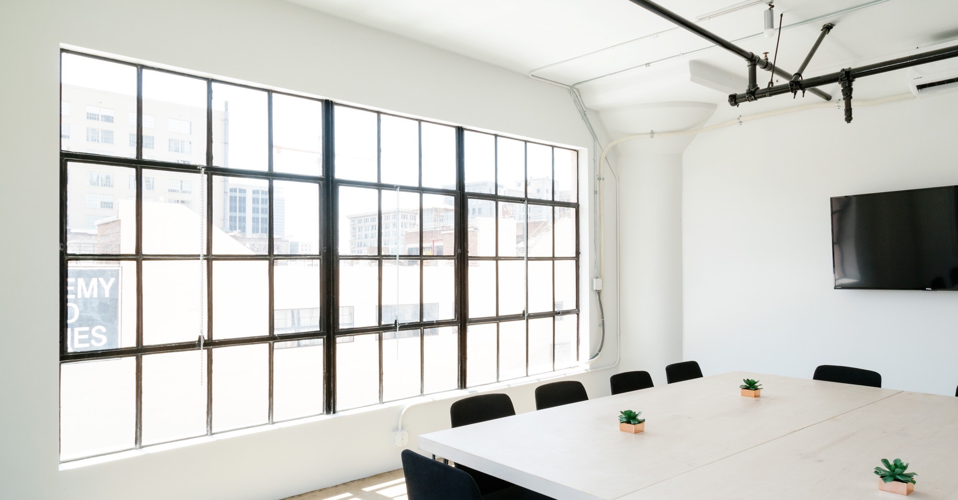
Large image
ASPIRATIONS INTERVIEW
Pupils will be given their interview times on Wednesday 29 Jan in form rooms and year 11 notice board, as well as Epraise You will be in group order (e.g. Group 1 interview time 9:30am Group 2 interview time 9:55 and so on)
All pupils will sign in at reception desk in the LRC and shown which interview room to go to
You will be assigned to an interviewer
Interviews will last for 18/20 minutes
Interviews will start at 9:30 and last interviews will be at 12:05
Please ensure you arrive a few minutes before interviews start

Slide 13
Remember! Remember!
Bring your
CV (Curriculum Vitae - a short written summary of a person's career, qualifications, and education)
PPE(mock exam) results

Slide 14

Reflection
All pupils will have a feedback from their interviews, but the feedback forms will be given to your form teachers so you can reflect on the interviews you just had

