Slide 1
RAISE Network at St Joseph’s
Receiving
Additional
Intervention
Support &
Enrichment
Information for Parents/Carers

Slide 2
RAISE Network
RAISE Network, our new name for our SEND department. Our vision for inclusion at St Joseph's is to ensure that our school welcomes and supports all students regardless of their abilities or challenges. So our RAISE Network is the structure across school for all students who are:
Receiving
Additional
Intervention
Support and
Enrichment.
St Joseph's implements a "Think Me" strategy to fully understand and meet individual student's needs and to remove barriers that restrict them from accessing the curriculum and wider opportunities so that the whole child is prepared for life beyond St Joseph's holistically not just academically. The RAISE Network is comprised of all governors, staff, students, parents and carers who support our students in "achieving beyond their wildest imagination". We are unstoppable!
We have a dedicated and passionate team of Teaching Assistants who offer daily support, care and guidance to students but in addition to this, we are moving forward as a school to develop and celebrate our inclusive practice.
Our Hive, now consists of five bespoke areas that provide a resource provision for our students, these are RISEN rooms.
Restore - a space for time out and regulation
Interact - a space for engagement and discussion
Support - a space for our interventions
Engage - a space for coordination of provision with RAISE leads.
Nurture - a space for pastoral care and guidance

Slide 3
Teaching Assistants
Key TA: First point of contact for parents/carers
Regularly checking-in with the students and providing in class support | Creating and reviewing student passports
Liaising with class teachers, form tutors and Heads of Year to ensure the best possible classroom and pastoral support for each child | Maintaining regular communication with parents/carers
Strategies of Support
In class support
Support with work
Alternative methods of recording
Targeted Intervention
Literacy
Social and Emotional
Personalised Curriculum
Personalised approach
Individual needs
Student Passports
Alternative qualifications
Behaviour and emotional regulation
1-1 occasional support
Phonics and reading
Handwriting
Use of ICT
Social skills
Alternative provision
Outdoor Education
Speech and Language
Personal strategies for support
Student informed
Behaviour management
Dyslexia Friendly School
Supporting a child access the curriculum and make progress

Slide 4
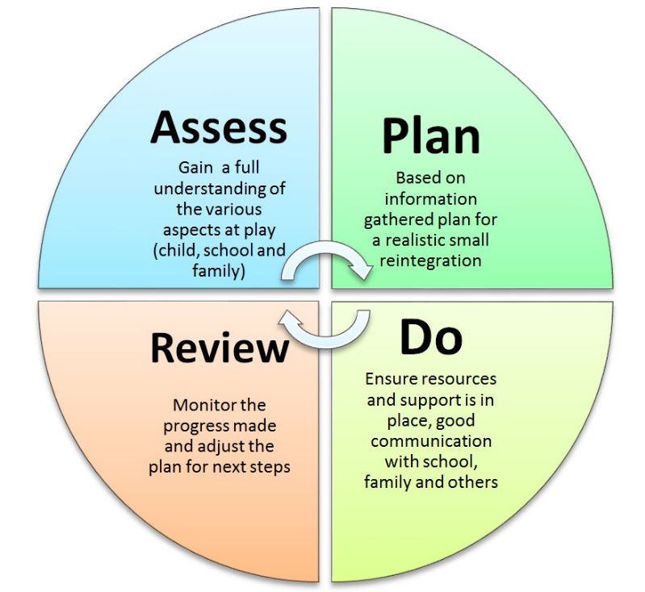
Long Term Support
Whole School Provision
StJoseph’s utilises a “THINKME” approach. The aim this approach is to ensure that the bespoke needs of each individual student are being met.
All students have Quality First Teaching which is an approach ensures adaptive teaching and encourages greater inclusion of pupils with SEND needs.
Monitoring Impact and Progress for Students
The SEND leadership team follow the cycle below to ensure that our students’ needs are being met and as a result of the provision in place that they are making expected progress.
Progress and provision is reviewed at least three times per year in line with school reports timescales.

Slide 5
Contacting the Team
The team can be contacted on the phone, via email or epraise
01204
697456
HHorridge991@st-josephs.bolton.sch.uk
Further Information
More detailed information can be found on the school website in the annual Special Educational Needs Information Report
https://stjosephsbolton.org.uk/our-school/send/
Bolton Local Offer
Provides a single point for information to help families access details about services that are available and to offer guidance.
https://www.bolton.gov.uk/sendlocaloffer/

Slide 6
RAISE Network
Restore Interact Support Engage Nurture
Safe Space
Reading Intervention
Breakfast Club
Lunch Club
Social skills Intervention
Break Time Club
Homework Club
Nurture Room
Fresh Start Phonics
Dyslexia Support
Regulation Space
Alternative Curriculum
Alternative Provision
Handwriting Support
Motor Skills Intervention
Use of ICT Support
Access Arrangements
Listening Staff
Emotional Regulation Intervention
Organisation Support

Slide 7
Interventions
Students may be involved in a range of interventions
Mc Graw Hill Reading Scheme
Closes the achievement gap by addressing difficulties in both Decoding and Comprehension
Regular assessments for progress and impact
Fresh Start Intervention
A phonics programme to accelerate progress for struggling readers aged 9-13+. Students are taught at their challenge point, so they learn to read accurately and fluently.
Talking Partners
A programme designed to improve the way children communicate across the curriculum, enabling them to be independent and skillful speakers and listeners.

Slide 8
Interventions
Students may be involved in a range of interventions
Zones of Regulation
A Social Emotional Learning Curriculum and Regulation Program. It provides an easy way to think and talk about how we feel on the inside. To build safe, supportive environments that foster learning & well-being for all.
Superflex
A Superhero Social Thinking Curriculum that helps students develop further awareness of their own thinking and social behaviours and learn strategies to help them develop better self-regulation
Personalised Intervention
Some intervention programmes are bespoke and designed to meet the individual needs of a student. These are created in liaison with specialists such as the Speech and Language Team.

Slide 9
RAISE Curriculum
Bespoke Curriculum Offer
NOCN Qualifications
NOCN Level 1/2 Award in Skills for Employment, Training and Personal Development
Employability skills are qualities that make a person employable. They are sometimes called “soft skills” or transferable skills as they are different from technical skills and work experience in a particular job role or industry..
AQA Unit Award Scheme
Students are rewarded with a certificate each time they successfully complete a unit of learning. They can build up a portfolio of certificates to evidence their skills, knowledge and experience.
Basic English & Maths
Students follow a personalised core curriculum alongside their classroom English and Maths. This develops their basic skills and knowledge and supports their access of the wider curriculum.

