Slide 1
Curriculum Development: Intent and Implementation
Opening our hearts and minds to dream the impossible and achieve beyond our wildest imagination.
Curriculum Consultation
2021 - 2022

Slide 2
Curriculum Development: Curriculum Consultation
St Joseph’s Curriculum Review
Parental Consultation: Curriculum Internet & Wider Curriculum
At St Joseph's we are committed to continually developing our curriculum, its content and the opportunities that are offered to our students. In school, we have a clear intent behind our curriculum design at whole school and department levels, where we have carefully considered the personal, social, moral, emotional and academic intent of our curriculum to support the development of all our students. Our curriculum aims to empower every student to develop as an independent, free-thinking individual with a conscience rooted in Christian values, who can cope with challenges by developing resilience and living Christ’s message. It aims to instill ambition in our young people, dream the impossible and achieve beyond wildest imaginations, with a curriculum that is ambitious in a bespoke way to meet the needs of learners. ​
We have sought parental opinion on the main areas of focus that parents and carers would like to see underpin our curriculum at St Joseph's as we continue its development. We also consulted parents and carers on the wider curriculum topics that we cover on days such as our Curriculum Enrichment Days and our range of enrichment activities.
A consultation survey was communicated to parents and the results are summarised in this document together with an action plan to implement the suggestions raised.

Slide 3
Curriculum Development: Curriculum Consultation
St Joseph’s Curriculum Review
What do you think should be the main drivers behind our whole school curriculum design to best support the development of our young people at St Joseph's?
The first question concern the fundamental principles of our Curriculum Design.
The response highlight that parents share the same aspirations for our students as are articulated in the whole school curriculum intent. Our curriculum is based on ambition, providing students with lifelong learning and transferrable skills and high academic achievement.
These responses do suggest that the school needs to promote the benefits of stewardship and faith formation with our parents/carers as these are a fundamental foundation for out students education in our Catholic school.
Action: Identify ways to increase the opportunities for promoting faith formation and its benefits with parents/carers.
Less religion, more opportunities to debate open discussion

Slide 4
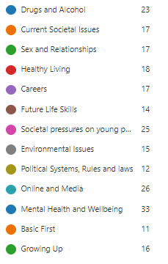
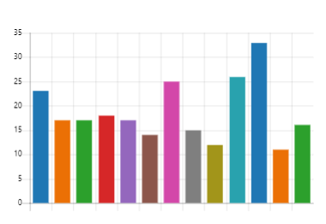
Curriculum Development: Curriculum Consultation
St Joseph’s Curriculum Review
What topics do you think are delivered well in our Curriculum Enrichment Days?
Our wider curriculum content was also reviewed to ensure that parents/carers feel that St Joseph’s has a broad and balance curriculum that meets the needs of all our students in today’s society.
This also ensures that the curriculum design is planned to deliver academic content and also the wider curriculum skills.
This review shows a consistent response to the all topics that are delivered on Curriculum Enrichment Day. This response from parents mirrors the responses from student voice which shows that students feel they make progress and understand more on these areas based on surveys after each Enrichment Day.
First Aid is an recent addition to the Curriculum Enrichment curriculum offer and is therefore progressing in terms of its implementation.

Slide 5
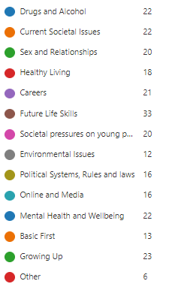
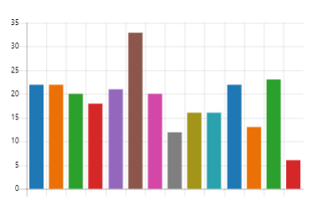
Curriculum Development: Curriculum Consultation
St Joseph’s Curriculum Review
What type of topics and themes would you like to see covered more in our Curriculum Enrichment Days?
Parents and carers were asked to consider which areas of the PSHEE, RSE, Careers and Citizenship they would like to see developed in our Curriculum Enrichment Days.
The main areas were around Future Life skills, with the following topics being highlighted in the “other” category,
Financial skills e.g. basic understanding of what expenses there are as an adult
Banking/finances/money management and information about savings.
Mortgage, saving, taxation, budgeting
Other areas were:
Vaping
Basic life support
Action: Review the 5 year spiral curriculum for Curriculum Enrichment Days to ensure these topics are embedded.
Revisit the Y9 Lifelong learning days to enhance the topic of Future Skills particularly in Day 3: My Future.

Slide 6
Curriculum Development: Curriculum Consultation
St Joseph’s Curriculum Review
Which of these experiences would you like your child to have the opportunity to experience as part of their wider curriculum at St Joseph's?
Parents/carers were also asked to consider what opportunities their child could be offered a St Joseph’s that would enhance and enrich their experience of education. Again, careers and life skills were a key area highlighted by parents, with the “other” topics being identified as:
Learn life skills-saving, budgeting, first aid, cooking, health etc
Visit and participate in more sporting events
Any day trip would be beneficial for all children, especially on low income families, where trips out at anytime , do not happen due to costs etc
This list and a similar list from student voice (detailed in the Autumn Enrichment Offer Review) have been provided to staff to consider and implement as part of our Extended School Day programme.
As visitors and careers providers can engage more with school visits post-Covid, there is a medium term plan to ensure that the student experiences surrounding Careers and future skills are embedded in our curriculum. This is done through Curriculum Enrichment Days, Lifelong learning days and other opportunities such as Y8 Work Shadow day and Y10 Work Experience Week.

