Slide 1

Year 8 2023/2024

Slide 2
A student’s prayer – At the crossroads again Lord!
Inspired by Fr David O'Malley “Trust the Road”

Slide 3
Overview
Welcome and Introduction
Curriculum and Pathways
Support and Guidance

Slide 4


Introduction
Information + support = a good choice

Slide 5
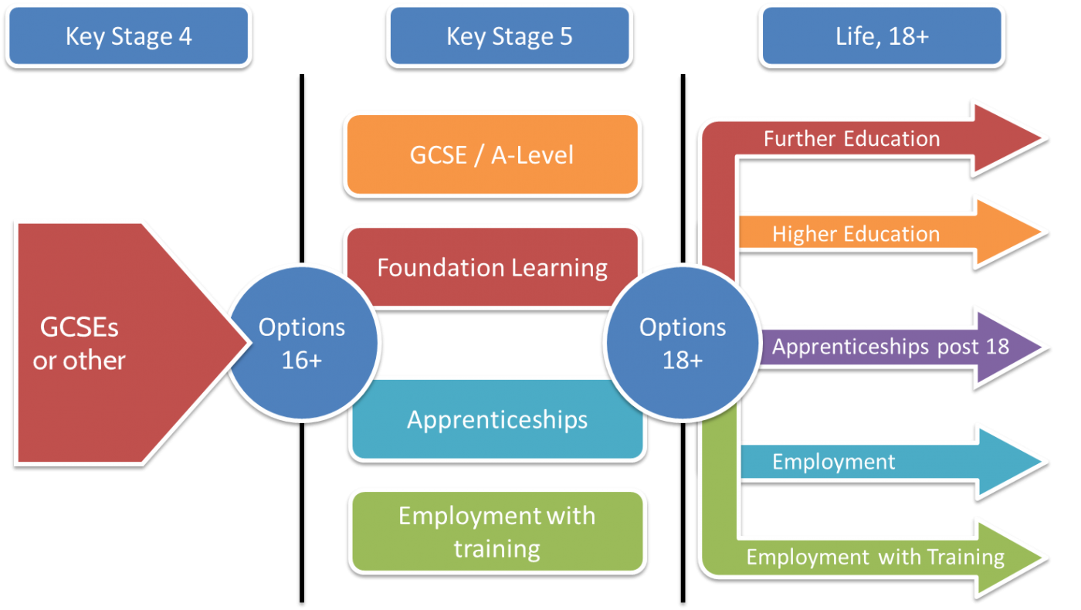

Slide 6
Why are the choices important?
‘In a competitive job market, academic and vocational qualifications are increasingly important. Those with good qualifications are at a lower risk of being unemployed.’
‘The EBacc is a set of subjects at GCSE that keeps young people’s options open for further study and future careers.
‘A broad and balanced curriculum inspires pupils to learn. The range of subjects and courses helps pupils acquire knowledge, understanding and skills in all aspects of their education’
Exclusion, employment and opportunity, Case Paper No 4, Atkinson. A and Hills J, (eds),
www.gov.uk
Ofsted

Slide 7

Aspirational Curriculum
A long standing history of high attainers at KS2.
Pathways designed to deliver an Aspirational Curriculum.
Curriculum Intent
Our curriculum aims to empower every student to develop as an independent, free thinking individual…
Our curriculum intends that students should ‘aspire to be more’. As such we will offer a range of challenging GCSE subjects so that our pupils can compete with the best.

Slide 8

Aspirational Curriculum
School need to challenge all our learners to reach their full potential.
At home you need to challenge your child to reach their full potential.
The suite of subjects on each Pathway aims to challenge each pupil to maximise their future possibilities.

Slide 9
Learning Pathways
A Learning Pathway is the learning experience of each individual 14-19 year old. It consists of a Learning Core and a choice of option.
Learners will select, with support and guidance, options which suit their interests, abilities and learning styles and which help them to realise their potential
All learners aged 14-16 will take the following subjects
  RE, English, Mathematics, Science and PE (Core)
  History/Geography, International Language
  A choice of specialist subject
Your pupil will be allocated a Pathway appropriate to their aspirations and ability.

Slide 10
Subject Choices
Subjects: Pathways Curriculum
Art and Design
Business
Creative iMedia (Cambridge National)
Design and Technology
Drama
Food : Preparation and Nutrition
Geography
Health and Social Care BTec Award
History
International Languages
Music
OCR National in Sport Science
Performing Arts BTec Award
Subjects: Core Curriculum
Religious Education
English
Mathematics
Science
Physical Education - core

Slide 11
Considerations for your choice
You like it or find it interesting
You think you will do well
You’re good at it
You can develop new skills
It will combine well with other subjects
Your teachers think it is suitable for you
It’s useful for your future aspirations
Your friends are doing it
You think it will be easy
You can’t think of anything else to choose
You like the teacher who teaches it
It sounds good
You think you should do it- even though you haven’t found out about it
Notes:
Think carefully about your subject choices; find out about subject content and assessment; research the necessary subject requirements for any career in which you may be interested.
Your choice should reflect YOUR interests and abilities. Do NOT make choices because of pressure from others. You are unlikely to have the same teachers next year as you have this year and you may well be in a different class to your friends. It is very important that you make the right choices NOW.
The timetable for next year will be designed according to the choices you make and any requests for changes at a later date may not be possible.

Slide 12

Parental Support
Talk to your child about their future
Encourage them to maximise their options
Share the Pathways booklet together
Maximise attendance
Support revision – even in Y8 and in Y9!
Encourage organisation
Use Unifrog
Monitor Epraise

Slide 13
Support and Guidance
Form Tutors
Mrs Weall – Head of Year
Mrs Hancock – Careers Advice and Guidance
Individual subject teachers
Heads of Department
Senior Leadership Team

Slide 14
Pathways Timeline
Thursday 18th January 2024 | Launch of Y8 -9 Pathways process parents/carers information evening
Thursday 25th January 2024 | Y8 Parents’ Evening: School Cloud
w/c 29th January 2024 | Y8 Assembly: Pathways Choices
w/c 29th January 2024 | Pathways forms and booklet issued to students
w/c 26th February 2024 | SLT Interviews: One-to-one interviews for students and parents/carers to discuss personal process and pathway choices
26th Feb – 8th March 2024 | Y8 Exam Weeks
Thursday 28th March 2024 | Y8 Report issued to parents/carers
Monday 15th April 2024 | Deadline for submission of KS4 Pathway Choices
June 2024 | Confirmation of Course Choice letter issued to students
During Spring Term 2024 | 1:1 student interviews with Mrs Hancock: Head of Careers

