Slide 1
Welcome to Year 6

Slide 2
Dr Seuss
Don’t Give up.
I believe in you all.
A Person’s a Person
No Matter how small.

Slide 3
Teaching and Support Staff
Class Teacher – Mrs Morris and Mrs Brooks
Teaching assistant – Mrs Campbell and Miss Palmer
Learning Mentor – Mrs Bond

Slide 4
Treat others as you would like to be treated
As ever, this year we will be giving your children the opportunity to grow as young people and encourage them to develop a closer relationship with God in an atmosphere of mutual love and respect. We seek to live out the values of Jesus Christ daily, promoting them by our words and deeds.
Jesus told us to “Treat others as you would like to be treated.” As our school motto, this reminds us every day to go the extra mile for the children within our care.

Slide 6
Treat others as you would like to be treated
It is our school motto that underpins our behaviour policy in school.
In Year 6, the children have come up with some rules for our classroom to ensure that we are happy, safe and able to learn.

Slide 7
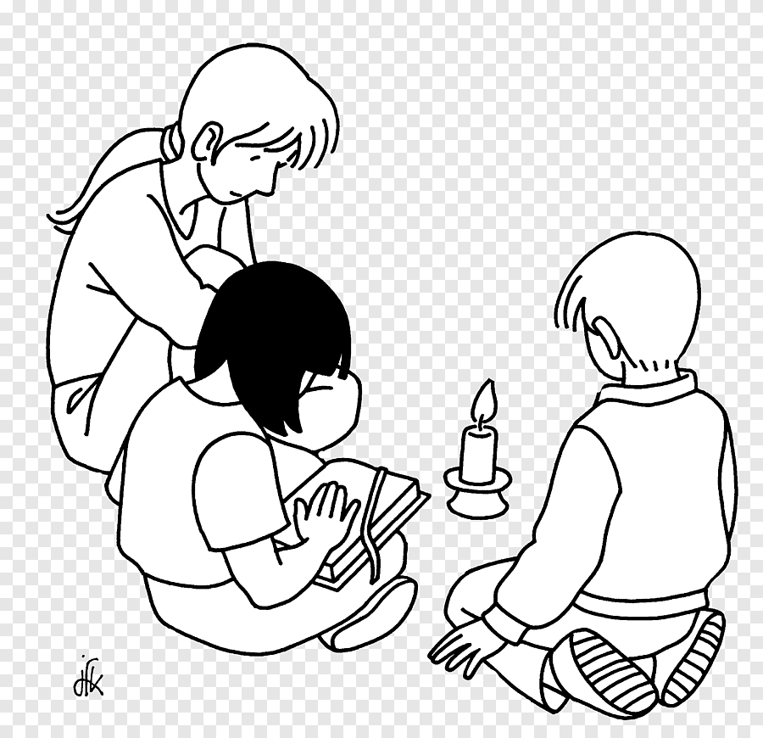
Prayer and liturgy

Slide 8
Gospel values and scripture at the heart of learning Autumn 1
beatitude
Gospel values
Big question
Blessed are the meek for they shall inherit the earth.
Gentleness
Humility
Selflessness
How can we care for God’s Earth?

Slide 10
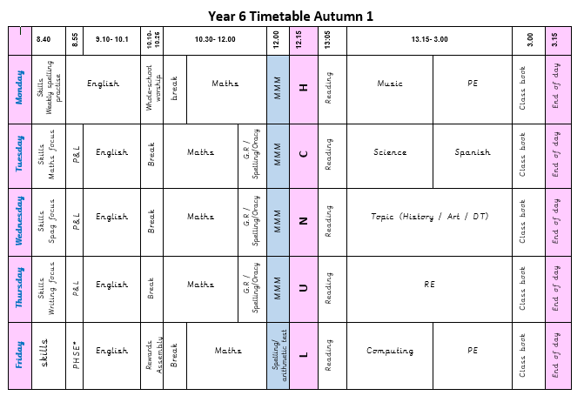
Insert timetable
Notes:
A typical week in Year 2

Slide 11
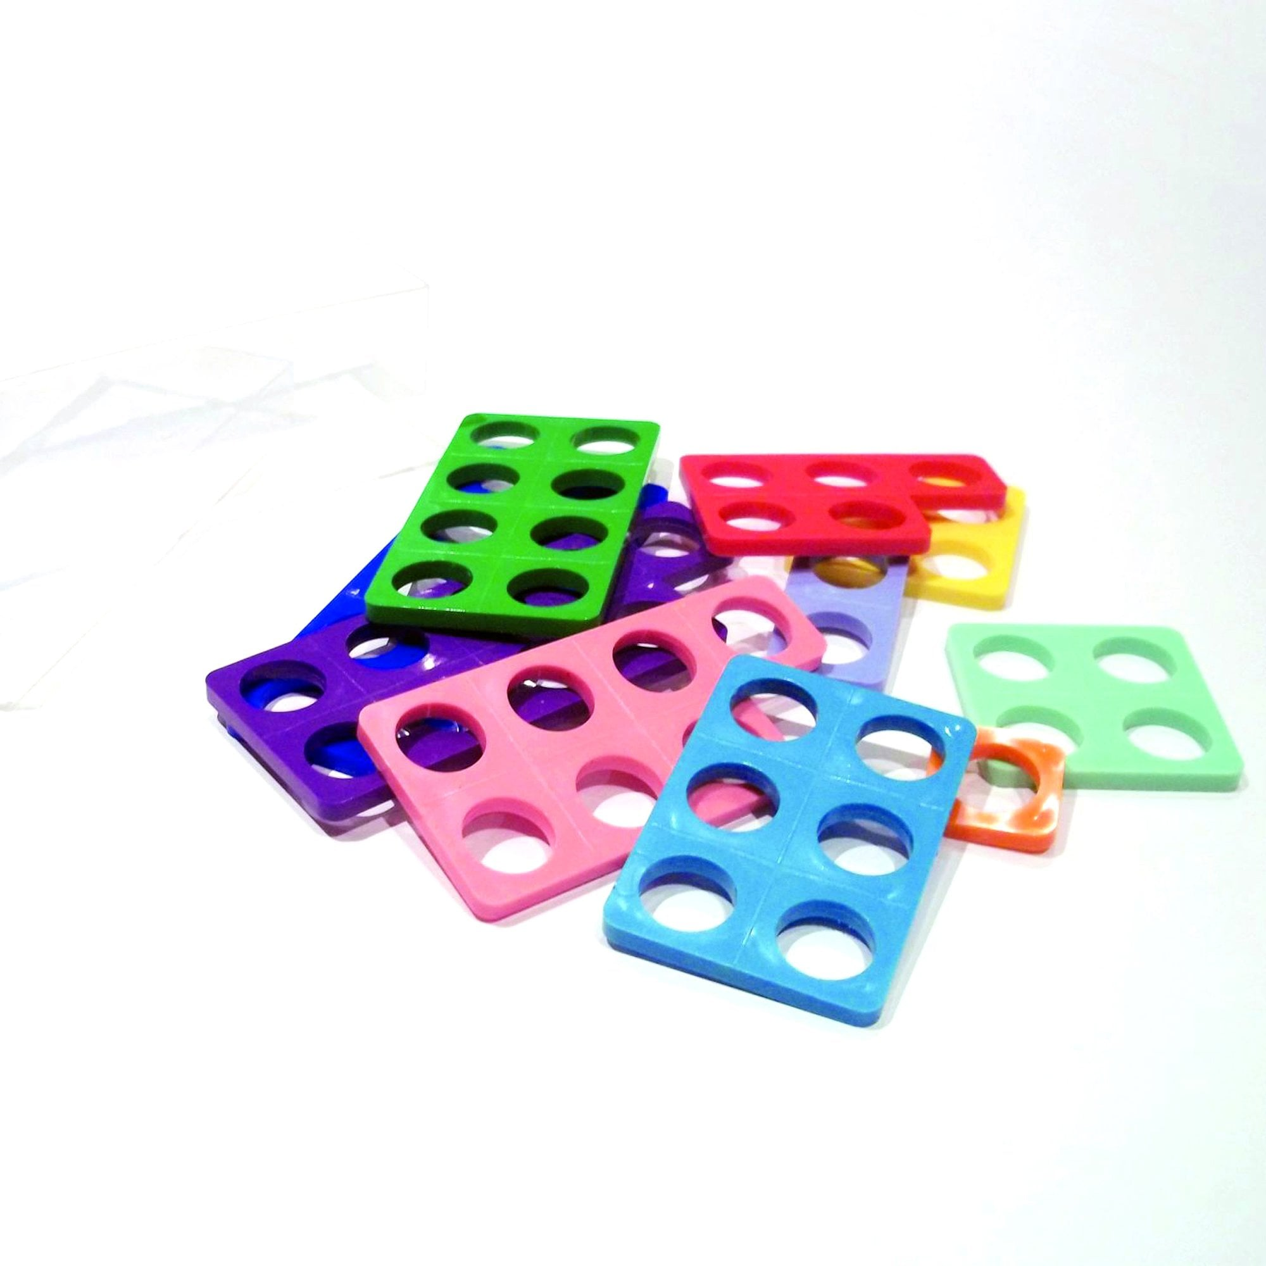
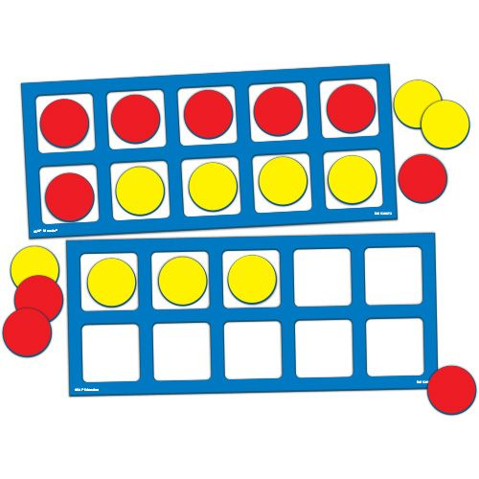
In maths, we are continuing to use the White Rose scheme of learning.
Morning Maths Meetings

Slide 12
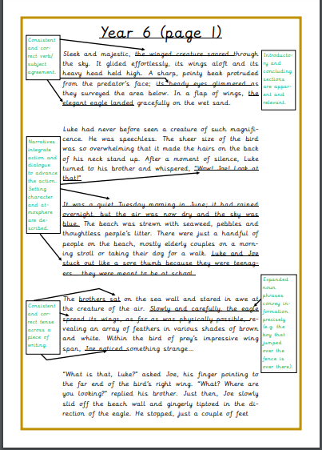
Children will develop their writing skills in English lessons and then have the opportunity to apply these skills across other areas of the curriculum.
writing
Full details of the expectations for Year 6 writing can be found on our website.
Please go to the Year 6 class page and click on ‘English’.
There is also a glossary for all the grammar and punctuation terminology your child needs to know.

Slide 13
Reading
Remember to try to read every night with your child and record this in their reading diary. We also have opportunities to read regularly in class and will enjoy a ‘Class Reader’ – a book we can read and enjoy together in class. There is time every day given to ERIC – Everyone Reading In Class.
From school:
Reading book
Library book (remains in school)
What should my child be reading?

Slide 14
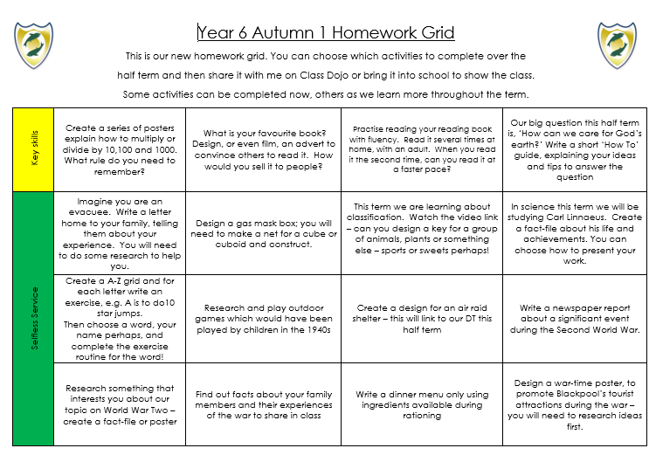
Homework grids

Slide 15
A quick word about statutory testing this year

Slide 16
Things to remember – Year 6
Staggered start time: 8:40am Finish time: 3:15pm
Monday
Tuesday
wednesday
Thursday
Friday
Books changed
PE
Instruments - flute
Wednesday Word
PE Day
Brass
Choir
Football
Check Dojo for updates
PE will be outside whenever possible so please send jogging bottoms and jumpers for when the weather gets colder.

Slide 17
Need to talk?
Class Dojo is our main method of communication.
You can privately message me (or other teachers connected to our class) at any time.
I will always respond as soon as I am able to.
Alternatively, I can be contacted by phone outside of lesson times.

Slide 18
Key reminders
Mornings
Our doors are open for children to enter school from 8.40am to 8.50am.
Registers close at 8.55am. After the register has closed, children will be marked as late.
Absences
If your child is going to be absent for any reason, rather than letting their teacher know on Dojo, please contact the school office and leave a message on our absence line, if no one answers.
A reminder that we are now following new statutory guidance regarding requests for leave during term time, such as for holidays or weddings. If you do have such a request, please visit the school office to pick up a request for leave form.

Slide 19
Key reminders
Uniform
Please label all items of uniform and PE kits with permanent pen/ stamps/ labels.
We have lots of spare uniform in school that is good quality. Items can be requested from Mrs Bond or Mrs Brooks.
Stud earrings may be worn but either plain silver, gold or diamante (not different colours). Watches are permitted but not smart watches.
PE
PE kits should stay in school for the half term and then taken home for washing.
No jewellery should be worn on PE days. Staff are not allowed to remove earrings. When removed by children, earrings often get lost.
PE is part of the National Curriculum so all children are expected to take part unless there is a medical reason why not – this should be shared with the class teacher prior to the lesson.

Slide 20
Key reminders
Medication
Where possible, medication should be taken at home but if your child needs to take medication whilst in school, please bring it to the office and complete a form, giving permission for staff to administer it.
Asthma – children with asthma should have an inhaler that is kept in school, along with an asthma care plan.
Health care plans should be completed for all children with a medical need. If you have any queries about medical needs, pleases contact Mrs Brooks.

