Slide 1
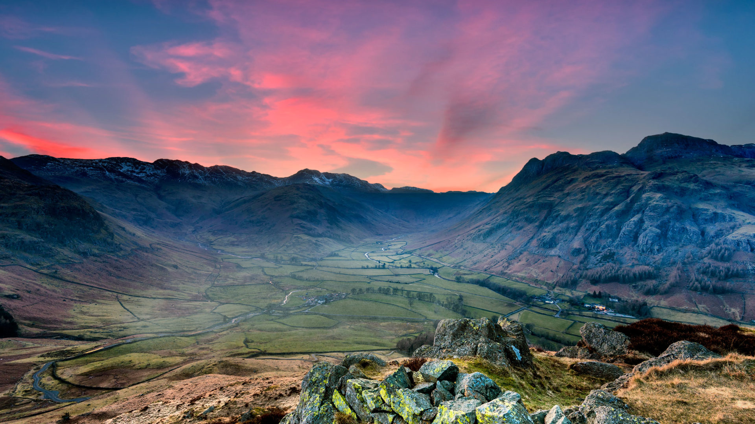
Bassenfell
Manor October 2026

Slide 2
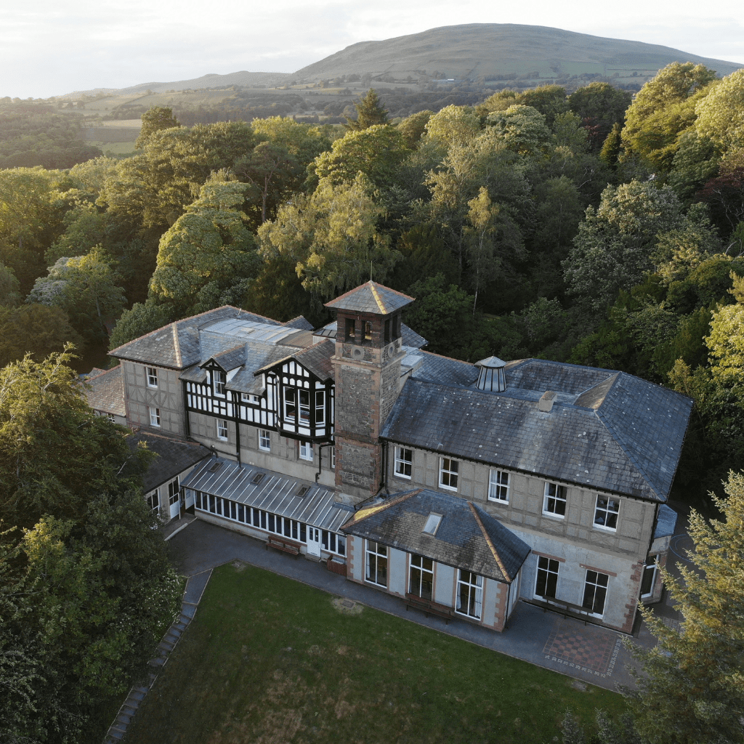
Where?
Bassenfell Manor Christian Centre.
Bassenfell Manor, near Bassenthwaite Lake in the Lake District, hosts school groups, youth groups, church groups and holidays.
It is situated in an acre of grounds with adventure play equipment and access to its own woodland, which is used for various bush craft and environmental activities.
During the week it will be for the exclusive use of St. Margaret’s School and Bassenfell staff will supervise all day time activities.

Slide 3
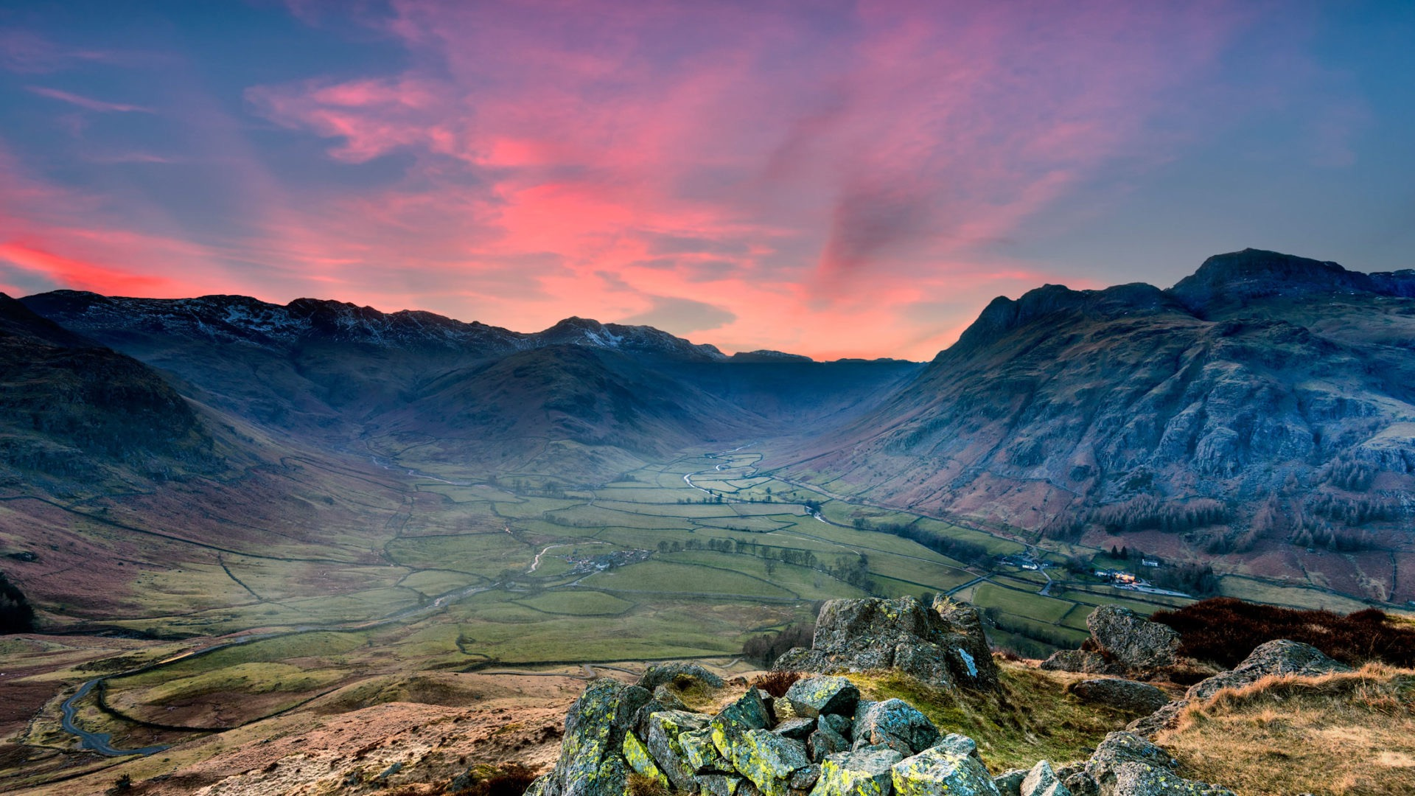
When?
Week beginning 12th October 2026.
Class 1 – Monday to Wednesday.
Class 2 – Wednesday to Friday.
Hosting 60 children results in Bassenfell running at capacity.
Splitting the week ensured smooth activity transition, and allowed classes to bond more meaningfully.

Slide 4
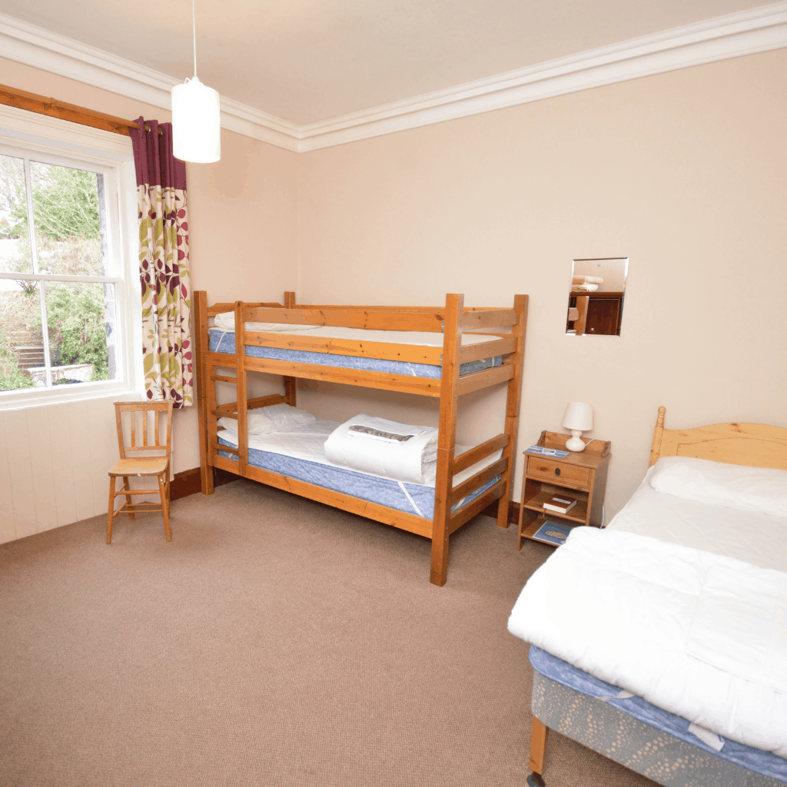
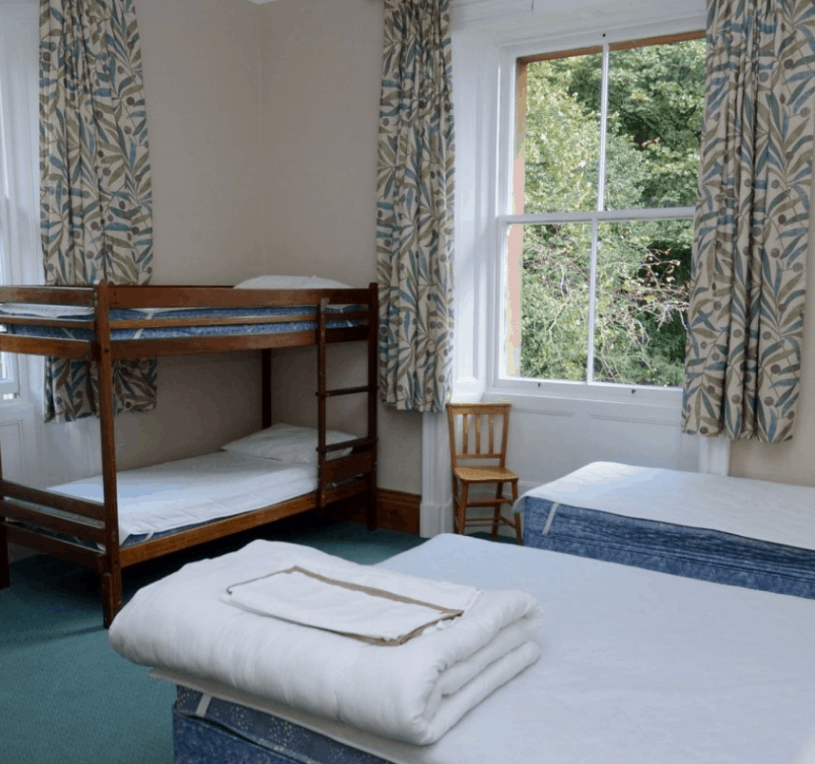
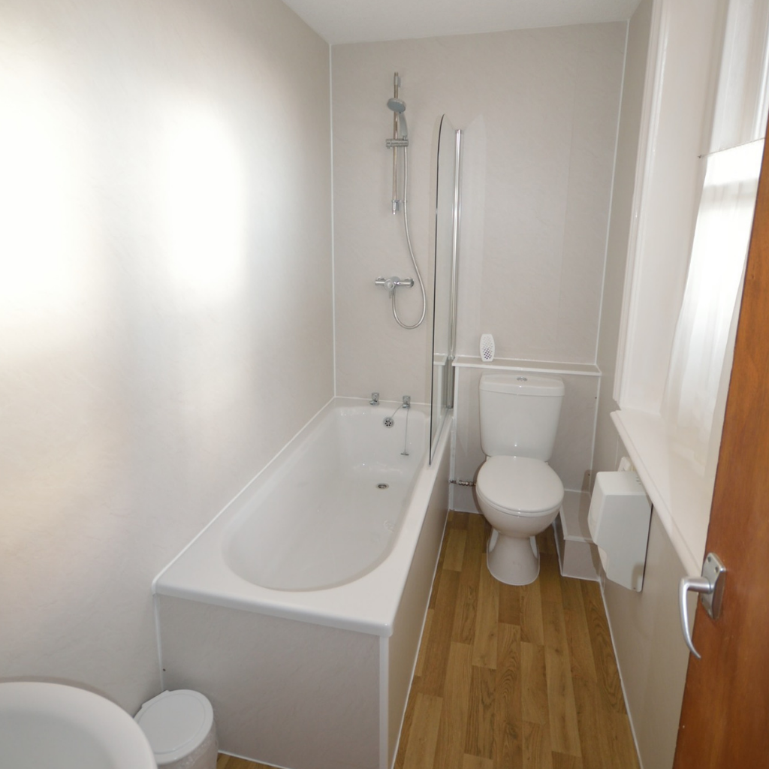
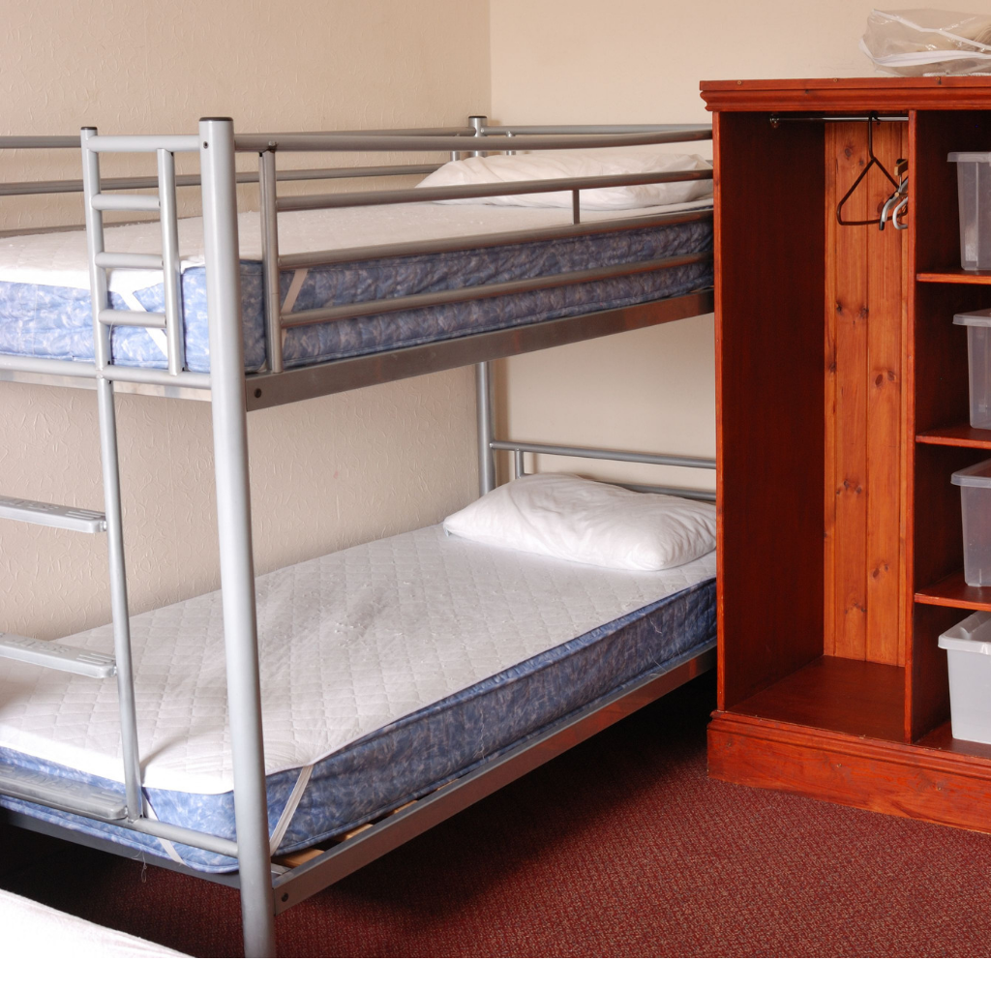
Accommodation
Rooms range from 2-6 people and all beds are either single or bunks.
All rooms have either en-suite or private bathrooms.
Children are required to provide sleeping bags/pillow cases. Pillows are provided by the centre. A full kit list will be provided nearer the time.
We ask children who they would be comfortable sharing a room with. Everyone will be with at least 1 friend.
St Margaret’s staff have their rooms close by should anyone need us.

Slide 5
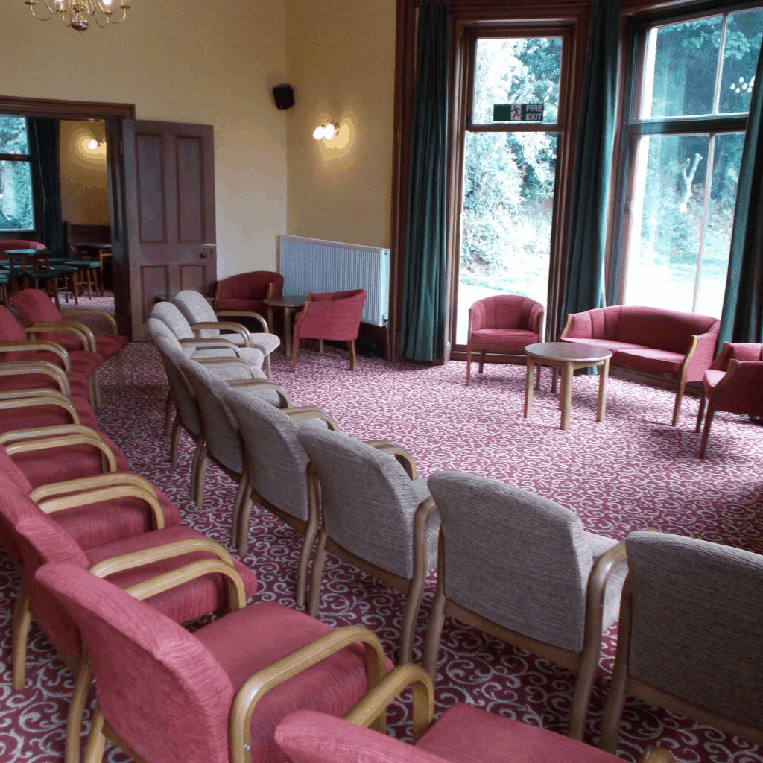
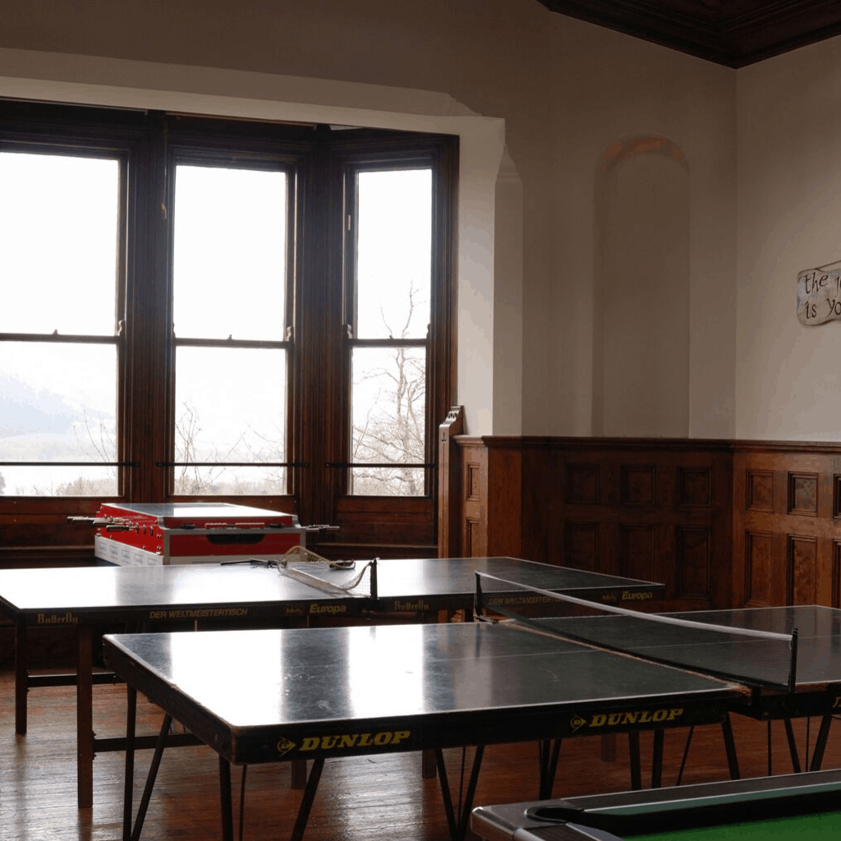
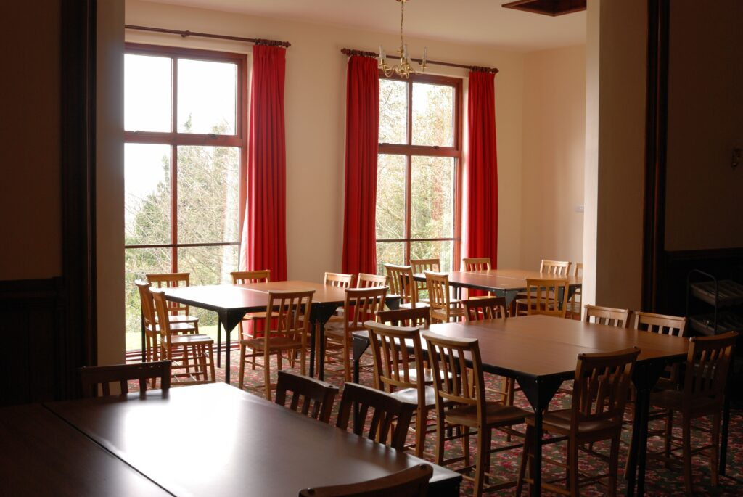
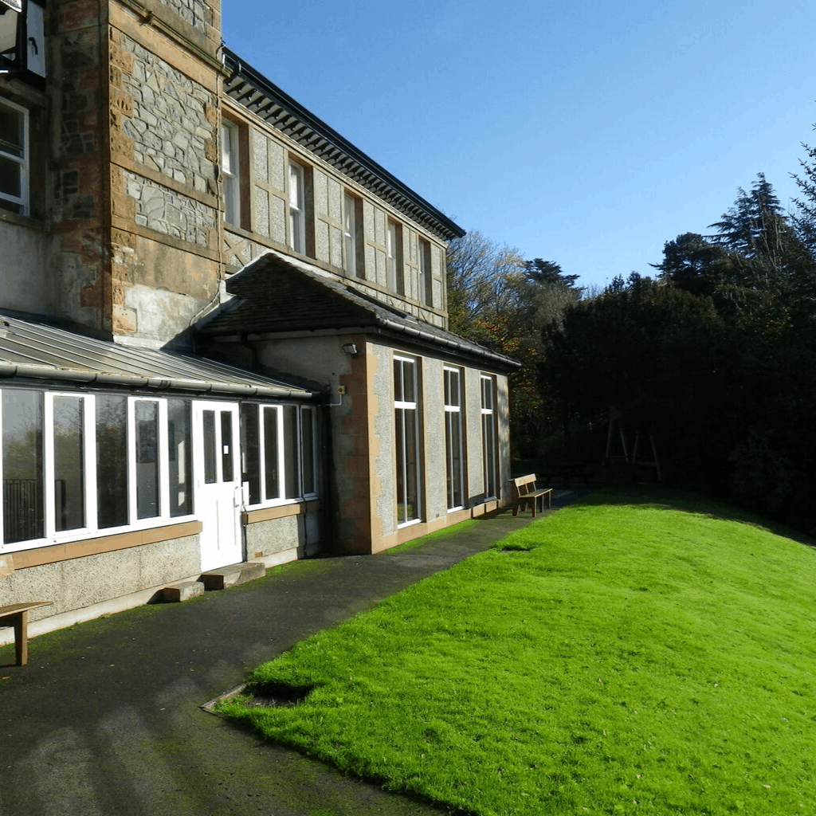
Facilities
Children will have plenty of space to relax, play and enjoy time together.
The common room is used for morning reflections and is ideal for movie nights on an evening.
Large dining room with views over the lake.
A games room for relaxing and free time (if the children aren’t outside!)
Large outdoor areas with a playing field and play equipment.
All spaces are for our exclusive use during the week.

Slide 6
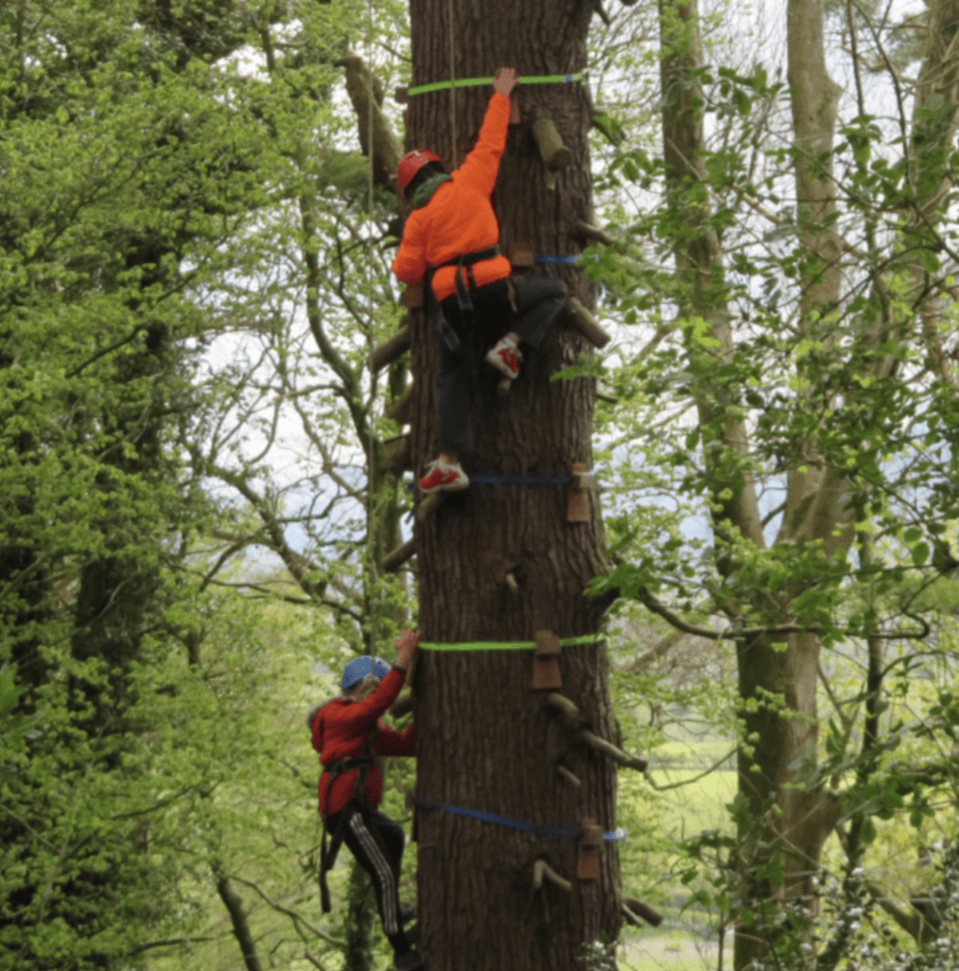
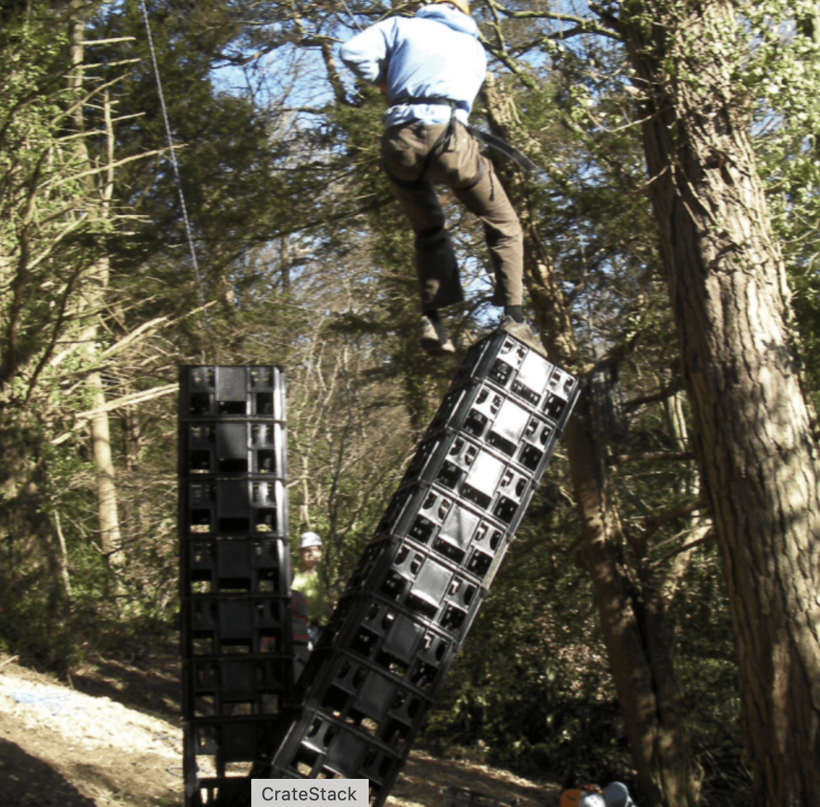
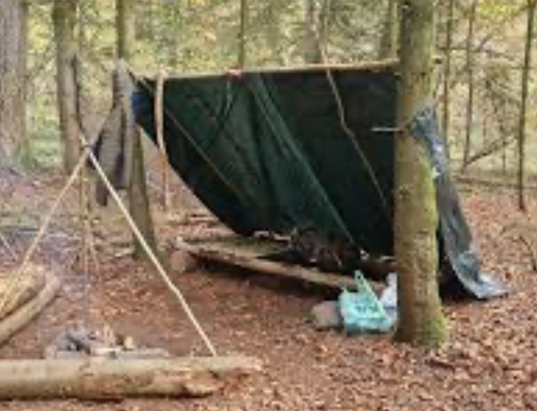
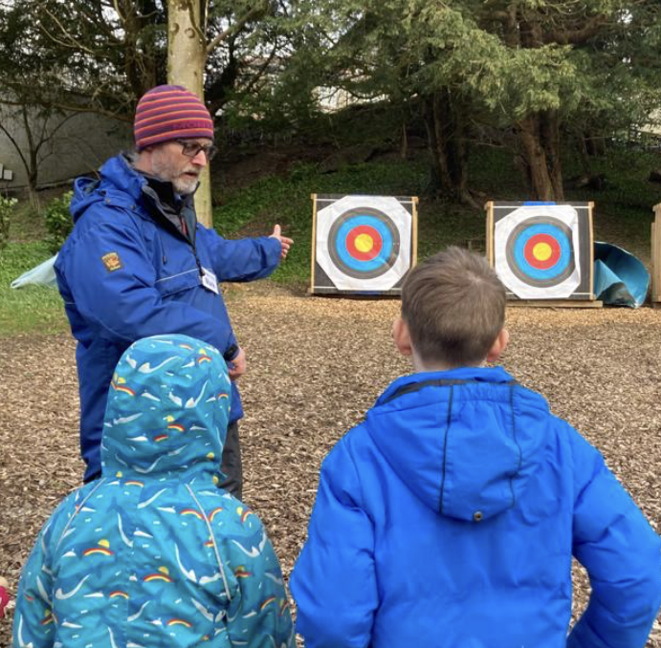
Day time activities
Crate stacking
Tree climbing
Bush craft (fire safety, break making and shelter construction)
Archery – A new addition this year, after having listened to the feedback last year.
Children will be in groups of approximately 8- 10. Bassenfell staff will run the activities, and St. Margaret’s staff will always stay with their allocated group.

Slide 7
Benefits
We understand that, for many, this may be their first evening spent away from home.
This is what we’ve seen in the past:
Develop self-awareness and strengthen social skills.
Grow in confidence by taking on new challenges.
Build independence and personal responsibility.
Strengthen teamwork through cooperation, trust and mutual support.
Experience awe and wonder in nature and take time to reflect.

Slide 8
Evening activities
Ran by St Margaret’s staff
Quiz night Film and hot chocolate night (more often than not, the children appreciate a chance to relax after busy days!)
Outdoor play (either in the open spaces or adventure play equipment)
Games room
Indoor games, puzzles and jigsaws
Relaxing with a book

Slide 9
Common questions
(anything else – just let me know)
Food
Allergies can be catered for and the cook at Bassenfell is happy to discuss dietary requirements with parents.
Breakfast is toast and cereals.
Lunch for days 2 and 3 are packed lunch prepared by Bassenfell staff. These include a choice of sandwiches, fruit, cakes/flapjacks and crisps.
A packed lunch from home is required for the first day.
Evening meals are selected by the children prior to our visit. The majority vote is chosen, but no meal is repeated. If there are concerns regarding the selection, they can be raised with Bassenfell staff.

Slide 10
Common questions
(anything else – just let me know)
Medication
Any child with a medical plan will need medication with them.
Please could this be handed to the office prior to the trip.
A named member of staff will be responsible for medicines.
It is really handy to know ahead of time, if your child is allowed emergency Calpol. This saves a phone call home (which might cause alarm at 2am!)
Travel sickness – Please ensure any travel sickness tablets are sent to the office. We can administer these prior to the return journey too.

Slide 11
Common questions
(anything else – just let me know)
Mobile phones and electronics
Please do no bring any high value items, including electronics and mobile phones. Invariably, things go missing. It’s wonderful to see the children enjoy some time away from screens.
Books and cuddly toys
Children can bring a book for the journey and relaxing time. Most also choose to bring a soft teddy. That’s absolutely fine, so long as they aren’t huge.

Slide 12
Common questions
(anything else – just let me know)
Money
There is a small gift shop. Please send no more than £5, preferably in coins. Labelling a small money bag would be helpful. Staff can keep these until the shop opens.
What’s on the kit list?
A full itemised list will be provided nearer the time, but old clothes that can be layered are most suitable. Please bring sturdy shoes or boots.
Put your name on absolutely everything!

Slide 13
Costing
The total cost of the visit is £171 (£140 for accommodation and £31 for the coach).
A £50 deposit is required by 20th May, followed by £60.50 by 15th July, with the final £60.50 due on 1st September.
Payments can be made via ParentPay, and we strongly advise taking out personal insurance as the Local Authority's policy does not cover cancellations.
If there any any concerns regarding costing, please contact the school office.

Slide 14
Thank you!
Any question?
Please don’t hesitate to contact me if anything comes to mind.
More information about the venue and activities can be found on Bassenfell’s webpage:
https://www.bassenfell.org.uk/

