Slide 1


Welcome to Willow Class (Year 3)
Meet the Teachers Evening 2025/2026

Slide 2

We all work together
to do our best to shine with God's love, pride and success
in a happy, peaceful and prayerful place where everyone tries to be kind, helpful and caring.
Vision
By reflecting the principles of the Catholic Faith we at St. Maria Goretti aim to celebrate the uniqueness of each child and through high expectations enable all our children to reach their full potential and become happy, confident and successful individuals.
Our School Mission Statement

Slide 3
In Willow class, we want our children to be happy, creative, imaginative and develop into independent learners, who have a love and passion for all their learning.
Our Class Vision
n

Slide 4

Mrs. Milne – Monday, Tuesday and Wednesday AM
Mr. Birchall – Wednesday PM, Thursday and Friday
Year 3 – Our Willow Class team……
Mrs Patel and Mrs Singh (Teaching Assistants)- Every day

Slide 5

SMG Golden Behaviour Rules
Is it caring?
Is it Safe?
Is it my best?

Slide 6
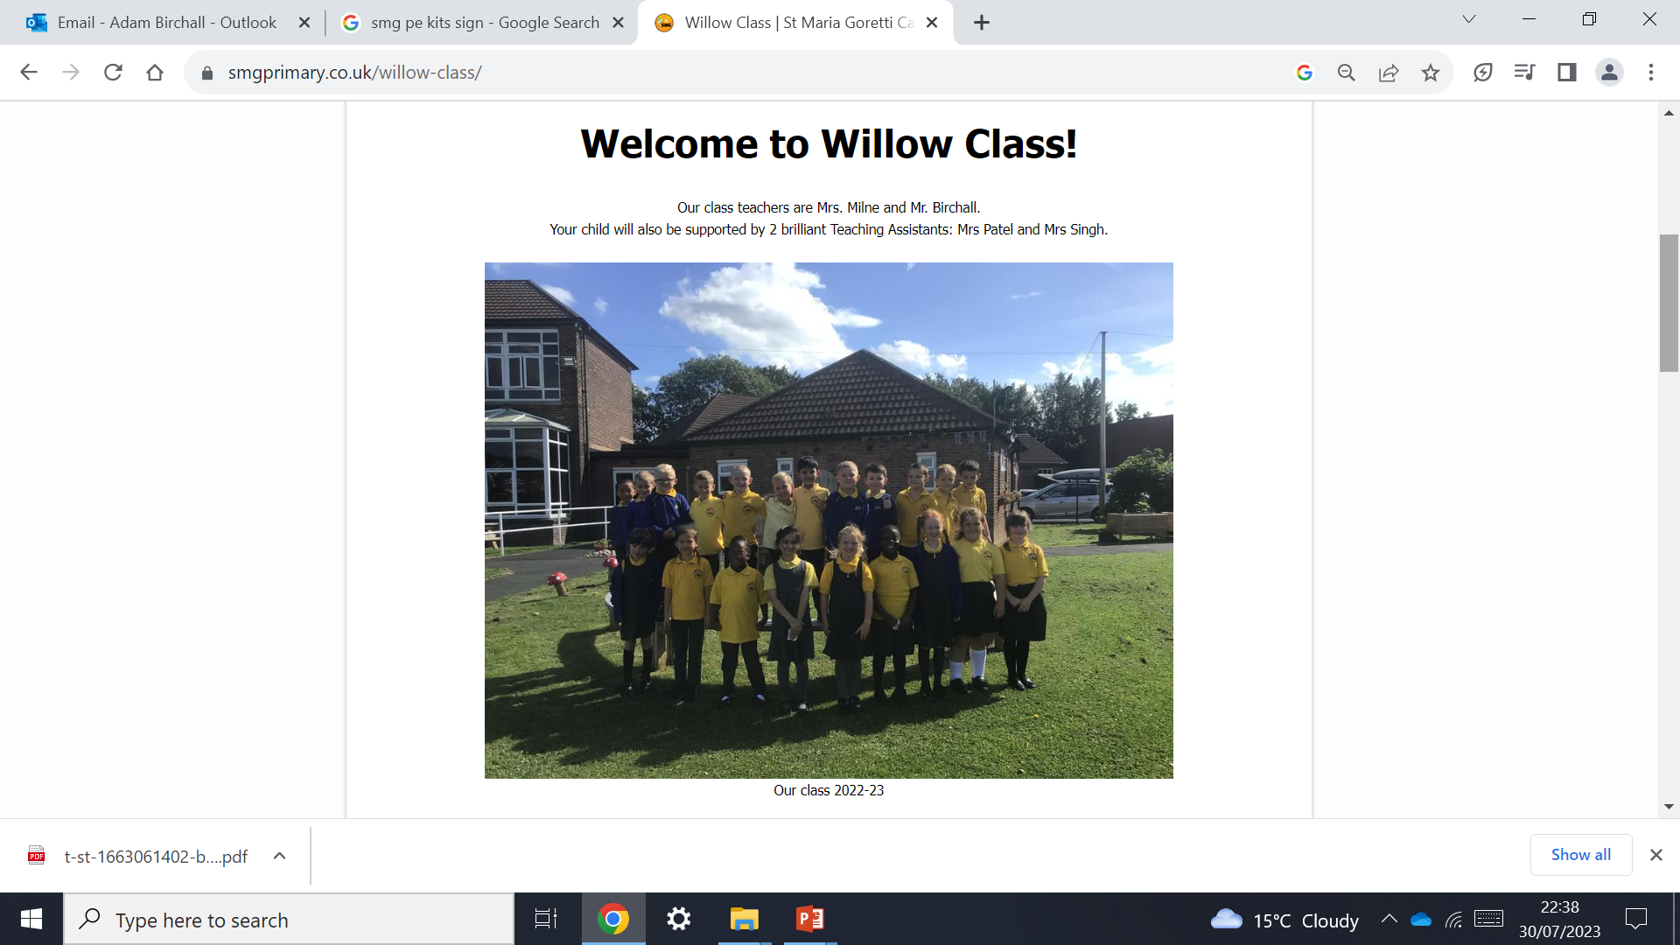
Our class page, on the school website contains our curriculum overview for the year. It also contains up to date photos.
https://www.smgprimary.co.uk/
willow-class/

Slide 7
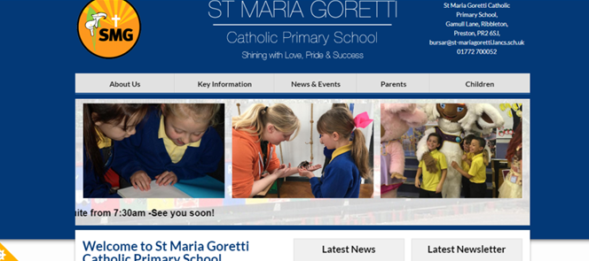
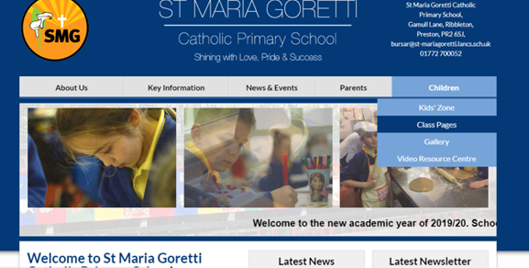

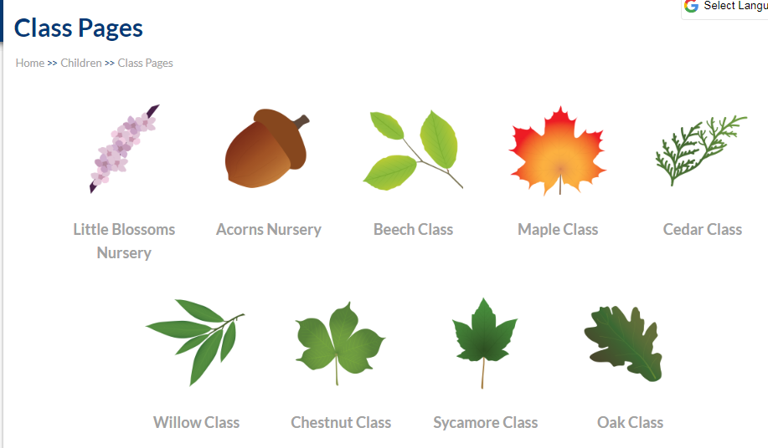


Slide 8
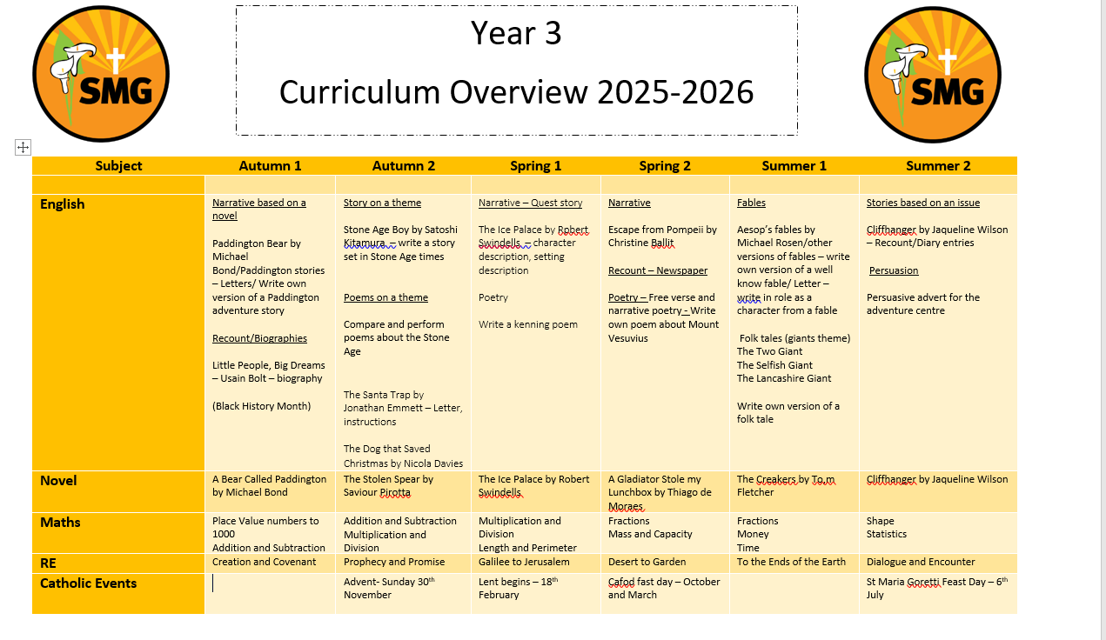
Our Curriculum Overview

Slide 9
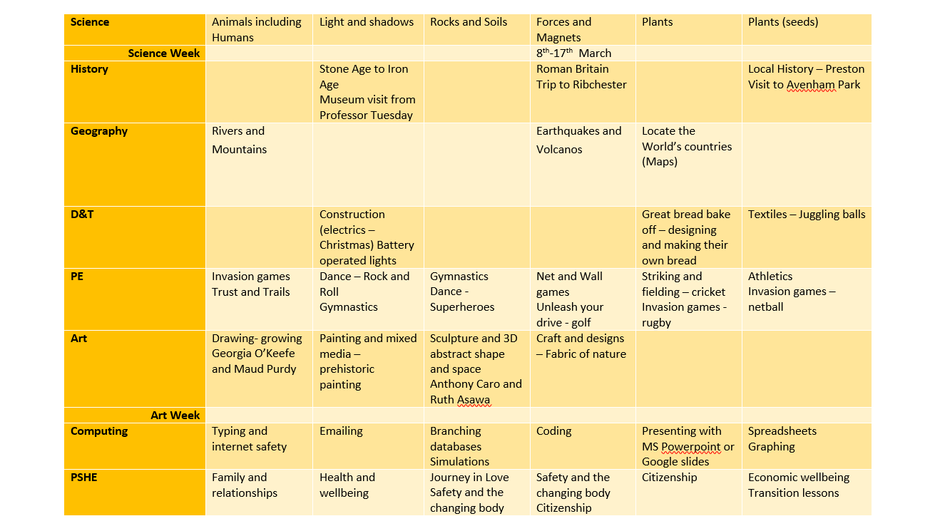

Slide 10
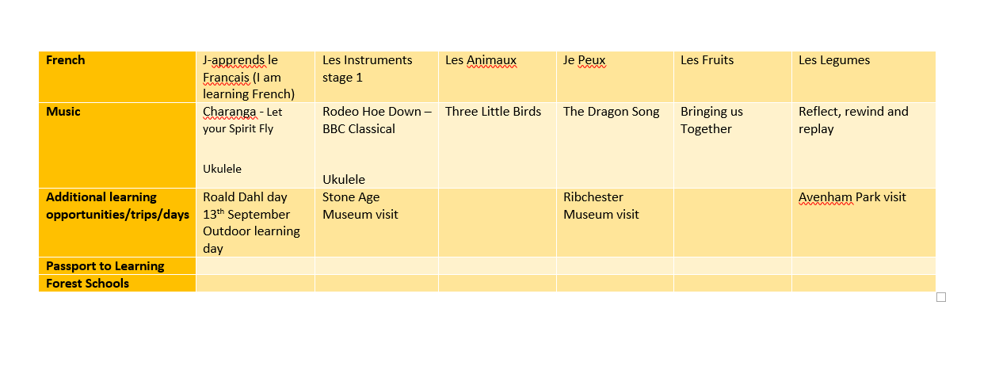

Slide 11
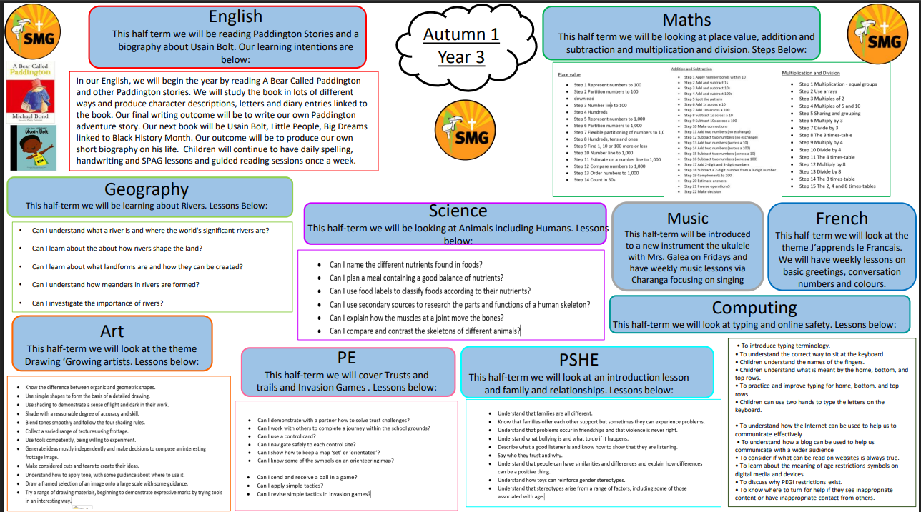

Slide 12
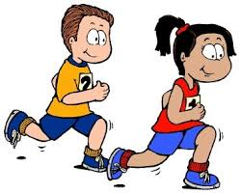

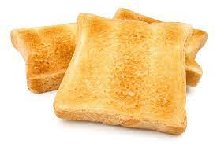
Key Information
PE day is twice a week on a Wednesday and Thursday.
Water bottles should be sent in to school every day. These need to be filled up in the morning BEFORE school has started.
Toast can be bought for 30p a day. This will be collected in class.

Slide 13
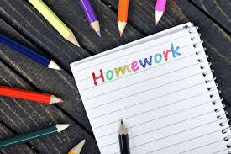


Homework in Willow Class
Spellings will be given out on a Monday and tests will be on a Monday.
Times table homework will be given out on a Friday and we will have a weekly test on Fridays
Please read with your child for at least 15 minutes EVERY DAY.
Children can also log on to Reading plus at home to further their reading skills (x2/3 sessions per week)

Slide 14
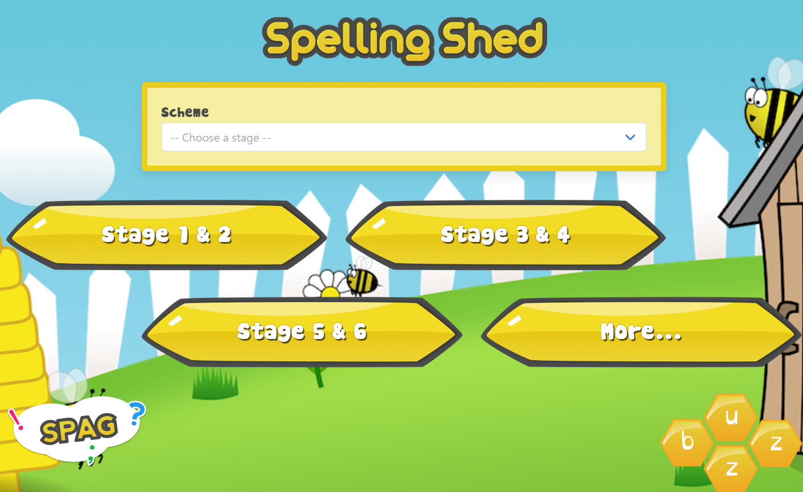

Slide 15
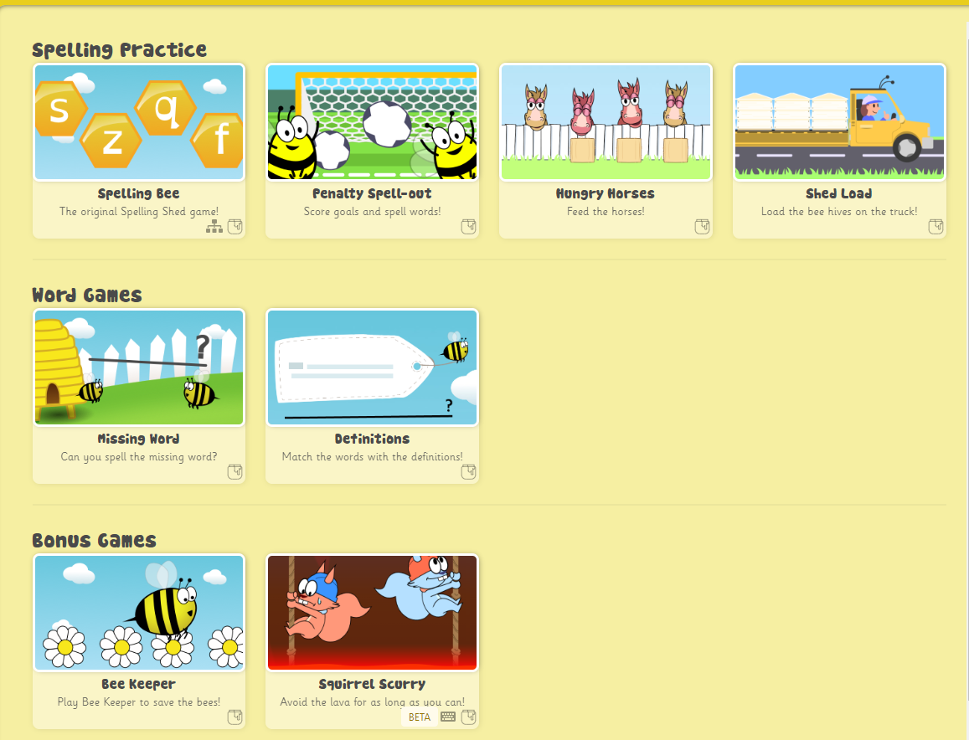

Slide 16


Slide 17

Reading in Willow Class
Reading is taught in many different ways in school. We have whole class shared reading, guided reading and class novels. Reading is also taught through other curriculum subjects.
Please read with your child for at least 15 minutes EVERY DAY. Complete at least two sessions of Reading Plus a week.

Slide 18
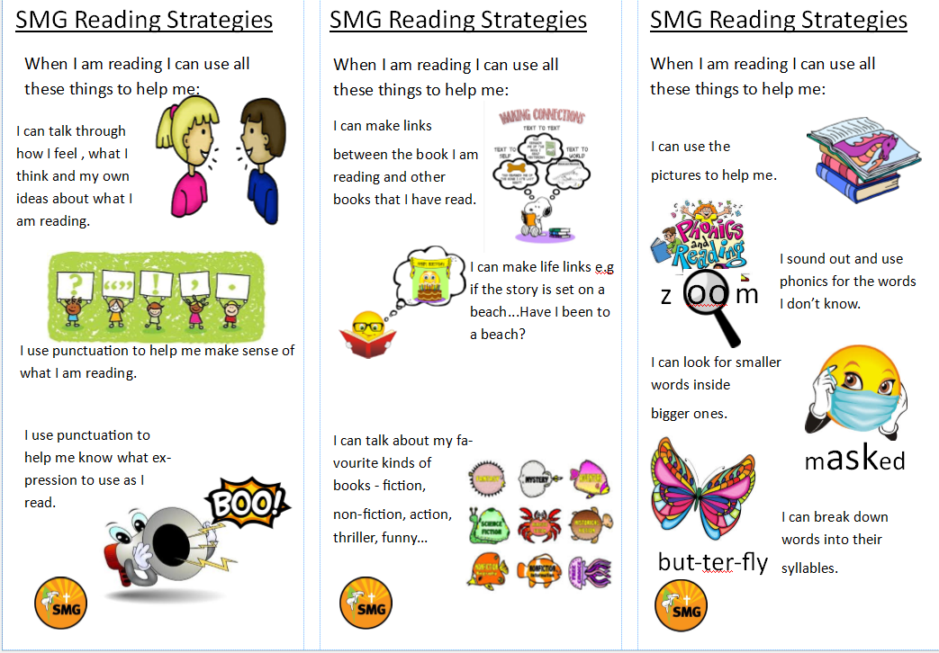

Slide 19
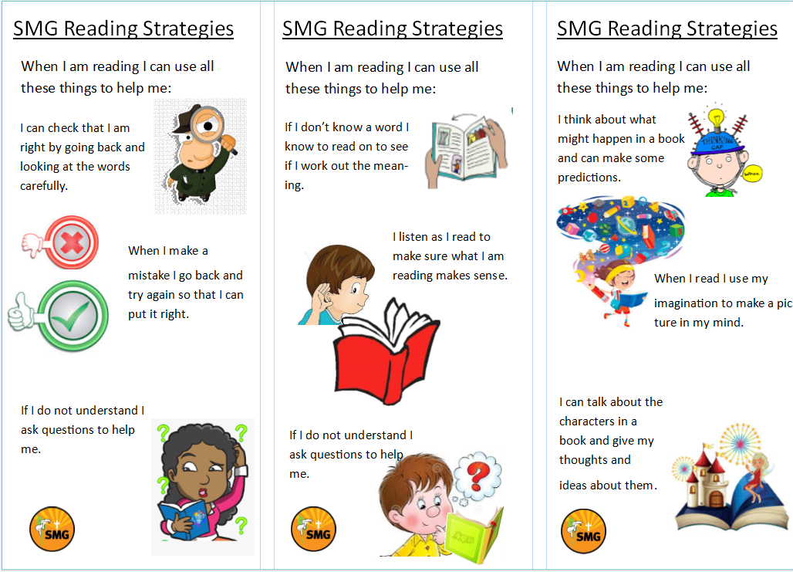

Slide 20
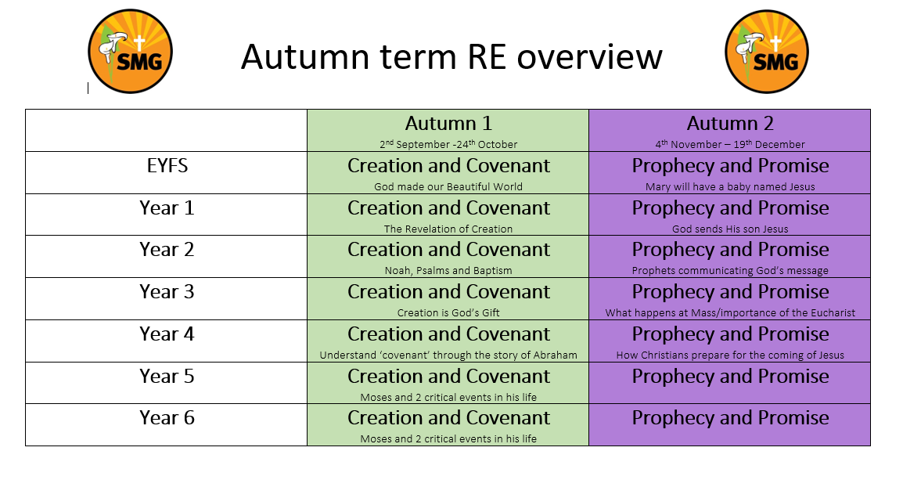
RE in Willow Class

Slide 21



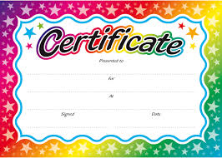
Rewards
We love to reward children in this school for putting effort into their work, being polite and helpful, having lovely manners and for being exceptionally behaved.

Slide 22

Attendance and punctuality
School starts at 8:40am
Children can arrive and the gates/doors open from 8:30am.
It is so important that children are in school and on time every day. If they miss days or are late for school you will miss vital learning. If your child is ill please ring the office to inform them of why they are absent. Otherwise the absence will be unauthorised.

Slide 23

Class Communication
Our main means of communicating with parents will be on Class Dojo.
Please check your Dojo regularly.
If you need to speak to either of us, please send us a message and we will try to reply as soon as possible. We will not always reply to Dojo messages after 6pm or at the weekend (unless they are urgent)
Please try and keep Dojo a positive means of communication.

