Slide 1
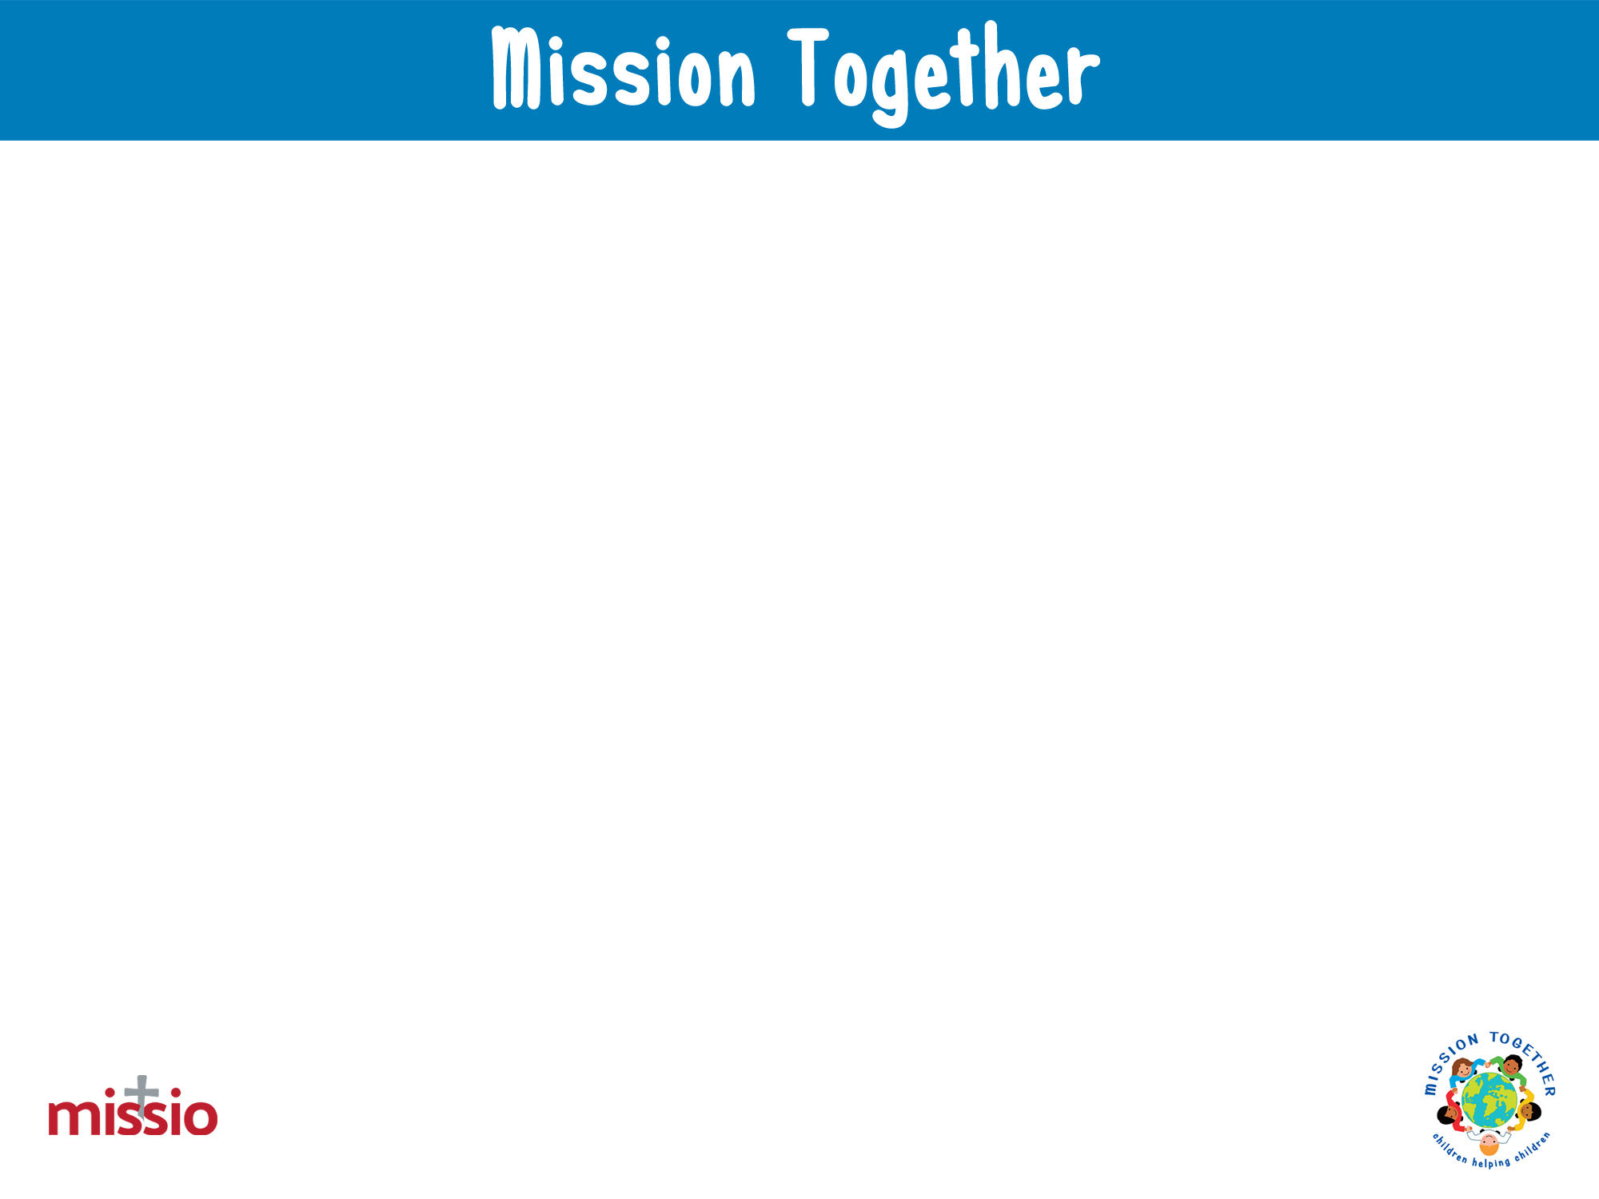
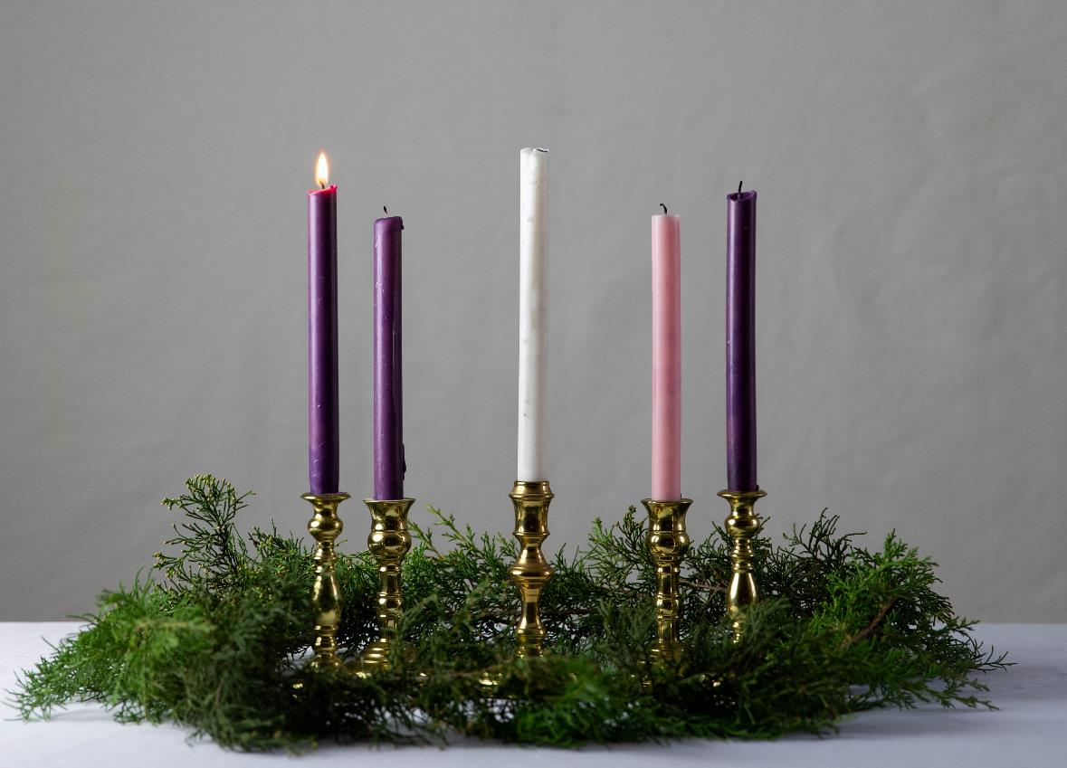
We gather
for our Advent Week One Liturgical Prayer
Photo by KaLisa_Veer on Unsplash
Opening hymn – We are Waiting

Slide 2
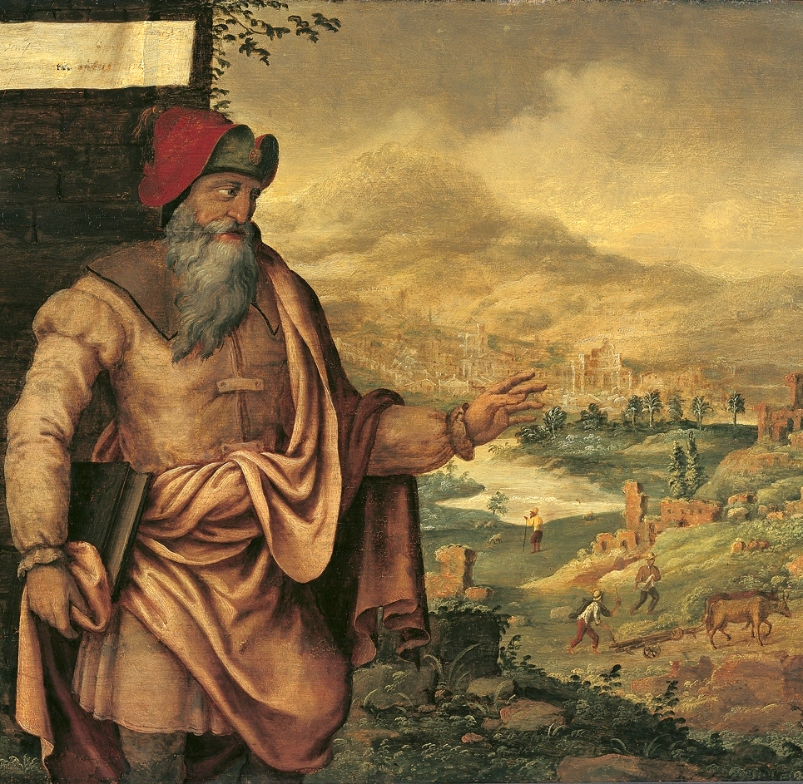
We hear
God’s Word
A reading from the Prophet Isaiah
In the last days the mountain on which the Lord’s Temple stands will become the most important of all mountains. It will be raised above the hills. People from all nations will come streaming to it. Many nations will come and say, ‘Come, let us go up to the mountain of the Lord. Let us go to the Temple of the God of Jacob. Then God will teach us his ways. And we will obey his teachings.’ ..
Maarten van Heemskerck, Public domain, via Wikimedia Commons

Slide 3
Then the Lord will settle arguments among many nations. He will make decisions for strong nations that are far away.
Then the nations will make their swords into plows to prepare soil for seeds. They will make their spears into hooks for pruning trees.
Nations will no longer fight other nations. They will not even train for war anymore.
The Word of the Lord
R/ Thanks be to God
Maarten van Heemskerck, Public domain, via Wikimedia Commons

Slide 4
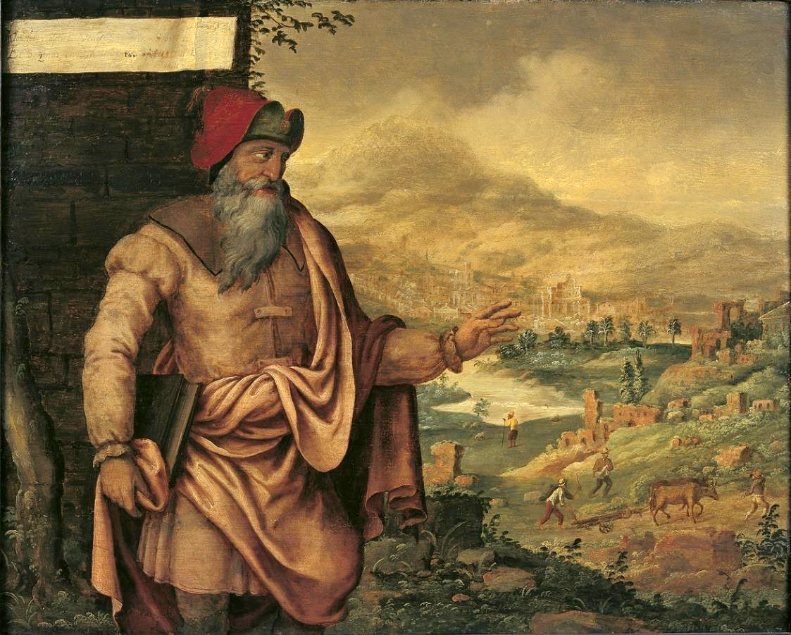
Maarten van Heemskerck, Public domain, via Wikimedia Commons

Slide 5
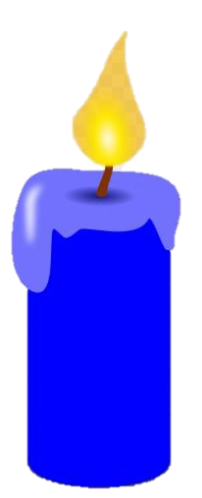

We respond
The response to our prayer is: Hear our prayer.
Heavenly Father, we pray for children around the world who are waiting for peace. We think of your children, our brothers and sisters, who live in warring countries. We ask you to protect them and to guide all leaders on the path of forgiveness and peace.
Lord in your mercy. R/ Hear our prayer.
Heavenly Father, we pray for children around the world who are waiting for a home. We think of your children, our brothers and sisters, who are refugees. We ask you to shelter them and to help them find welcome and safety.
Lord in your mercy. R/ Hear our prayer.
Heavenly Father, we pray for children around the world who are waiting to celebrate your Son’s birth on Christmas Day. Help us all to use our Advent time wisely, praying for our brothers and sisters everywhere, and doing what we can to share your light and hope with everyone.
Lord in your mercy. R/ Hear our prayer.
Let us now say the Mission Together prayer.

Slide 6
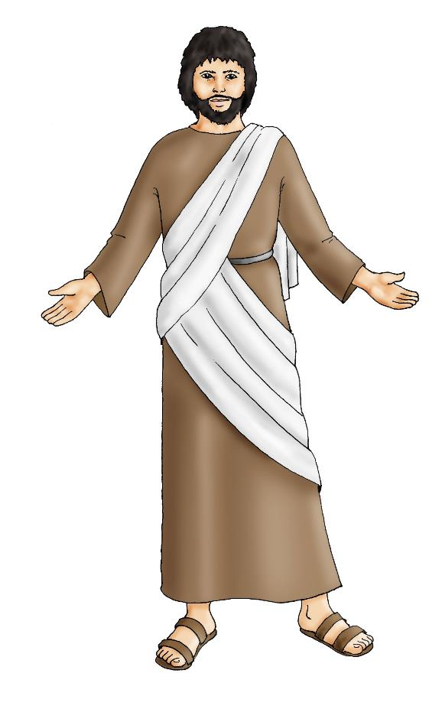
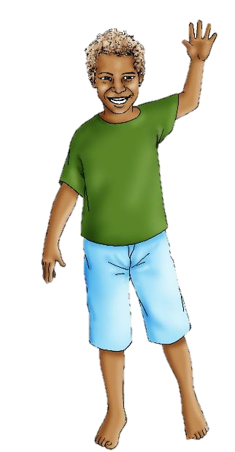
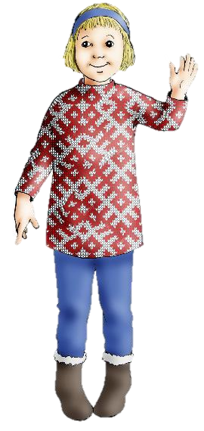
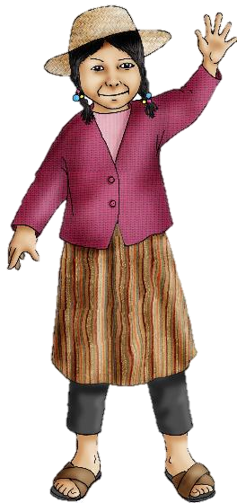
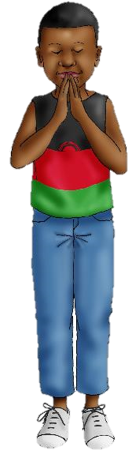
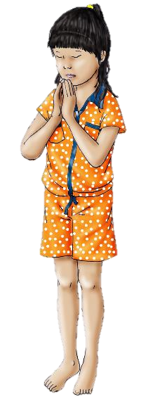
We are sent
May all children
In the world
Share love
Share friendship and live
In the peace
Of God’s love,
Now and forever.
Amen.
Closing hymn – Maranatha

Slide 7


