Slide 1


Slide 2

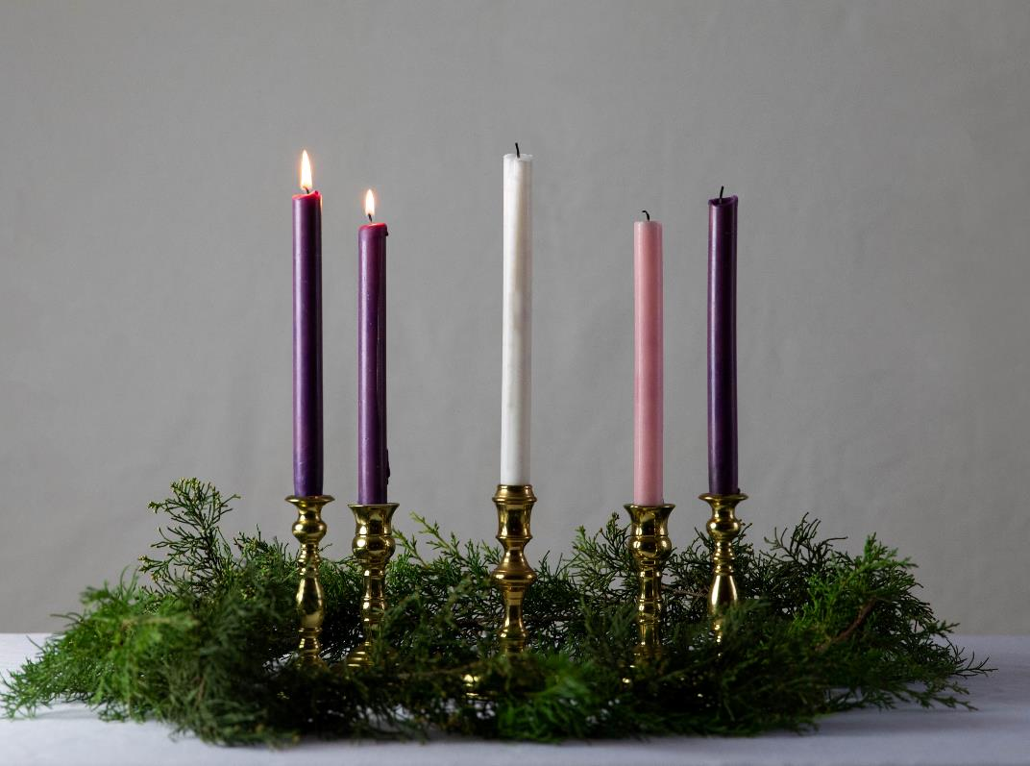
We gather
for our Advent Week Two Liturgical Prayer
Photo by KaLisa_Veer on Unsplash
Opening hymn – We are Waiting

Slide 3
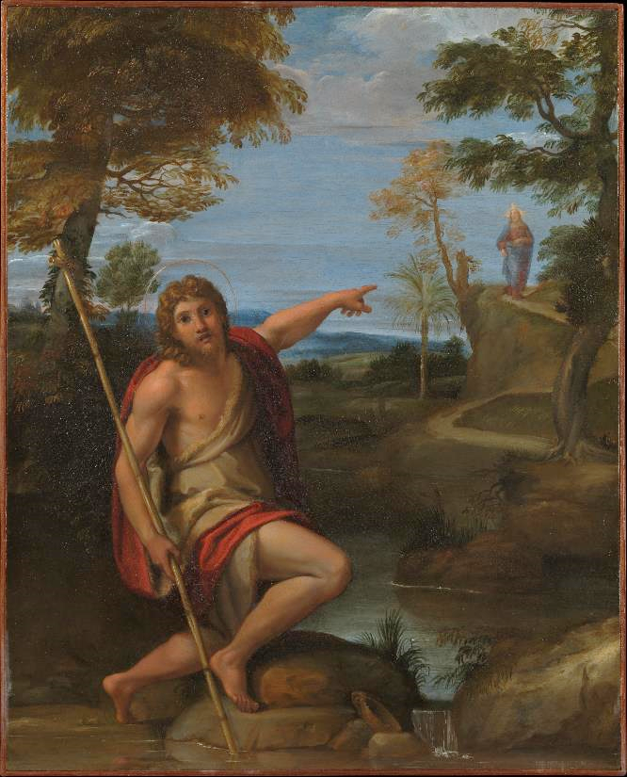
We hear God’s Word
A reading from the Gospel of Matthew
About that time John the Baptist came and began preaching in the desert area of Judea. John said, “Change your hearts and lives because the kingdom of heaven is coming soon.” John the Baptist is the one Isaiah the prophet was talking about. Isaiah said: “This is a voice of a man who calls out in the desert: ‘Prepare the way for the Lord. Make the road straight for him.’”
The Gospel of the Lord
R/ Praise to you Lord Jesus Christ
Annibale Carracci, CC0, via Wikimedia Commons

Slide 4




Slide 5


We respond
The response to our prayer is: Hear our prayer.
Heavenly Father, help us to prepare the way for your Son this Advent, by saying sorry for our wrongs and by forgiving others theirs.
Lord, in your mercy. R/ Hear our prayer.
Heavenly Father, help us to prepare the way for your Son this Advent, by being peace-builders in our school, home, country, and world.
Lord in your mercy. R/ Hear our prayer.
Heavenly Father, help us to prepare the way for your Son this Advent, by sharing what we have so that no one lacks what they need.
Lord in your mercy. R/ Hear our prayer.
Heavenly Father, help us to prepare the way for your Son this Advent, by praying for all God’s children, especially those born into poverty and conflict.
Lord, in your mercy. R/ Hear our prayer.
Let us now say the Mission Together prayer.

Slide 6
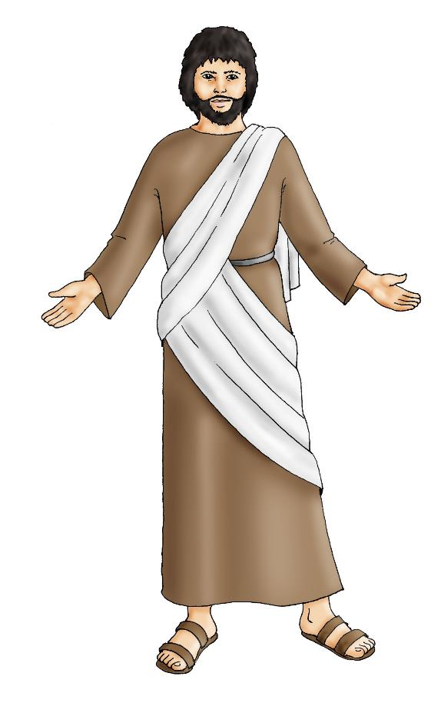
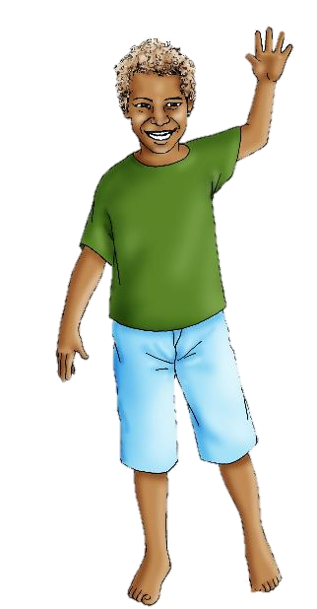
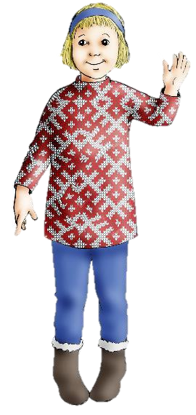
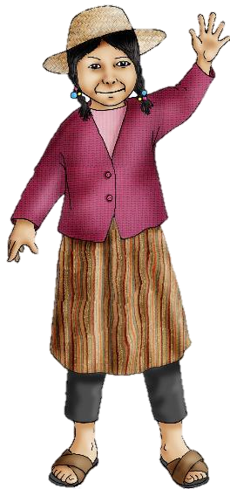

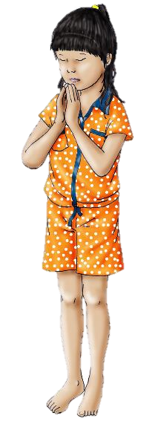
We are sent
May all children
In the world
Share love
Share friendship and live
In the peace
Of God’s love,
Now and forever.
Amen.
Closing hymn – Maranatha

