Slide 1
Art Lesson
11th May 2020
Today you will be designing your own Roman Soldier’s shield.
Look at the following slides for ideas.

Slide 2
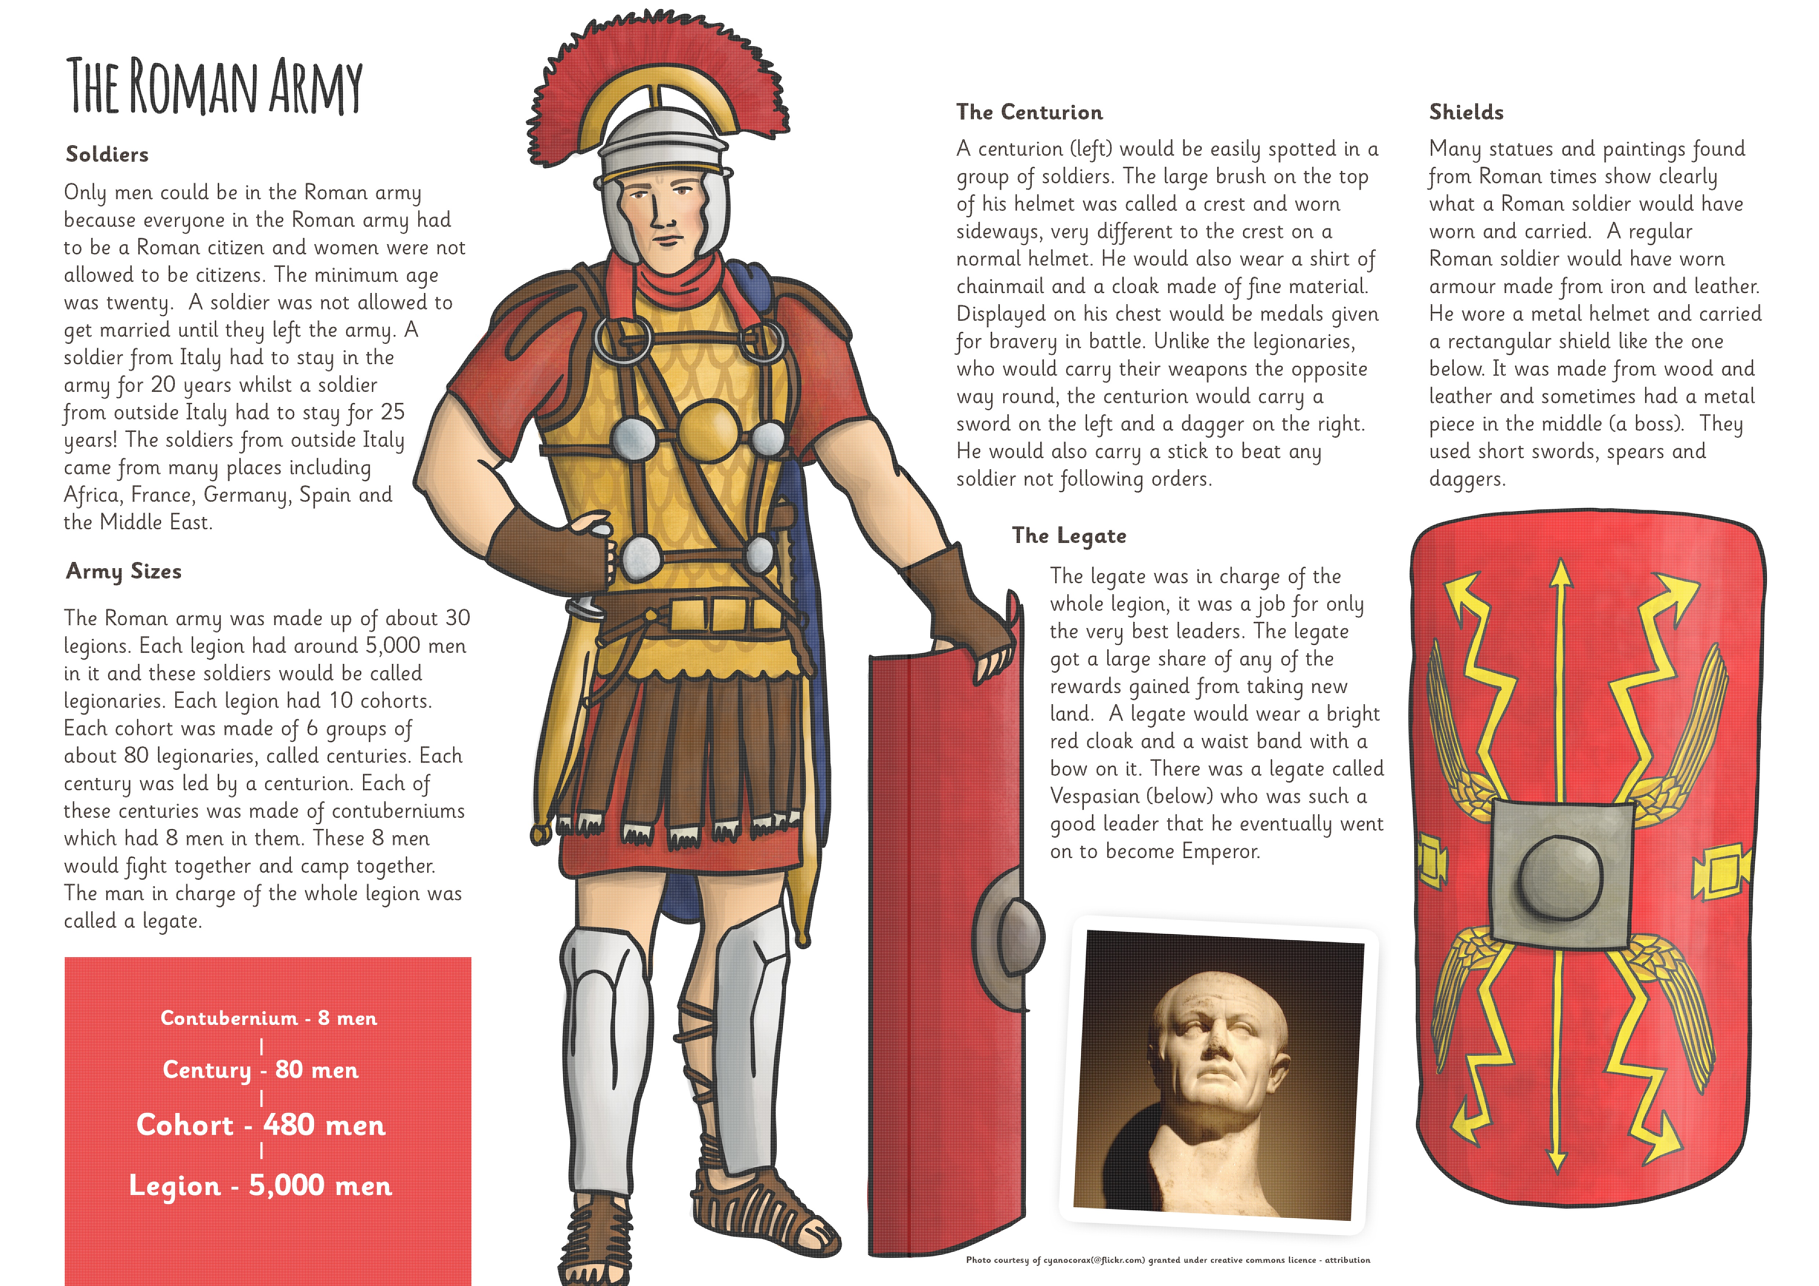

Slide 6
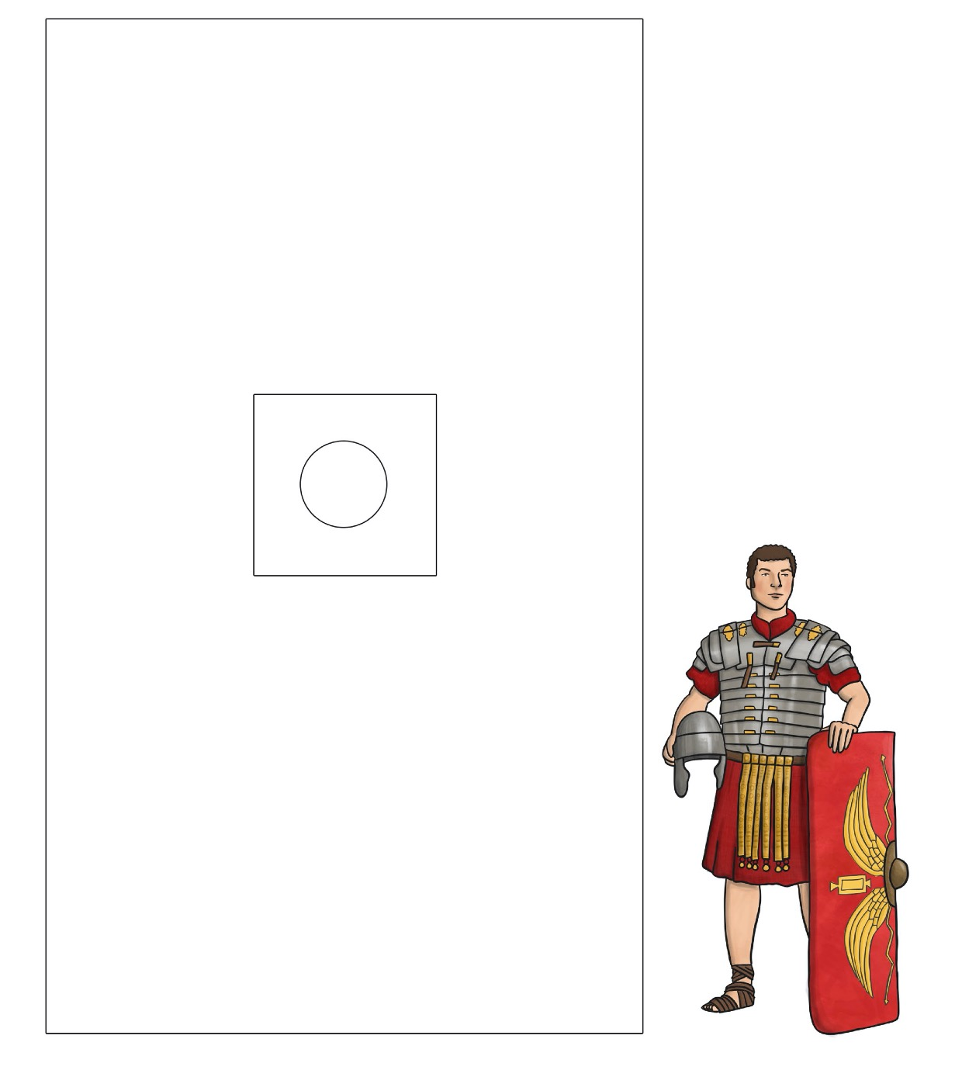
Task: Design your own Roman shield.
You can use card or paper.
You can make a large shield or a small one.
If you want, you can use this template to help you.
You could even make a cardboard sword to go with it!

