Slide 1

Spelling rules
The /ʌ/ sound spelt ou

Slide 2
Which words can you think of that have the u sound but are spelt ou.
Write as many as you can on your board.

Slide 3
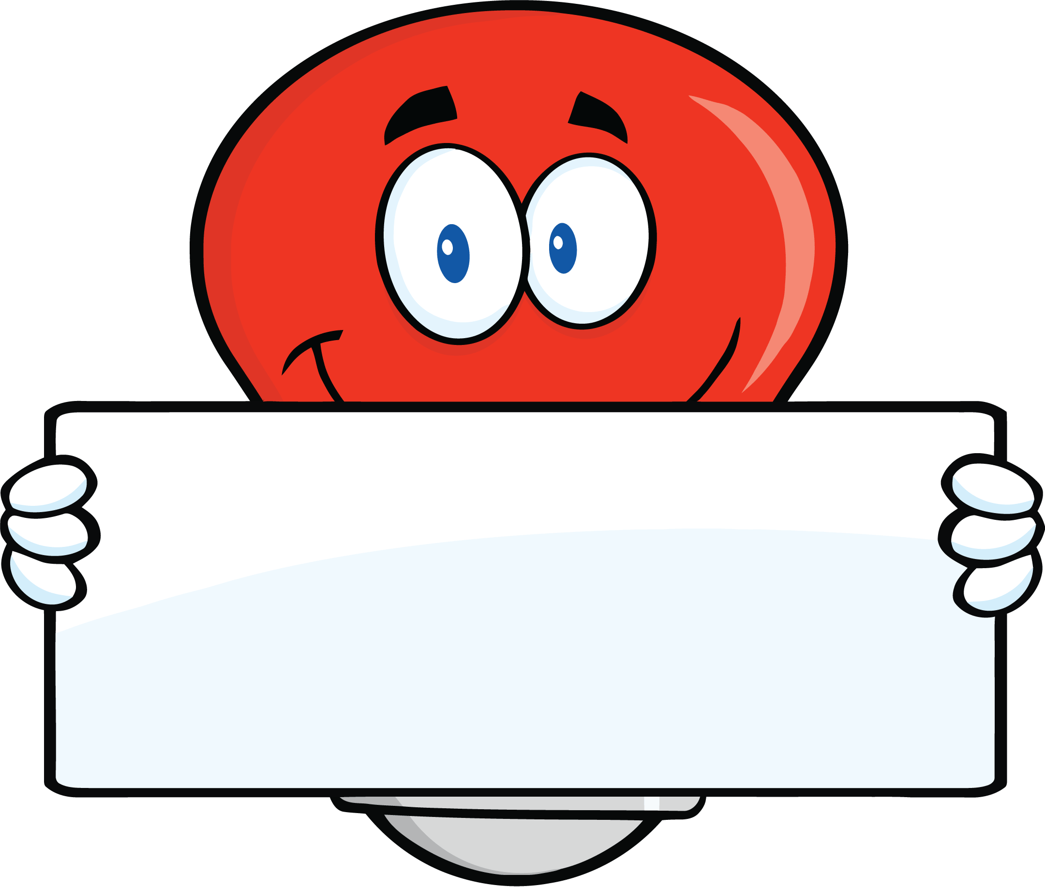
The /ʌ/ sound can sometimes be spelt ou.

Slide 4
There are not very many words with ou for the /u/ sound.
Let’s look at some of them….

Slide 5
young
touch

Slide 6
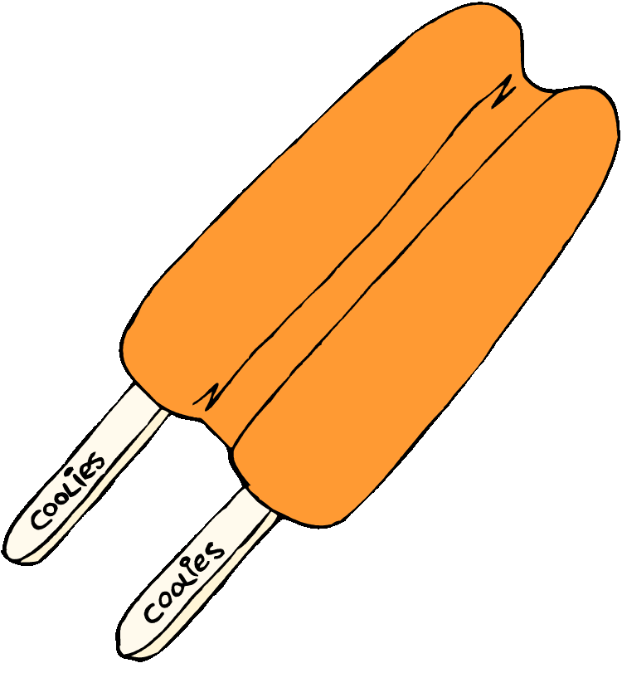
double
trouble

Slide 7
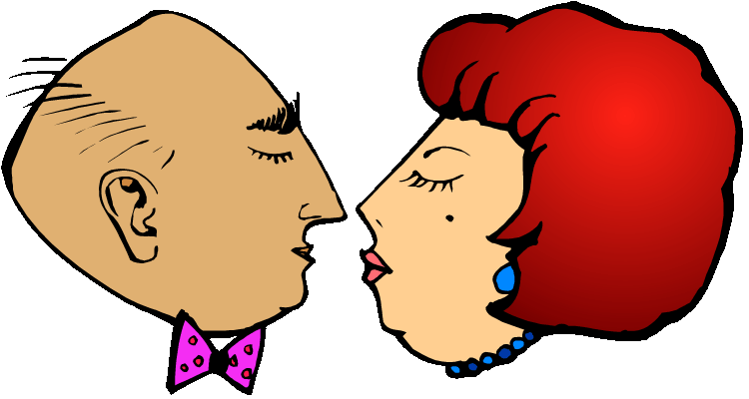
country
couple

Slide 8
Time to practise writing these words.
Are you ready?

Slide 9
Hide the word
Show the word
young

Slide 10
Hide the word
Show the word
touch

Slide 11
Hide the word
Show the word
double

Slide 12
Hide the word
Show the word
trouble

Slide 13
Hide the word
Show the word
country

Slide 14
Hide the word
Show the word
couple

Slide 15
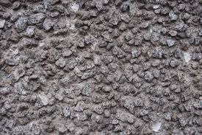
Hide the word
Show the word
rough

Slide 16
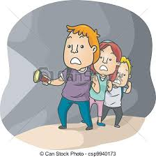
Hide the word
Show the word
Courage

Slide 17
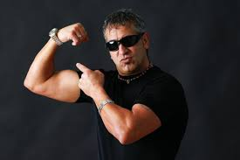
Hide the word
Show the word
tough

Slide 20
Let’s play a few games to see if you can remember how to spell these words.

Slide 21
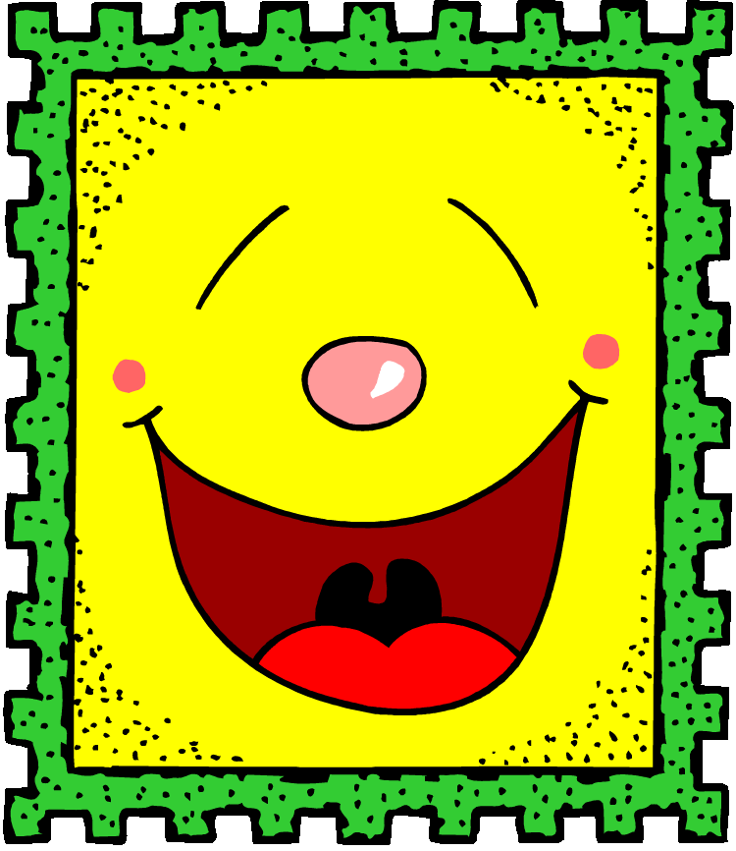
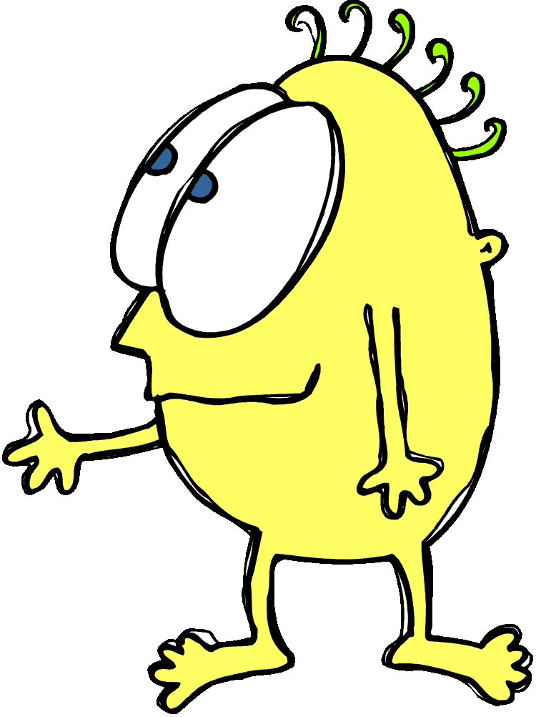
How did you do?
Will you be able to remember how to spell these words that have ou for the /u/ sound?

