Slide 1

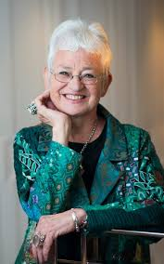
Read chapter 3 of Cliffhanger.

Slide 2
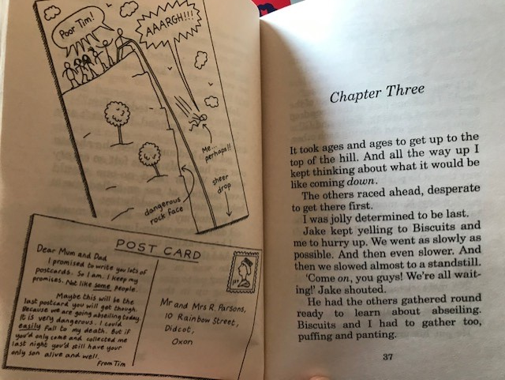

Slide 3
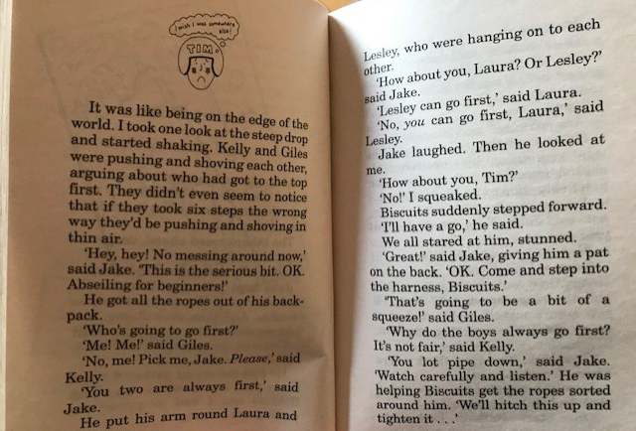

Slide 4
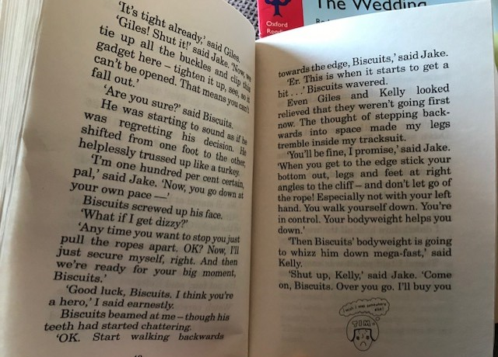

Slide 5
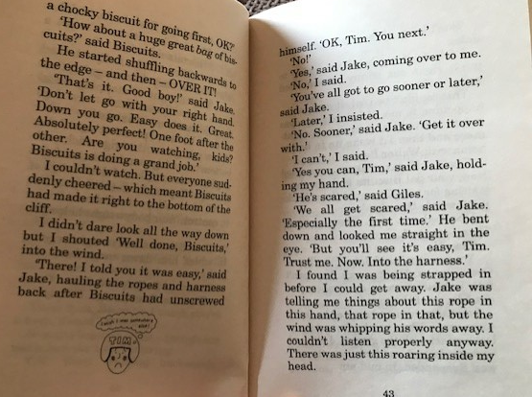

Slide 6
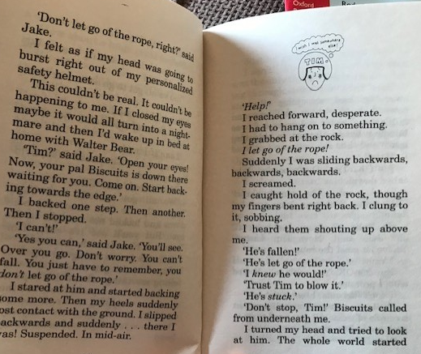

Slide 7
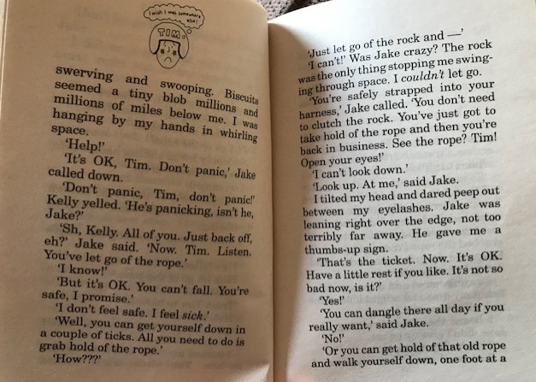

Slide 8
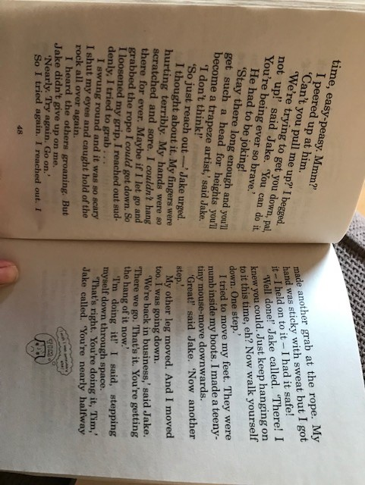

Slide 9
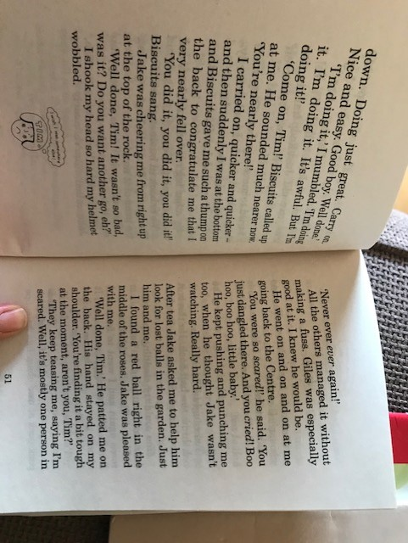

Slide 10
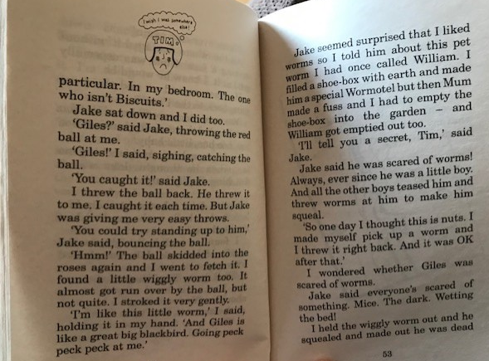

Slide 11
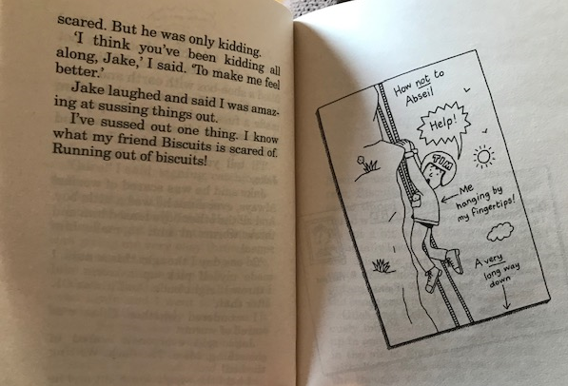

Slide 13
Pretend that you are Tim. Write a postcard to your Mum and Dad telling them about what happened to you today. You can use the template on the following slide.
Try to include these things :
- Write in the first person – I, me, my
- Include details about the activities and what he has learned.
- Keep it quite chatty, like you are talking to them
- Use subordinating conjunctions
- Say your thoughts e.g. I nearly died today!

Slide 14
